Slide 1
OVERVIEW OF API & RESTAPI’s PRESENTED BY: SURESH.R

Slide 2
Agenda:​
API vs REST API’s
Client vs Server
URL vs URI
What is HTTP​
What is HTTPS
HTTP requests vs HTTP responses​
HTTP Methods
What is Postman Tool
How to execute API’s using Postman Tool
HTTP status codes​
Client Side Error codes
Server Side error codes

Slide 3
API vs Rest API.
API
It defines Application Programming Interface to provide interface and allows the data transmission between two different applications.
REST API’s
It defines “Representational State Transfer” also to create Web API using web services and framework through http and web browser.
Notes:
RESTAPI create interface between framework and web services

Slide 4
CLIENT Vs SERVER
Client:
The client is an user for getting information by sending requests to server.
Server:
A server is a software or hardware it provides the data from any web resources.
EX: Client requesting Gmail Service from google server.

Slide 5
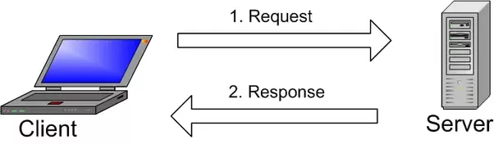
CLIENT Vs SERVER

Slide 6
URL VS URI
URL:
This points to the resource on the web.
EXAMPLE : www.google.com
URI:
A URI (Uniform Resource Identifier) is an identifier of a specific resource such as people and places or information resources such as books and web pages(Documents).
EXAMPLE : URI = scheme:[//authority]path[?query][#fragment]
Notes:
To access URI through URL.

Slide 7
HTTP
HTTP (Hyper Text Transfer Protocol) is the set of rules for transferring files such as text, images, sound, video and other audio files over the web.
The HTTP protocol resources are exchanged between client devices and servers over the internet.
Requests and responses share documents such as data on images and text.

Slide 8
What is HTTPS.
HTTPS is the encrypted version of HTTP. Encrypted is defined as to translates the data in another form of Source Code like Password.
HTTPS was developed by Netscape.
HTTPS helps to create a secured encrypted connection between the server and the browser.

Slide 9
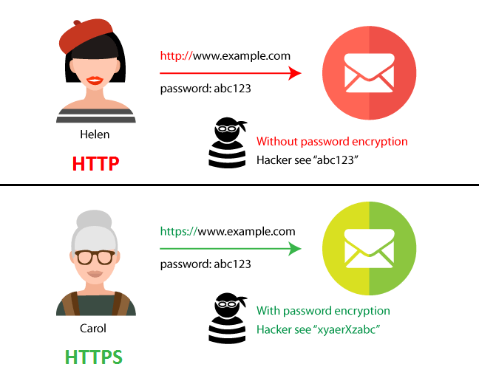

Slide 10
HTTP REQUESTS Vs HTTP RESPONSES.
The interaction between the client and server is called a HTTP message.
The HTTP response message is the data received by a client device from the web server.
The received information stored in an HTTP response is verified by server.
Notes:
In HTTP requests the client device ask the information from the server to load a data on website.

Slide 11
HTTP METHODS:
HTTP methods:
The HTTP methods are used to retrieve the information for a given resource such as webpages from server. The basic HTTP Methods are: GET , POST , PUT , DELETE
GET:
It is used to get the data from a server for specified resource.

Slide 12
POST :
It is used to send data on server for created the folder in specified resource.
EX:
POST http://www.example.com/customers
POST http://www.example.com/customers/12345/orders
PUT:
It is used to update the previous data available on server of specified resource.
DELETE:
It is used to delete the data of specified resource from a server.

Slide 13
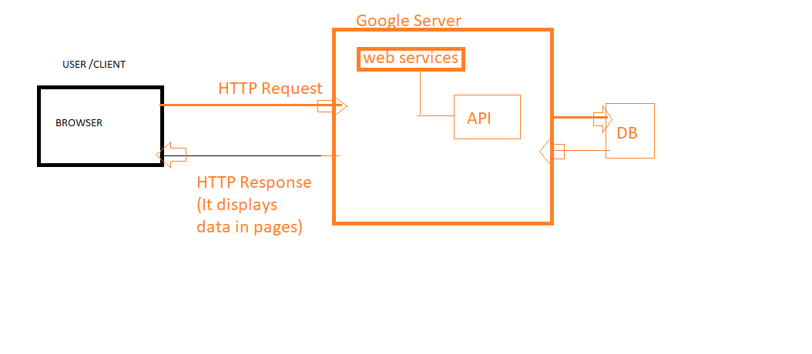
Interaction between client and server.

Slide 14
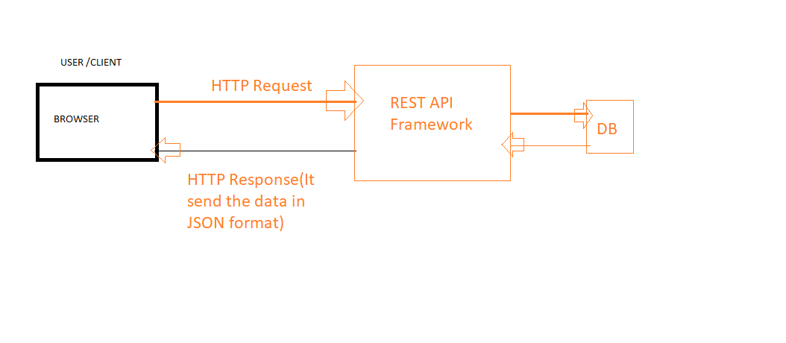
HTTP METHODS
Interaction between client and REST API Framework

Slide 15
What is Postman Tool:
Postman is an API(application programming interface) development and testing tool which helps to Create, test and modify APIs.
To create and save HTTP requests as well as response.
Postman can be accessed through native apps for MacOS, Linux and Windows.

Slide 16
How to execute API’s using Postman Tool:
New
To create a new request, collection or environment.
Import
This is used to import a collection or environment and options such as import from file, folder, link or paste raw text.
Runner
Automation tests can be executed through the Collection Runner.
My Workspace
To create a new workspace individually or as a team.
Invite
Collaborate on a workspace by inviting team members.

Slide 17
History
Past requests that you have sent will be displayed in History. This makes it easy to track actions that you have done.
Collections
To create subfolders and multiple requests.
HTTP Request
In HTTP Request drop-down window displays a list of different requests such as GET, POST, COPY, DELETE, etc. The most commonly used requests are GET and POST.
Params
This is where you will write parameters(double-brackets) needed for a request such as key values.

Slide 18
Authorization
To access APIs, proper authorization is needed. It may be in the form of a username and password, bearer token, etc.
Headers
To set headers such as content type JSON depending on the needs of the organization.
Body
It can customize(modify) details in a request commonly used in POST request.

Slide 19
Pre-request Script
These are scripts that will be executed before the request. It ensure that tests will be run in the correct environment(Key-Value pairs).
Tests
These are scripts executed during the request.
Tokens
It provides security to get the user information from Web Services and access an API using Bearer Token.

Slide 20
HTTP status codes:
In HTTP requests the Server indicating the response codes ,the request is being processed or an error the request is being redirected.
The Common HTTP status codes:
200 OK.
This shows the request such as GET or POST, worked and is being acted upon.(Indicates that the request has succeeded.)
201 CREATED.
The request has been accepted and resulted in a new resource being created.(Indicates that the request has succeeded and a new resource has been created as a result.)

Slide 21
204 No Content.
The server successfully processed the request and deleted the files in specified folder.
207:mulit status:
301 Moved Permanently.
This response code means that the URL of the requested resource has been changed permanently.
303 See Other.
The response to the request can be found under another HTTP method.

Slide 22
Client Side Error Codes :
400 Bad Request.
This error indicates that the user's request contains incorrect syntax.
404 Not Found
Redirect the permanently removed pages and pages those are temporarily unavailable.
408 Request Time Out
Check your internet connection
413 Payload Too Large
Request entity is larger than limits defined by server. The server might close the connection or return an Retry-After header field.
414 URI Too Long
The URI requested by the client is longer than the server is willing to interpret.

Slide 23
401 Unauthorized.
The client, or user making the request of the server, has not been authenticated.
403 Forbidden.
The client's identity is known but has not been given access authorization.
404 Not Found.
This is the most frequent error code. It means that the URL is not recognized
406:Not acepatable:status code means that the server is unable to provide a response that matches the client's requested format, typically specified in the Accept header of the request.

Slide 24
SERVER SIDE ERROR CODES:
500 Internal Server Error.
The server has encountered a situation it doesn't know how to handle.(,IT was unable to provide a valid response.which means request cannot be completed that time.)
501 Not Implemented.
The methods used in HTTP (HyperText Transfer Protocol) communication.
502 Bad Gateway
The one server on the internet received an invalid response from another server.

Slide 25
503 Service Unavailable.
The response code indicates that the server is not ready to handle the request.
504 Gateway Timeout.
The web server is waiting too long for a response from another server.

Slide 26
Key Takeaways....
HTTP (Hypertext Transfer Protocol) is the set of rules for transferring files such as text, images ,etc.
The HTTP methods are used to retrieve the information for a given resource such as webpages from server.

Slide 27
THANK YOU....

