Slide 1
What is Linux?
Linux is an operating system's kernel. it was actually created by Linus Torvalds from Scratch. Linux is free and open-source, that means that you can simply change anything in Linux and redistribute it in your own name! There are several Linux Distributions, commonly called “distros”.
Ubuntu Linux
Red Hat Enterprise Linux
Linux Mint
Debian
Fedora

Slide 2
Linux is Mainly used in servers.
Linux is fast, secure, and free
The OS that runs in about 80% of the smartphones in the world, Android, is also made from the Linux kernel.
Most of the viruses in the world run on Windows, but not on Linux!

Slide 3
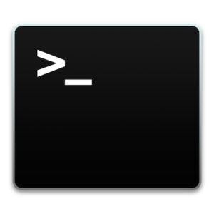
Linux shell or terminal?
Shell is a program that receives commands from the user and gives it to the os to process, and it shows the output
Linux's shell is its main part.
Linux has a CLI (command line interface).

Slide 4
What is command?
In computers, a command is a specific order from a user to the computer's operating system or to an application to perform a service, such as "Show me all my files" or "Run this program for me.

Slide 5

Linux commands
Pwd(present working directory):
pwd prints the current working directory.

Slide 6
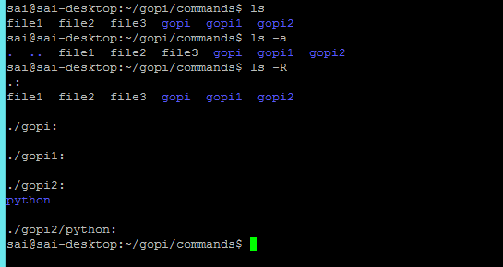
Ls(listing file):
list the contents (files and folders)of the current working directory. you can use “ls –a” to view the hidden files. you can use ” ls -R “ to view the subdirectory.

Slide 7
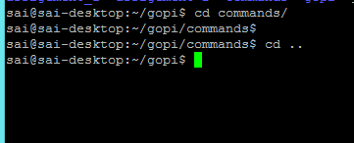
Cd (change directory):
cd<directory> set the given folder (or directory)as the current working directory for the current running session of the terminal. You can use “cd .. “ To go back from folder to folder.

Slide 8
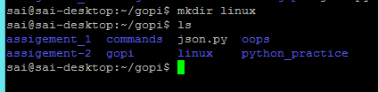
Mkdir (make directory):
mkdir <new-directory-name> makes a new/create directory.

Slide 9

rmdir (remove directory):
rmdir <directory-name> removes(or deletes)the given directory.

Slide 10
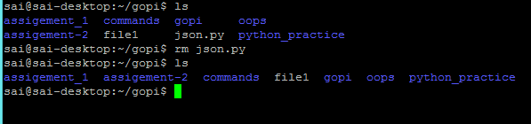
rm (remove):
rm<file-name> removes the given file or folder. you can use “rm –r” <directory-name> to delete folders recursively.

Slide 11
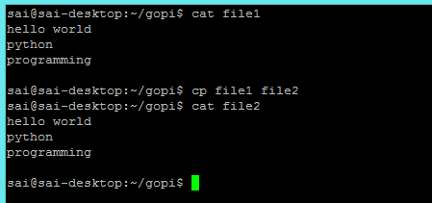
cp (copy):
cp <source-file> <destination-file> copies the file or folder from one location to another location. you can use its cp –r <source-folder > <destination-file> option to copy folder recursively.

Slide 12
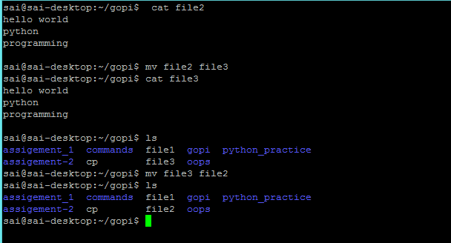
mv(move):
mv<source-file> <destination-file>moves the files or folder from one location to another location. we can also use the mv command to rename file.

Slide 13
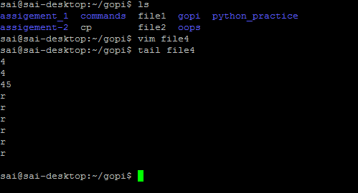
tail(from last):
tail<file-name> print the last 10 lines of the given file on the standard output. you can use tail –n N<file-name> to the last N number of lines to print on the screen.

Slide 14
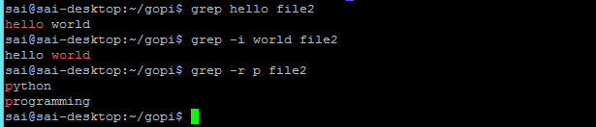
grep :
grep<string> <file-name> searches for a given string in a given file. you can use grep -i <string> <file-name> to make a case insensitive search and grep -r <string> <file-name> to search the given string in files recursively in the current directory.

Slide 15

Cat :
cat<file-name> use the cat command .display the content of file.

Slide 16
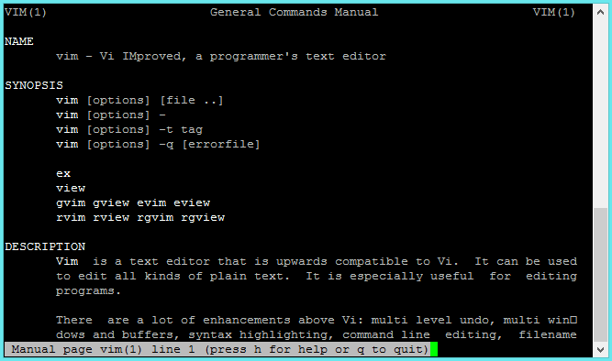
Man:
man<common-name> shows the manual pages of the command.

Slide 17
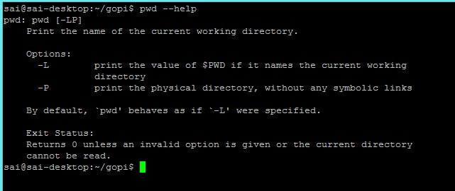
help :
<command> -- help lists all the available commands in the terminal. you can use “-h “ or“-help” option with any command to get help for that specific command.

Slide 18

Whatis:
whatis <command-name> shows a single line description for the given command.

Slide 19
man:
man<command-name> shows the manual page for the given command.

Slide 20

Who :
shows the list of currently logged in users.

Slide 21
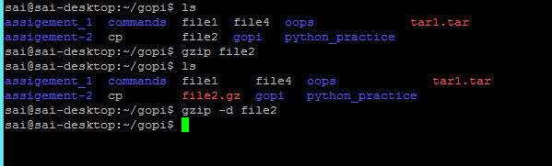
gzip:
gzip <filename> creates and extracts gzip archives. you can use its gzip –d <filename> to extract gzip archives.

Slide 22
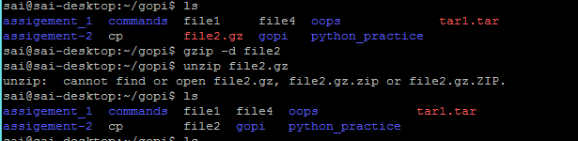
unzip:
unzip<archive-to-extract.zip> unzip a given zip archive. you can use unzip –l <archive-to-extract.zip> to view the content of the zip file without extracting.

Slide 23

uname:
shows important information about your system such as a kernel name ,host name ,kernel release number, process type and various. you can use “uname –a” to view all information.

Slide 24
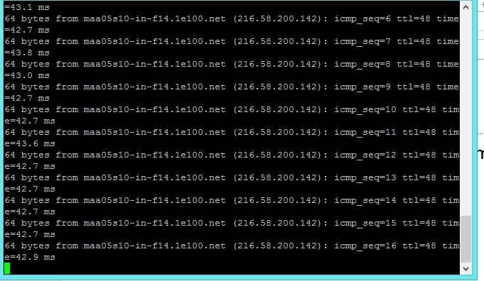
ping:
ping<remote-host-address> pings a remote host(server) by sending ping packets.

Slide 25
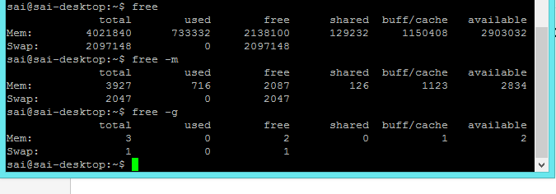
free (free memory):
shows the information about the free ,used, swap memory available in your system. You can use free –m to view memory in KBs and you can use free -g to view memory in GBs.

Slide 26
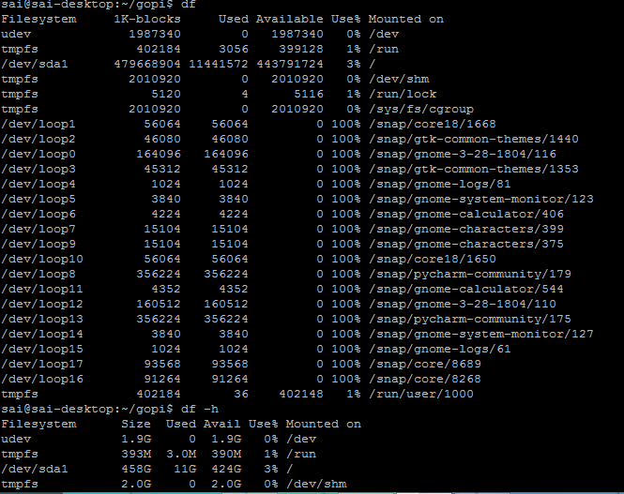
Df(disk space free):
df shows the information about the file system’s disk spaces usages. You can use df –h to view the space usages in human readable form(memory in GBs)

Slide 27
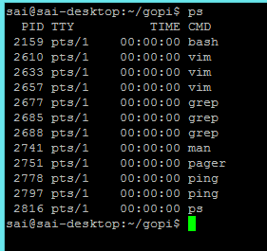
PS(process):
ps shows the information about the running process of the system.

Slide 28
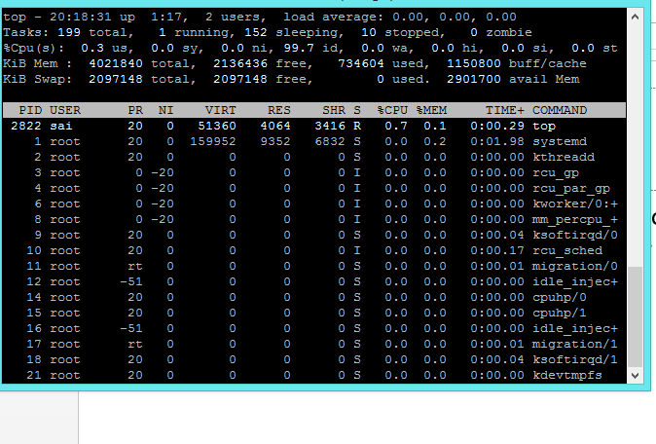
top(top process):
top shows information about the top process in the system .you can use top –u <user-name> to view the top process of a single user .

Slide 29
Shutdown:
shutdown your computer. you can use shutdown -r to restart your computer.
We don’t need to shutdown . You can use command shutdown –c

Slide 30
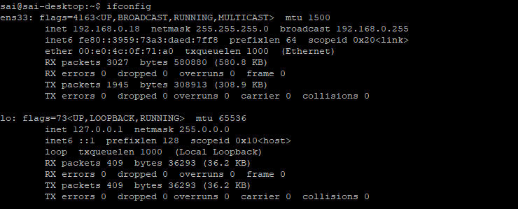
ifconfig (interface configurator):
command is use to initialize an interface, assign IP Address to interface and enable or disable interface on demand. With this command you can view IP Address and Hardware / MAC address assign to interface and also MTU (Maximum transmission unit) size.

Slide 31
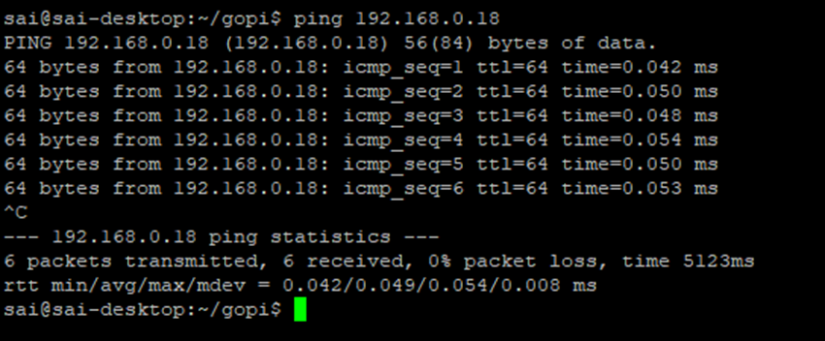
PING (Packet Internet Groper): Checks connectivity to a host.
command is the best way to test connectivity between two nodes. Whether it is Local Area Network (LAN) or Wide Area Network (WAN). ping use ICMP (Internet Control Message Protocol) to communicate to other devices. You can ping host name of ip address using below command.
#ping 192.168.0.18(ip address)

Slide 32
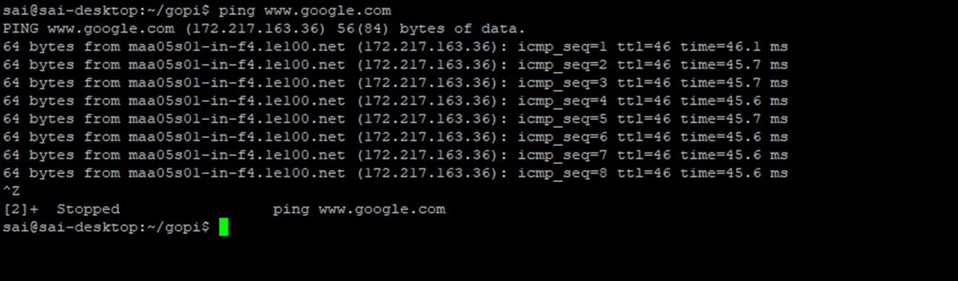
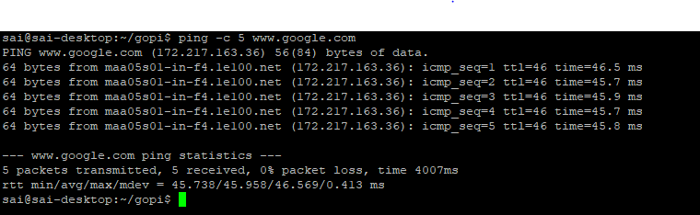
ping www.google.com
In Linux ping command keep executing until you interrupt. Ping with -c option exit after N number of request (success or error respond).
ping -c 5 www.google.com

Slide 33
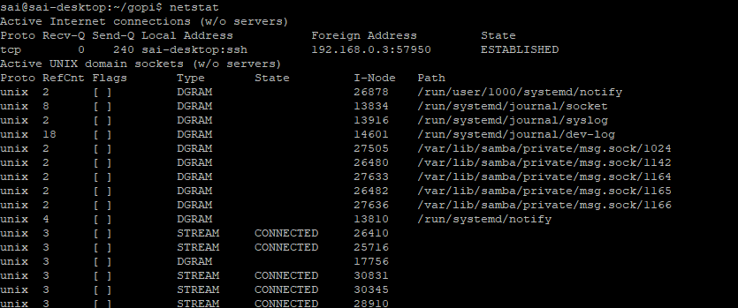
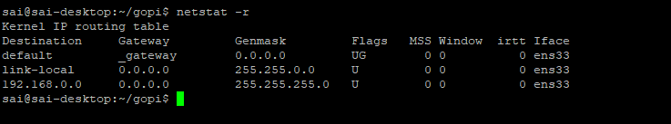
Netstat (Network Statistic):
command display connection info, routing table information etc. To displays routing table information use netstat -r.
netstat –r

Slide 34
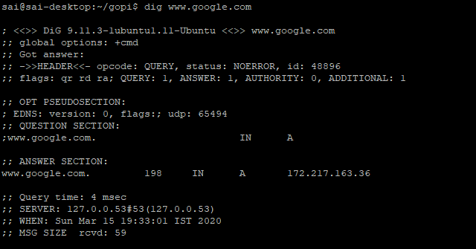
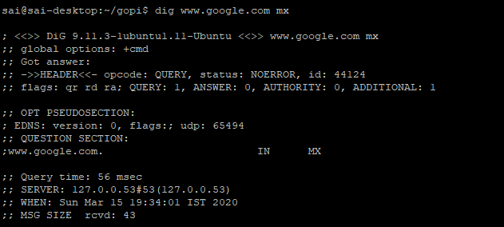
Dig (domain information groper) :
query DNS related information like A Record, CNAME, MX Record etc. This command mainly use to troubleshoot DNS related query.

Slide 35
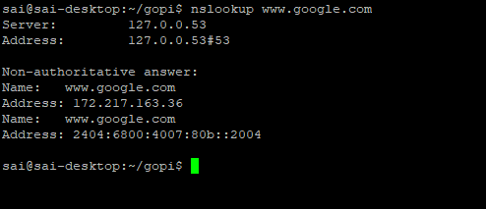
Nslookup:
command also use to find out DNS related query. The following examples shows A Record (IP Address) of tecmint.com.

Slide 36
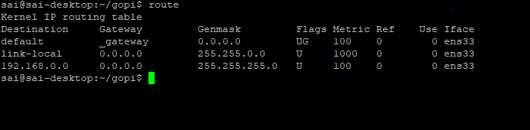
Route:
command also shows and manipulate ip routing table. To see default routing table in Linux, type the following command.
Route adding
route add –net 10.10.10.1/24 gw 192.168.0.19
Route deleting
route del –net 10.10.10.0/24 gw 192.168.0.18
adding default gateway
Route add default gw 192.168.0.18

Slide 37


host command :
Host command to find name to IP or IP to name in IPv4 or IPv6 and also query DNS records.
host www .google.com
We can find out DNS resource records like CNAME ,NS,MX,SOA etc
host -t CNAME www.redhat.com

Slide 38

Hostname
is to identify in a network. Execute hostname command to see the hostname of your box. You can set hostname permanently in /etc/sysconfig/network. Need to reboot box once set a proper hostname.

Slide 39

ARP (Address Resolution Protocol):
is useful to view / add the contents of the kernel’s ARP tables. To see default table use the command as.
arp -e

Slide 40

iwconfig :
command in Linux is use to configure a wireless network interface. You can see and set the basic Wi-Fi details like SSID channel and encryption. You can refer man page of iwconfig to know more.

Slide 41
Tips and Tricks for Using linux Command Line
You can use the clear command to clear the terminal if it gets filled up with too many commands.
TAB can be used to fill up in terminal. For example, You just need to type “cd Doc” and then TAB and the terminal fills the rest up and makes it “cd Documents”.
Ctrl+C can be used to stop any command in terminal safely. If it doesn't stop with that, then Ctrl+Z can be used to force stop it.
You can exit from the terminal by using the exit command.
You can power off or reboot the computer by using the command sudo halt and sudo reboot.

Slide 42
Extraa commands
Find: It is used for find the file in system
Syntax: find ./gfg –name “filename” #specific file name
Find ./gfg –name “*txt” file # it gives the all txt file
Vim or VI: it is use for to create the file
Touch : it is used for to create the empty file.
Chmod u+x filename
Chmod guo +x filename
Chmod guo +rwx filename
Sudo apt install “librry name”
Sudo systemctl start
Sudo systemctl stop
Sudo systemctl restart
Ps kill –pid
Ps –aux |-grep|ls -lrt

Slide 43
NS lookup:Queries DNS servers for information about host addresses, mail exchanges, name servers, and related information.
Chown:it command is used for change the owner of file or folder
EX:chown gopi fruit.txt
chown flavio:users test.txt ---for group

Slide 44
Change the permissions
Chmod :it is used for to change the permission for specificfile
Chmod is can be two way one is sysmbloci and numric
We can add “+” or “-” for add permission and remove
EX: chmod a+r #everyone can read
Chmod a+rw #everyon can read and write
Chmod a-rwx# not everyone can not read
# for group
Chmod g-r# group cannot read

Slide 45
1 if has execution permission 2 if has write permission 4 if has read permission

Slide 46


