Slide 1
Section 1: Project selection

Slide 2
RANKING CRITERIA IN ORDER OF PRIORITY
Criteria |  | A | B | C | D | E
24 weeks to complete | A |  | B | C | A | E
Feasibility (budget & resource) | B |  |  | C | B | E
Safety ( participants & protocols ) | C |  |  |  | C | C
Impact on society and environment | D |  |  |  |  | DE
Accessibility | E
TOTAL A = 1, B = 2, C = 4, D = 0.5, E = 2

Slide 3
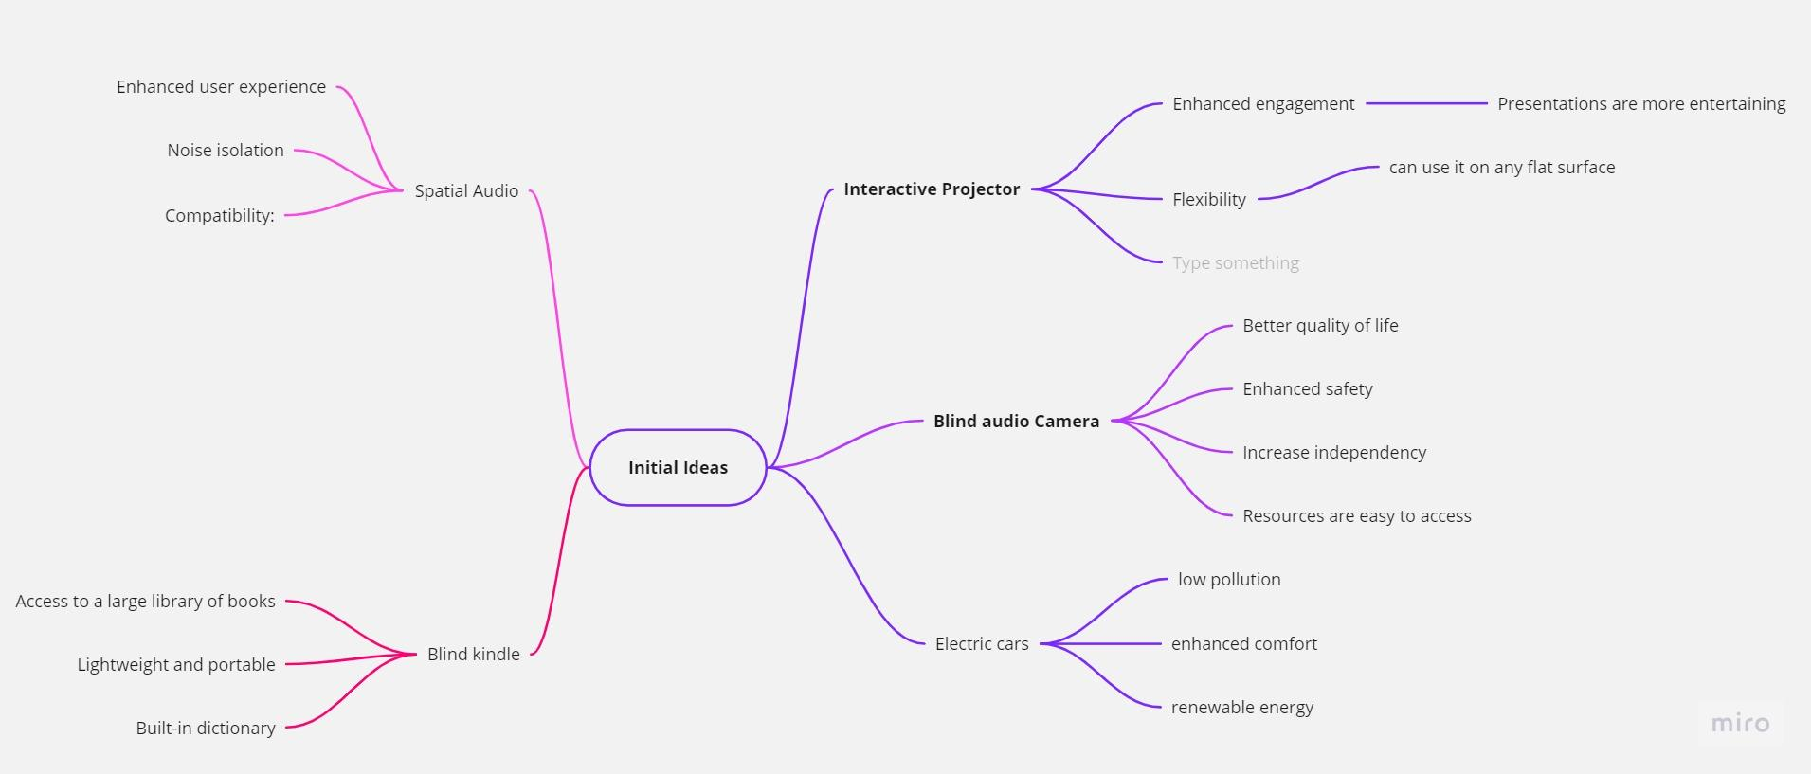
NETWORK OF INITIAL IDEAS

Slide 4
SELECTION OF DESIGN
DESIGN A | DESIGN B | DESIGN C
Sensors With mobile phone LIDAR Application feature | Image processing With mobile phone No LIDAR Built-in software | Without mobile phone Image processing - NO LIDAR Built-in software

Slide 5
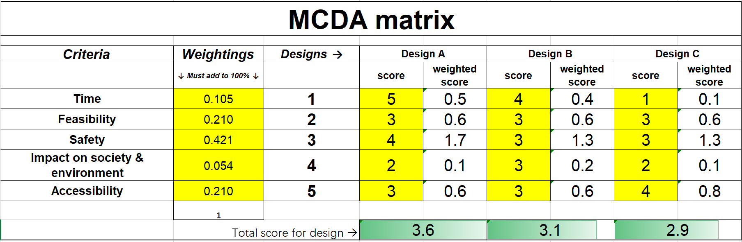
MCDA matrix for different designs

Slide 6
Section 2: Team Roles

Slide 7
Yichen Zhang
Wan Zaqeem
Siraj Salih
Project manager
Resource Investigator
Health and Safety
Dheeraj Polanki
Kevin Wang
Isaac
Hardware developer
Software developer
Research analyst

Slide 8
Social-oriented roles
Action- oriented roles
Thinking roles
Project Manager
Health and Safety
Resource Investigator
Software Developer
Hardware Developer
Research Analyst

Slide 9
Roles | Job Description | Justification
Project Manager | responsible for overall project planning, scheduling, and coordination, ensuring that the project is completed within scope, budget, and timeline.
Resource Investigator
Software Developer | responsible for writing the code and developing the software that will enable the Bluetooth audio camera system to work effectively.

Slide 10
Roles | Job Desciption | Justification
Hardware Developer | responsible for designing, building, and testing the physical components of the Bluetooth audio camera system, including the camera and Bluetooth module.
Health and Safety Lead
Research Analyst | responsible for conducting research on the needs and preferences of blind people when it comes to assistive technologies like the Bluetooth audio camera system, as well as analyzing the data collected during user testing.

Slide 11
Section 3: Project outline and requirement

Slide 13
Section 4: Project Planning

Slide 14
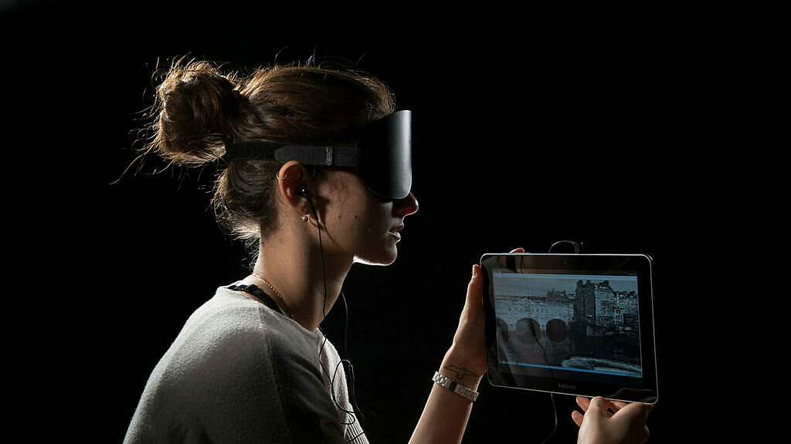
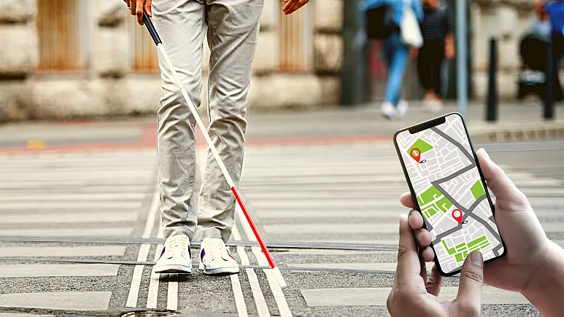
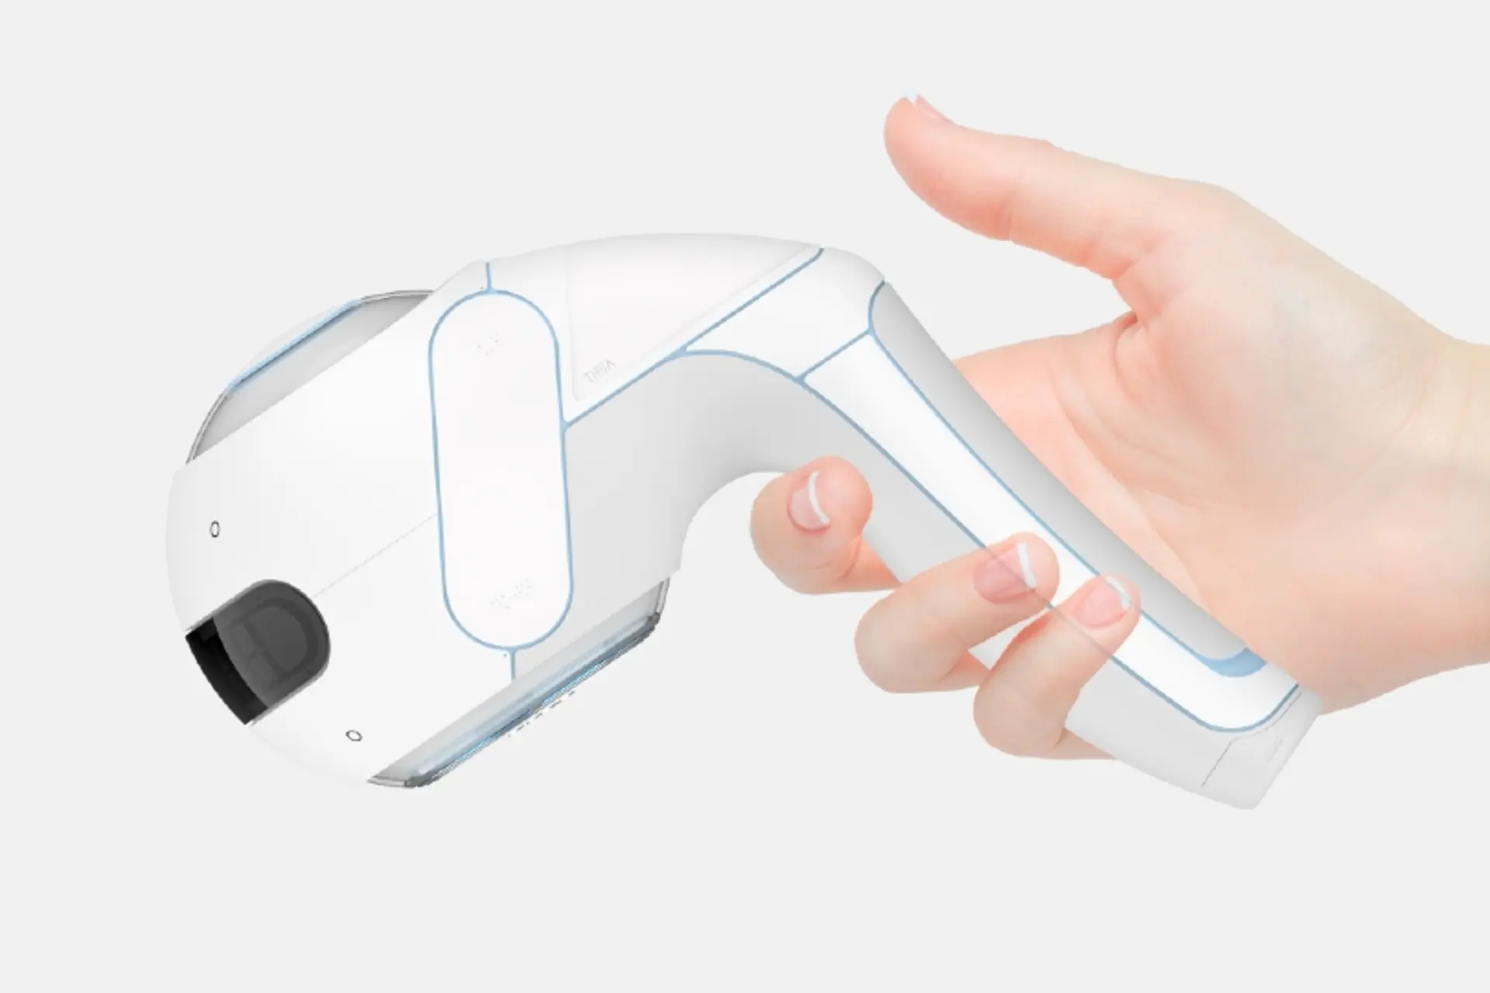
Existing Projects
E
The vOICe’ | 3D sound map | Handheld robotic guide dog
Soundscape headset that allows blind people to ‘see’ the world. The system uses a visor camera to convert images into intricate "soundscapes," which are then transmitted to the user through headphones. | An AR navigation app that can guild the blind in the right direction. It is like a ‘complement’ to the hardware device or guide dog. | Uses sensors, cameras, and algorithms to detect obstacles and provide real-time feedback to blind people through audio signals (voice recognition).

Slide 15
SECTION 4B: OUR DESIGN

Slide 16
SECTION 4B.1: SOFTWARE

Slide 17
SECTION 4B.2: HARDWARE

Slide 18
SECTION 4B.3: ASSEMBLY AND TESTING

Slide 19
network

Slide 20
gantt

