Slide 1

Blockchain Based Crowdfunding Platform
Submitted to, Submitted by,
Shammi Akhtar Bidita Sarkar Diba(20101016)
Assistant Professor MD. Mahmudur Rahman(20101009)
Dept of CSE, UAP Jayonto Dutta Plabon(20101022)
September 26, 2022

Slide 2



Meet our team
MD. Mahmudur Rahman
20101009
Bidita Sarkar Diba
20101016
Jayonto Dutta Plabon
20101022

Slide 3
What is Crowdfunding?
Crowdfunding is a financing method that involves funding a project with relatively modest contributions from a large group of individuals, rather than seeking substantial sums from a small number of investors.
It is a form of crowdsourcing and Alternative Finance.
Organizations, businesses, and individuals alike can use crowdfunding for any type of project, for example: charitable cause; creative project; business startup; school tuition; or personal expenses.
It enables fundraisers to collect money from a large number of people via online platforms.
Crowdfunding has made it possible for people to offer direct support to those who need emergency financial assistance, contributing to the larger trend of individual giving.

Slide 4


Slide 5
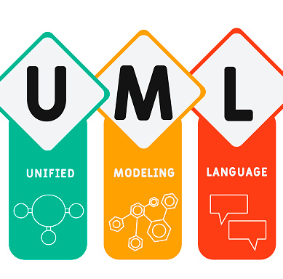
Contents Of Presentation
UML - It stands for Unified Modeling Language. This is primarily a graphical communication mechanism for developers and customers. UML is a Language for Visualizing, Specifying, Constructing, Documenting.

Slide 6
Use Case Diagram
In the Unified Modeling Language (UML), a use case diagram can summarize the details of system's users (also known as actors) and their interactions with the system.
A key concept of use case modeling is that it helps us design a system from the end user's perspective.
It is an effective technique for communicating system behavior in the user's terms by specifying all externally visible system behavior.
A use case diagram is usually simple. It does not show the detail of the use cases:
It only summarizes some of the relationships between use cases, actors, and systems.
It does not show the order in which steps are performed to achieve the goals of each use
case.

Slide 7
Use Case Diagram
UML use case diagrams are ideal for:
Representing the goals of system-user interactions.
Defining and organizing functional requirements in a system.
Specifying the context and requirements of a system.
Modeling the basic flow of events in a use case.

Slide 8
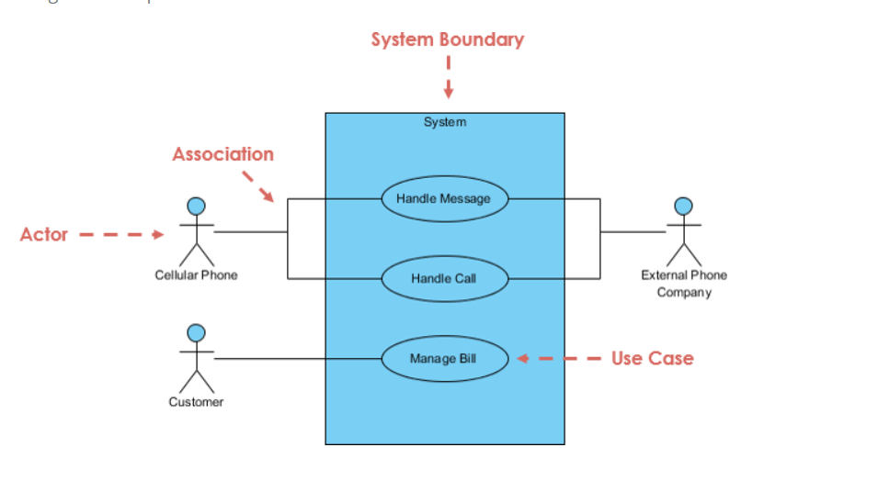
Use Case Diagram at a Glance

Slide 9
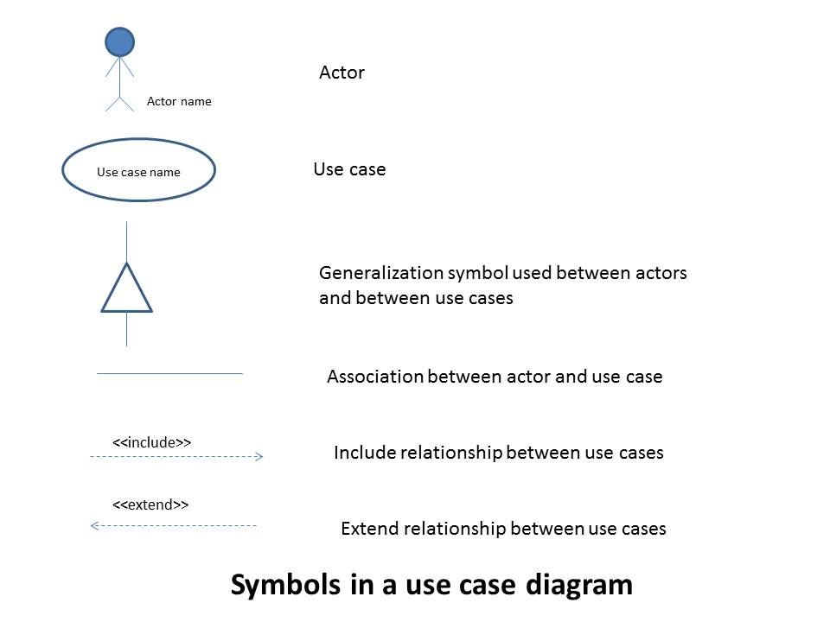
Use-case diagram notations

Slide 10
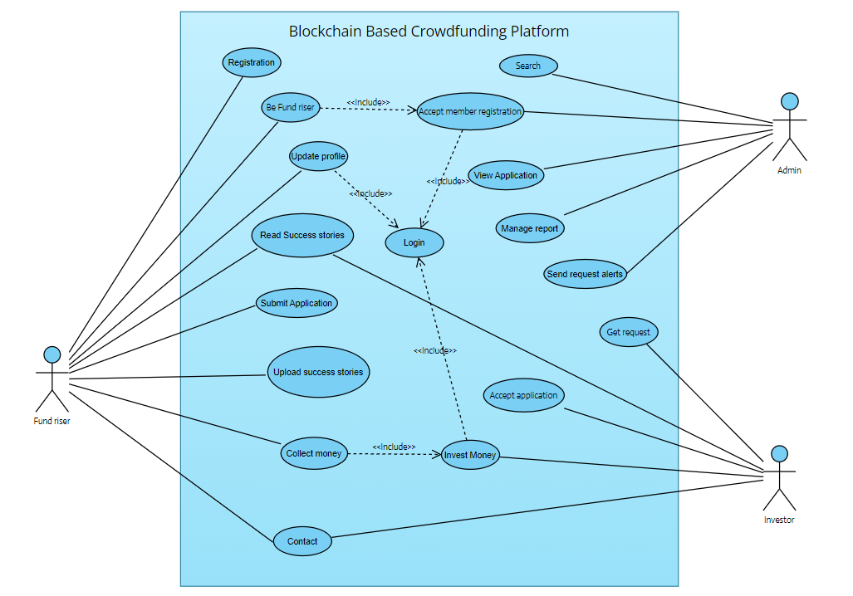
Use-case diagram Of our system

Slide 11
THANKS FOR YOUR ATTENTION

