Slide 1

Game Audio Plan
The game design required an atmosphere that encompassed lighter and darker feelings to correspond with the two accessible worlds. The aim was to create these feelings with the zonal background music.
The overall audio requirements included a mix of specific zonal background music along with global interaction sounds. The game design has an initial five zones and has an option for two different worlds that may be accessed from within each zone. The worlds are classified as normal world (nw) and upside-down / alternate world (usw).
The upside-down world has a tense, eerie soundscape that encompasses the distressing feeling of the world being overrun with the eldritch horrors. The normal world has a more optimistic tone. Global sounds have been created to support the intended gameplay at the current design stage. As the game development nears completion it is highly likely that additional sounds may be required. All game sounds have been uploaded to the team GitHub along with Game Audio Plan documents (MS Word and MS Excel).

Slide 2
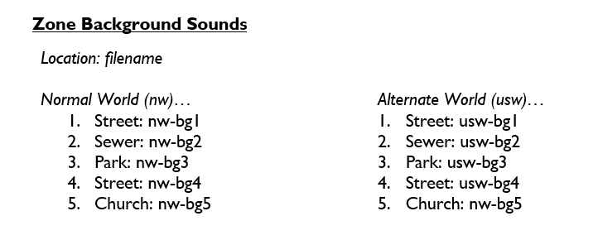
Game Audio Plan - Zones
As mentioned previously the worlds are classified as normal world (nw) and upside-down / alternate world (usw). The picture below shows the actual location and filenames for the various zones…

Slide 3
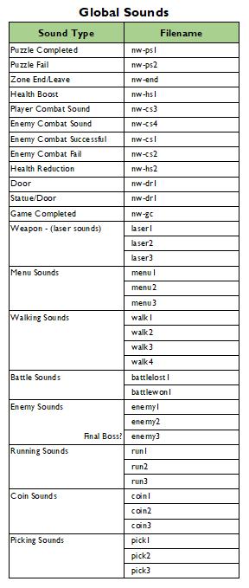


Game Audio Plan - Global
Global sounds have been created to support the desired gameplay for each zone. Global sounds have a number of options to allow for variety within the game as the player encounters different scenarios.

Slide 4
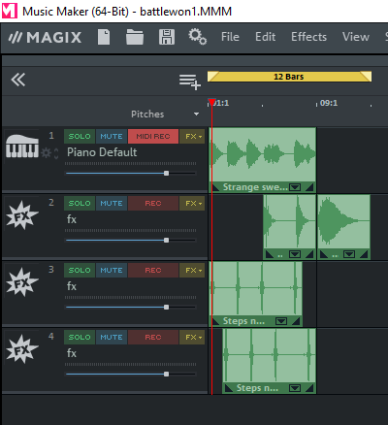

Creating The Game Audio
The game audio was created using the software ‘Music Maker’ by Magix. All files have been created in the Vorbis (. ogg) format. Where possible, filenames contain relevant intuitive naming conventions.
The audio is created using a number of sound loops that have been mixed to create the desired final sound.
An example sound mix for the audio ‘battlewon1.ogg’ is shown to the left and the actual sound file is included below…
Battle Won -

Slide 5
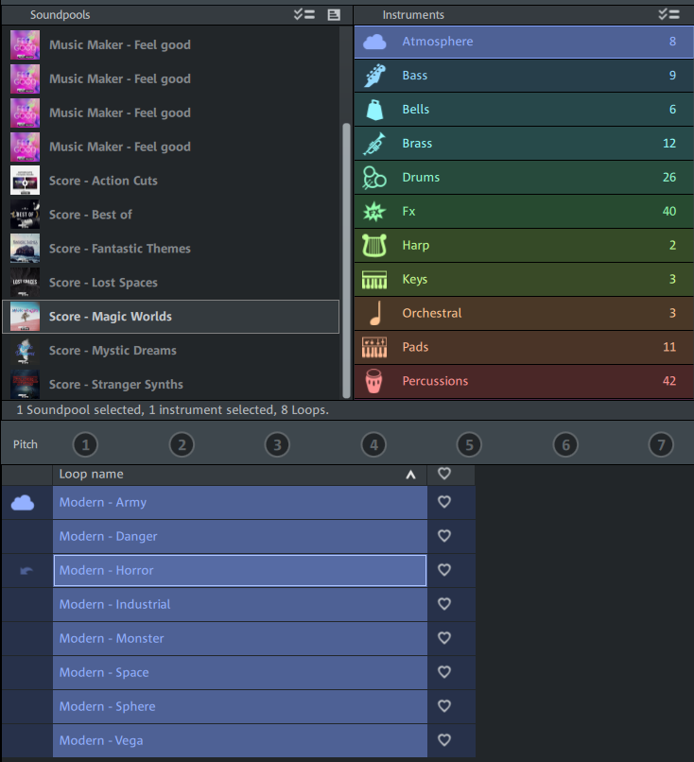
Magix – ‘Soundpools’
Sound loops can be chosen from a number of different ‘Soundpools’. Each Soundpool contains a number of different sounds ranging from vocals down to individual instruments.
The example to the left shows a selection from the Soundpool – Magic Worlds / Atmosphere / Modern – Horror.
The free program comes with the Music Maker – ‘Feel Good’ Soundpool that has a broad range of loops to showcase the program capabilities.
Additional Soundpools can be purchased with or without commercial rights.

Slide 6
Any Questions?

