Slide 1


Using Azure Resource Manager Templates to supercharge your Azure Deployments
Daniel Scott-Raynsford
27 April 2019

Slide 2

Azure Resource Manager (ARM) Templates
What are they?
Features
Recommended Tools
Creating
Components
Deploying
Important Techniques
Functions
Tips
Notes:
Join the conversation.
Potentially replace for speaker contact details / intro.

Slide 3



The journey of an Azure Professional
Crawl
Walk
Run
Manually create and manage resources in Azure Portal
Automate deployment of Azure resources using Infrastructure as Code.
E.g. ARM templates, PowerShell or Terraform.
Orchestrate deployment of Azure resources using CI/CD tools.
E.g. Azure DevOps or Jenkins.

Slide 4
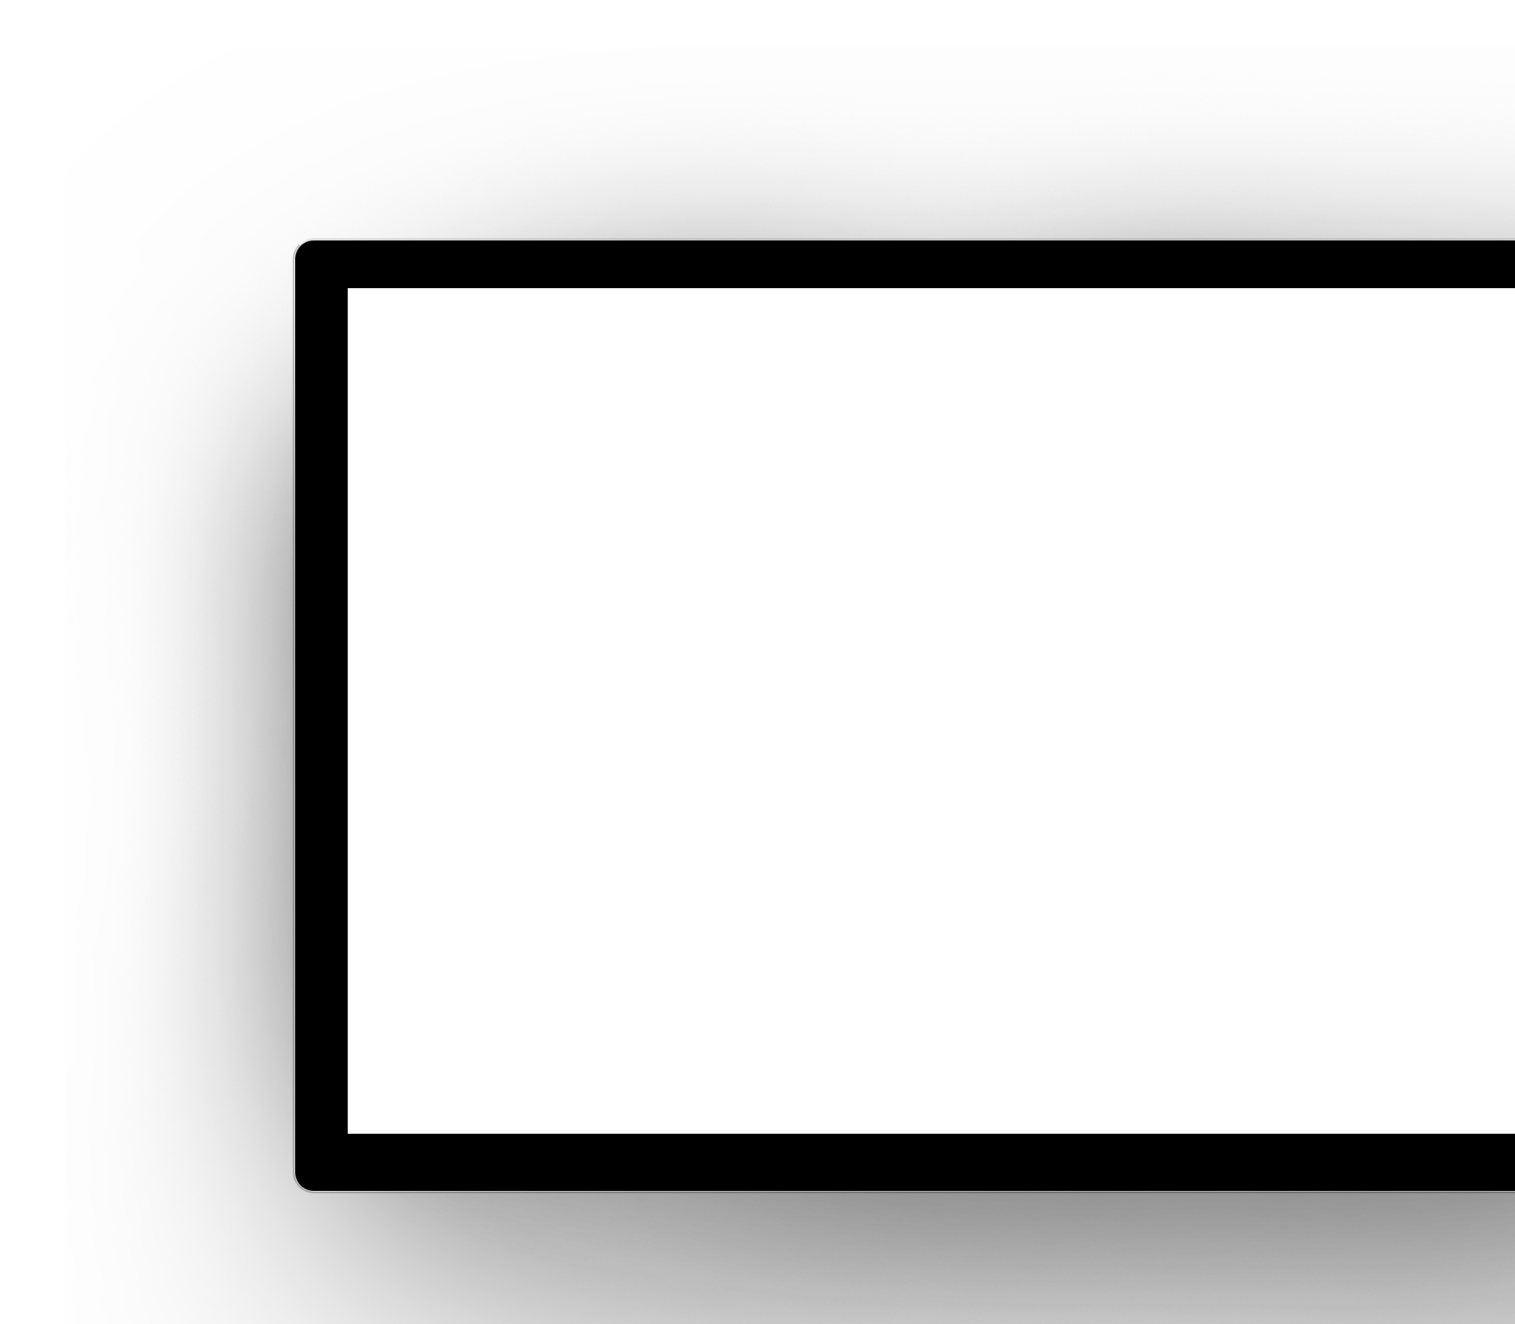
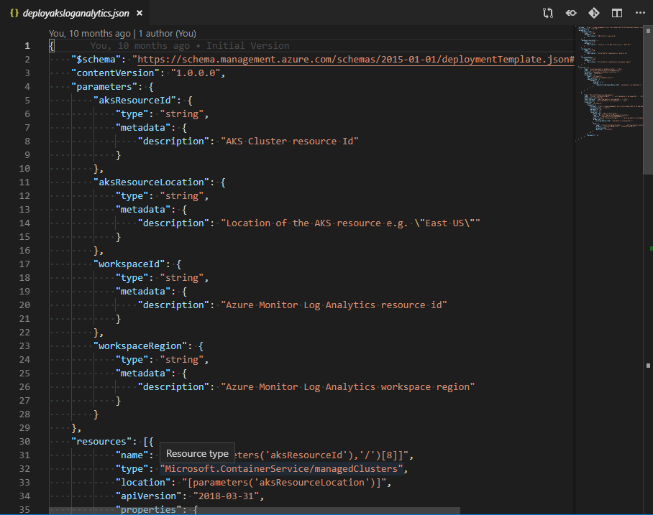




What are ARM Templates?
Declarative files for creating Azure resources in a reliable, repeatable and auditable way.
Infrastructure as Code
Define Azure resources using text files.
Declarative Syntax
Declare how the resources should be and Azure Resource Manager “makes it so”.
JSON
ARM Templates are JSON format text files. Edit them in Visual Studio Code (or other text editors). Version control them.
Meta-Language
Contains some programming language constructs such as functions and loops.
➔
https://docs.microsoft.com/en-us/azure/templates/

Slide 5
Features of ARM Templates
Parameterized
Modular
Idempotent
Parameters can be used to configure resource attributes at deployment time. Allows generalization and re-use of ARM Templates.
Templates can be broken into smaller, re-usable components and linked together at deployment time by using Deployment resources.
Templates can also be nested inside other templates.
Resources will only be changed or created if they have drifted out of state or need to be updated or created.
Testable
Version Control
➔
Templates can be validated prior to deployment.
Using ARM Templates with version control allows your infrastructure to be reviewable, traceable and auditable.
https://docs.microsoft.com/en-us/azure/azure-resource-manager/template-best-practices
Notes:
So does TFS

Slide 6
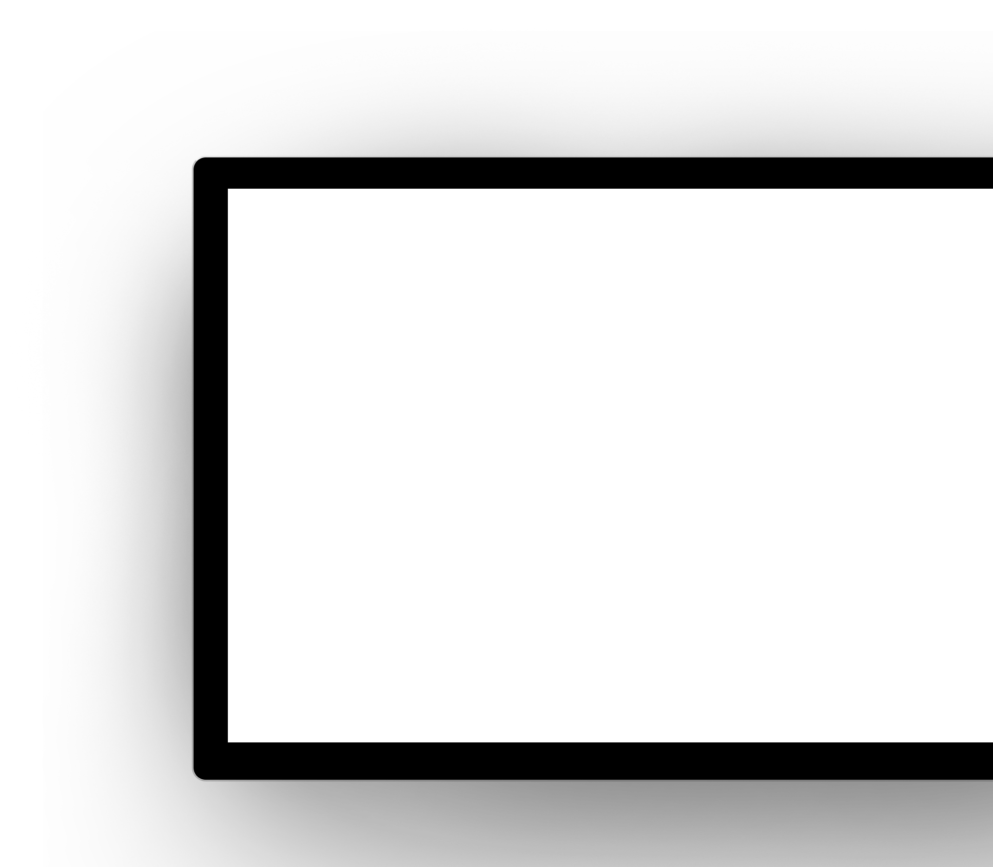
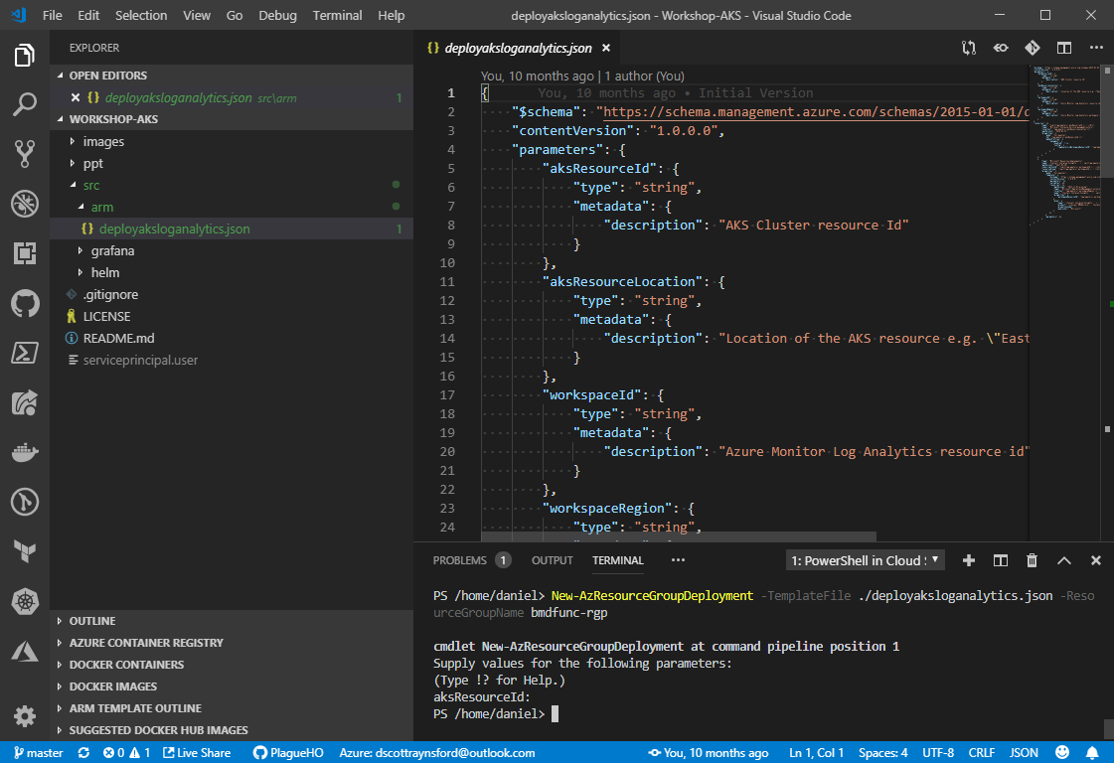




Recommended Tools
You can use many different tools to work with ARM templates, but the following will enhance your experience and productivity.
Version Control
Visual Studio Code
https://code.visualstudio.com
Include Extensions:
Azure Account
Azure Resource Manager Tools
Azure Cloud Shell
https://shell.azure.com
Includes:
PowerShell & PowerShell Az Modules
AzCli
Useful Links
Visualize ARM Templates: http://armviz.io/
Reference: https://docs.microsoft.com/en-us/azure/templates/
Quickstart Templates: https://azure.microsoft.com/en-us/resources/templates/

Slide 7
Section 1 - Getting Setup
In this section we'll set up Azure Cloud Shell and Visual Studio Code, so that we're all set to create and deploy ARM templates right from our desktop.
➔
https://github.com/PlagueHO/Workshop-ARM-Templates

Slide 8
Creating ARM Templates
There are several approaches to creating ARM templates. Some common methods are:
Export deployed Resources
or
Export during creation
Easy to get started
Requires some editing
Not all resource providers currently supported
Export one resource or entire Resource Group.
From Scratch
Harder to get started
More effort
Azure Quickstart Templates
Easy to get started
Minimal editing
Lots of quick start templates
May require customization
Hosted on GitHub
Constantly growing from Microsoft and Community contributions
➔
https://azure.microsoft.com/en-us/resources/templates/
https://github.com/Azure/azure-quickstart-templates

Slide 9
When to Export ARM Templates
You may export ARM Templates at time of creation of resources in the portal and after resources have been deployed. It is helpful to know the differences between these methods. *
During Creation | After Deployment
Export only resource(s) being created | Export single resource or entire Resource Group
Smart parameter generation | Limited parameter generation
Only exports properties exposed in create screen | Exports most properties and child resources
Cleaner template output | Template requires some clean-up
Currently exports components in reverse order (still works correctly though)* | Exports components in logical order*
When to use?
When building a new basic or complex set of resources from components that are not yet deployed | When templating complex resources that are already deployed
When After Deployment method results in an unclear or broken resource | When you want to export all properties on a deployed resource or child resources
*Note: ARM Template export has regular enhancements, so these will change.

Slide 10
Section 2 - Creating an ARM Template
In this section we'll create some resources in the Azure Portal and then export them as a new ARM Template.
➔
https://github.com/PlagueHO/Workshop-ARM-Templates

Slide 11
Components of an ARM Template
An ARM template a JSON text file and is currently made up of 5 components.
Parameters
Contains the parameters that can be passed into the template when it is deployed.
Variables
Create variables from parameters and functions that can be used in your resources.
Functions
Contains custom functions that take input parameters and return values that can be used in resources or other functions.
Resources
The actual resources that may be deployed with this ARM template.
Outputs
Values that will be outputted at the completion of deploying this template. This is used mainly with linked/nested templates.
➔
https://docs.microsoft.com/en-us/azure/azure-resource-manager/resource-group-authoring-templates

Slide 12
Section 3 - Deploying an ARM Template
We are now ready to deploy the ARM Template created in the previous section.
➔
https://github.com/PlagueHO/Workshop-ARM-Templates

Slide 13
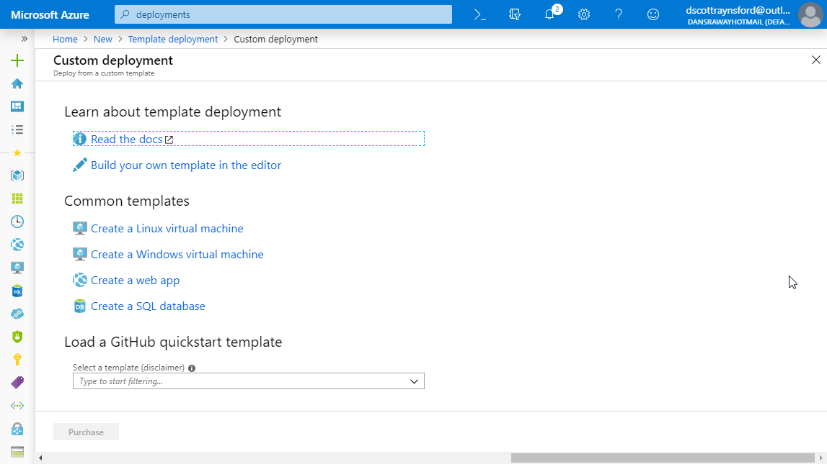
Methods of Deploying ARM Templates
There are many different methods to deploy ARM templates:
CI/CD Tools (e.g. Azure DevOps)
Deploy your Azure resources automatically as part of your deployment pipelines using either built in tasks or AzCli/Azure PowerShell Modules.
Azure Automation and Azure PowerShell
Automate the deployment of Azure resources using Azure Automation and the Azure PowerShell modules.
Manually using AzCli or Azure PowerShell
The AzCli or Azure PowreShell Modules can be used in many different environments to manually deploy ARM templates.
Manually using the Azure Portal
A Template Deployment can be created in the Azure Portal to deploy the resources in an ARM template.
➔
https://docs.microsoft.com/en-us/azure/azure-resource-manager/resource-group-template-deploy-portal

Slide 14
Section 4 - Important Techniques, Functions & Tips
Take a look at some important techniques and functions available in ARM templates.
➔
https://github.com/PlagueHO/Workshop-ARM-Templates

Slide 15
Important Techniques
Special Resources
Resource Dependencies
Modularize Templates
Templates can also be used to configure and deploy Azure components that are not strictly resources: Deployments, Resource Groups, Policies and Role assignments.
We can control the order resources are deployed by using dependsOn, child resources or reference() functions.
Templates can be broken into smaller, re-usable components and linked together at deployment time by using Deployment resources.
Templates can also be nested inside other templates.
Manage Secrets
Create Multiple Instances
➔
Instead of putting secrets into templates at design time or run time, a reference to an Azure Key Vault secret can be used to instruct ARM to pull the it at deployment time.
Using the copy property of a resource, multiple copies of the resource can be easily created.
https://docs.microsoft.com/en-us/azure/azure-resource-manager/deploy-to-subscription
Notes:
So does TFS

Slide 16
Tips
The following are some tips that will help your journey to Infrastructure as Code with ARM Templates.
Review ARM Template best practices: https://docs.microsoft.com/en-us/azure/azure-resource-manager/template-best-practices
Adopt a naming standard for your resources and resource groups: https://docs.microsoft.com/en-us/azure/architecture/best-practices/naming-conventions
Break ARM templates into small modules and use linked/nested templates: https://docs.microsoft.com/en-us/azure/azure-resource-manager/resource-group-linked-templates
Store ARM Templates in version control such as Azure DevOps repos: https://azure.microsoft.com/en-us/services/devops/repos/
Use ARM Templates with Azure Blueprints to automatically configure subscriptions with shared resources: https://azure.microsoft.com/en-us/services/blueprints/
Any deployment into a Resource Group is recorded in the Deployments section of the resource group and will also appear in the Azure Monitor: https://docs.microsoft.com/en-us/azure/azure-resource-manager/resource-group-audit
Get familiar with ARM Template functions: https://docs.microsoft.com/en-us/azure/azure-resource-manager/resource-group-template-functions

Slide 17

Thank You

