Slide 1


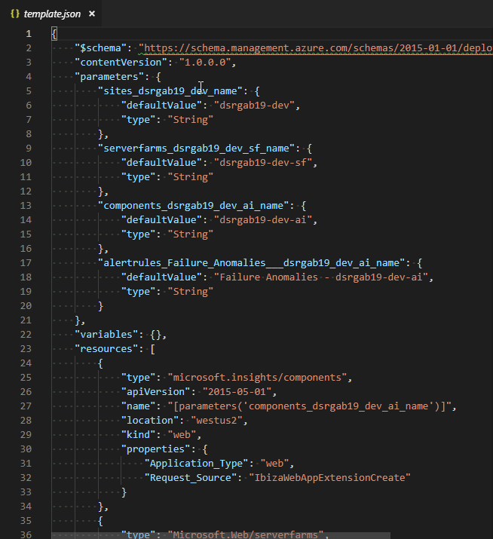


ARM Template Workshop Scenario
Dev
Test
Prod
Resource Group
appgab19-dev-rg
Resource Group
appgab19-test-rg
Resource Group
appgab19-prod-rg
Parameterized
ARM template
Web App
appgab19-dev
Web App
appgab19-test
Web App
appgab19-prod
App Service Plan (S1)
appgab19-dev-sf
App Service Plan (S1)
appgab19-test-sf
App Service Plan (S2)
appgab19-prod-sf
Application Insights
appgab19-dev-ai
Application Insights
appgab19-test-ai
Application Insights
appgab19-prod-ai

