Slide 1

FAKE NEWS DETECTION COURSE PROJECT
Vishwakarma Institute of Technology
GROUP 3 CS-A BATCH 1
DATE SCIENCE

Slide 2
GROUP MEMBERS
Rollno | NAME | GR. NO.
2 | Aahan Jain | 12010250
3 | Aarya Tiwari | 12010588
5 | Harshal Abak | 12011089
8 | Omkar Abhang | 12011406
9 | Abu Ansari | 12010599

Slide 3
INTRODUCTION
In our modern era where the internet is ubiquitous, everyone relies on various online resources for news. With the increase in the use of social media platforms news spread rapidly among millions of users within a very short span of time.
The spread of fake news has far-reaching consequences like the creation of biased opinions to sway election outcomes for the benefit of certain candidates. Even spammers use appealing news headlines to generate revenue using advertisements via click-baits.
In our project, we aim to perform binary classification of various news articles available online with the help of concepts pertaining to Data Science , and Python. We aim to provide the user with the ability to classify the news as fake or real and also check the authenticity of the website publishing the news.

Slide 4

TASK/OBJECTIVE
Make any Machine Learning model that can tell whether a news article is real or Fake.

Slide 5
STEPS
1-Dataset Acquirement
2-Preprocessing of texts:-
- Cleaning
-Tokenization
-Word embedding
-Vectorization
-Document term matrix creation
3-Training a Logistic Regression Model
4-Testing the Model using test dataset and manual entry

Slide 6
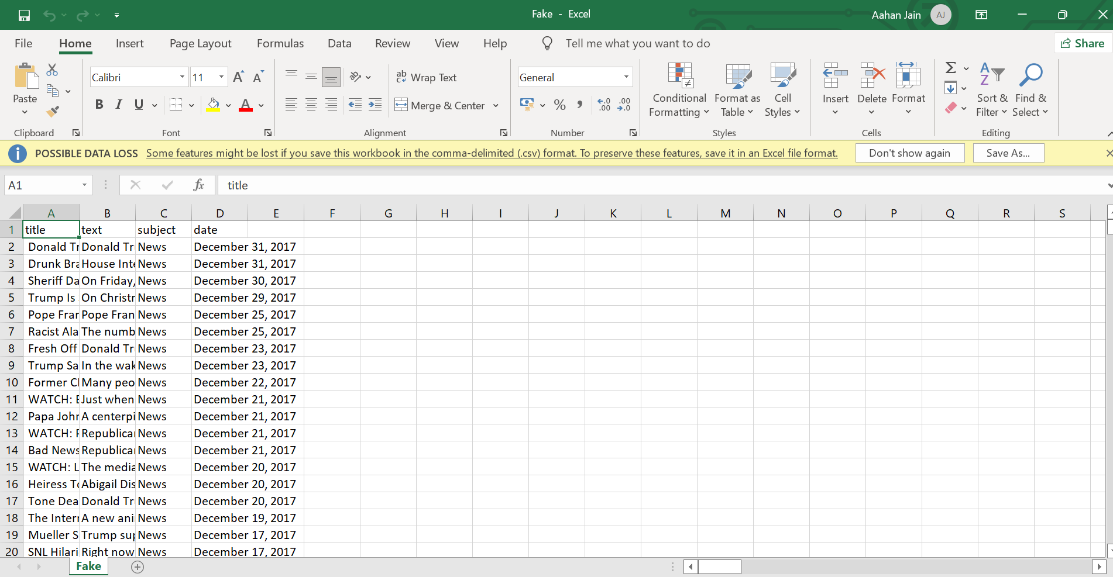
DATA SET
FAKE DATASET

Slide 7
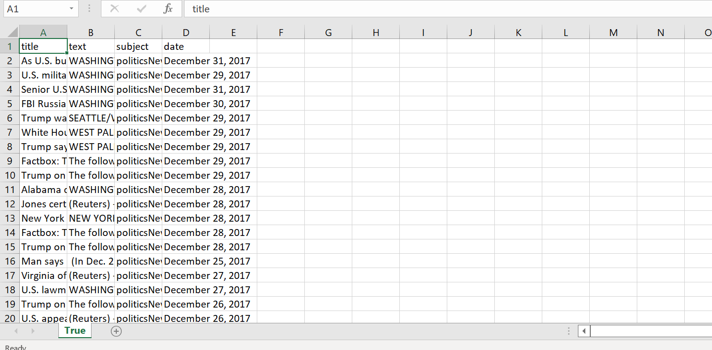
DATA SET
TRUE DATASET

Slide 8
DEMONSTRATION

Slide 9
Final Thoughts and Conclusion
This is only one of the many approaches to achieve this task
Various other models can be prepared this way for binary classification of texts
This project helps with a lot of applications

Slide 10
REFERENCES
Youtube - https://youtu.be/5X27excCyXk
Medium.com - https://medium.com/analytics-vidhya/getting-started-with-nlp-tokenization-document-term-matrix-tf-idf-2ea7d01f1942
THAT-A-SCIENCE.com
Analytics Vidhya.com

Slide 11
THANK YOU

