Slide 1
Microservices Architecture MSA
22.11.2017
MSA overview
NOMBRE DEL PONENTE
CARGO DEL PONENTE

Slide 2
Best Practices & Antipatterns
Resilience
Health monitoring
Ready to Prod
#MicroservicesEvent

Slide 3
Best Practices & Antipatterns

Slide 4
Serverless concept
Azure Functions are defined as Serverless backends
The Serverless term does not mean that there is no server but there is no need to manage it
Just deploy your piece of code and run it without worrying about configuring the backend
It is defined as a intermediate layer between PaaS and SaaS
Azure Functions are executed by triggers and have bindings to other services

Slide 5
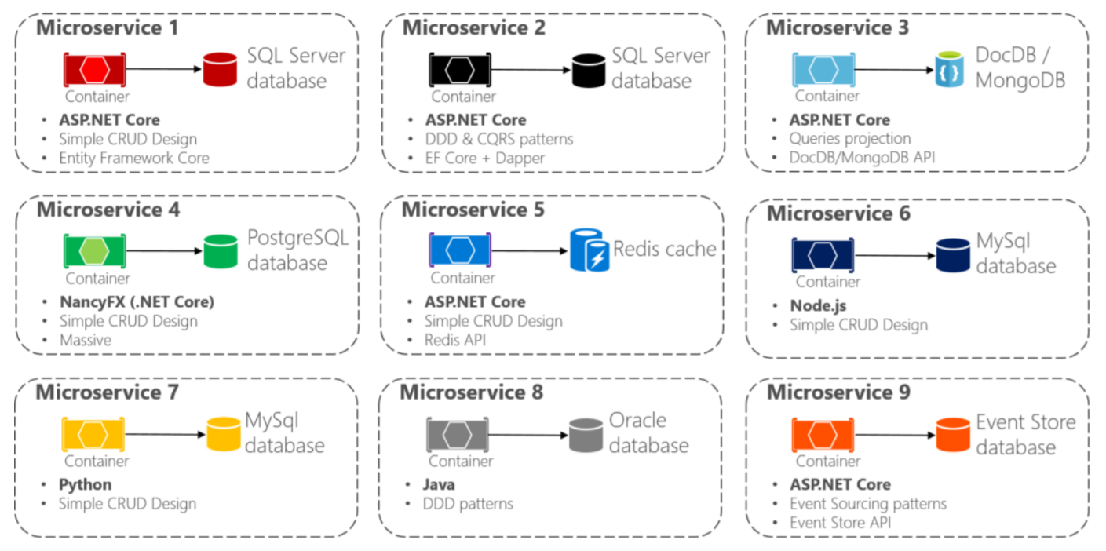
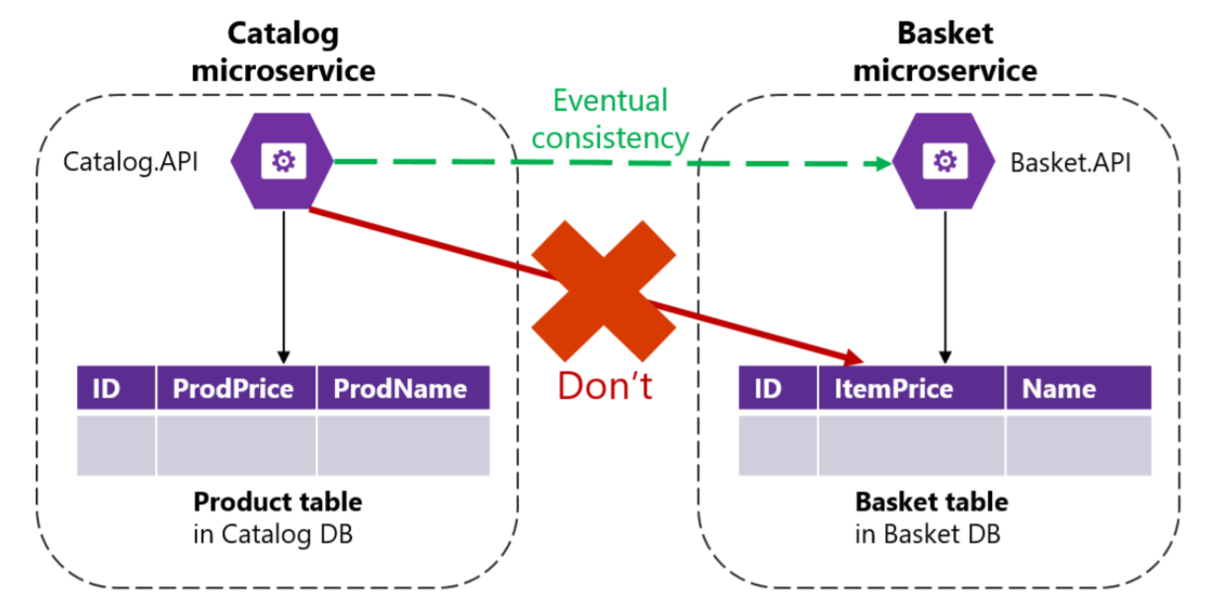
Decentralized Data
Each microservice owns its own data source
Polyglot microservices and persistence
Data must not be shared with other microservices
Data must not be directly queried from other microservices db

Slide 6
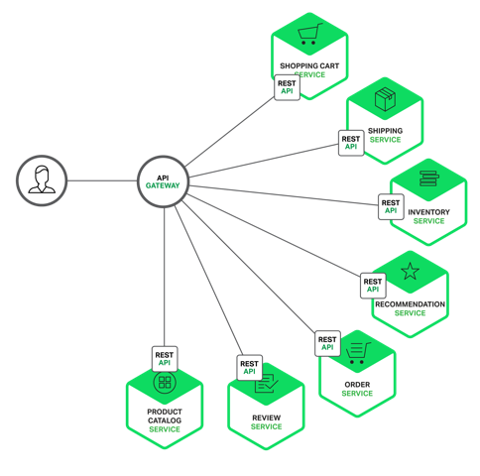
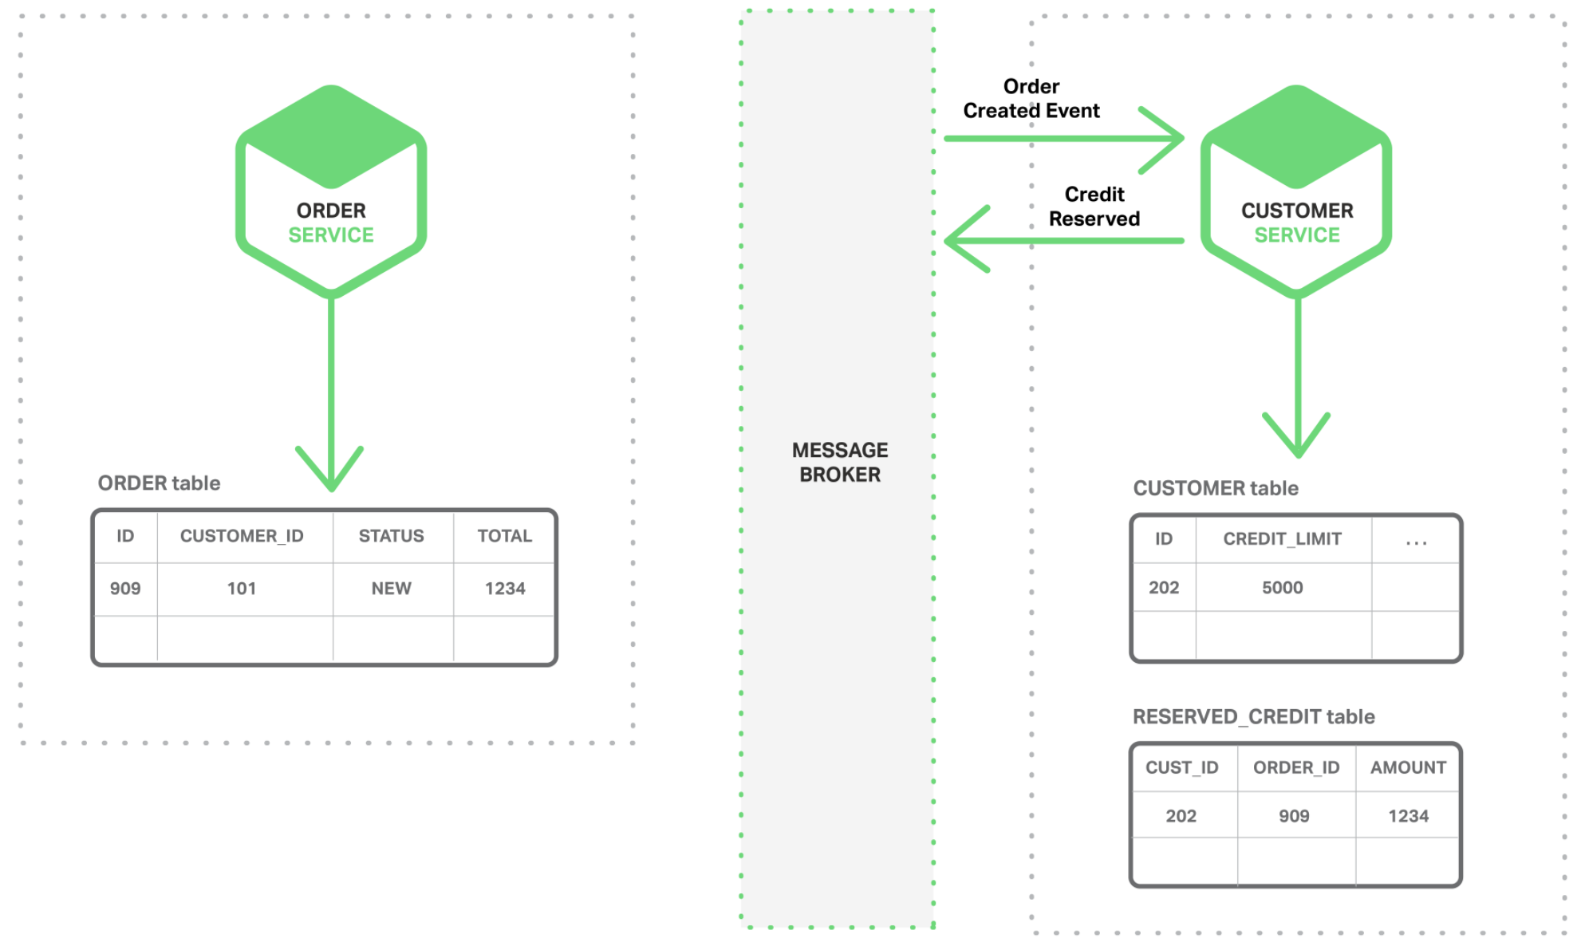
Decentralized Data
Avoid chatty communications when retrievieng data from multiple microservices
Use fine-grained Api Gateways or read-data models (materialized views) for data aggregation
CAP Theorem
Ensure eventual consistency (CQRS or Event Sourcing)

Slide 7
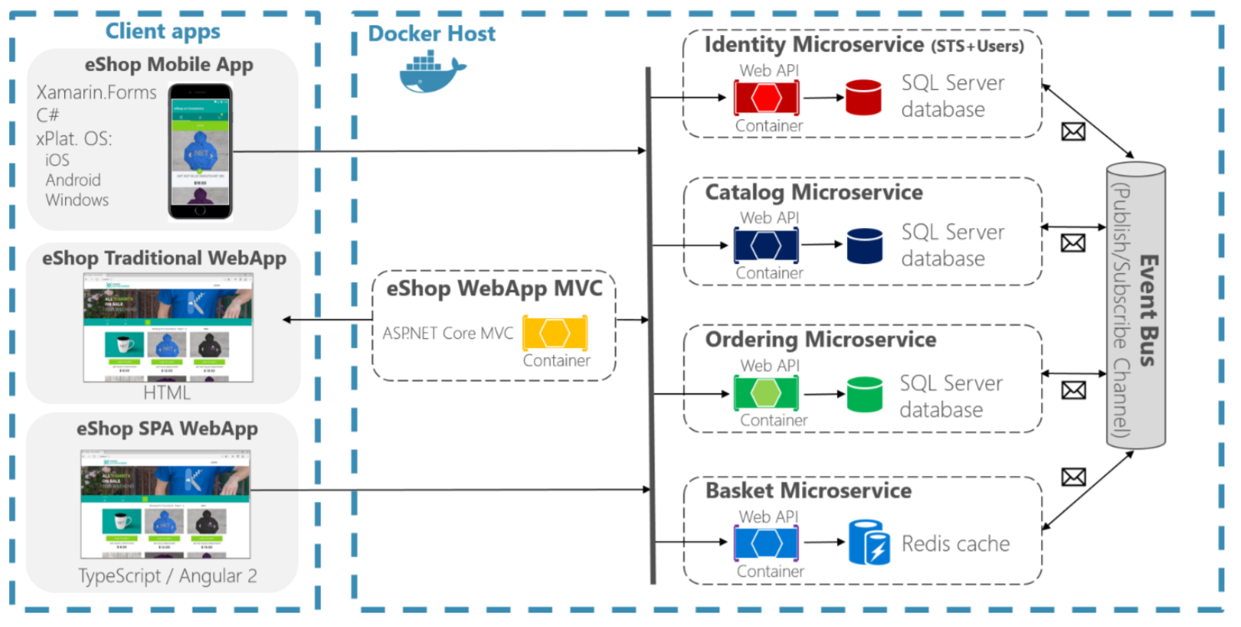
Microservices Communication
Request/Response Http for client to services communication
Client apps do not orchestrate
Microservices interaction as an asynchronous event-driven communication (choreography)
Do not use Http calls for microservices communication
Use of message queues

Slide 8
Triggers and Bindings

Slide 9
Triggers
A trigger defines how a function is invoked
Function must have only one trigger
Triggers have associated data, which is usually the payload that triggered the function
In addition to the data payload provided by a trigger, many triggers provide additional metadata values
Some Triggers supported by Azure Functions
Scheduler or timer
Http calls (Rest or Webhook)
Files added to Blob storages
Messages queued in a service bus
Events in an event hub stream service
Data inserted in a nosql db

Slide 10
Bindings
Bindings are optional and a function can have multiple input and output bindings
Allow output data to another service, by using the return value of the method
Some Bindings supported by Azure Functions
Http calls (Requires Http trigger)
Add files to Blob storages
Queue messages in a service bus
Insert data to a sql or nosql db
Push notifications

Slide 11
Components

Slide 12
.csx Files
#r "Newtonsoft.Json"
using Newtonsoft.Json.Linq;
// From an incoming queue message that is a JSON object, add fields and write to Table Storage
// The method return value creates a new row in Table Storage
public static Person Run(JObject order, TraceWriter log)
{
return new Person() {
PartitionKey = "Orders",
RowKey = Guid.NewGuid().ToString(),
Name = order["Name"].ToString(),
MobileNumber = order["MobileNumber"].ToString() };
}
public class Person
{
public string PartitionKey { get; set; }
public string RowKey { get; set; }
public string Name { get; set; }
public string MobileNumber { get; set; }
}
Features
Defines a Run method as an entry point
Creating additional classes are allowed
Supports loading other .csx files using #load syntax
Includes some default libraries that are automatically referenced
Other libraries must be referenced using #r syntax
Using Nuget packages can be achieved by adding a Project.json file and reference them with #r

Slide 13
Function.json Files
{
"bindings": [
{
"name": "order",
"type": "queueTrigger",
"direction": "in",
"queueName": "myqueue-items",
"connection": "MY_STORAGE_APP_SETTING"
},
{
"name": "$return",
"type": "table",
"direction": "out",
"tableName": "outTable",
"connection": "MY_TABLE_STORAGE_APP_SETTING"
}
]
}
Features
Defines the triggers and bindings of the Function
The name property defines the identifier in your code to access the trigger associated data.
The type property defines the type of trigger/binding
All triggers and bindings have a direction property
For triggers, the direction is in
For bindings, the direction is out
Use of Function return value $return to provide output to a binding

Slide 14
Pricing Plans

Slide 15
App Service Plan
Function apps run on dedicated VMs similar to Web Apps, API Apps, and Mobile Apps.
Suitable for function apps that need to run continously.
Offers more CPU and memory options than what is provided on the Consumption plan
Function apps not limited to a maximum execution time
Scale VM instances manually or automatically
Pay only for the cost of VMs allocated

Slide 16
Consumption Plan
Pay only when your functions are running.
Instances of Azure Functions scale automatically based on the number of incoming events.
Each instance of the Functions host is limited to 1.5 GB of memory.
The maximum timeout for functions on a Consumption plan is 10 minutes.
Billing is based on number of executions, execution time, and memory used.

Slide 17
Demo

Slide 18
¡Thank you!
www.plainconcepts.com
@plainconcepts

