Slide 1
Microservices Architecture MSA
22.11.2017
MSA overview
NOMBRE DEL PONENTE
CARGO DEL PONENTE

Slide 2
Best Practices & Antipatterns
Resilience
Infrastructure Automation
Ready to Prod
#MicroservicesEvent

Slide 3
Best Practices & Antipatterns

Slide 4
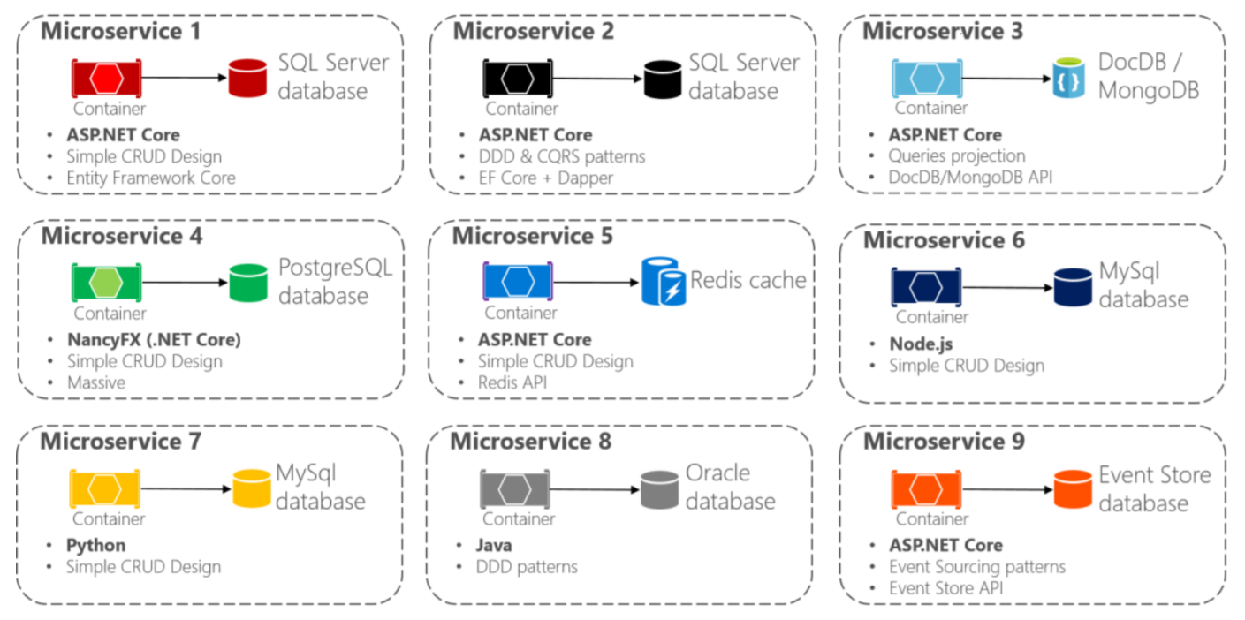
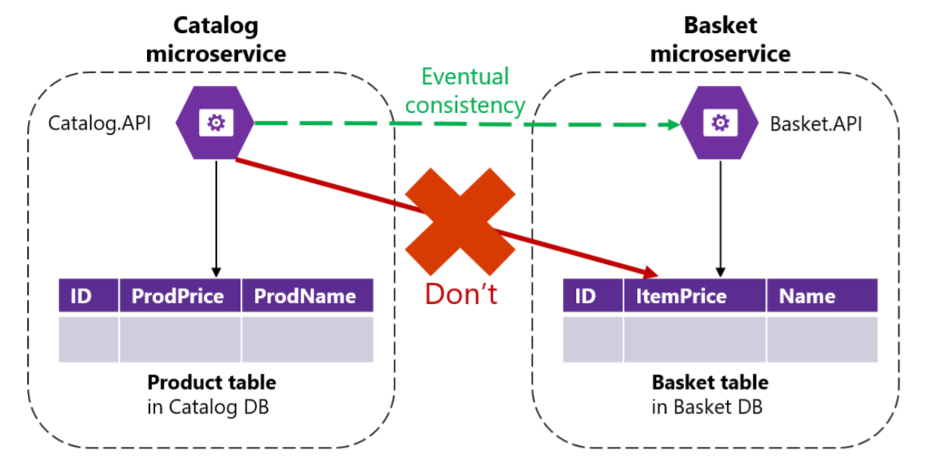
Decentralized Data
Each microservice owns its own data source
Polyglot microservices and persistence
Data must not be shared with other microservices
Data must not be directly queried from other microservices db

Slide 5
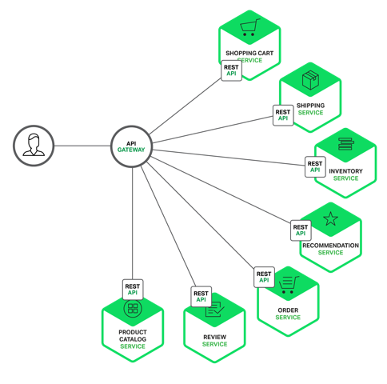
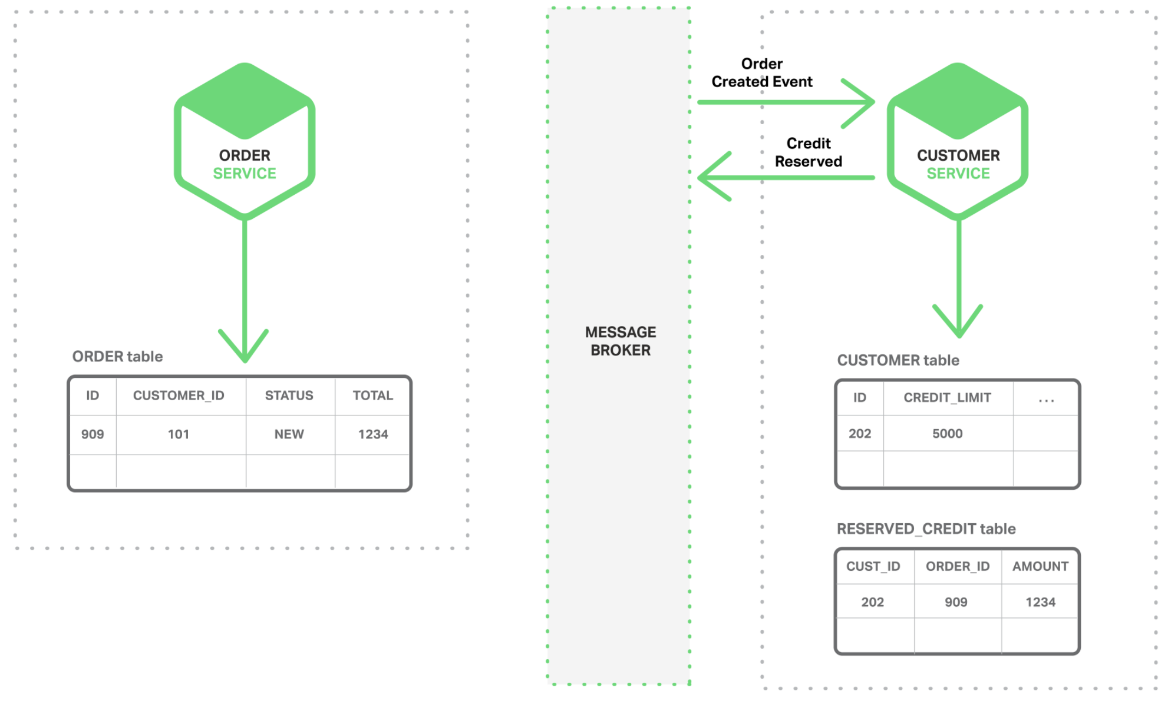
Decentralized Data
Avoid chatty communications when retrievieng data from multiple microservices
Use fine-grained Api Gateways or read-data models (materialized views) for data aggregation
CAP Theorem
Ensure eventual consistency (CQRS or Event Sourcing)

Slide 6
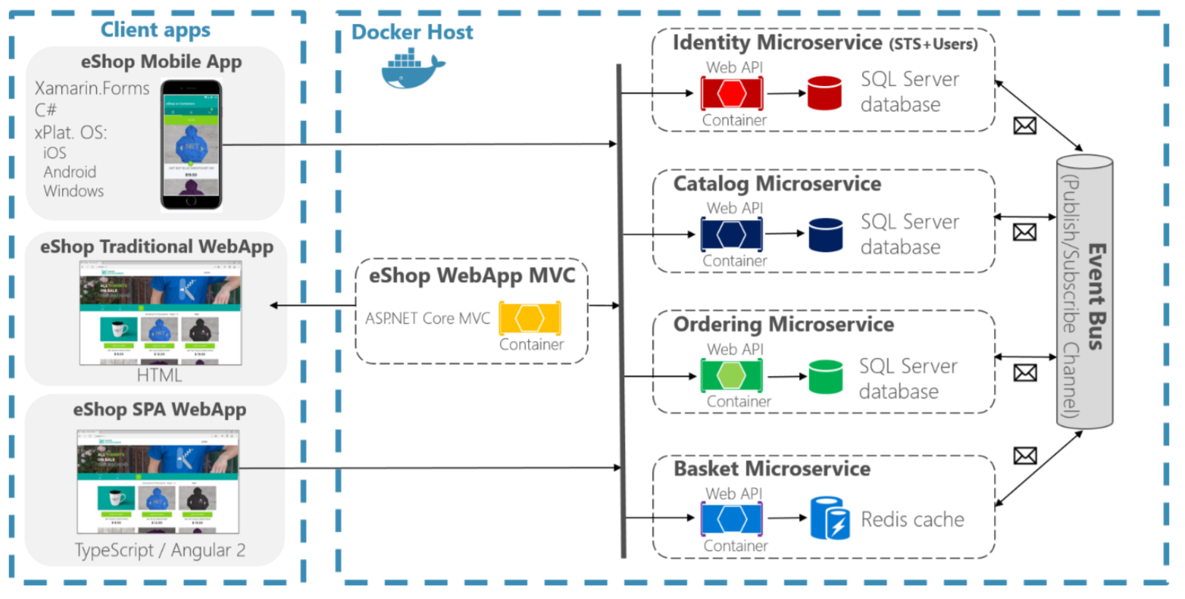
Microservices Communication
Request/Response Http for client to services communication
Client apps do not orchestrate
Avoid synchronous Http calls between services
Microservices interaction as an asynchronous event-driven communication (choreography)
Use of message queues.
Idempotency

Slide 7
Resilience

Slide 8
Design for failure
System fault tolerant
Services recovers after a network or service failure avoiding downtime or data loss
Use of asynchronous communication
Use of timeouts
Use of retries with exponential backoff policies
Use of Circuit Breaker patterns
Limit the number of queued requests
Health monitoring

Slide 9
Infrastructure Automation

Slide 10
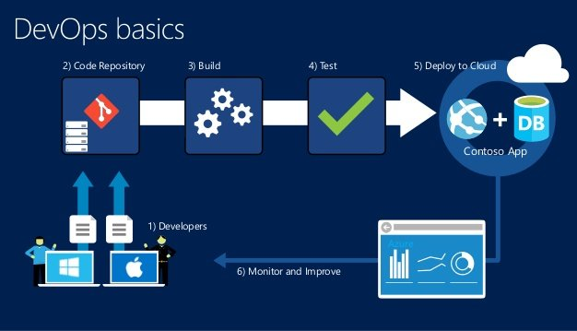
Infrastructure Automation
Adopt DevOps methodology
Continous Integration Continuous Deployment (CI/CD)
Faster and independent deliveries
Automated QA and Deployments

Slide 11
Demo

Slide 12
¡Thank you!
www.plainconcepts.com
@plainconcepts

