Slide 1
The Twelve-Factor App
A methodology for building software-as-a-service apps

Slide 2

What is Twelve-Factor App
Twelve-Factor App is a methodology and/or manifesto for the organizations to develop web apps in a correct way.
It has been done by experts in the field (mainly working at Heroku), and based in their practical experiences.
It is composed of twelve points or “factors”.

Slide 3
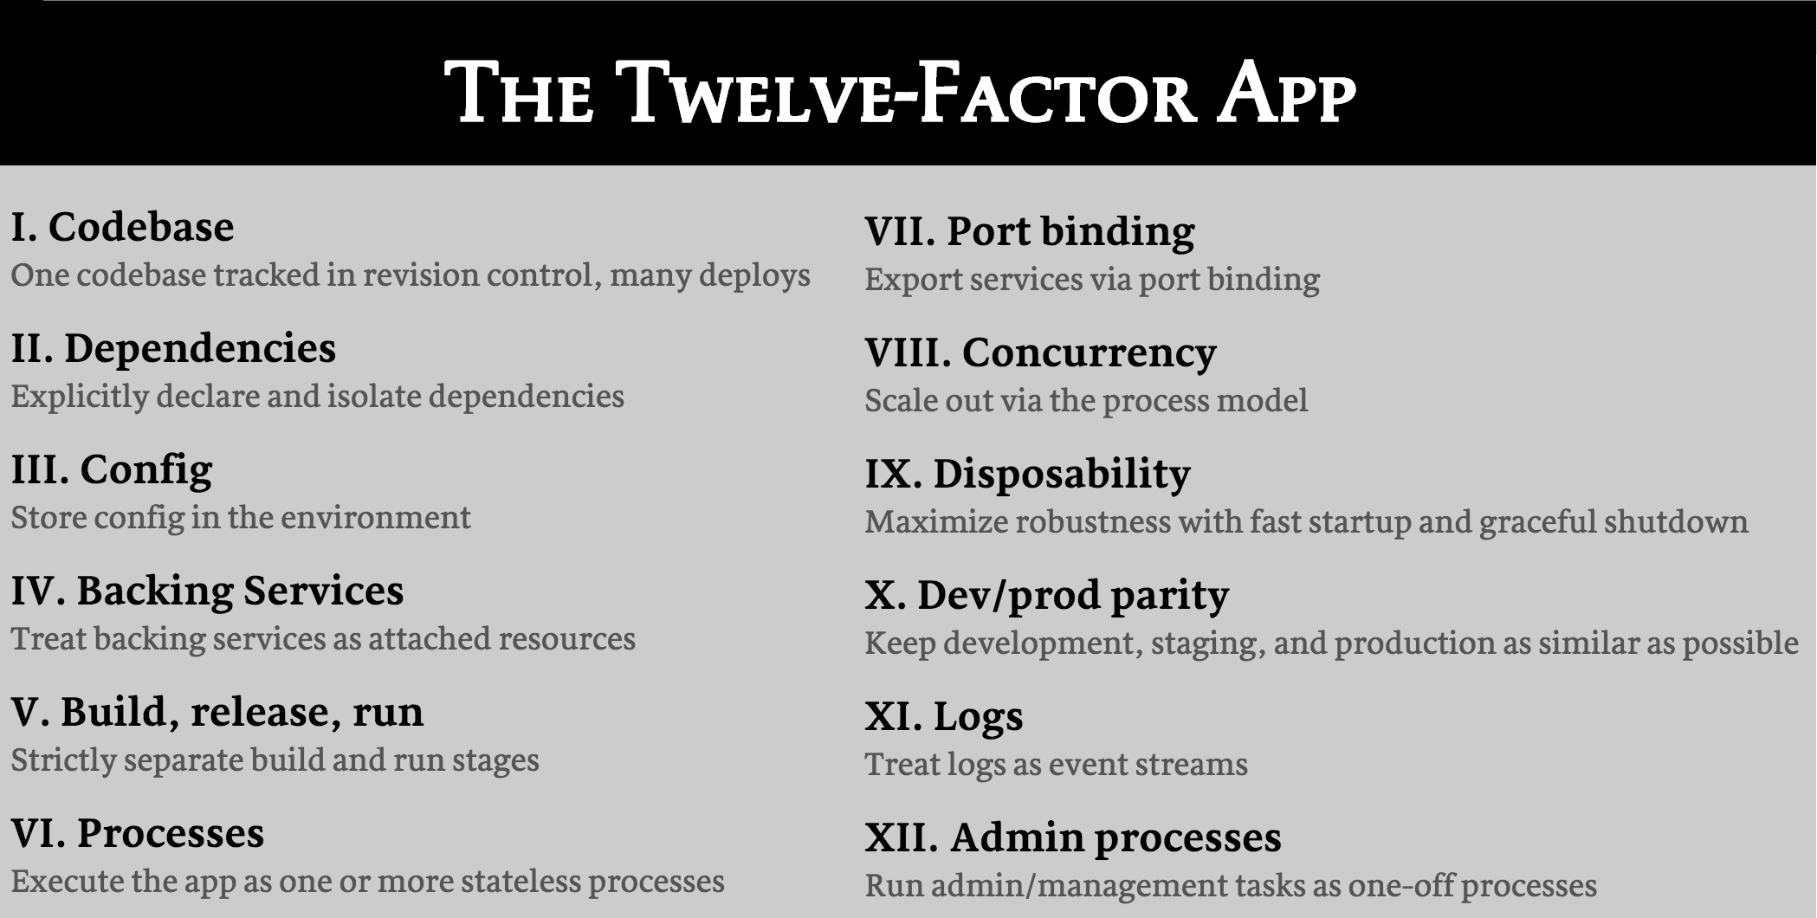

Slide 4
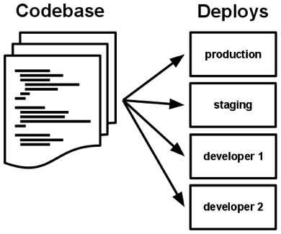
I. Codebase
One codebase tracked in revision control, many deploys
The app is always tracked in a version control system, with a code repository.
There is only one codebase per app.
There are many deploys (a running instance of the app) per app.
Violation of the Twelve-factor: more than one app pointing to the same codebase.

Slide 5
II. Dependencies
Explicitly declare and isolate dependencies
It declares all dependencies, completely and exactly, via a dependency declaration manifest.
It uses a dependency isolation tool during execution to ensure that no implicit dependencies “leak in” from the surrounding system.
The full and explicit dependency specification is applied uniformly to both production and development.
Test for this rule: a new developer can check out the app’s codebase onto his development machine, requiring only the language runtime and dependency manager installed as prerequisites.

Slide 6
III. Config
Store config in the environment
Config is everything that varies between deploys: database handles, credentials, etc
The twelve-factor app stores config in environment variables
Env vars are easy to change
Unlike config files, there is little chance of them being checked into the code repo accidentally
They are a language- and OS-agnostic standard
Violation of twelve-factor : store config as constants in the code. Config and code must be strictly separated.

Slide 7
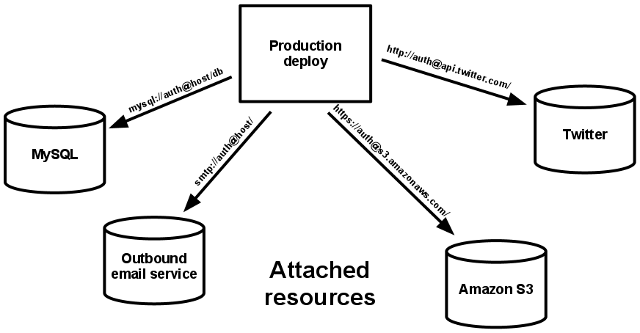
IV. Backing services
Treat backing services as attached resources
A backing service is any service the app consumes over the network as part of its normal operation.
The code for a twelve-factor app makes no distinction between local and third party services.
All the resources are accessed via a URL or other locator/credentials stored in the config.
Test for this rule : a deploy of the twelve-factor app should be able to swap out a local resource with one managed by a third party (f.i. in Azure) without any changes to the app’s code, only by configuration.

Slide 8
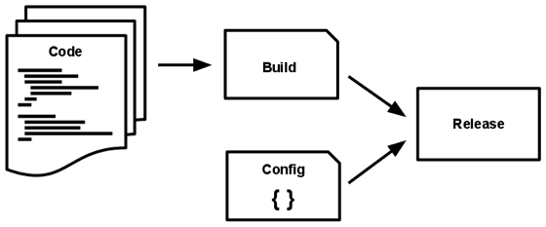
V. Build, release, run
Strictly separate build and run stages
Strict separation between the build, release, and run stages. Example: impossible to make changes to the code at runtime.
The build stage: code repo → executable bundle, the build
The release stage: build + deploy’s current config
The run stage (aka “runtime”) runs the app in the execution environment

Slide 9
VI. Processes
Execute the app as one or more stateless processes
You app should be stateless.
Any data that needs to persist must be stored in a stateful backing service, typically a database.
The memory space or filesystem of the process can be used as a brief, single-transaction cache. For example, downloading a large file, operating on it, and storing the results of the operation in the database.
Do not keep session state data in the app memory. Use a datastore that offers time-expiration such as Redis.

Slide 10
VII. Port binding
Export services via port binding
The web app exports HTTP as a service by binding to a port, and listening to requests coming in on that port.
The application must be self-hosted (as Asp.Net Core apps)
Local development environment, the developer visits a service URL like http://localhost:5000/
In deployment, a routing layer handles routing requests from a public-facing hostname to the port-bound web processes.
One app can become the backing service for another app, by providing the URL as a resource handle in the config for the consuming app.

Slide 11
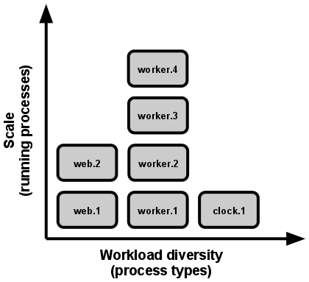
VIII. Concurrency
Scale out via the process model
Do not scale vertically, but horizontally. More instances instead of more CPU or memory.
Each workload assigned to the correct type process:
HTTP request → wep process
Log running task → worker process
Individual processes should manage their own multithreading as efficiently as possible, but never scale out based on this.
The share-nothing nature of the 12-f processes makes them very easy to scale.

Slide 12
IX. Disposability
Maximize robustness with fast startup and graceful shutdown
Processes should facilitate fast scaling, rapid deployment and robustness.
Can be started and stopped at a moment’s notice.
Processes should strive to minimize startup time (few seconds).
Agility for the release process and scaling up
Robustness, process manager can more easily move processes to new physical machines.
Processes shut down gracefully:
It refuses new requests
Short requests (HTTP) → current requests are allowed to finish before exiting.
Long requests (worker process) → returns the current job to the work queue
Processes should also be architected to handle unexpected, non-graceful terminations

Slide 13
X. Dev/prod parity
Keep development, staging, and production as similar as possible
Design for continuous deployment by keeping the gap between development and production small
A developer may write code and have it deployed hours or even just minutes later.
Personnel gap small: developers who wrote code are closely involved in deploying it and watching its behavior in production.
Tools gap small: keep development and production as similar as possible.
Environment gap small: resists the urge to use different backing services between development and production, even when adapters theoretically abstract away any differences in backing services.

Slide 14
XI. Logs
Treat logs as event streams
Logs are the stream of aggregated, time-ordered events collected from the output streams of all running processes and backing services.
App never concerns itself with routing or storage of its output stream. Each running process writes its event stream, unbuffered, to stdout.
During local development, the developer will view this stream in the foreground of their terminal. In staging or production, all the streams are aggregated and routed to a common destination (ex: Azure Application Insights)
Exception in MSA: all the microservices have a unified criteria. These archival destinations are completely managed by the execution environment, not configurable.

Slide 15
XII. Admin processes
Run admin/management tasks as one-off processes
One-off admin processes should be run in an identical environment as the regular long-running processes of the app.
Admin code must ship with application code to avoid synchronization issues.
The same techniques explained for other code applies to the admin processes (dependency isolation, dev/prod parity, one codebase multiple releases…)

