Slide 1
Orchestrators
22.11.2017
Orchestrators overview
NOMBRE DEL PONENTE
CARGO DEL PONENTE

Slide 2
Orchestrator Concepts
Kubernetes
Workshop
#MicroservicesEvent

Slide 3
1. Orchestrator Concepts

Slide 4
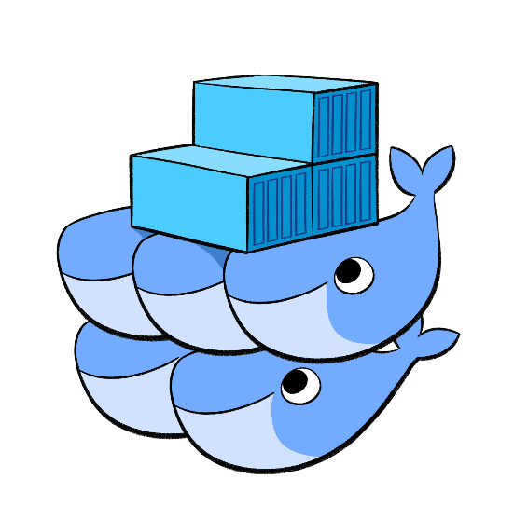
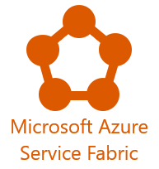

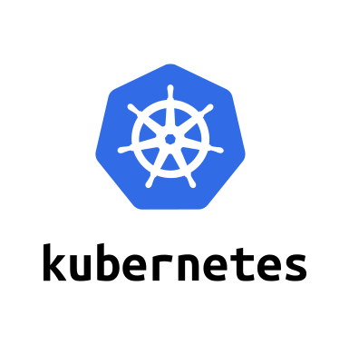
Introduction
Containers sound nice but how do they fit in a Prod environment?
What about:
Scaling?
Manage deployments?
Configuration?
Communication?
Failover?
Health checking?
Solution: Orchestrators

Slide 5
Concepts
Automates the provisioning and management of containerized infrastructure
Specially important in cluster environments with hundreds or thousands of services
Schedule deployments and find a suitable cluster machine on which to run the container
Watch for container failures and automatically reschedule them with Health monitoring
Implements Failover to reschedule containers from failed to health machines
Allows Scaling to add or remove container instances manually or automatically
With Networking provide an overlay network for container communication across cluster machines
Provides a Service Discovery for containers to locate each other in a cluster environment
Manages Coordinated application upgrades to avoid service down times during deployments and provides rollback in case of failure

Slide 6
2. Kubernetes

Slide 7

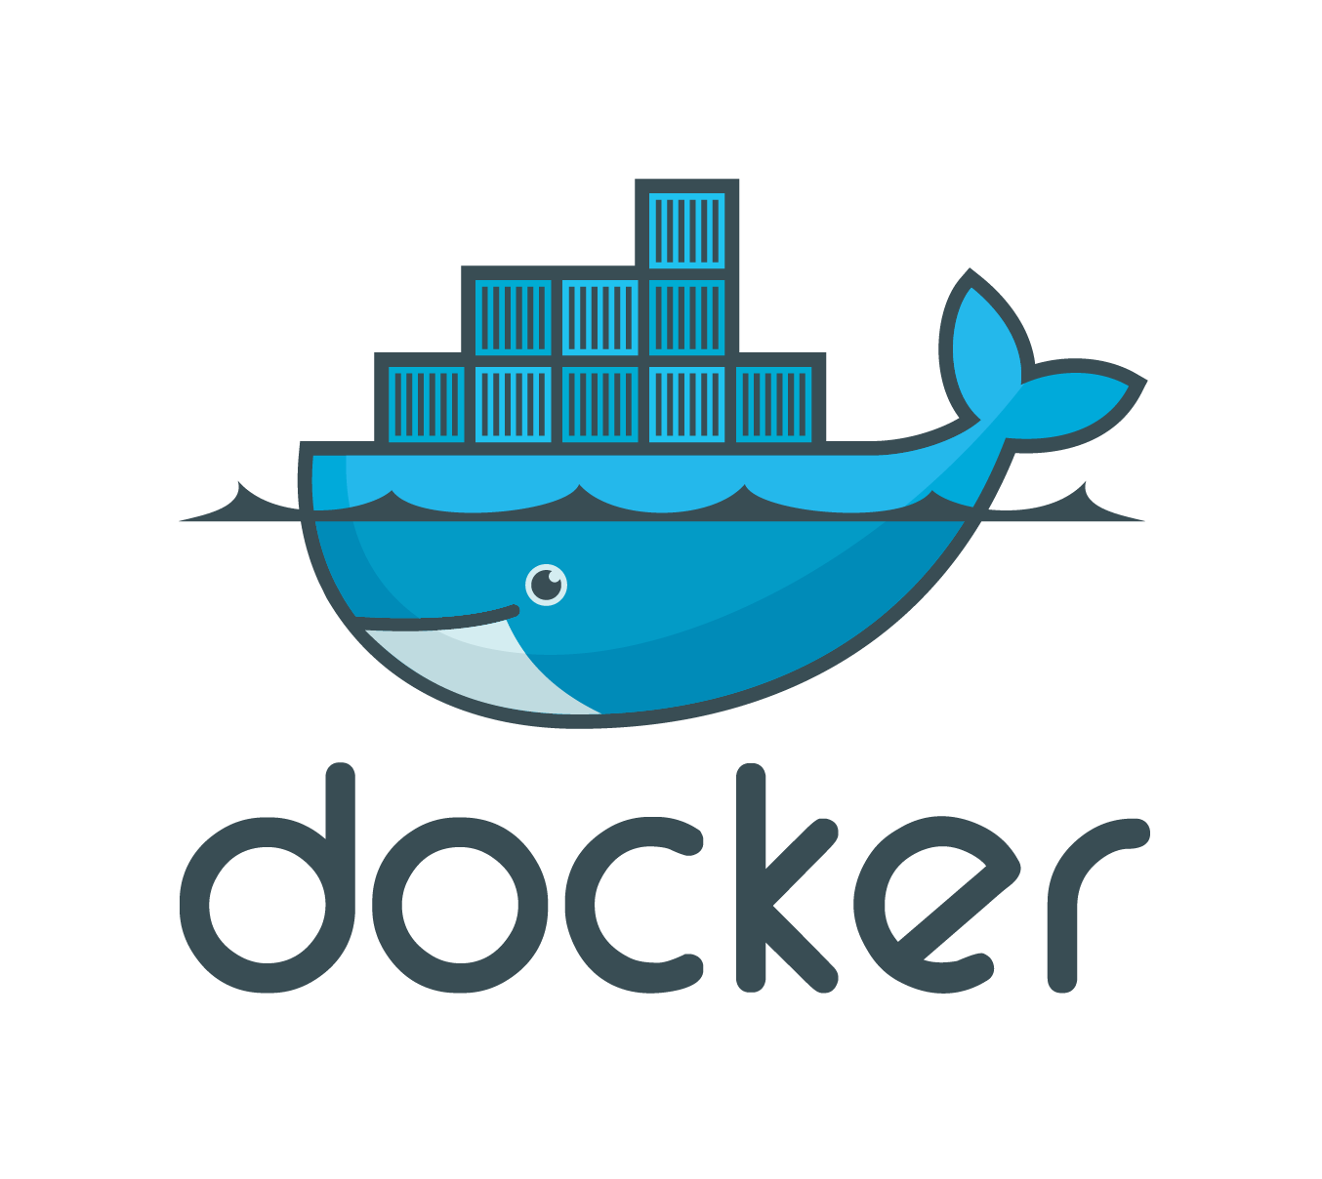
Kubernetes is an open source orchestration platform originally created at Google
Automates the deployment of distributed containerized microservices
Supports Linux and Windows docker containers
Very mature and highly adopted by many organizations

Slide 8
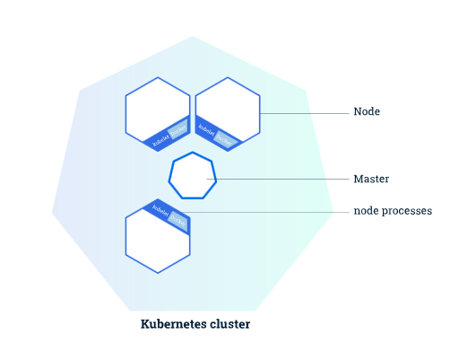
Kubernetes Cluster
The master coordinates all activities in your cluster
The nodes communicate with the master using the Kubernetes API
A node is a working machine in a Kubernetes cluster

Slide 9
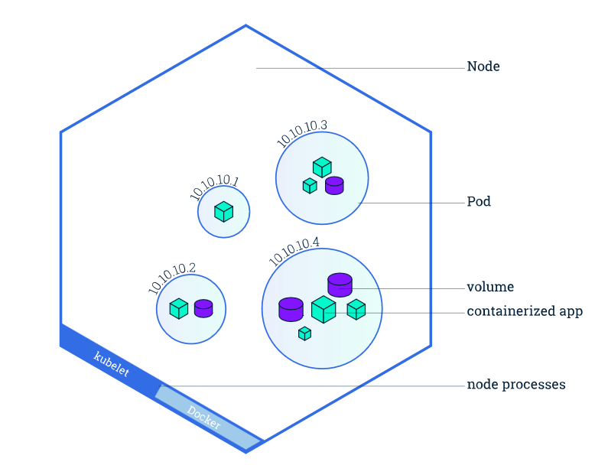
Kubernetes Machine (Node)
Node contains n Pods
Pod is a Kubernetes abstraction that represents a group of containers or shared resources. It is the atomic unit.
Containers in a Pod shared the same IP
Container lifecycle tight to its Pod
Each node contains a Kubelet agent and Docker engine

Slide 10
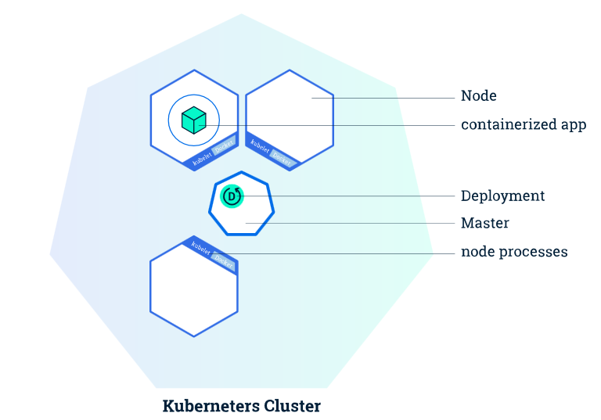
Kubernetes Deployment
Kubectl command line tool or UI
Instructions can be executed through command line or scripts
Instructions contains params like image, # of replicas, container details, env var,…
Master creates instances and a deployment controller continuously monitors those instances.

Slide 11
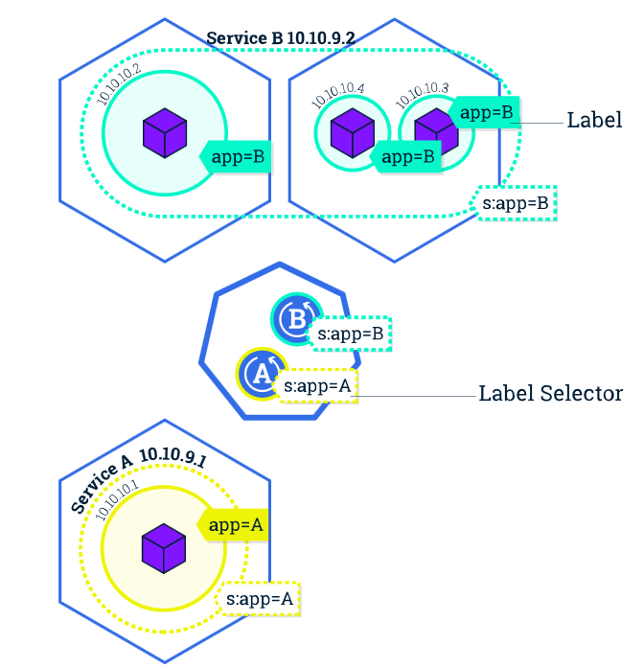
Kubernetes Services
A Service is an abstraction which defines a logical set of Pods and a policy by which to access them
A Service routes traffic across a set of Pods
Allows discovery and routing among dependent Pods
The set of Pods targeted by a Service is determined by a LabelSelector
Services expose a fixed IP address for internal-cluster communication but can optionally be exposed outside the cluster

Slide 12
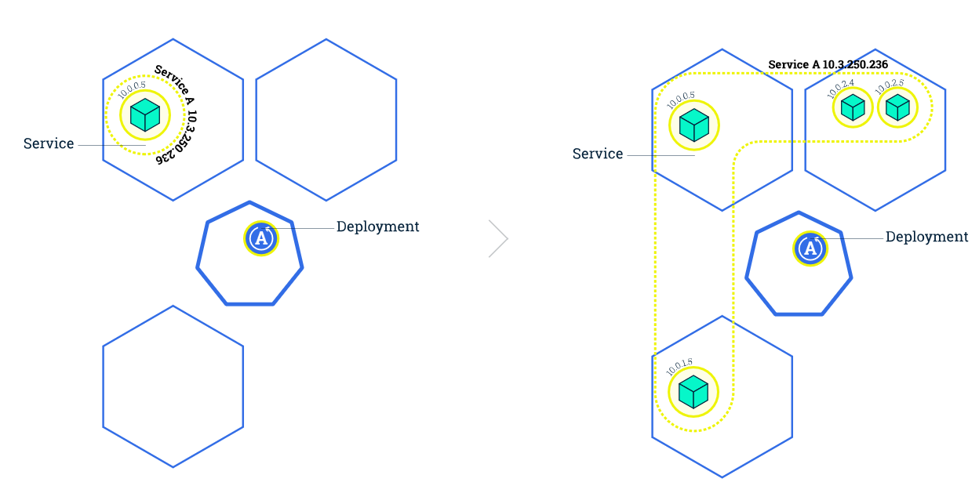
Kubernetes Scaling

Slide 13
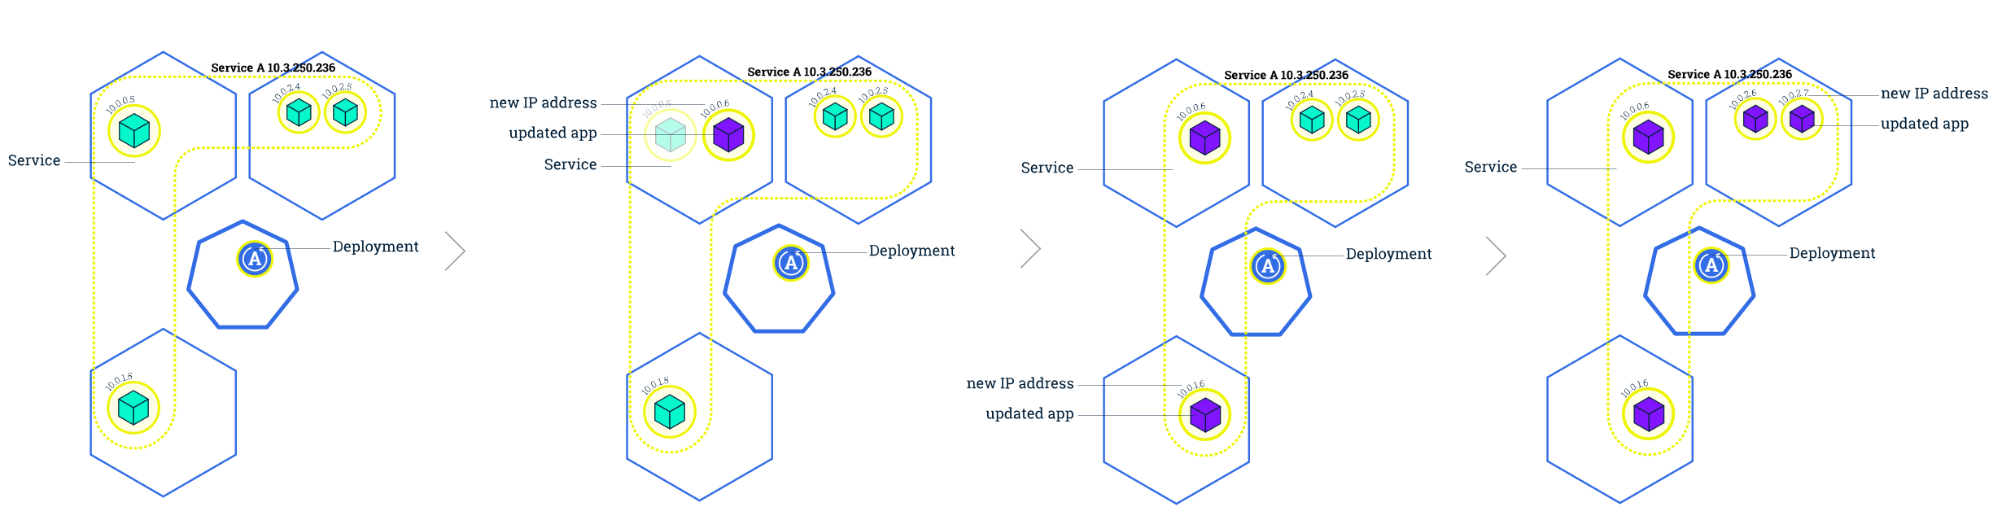
Kubernetes Rolling updates

Slide 14
Other Features
Namespaces
Replicas autoscale based on node cpu, ram,..
Network policies
Nodes affinity
Compute resource management
Jobs & Cron jobs
Volumes to share resources

Slide 15
Workshop: deploying K8S

Slide 16
¡Thank you!
www.plainconcepts.com
@plainconcepts

