Slide 1
Microservices Architecture MSA
22.11.2017
MSA overview
Ramón Tomás
David Sanz

Slide 2
Best Practices & Antipatterns
Resilience
Infrastructure Automation
Health Monitoring
Ready to Prod
#MicroservicesEvent

Slide 3
1. Best Practices & Antipatterns

Slide 4
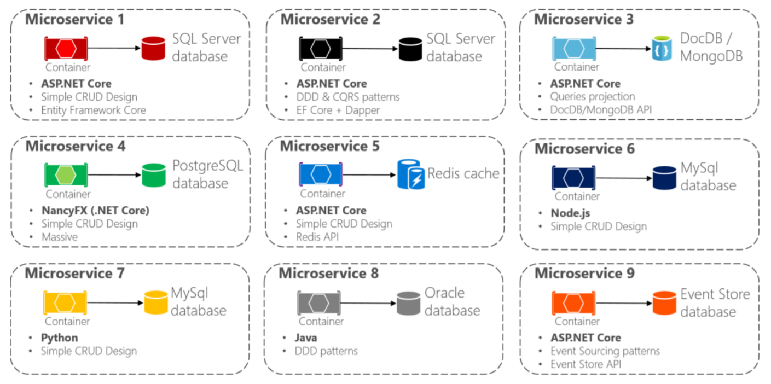
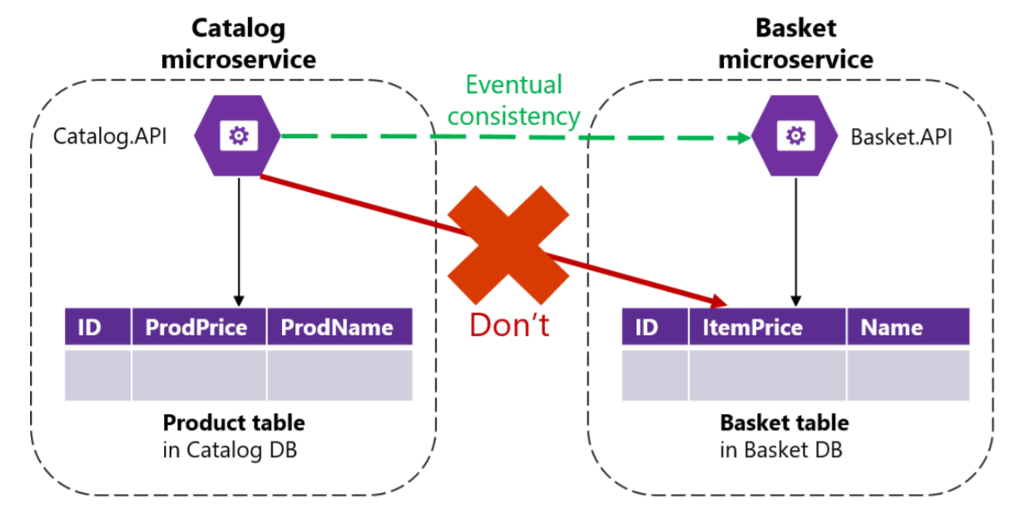
Decentralized Data
Each microservice owns its own data source
Polyglot microservices and persistence
Data must not be shared with other microservices
Data must not be directly queried from other microservices db

Slide 5
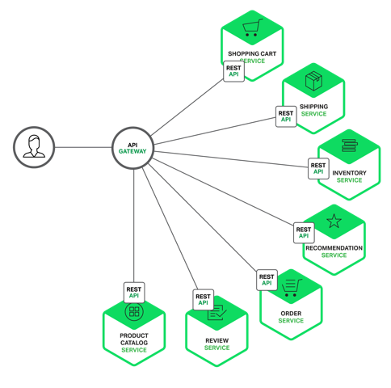
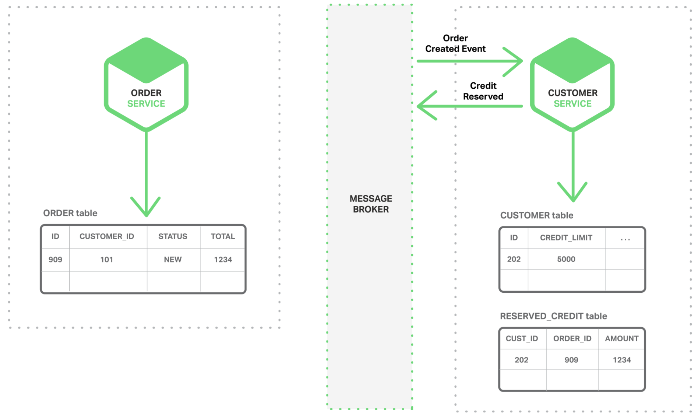
Decentralized Data
Avoid chatty communications when retrievieng data from multiple microservices
Use fine-grained Api Gateways or read-data models (materialized views) for data aggregation
Trade-off between consistency and availability in distributed systems (CAP Theorem)
Ensure eventual consistency (CQRS or Event Sourcing)

Slide 6
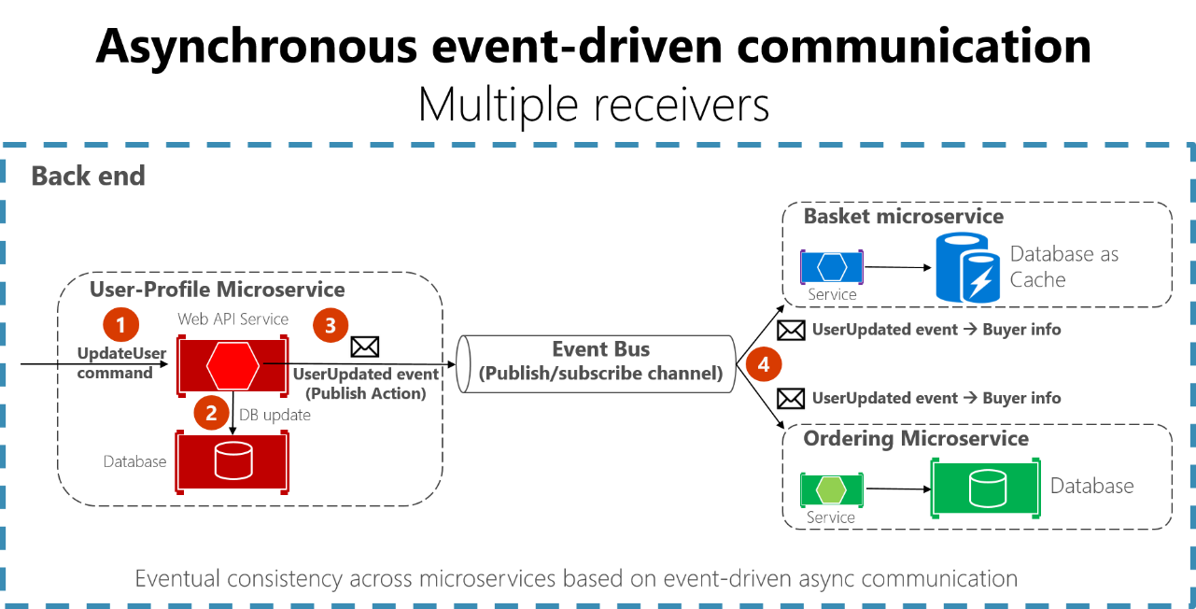
Eventual Consistency
Avoid distributed transactions
Scalability and high availability
System inconsistency window
Event Sourcing or Outbox patterns provides consistency

Slide 7
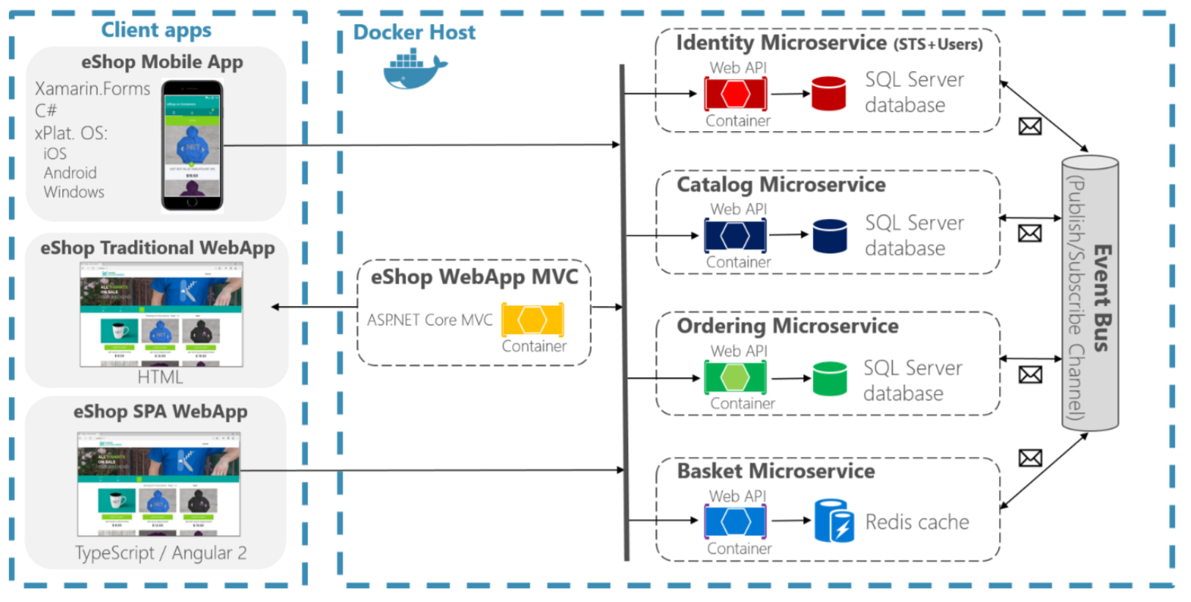
Microservices Communication
Request/Response Http for client to services communication
Client apps do not orchestrate
Avoid synchronous Http calls between services
Microservices interaction as an asynchronous event-driven communication (choreography)
Use of message queues.
Avoid adding business rules in the queue bus
Idempotency

Slide 8
2. Resilience

Slide 9
Design for failure
System fault tolerant
Services recovers after a network or service failure avoiding downtime or data loss
Use of asynchronous communication
Use of timeouts
Use of retries with exponential backoff policies
Use of Circuit Breaker patterns
Limit the number of queued requests
Health monitoring

Slide 10
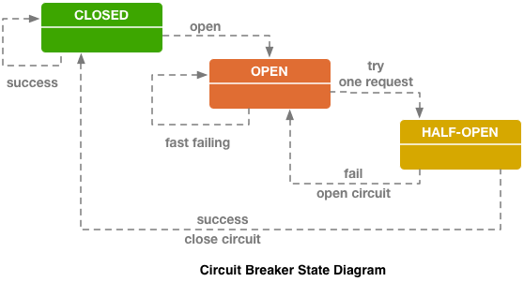
Circuit Breaker Pattern
Protects a function call in a circuit broker objects which monitores for failures
Avoids putting load on a strugling service
If the number of failures reach a certain threshold, the circuit changes to Open state and subsequent requests will fail.
After a timeout the circuit changes to Half-open state and makes a trial request.
If successful, the circuit changes to Closed state and subsequent request will be sent.
If not, is changed to Open state again.

Slide 11
3. Infrastructure Automation

Slide 12
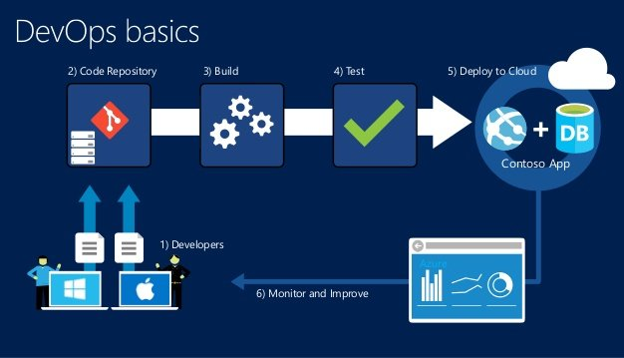
Infrastructure Automation
Adopt DevOps methodology
Continous Integration Continuous Deployment (CI/CD)
Faster and independent deliveries
Automated QA and Deployments

Slide 13
Workshop: adding Circuit Breaker with Polly

Slide 14
4. Health monitoring

Slide 15
The situation
We have lots of instances of our services
A service instance can be down for handling requests but the host be running
We need a way to detect these outages to raise a warning and handle the situation
Move traffic to other instances of the same service
Notify the team
Recycle the service

Slide 16
What is Health monitoring
It is the group of operations and activities related to provide the near-real-time information about the containers and microservices.
Health monitoring is different from diagnostics:
Diagnostics is about tracking and measuring data
Health monitoring is about the state of a service

Slide 17
Container managers
There are programs that automatize the management of our microservices when they are containerized.
Container managers (Kubernetes, Service Fabric, Swarm…) have health monitoring as a built-in feature. They notify when an instance fails and can take actions automatically.
Kubernetes has two kinds of health check, in addition to the detection of application terminated:
Liveness probes: checks if the application is up and running. Case where application is crashed or deadlocked but not terminated. HTTP call serves to probe it is ok.
If detected Liveness fail, pod is restarted.
Readiness probes: checks if the application is ready to serve traffic. It implies that all the dependencies (database, other services) are up and running. It can happen when starting pod, updating, etc.
Traffic will not be sent until the application is ready

Slide 18
Docker
# Test html
healthcheck:
test: ["CMD", "curl", "-f", "http://localhost"]
interval: 1m30s
timeout: 10s
retries: 3
start_period: 40s
Docker already provided status about the containers (Running, Exited, Paused…), but not really about the apps running inside the container
Since Docker version 1.12 and for Cocker compose v 2.1, it provides a health check system for the apps
You can configure several checks to indicate if the application is healthy

Slide 19
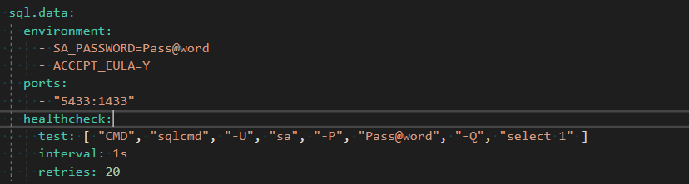
Docker
Another example with database

Slide 20
ASP.NET Core
For custom health checks there exist libraries to add code to our services
For ASP.NET Core we can use HealthChecks from the ASP.NET team. You can download the NuGet package Microsoft.AspNetCore.HealthChecks
It allows several kind of checks, and it is extensible for custom cases.

Slide 21
ASP.NET Core
Setting the check for SQL dependency
At Startup class, when configuring the services
public IServiceProvider ConfigureServices(IServiceCollection services)
{
// Add HealthChecks for SQL server and for Azure Blob storage.
services.AddHealthChecks(checks =>
{
var minutes = 1;
if (int.TryParse(Configuration["HealthCheck:Timeout"], out var minutesParsed))
{
minutes = minutesParsed;
}
// Minutes configures the cache duration
checks.AddSqlCheck("CatalogDb", Configuration["ConnectionString"],
TimeSpan.FromMinutes(minutes));
});
(...)
MS eShopOnContainers

Slide 22
ASP.NET Core
Setting the checks for other services dependencies
At Startup class, when configuring the services
// Add HealthChecks for dependencies of other services.
services.AddHealthChecks(checks =>
{
var minutes = 1;
if (int.TryParse(Configuration["HealthCheck:Timeout"], out var minutesParsed))
{
minutes = minutesParsed;
}
// the CatalogUrlHC would change byt the endpoint, f.i. “http://catalog.api/hc”
checks.AddUrlCheck(Configuration["CatalogUrlHC"], TimeSpan.FromMinutes(minutes));
checks.AddUrlCheck(Configuration["OrderingUrlHC"],TimeSpan.FromMinutes(minutes));
checks.AddUrlCheck(Configuration["BasketUrlHC"], TimeSpan.Zero);
checks.AddUrlCheck(Configuration["IdentityUrlHC"], TimeSpan.FromMinutes(minutes));
checks.AddUrlCheck(Configuration["MarketingUrlHC"],TimeSpan.FromMinutes(minutes));
});
MS eShopOnContainers

Slide 23
ASP.NET Core
Setting the check for the own service
At Startup class, when configuring the services
// Add HealthChecks for service without dependencies
// we need to implement Func<ValueTask<IHealthCheckResult>> check
services.AddHealthChecks(checks =>
{
checks.AddValueTaskCheck("HTTP Endpoint",
() => new ValueTask<IHealthCheckResult>(HealthCheckResult.Healthy("Ok")),
TimeSpan.Zero ); // no cache here, for testing or demo only
});
MS eShopOnContainers

Slide 24
ASP.NET Core
Exposing the HealthCheck endpoint
At Program class, BuildWebHost method
public static IWebHost BuildWebHost(string[] args) =>
WebHost.CreateDefaultBuilder(args)
.UseStartup<Startup>()
.UseApplicationInsights()
// Reporting health status at service address/hc
.UseHealthChecks("/hc")
.UseContentRoot(Directory.GetCurrentDirectory())
.UseWebRoot("Pics")
(...)
MS eShopOnContainers

Slide 25
Workshop: implementing HealthChecks

Slide 26
5. Ready to prod

Slide 27
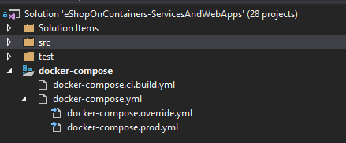
Docker compose: layering
Add specific docker-compose files for different environments
For each environment execute the compose chain starting from docker-compose.yml
Do not put app configuration in setting files (f.i. appsettings.json) because the files are part of he image. Set instead the configuration in Docker-compose files with environment variables.

Slide 28
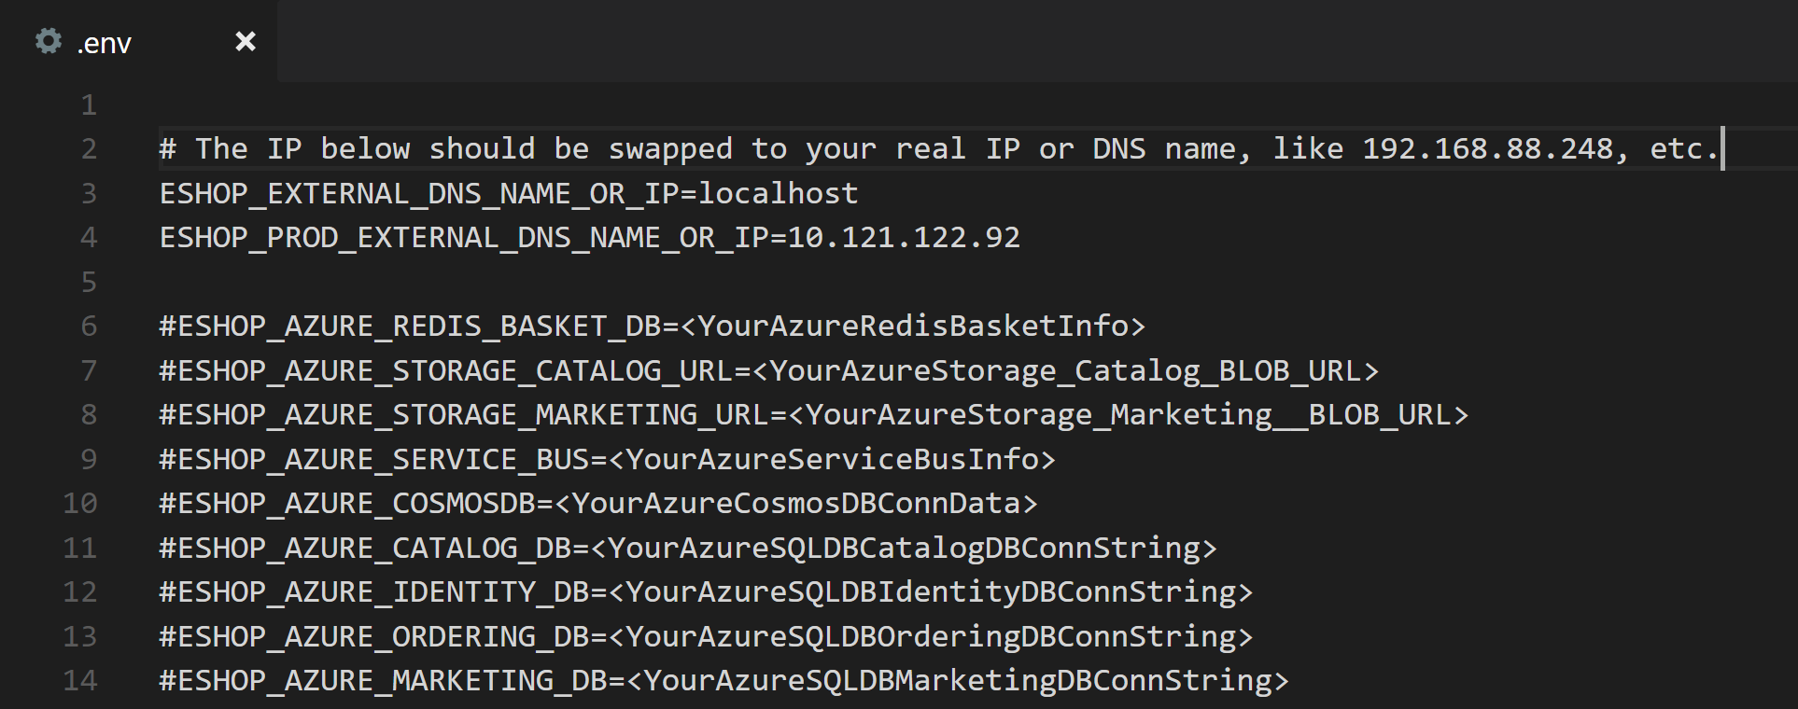
Docker Compose: env variables
Set the configuration values through the environment variables
For Docker-compose use the .env file. Change the values of the .env file during Release for each environment.

Slide 29
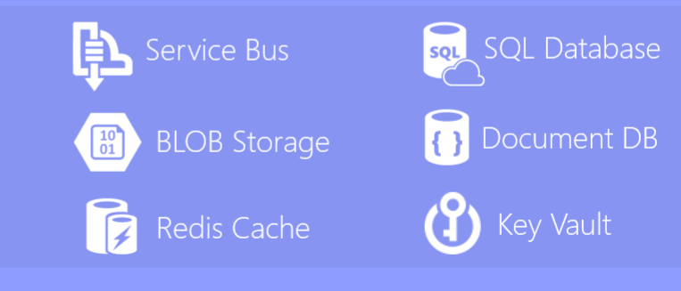
Stateful services
All that requires persistence data, goes out of our containerized services
For stateful services we create and consume resources in Azure or equivalent system
As easy as change the value of one environment variable we change the instance of one resource
Do not store session in the service. Store it a shared store, like Redis or another.
Do not use in-memory data (requests will arrive to different instances)

Slide 30
Test scaling
Test with multiple instances of the services to detect concurrency anomalies.
Scale on local with docker compose ‘scale’ parameter: ‘docker-compose scale service_name=5’
The system must be protected by desing from concurrences (there will be multiple instances running)
Deploy in orchestrators like Kubernetes with multiple pods and execute load tests with multiple users
Do not let it for the final phase of development!!
Ensure that the health monitoring is working as expected before going to prodction

Slide 31
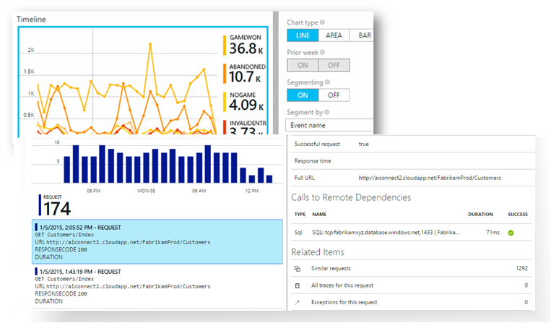
Logs centralized
Logs are automatically send to a centralized system (Application Insights for Azure)
Shared log system for all the system (routing, format, data…)
Ensure that all messages/events derived from one request/command share the same correlation ID
Logs can be observed from the service level to the aggregation of the whole system in metrics

Slide 32
CI/CD
Create the CI/CD chains as one of the first tasks in the project. VSTS is a good tool for that.
Set the values in the Release Management tasks, in the CD, not in config files.
Use secrets and key vaults for sensitive data (Azure Key Vault can be integrated fast with VSTS)
Include your scripts and other configuration files as ARM templates in the repository with the code, to keep it synchronized.
Include test run in the CI/CD

Slide 33
¡Thank you!
www.plainconcepts.com
@plainconcepts

