Slide 1
The Twelve-Factor App
A methodology for building software-as-a-service apps

Slide 2

What is Twelve-Factor App
Twelve-Factor App is a methodology and/or manifesto for the organizations to develop web apps in a correct way.
It has been done by experts in the field (mainly working at Heroku), and based in their practical experiences.
It is composed of twelve points or “factors”.

Slide 3
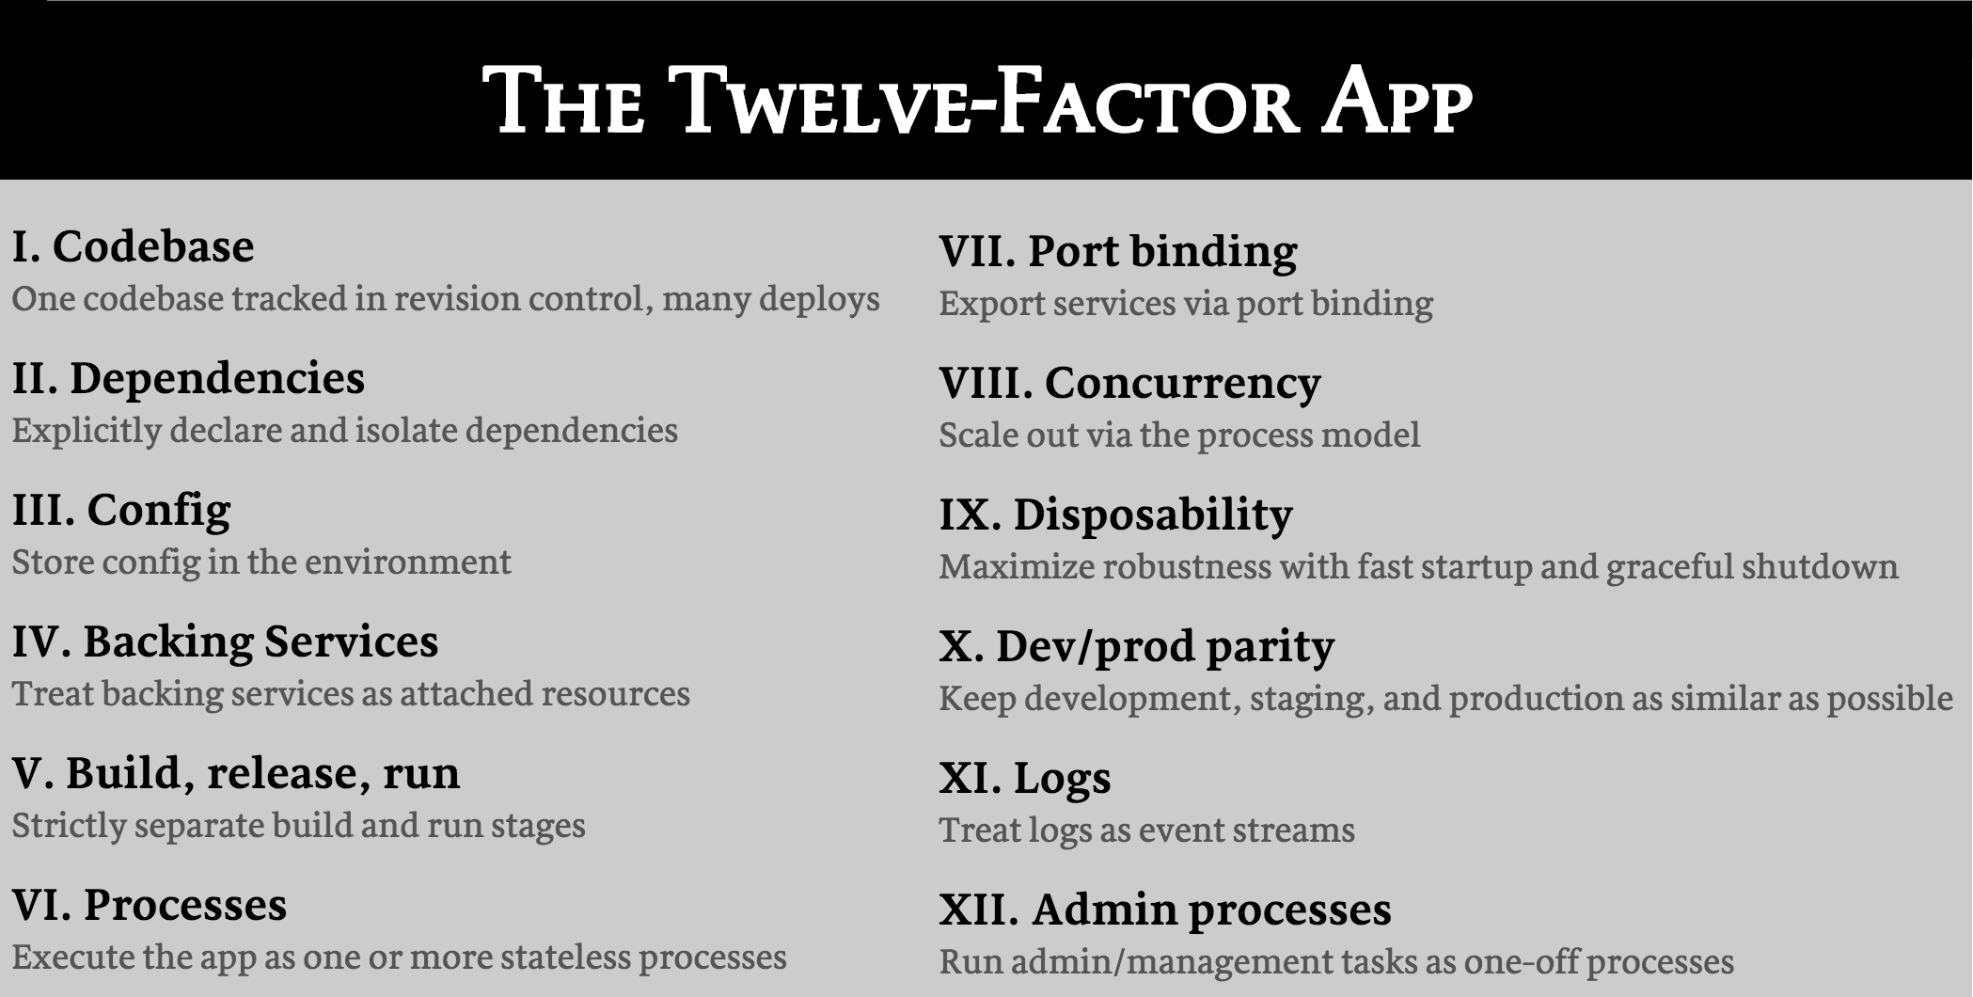

Slide 4
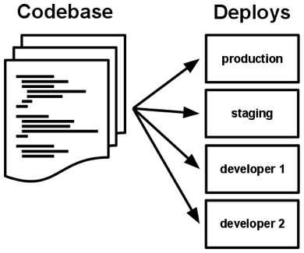

I. Codebase
One codebase tracked in revision control, many deploys
The app is always tracked in a version control system, with a code repository.
There is only one codebase per app.
There are many deploys (a running instance of the app) per app.
Violation of the Twelve-factor: more than one app pointing to the same codebase.

Slide 5
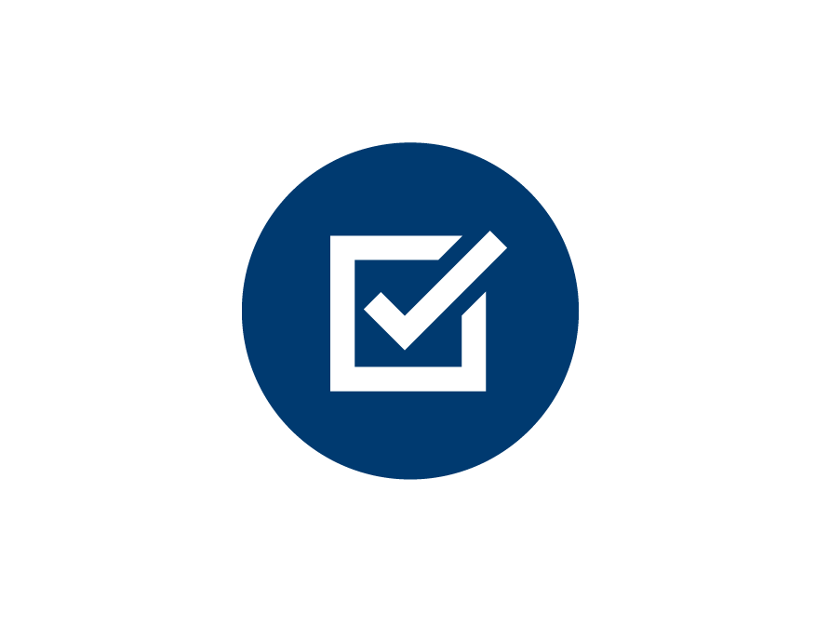
II. Dependencies
Explicitly declare and isolate dependencies
It declares all dependencies, completely and exactly, via a dependency declaration manifest.
It uses a dependency isolation tool during execution to ensure that no implicit dependencies “leak in” from the surrounding system.
The full and explicit dependency specification is applied uniformly to both production and development.
Test for this rule: a new developer can check out the app’s codebase onto his development machine, requiring only the language runtime and dependency manager installed as prerequisites.

Slide 6
III. Config
Store config in the environment
Config is everything that varies between deploys: database handles, credentials, etc
The twelve-factor app stores config in environment variables
Env vars are easy to change
Unlike config files, there is little chance of them being checked into the code repo accidentally
They are a language- and OS-agnostic standard
Violation of twelve-factor : store config as constants in the code. Config and code must be strictly separated.

Slide 7
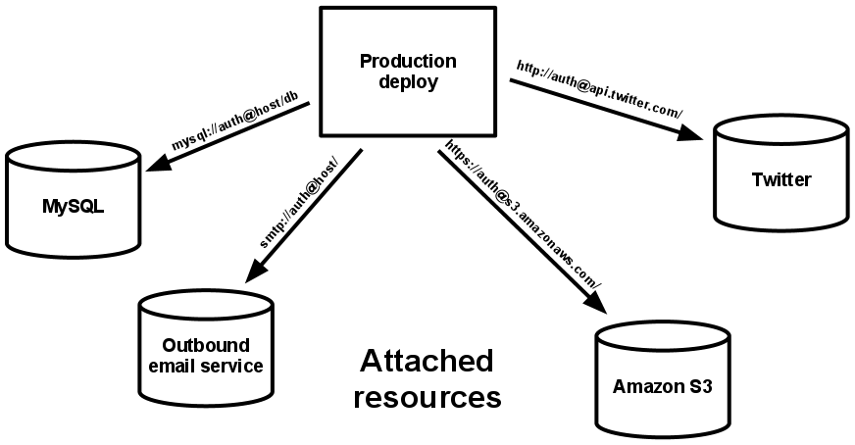
IV. Backing services
Treat backing services as attached resources
A backing service is any service the app consumes over the network as part of its normal operation.
The code for a twelve-factor app makes no distinction between local and third party services.
All the resources are accessed via a URL or other locator/credentials stored in the config.
Test for this rule : a deploy of the twelve-factor app should be able to swap out a local resource with one managed by a third party (f.i. in Azure) without any changes to the app’s code, only by configuration.

Slide 8
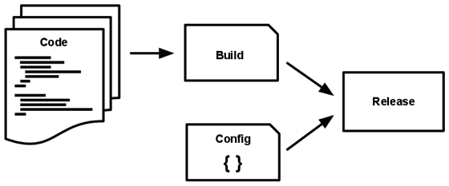
V. Build, release, run
Strictly separate build and run stages
Build : code, dependencies, assets
Release: build, deployment config
Run (aka “runtime”): execute, no code changes

Slide 9
VI. Processes
Execute the app as one or more stateless processes
Do not | Do
Store state in the service | Store state in a databse
Keep sesion state in-memory | Time-expiration datastore (Redis)
 | Use local filesystem only for single-transactions (ex. Process a file)

Slide 10
VII. Port binding
Export services via port binding
The web app exports HTTP as a service by binding to a port, and listening to requests coming in on that port.
The application must be self-hosted (as Asp.Net Core apps)

Slide 11
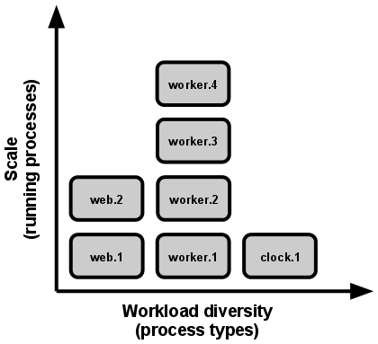
VIII. Concurrency
Scale out via the process model
Do not scale vertically, but horizontally.
Classify processes:
HTTP request → wep process
Log running task → worker process
Individual processes should manage their own multithreading as efficiently as possible, but never scale out based on this.
The share-nothing nature of the 12-f processes makes them very easy to scale.

Slide 12
IX. Disposability
Maximize robustness with fast startup and graceful shutdown
Facilitate fast scaling, rapid deployment and robustness.
Minimize startup time (few seconds).
Agility for the release process and scaling up
Robustness, process manager can more easily move processes to new physical machines.
Processes shut down gracefully, BUT desing for non-graceful terminations:
Refuse requests
Finish short requests
Return long requests to the queue

Slide 13
X. Dev/prod parity
Keep development, staging, and production as similar as possible
Gap between development and production small
Personnel gap: developers who are closely involved in deploying it and watching its behavior in production.
Tools gap: keep development and production as similar as possible.
Environment gap: resists the urge to use different backing services between development and production, even when adapters theoretically abstract away any differences in backing services.

Slide 14
XI. Logs
Treat logs as event streams
App never concerns itself with routing or storage of logs.
Each running process writes its event stream to stdout:
Unbuffered
On local the developer sees log in the terminal.
In staging or production the streams are aggregated and routed to a common destination (ex: Azure Application Insights)

Slide 15
XII. Admin processes
Run admin/management tasks as one-off processes
One-off admin processes should be run in an identical environment as the regular long-running processes of the app.
Admin code must ship with application code to avoid synchronization issues.
The same techniques explained for other code applies to the admin processes (dependency isolation, dev/prod parity, one codebase multiple releases…)

