Slide 1


TEAM COPENHAGEN
https://github.com/PlamenaMiteva/Copenhagen

Slide 2
Anton Velikov
project management
create collision events
Katerina Kotseva
turtle character and motions creation
audio effects
Nikolay Panayotov
level design and implementation
board and maps layout design and creation
Plamena Miteva
enemies character and motions creation
power point presentation creation

Slide 3
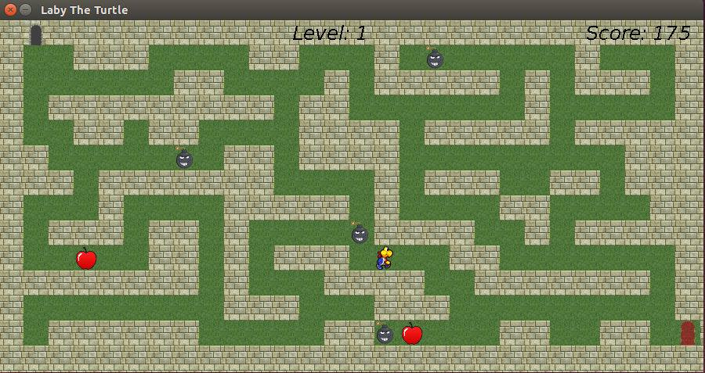
WELCOME TO THE MAGICAL WORLD OF
LABY THE TURTLE
3+

Slide 4
GAME DESCRIPTION
Player
The turtle must search the Labyrinth for the magical key that will open the door to exit the game. You can move as far as you want and even change direction as part of your move. But you can only travel along connecting corridors: you cannot go through walls, or jump to a corridor that does not connect.

Slide 5


GAME DESCRIPTION
Enemy
Be careful though, not all the passage is safe! You might encounter some obstacles on your way! However if you bump into an enemy, you will be able to start over.
Apples
Collect as many apples as possible on your way out and you will add bonus points to your score.
Multiple levels
100 bonus points reward upon successful completion of the previous level.

Slide 6
READY TO PLAY?

