Slide 1

Plan4Ba
Maximilian Schädlich
Robert Beier
Eric Mäuer

Slide 2




Structure
Motivation and goals
Design and user interface
Architecture and technical specifications
Project organization

Slide 3


Motivation and goals
Current situation
Only way to access schedule is Campus-Dual website
Campus-Dual is sluggish
No automatic updates for calendar files from Campus-Dual
Discontinued support for StpApp

Slide 4

Motivation and goals
Target situation
Access the schedule via website or mobile app
Quick access to the schedule
Notifications in case of a schedule change
Automatic updates of the schedule data via the Campus-Dual-API

Slide 5


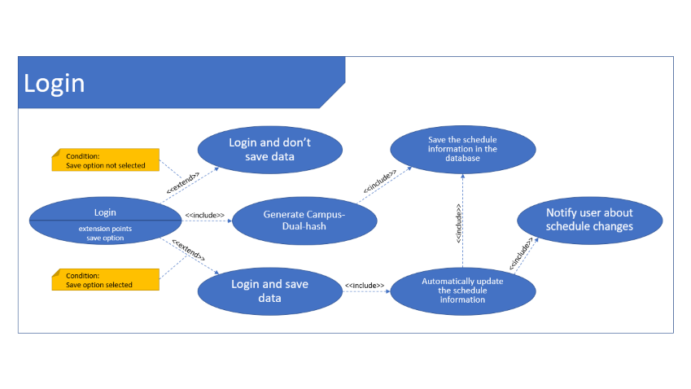
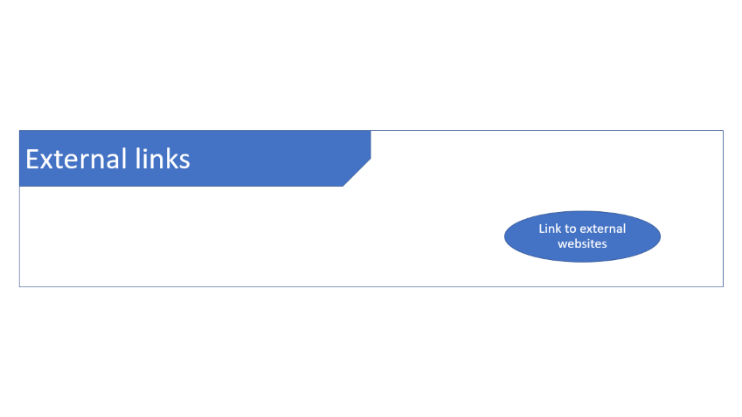
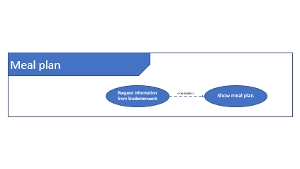
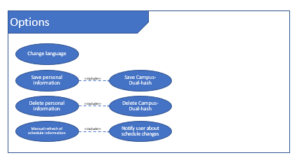
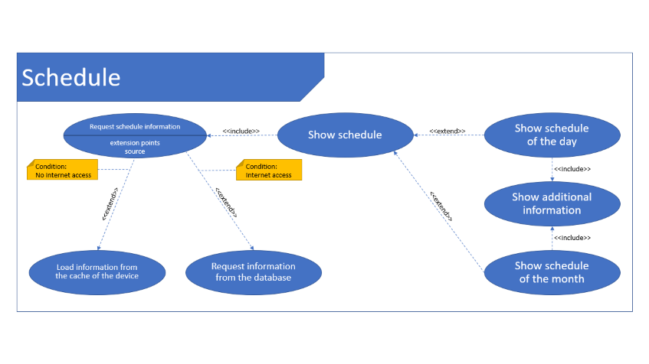
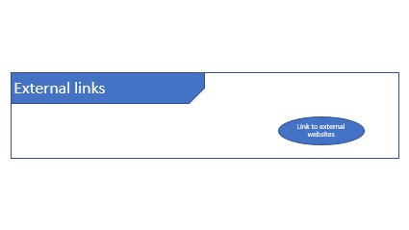

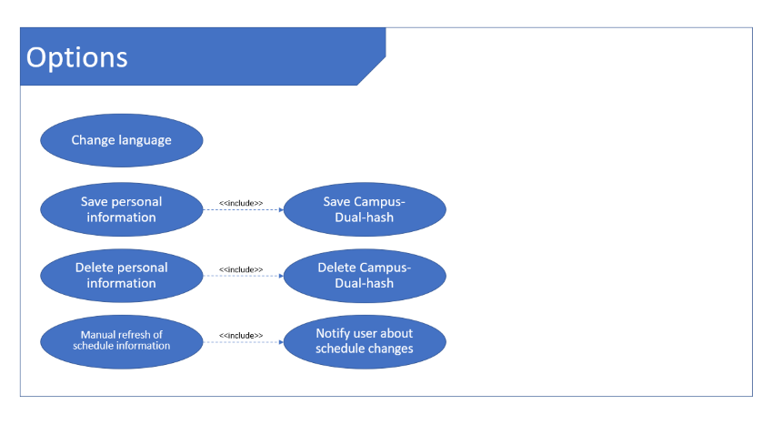
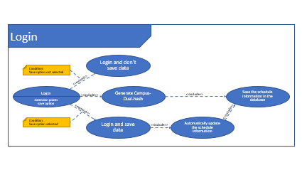
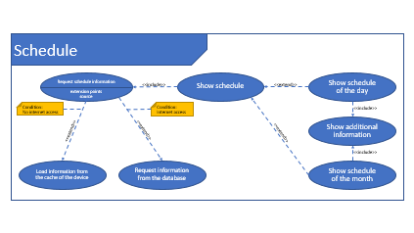
Motivation and goals
Core functions

Slide 6

Design and user interface
Live demo

Slide 7
Design and user interface
Live demo
AuthService
LectureService
MealsService
UserService
Notifications
Service
Settings Component
App Component
DailyLectureList
Component
MonthlyCalendar
Component
Home Component
Meals Component

Slide 8
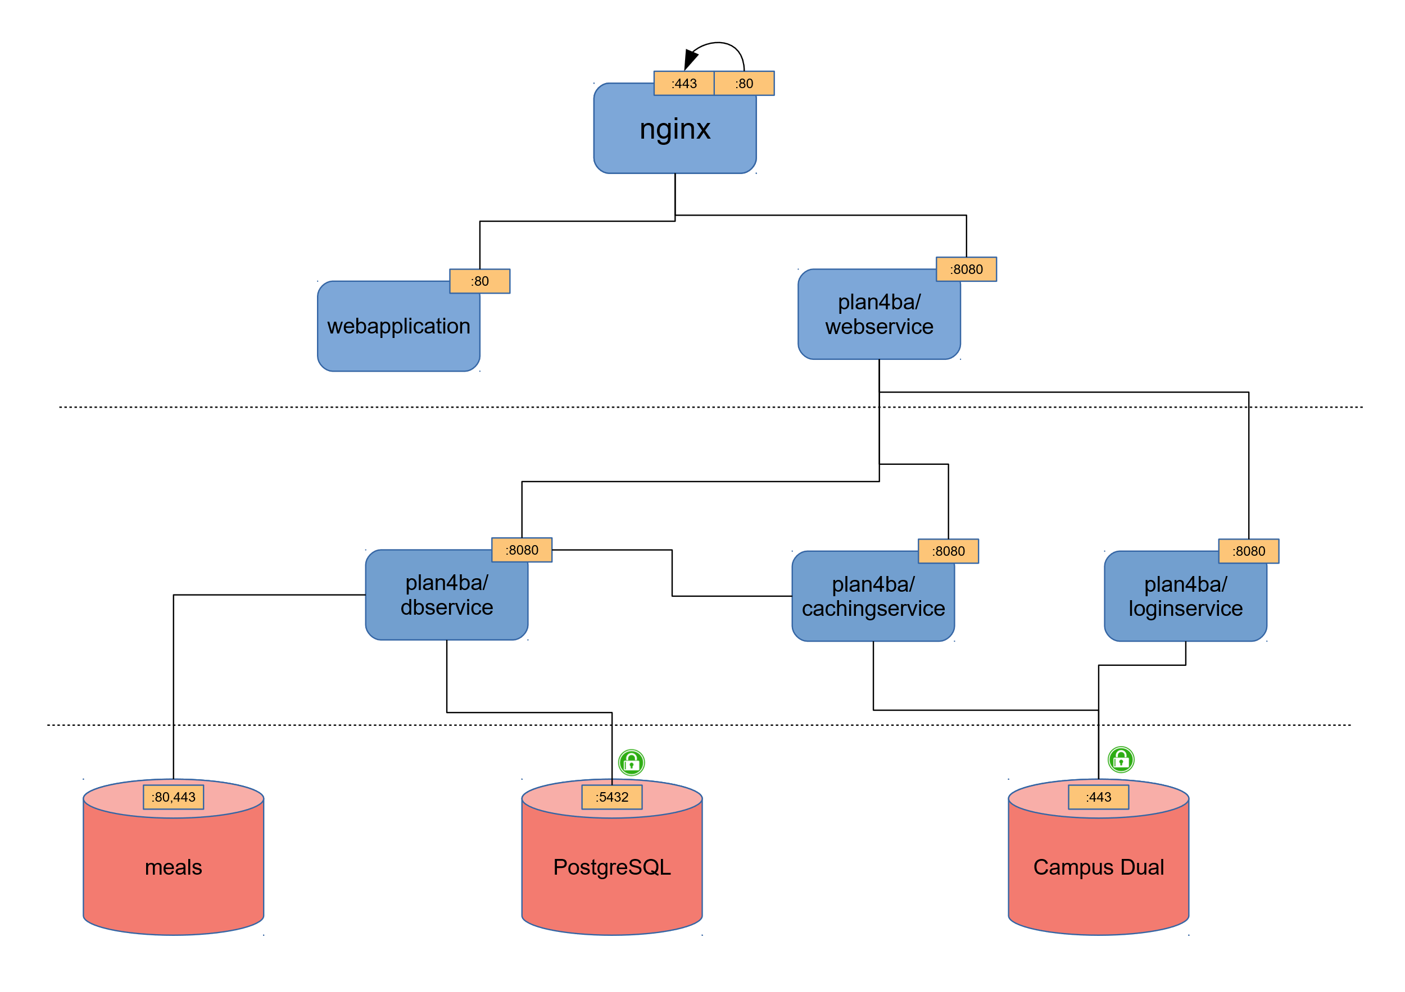
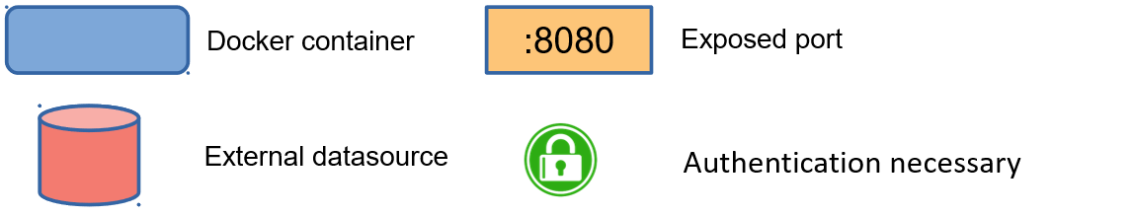
Architecture and technical specifications
Architecture

Slide 9


Project organization
Tools and general organization
GitHub as:
Project management tool
Revision control system
Weekly meetings and discussions
Additional communication via instant messaging
Open test for volunteer Campus-Dual users

Slide 10


Question and answer
Thank you for your attention

Slide 11
Meal plan
Request information from Studentenwerk
Show meal plan
<<include>>

Slide 12
External links
Link to external websites

Slide 13
Schedule
Request schedule information
Show schedule
Show schedule of the day
<<include>>
<<extend>>
extension points
source
Condition:
No internet access
Condition:
Internet access
<<include>>
Show additional information
<<extend>>
<<extend>>
<<extend>>
<<include>>
Load information from the cache of the device
Request information from the database
Show schedule of the month

Slide 14
Login
Login and don’t save data
Save the schedule information in the database
Condition:
Save option not selected
<<extend>>
<<include>>
Login
Generate Campus-Dual-hash
Notify user about schedule changes
extension points
source
<<include>>
<<include>>
extension points
save option
<<extend>>
<<include>>
Condition:
Save option selected
Login and save data
Automatically update the schedule information
<<include>>

Slide 15
Options
Change language
Save personal information
Save Campus-Dual-hash
<<include>>
Delete personal information
Delete Campus-Dual-hash
<<include>>
Manual refresh of schedule information
Notify user about schedule changes
<<include>>

