Slide 1


Slide 2


Slide 3
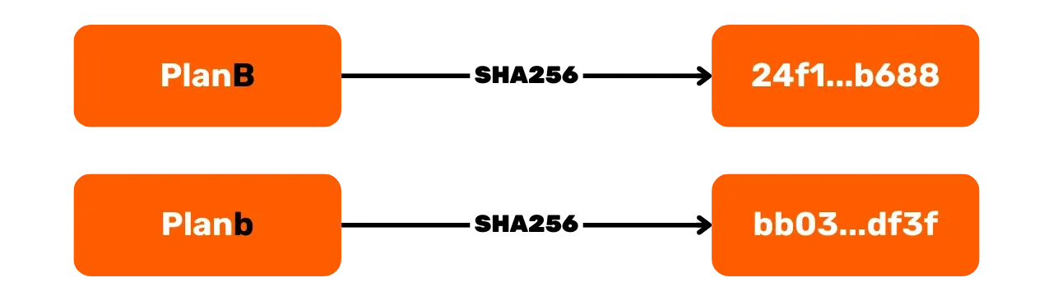

Slide 4
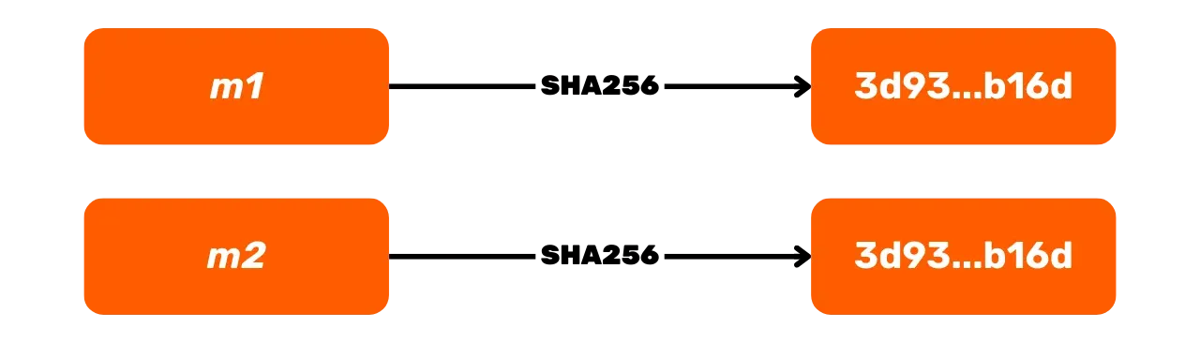

Slide 5
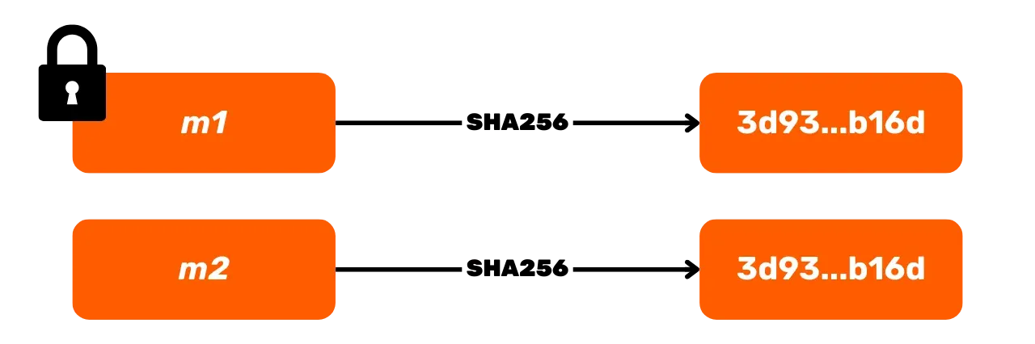

Slide 6
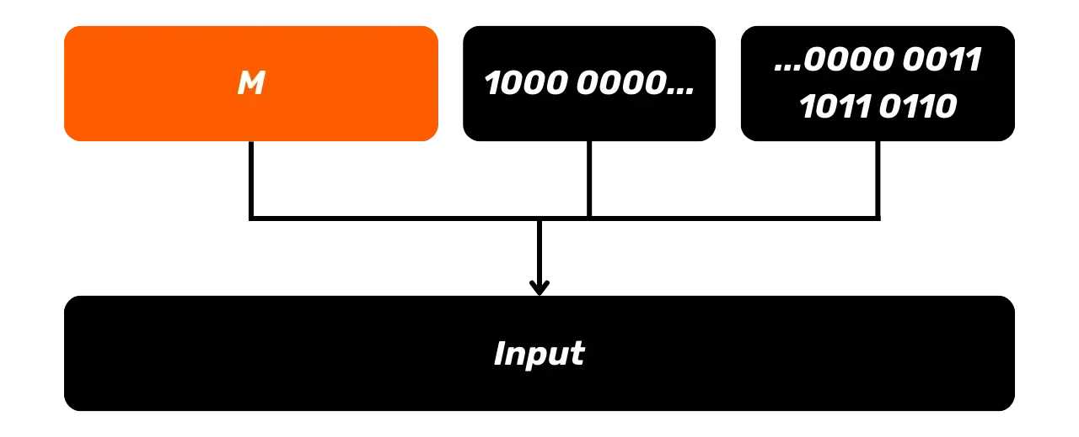
Input

Slide 7
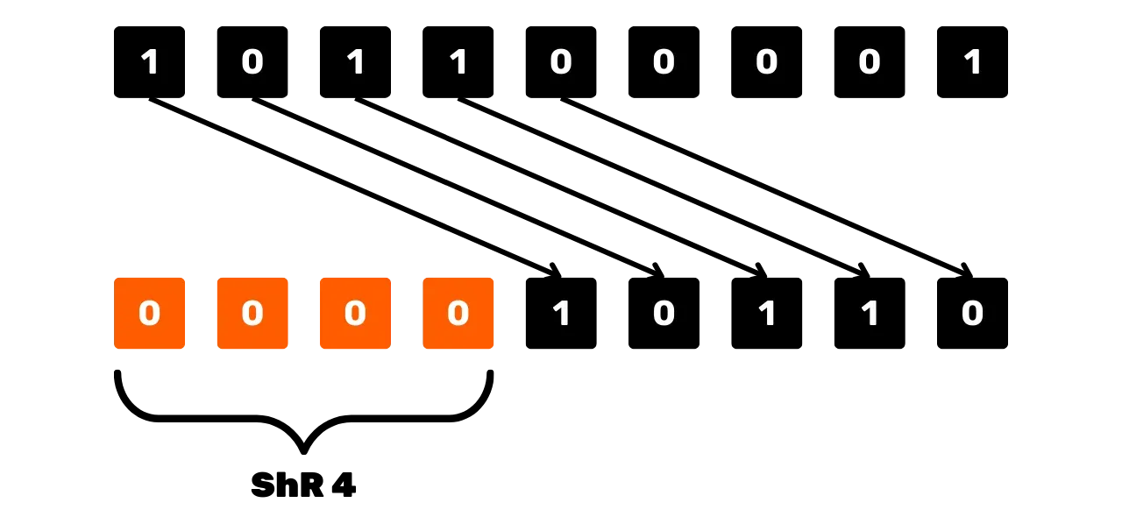

Slide 8
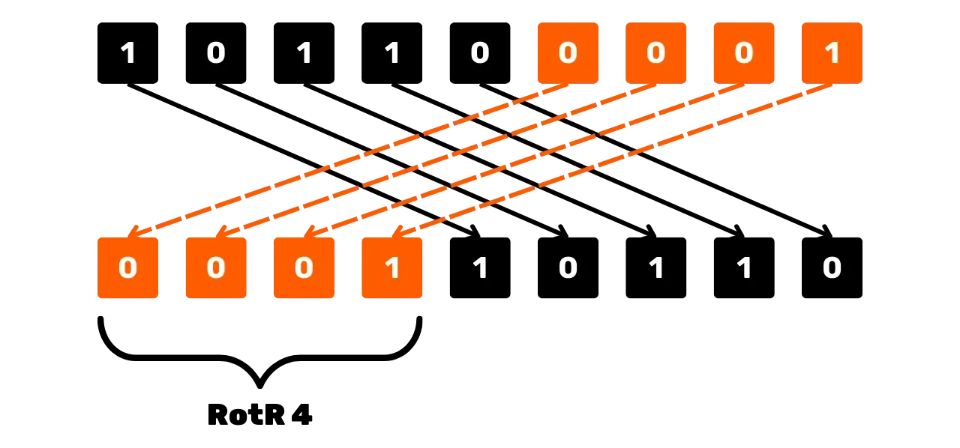

Slide 9
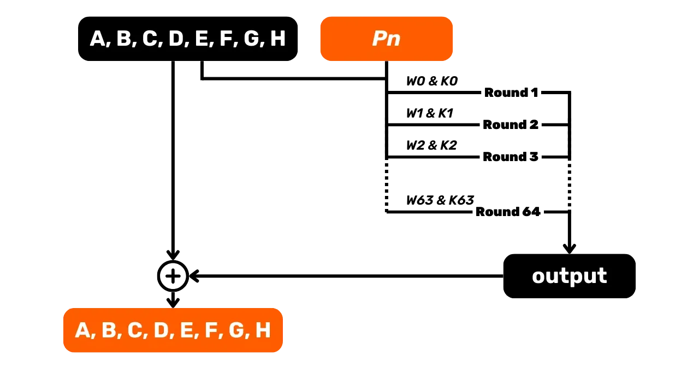
A, B, C, D, E, F, G, H
Round 1
Round 2
Round 3
Round 64
output
A, B, C, D, E, F, G, H

Slide 10
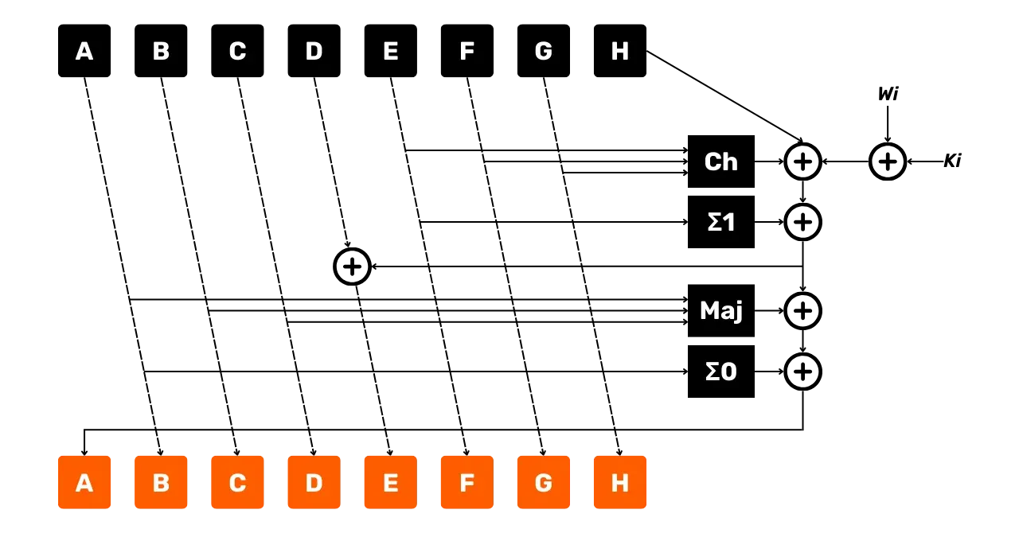
A
B
C
D
E
F
G
H
A
B
C
D
E
F
G
H

Slide 11

output

Slide 12
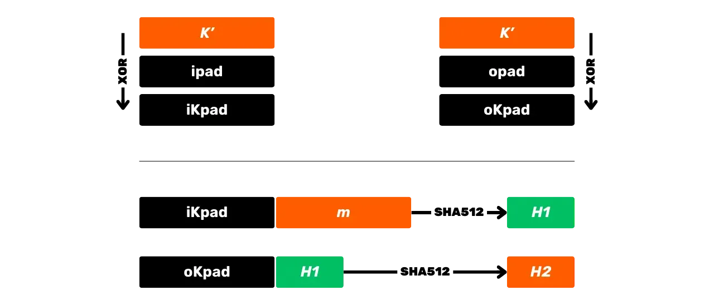

Slide 13
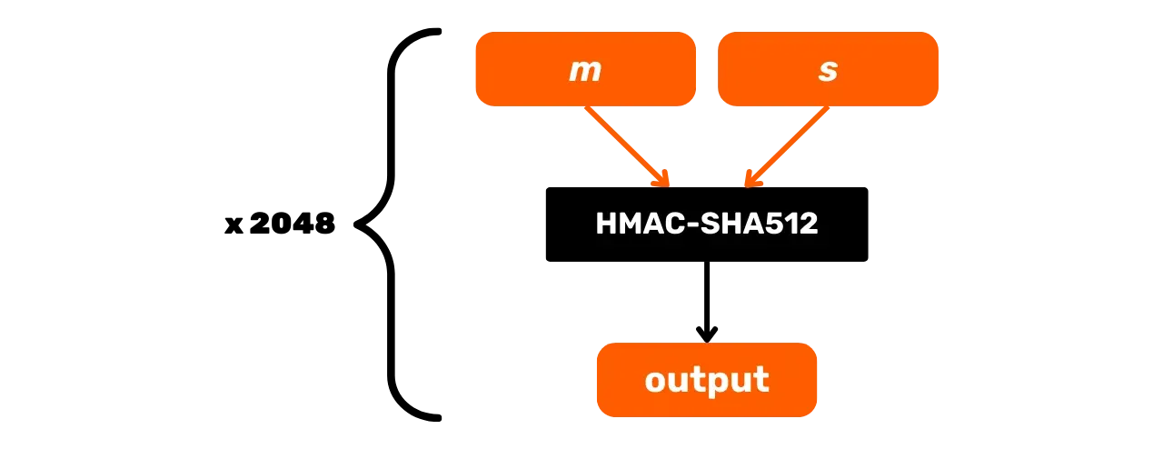
output

Slide 14
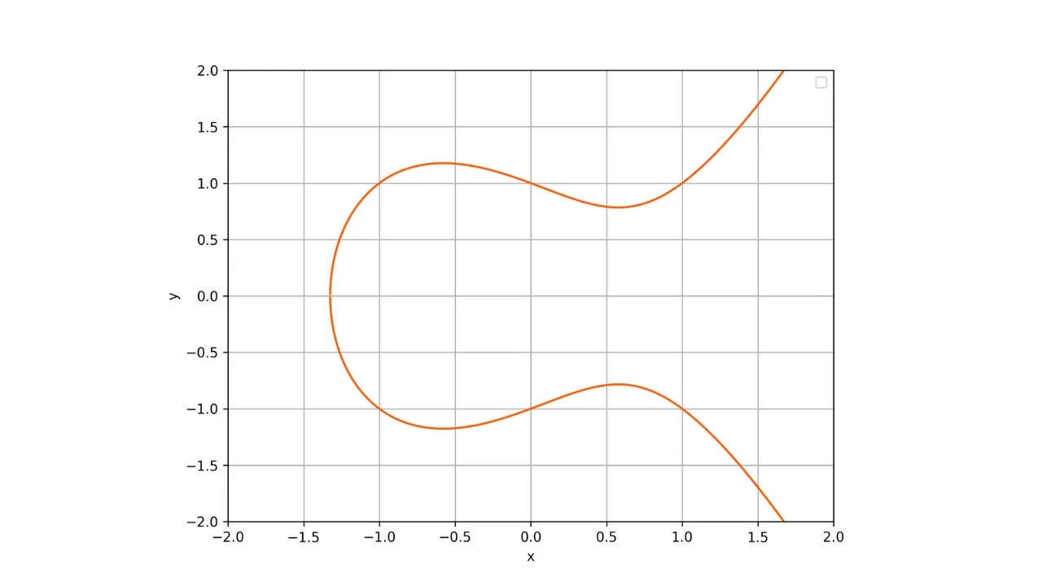

Slide 15
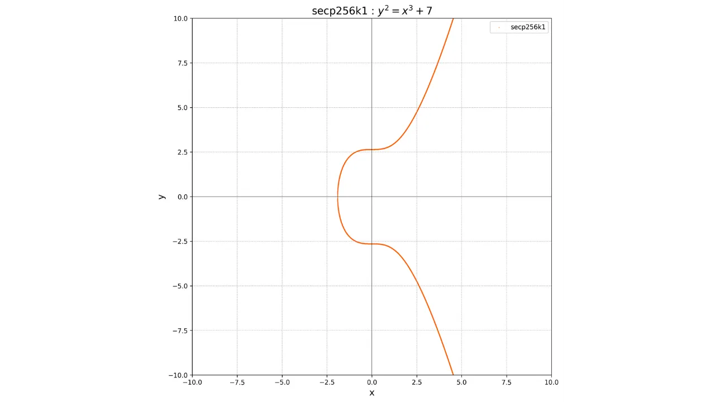

Slide 16
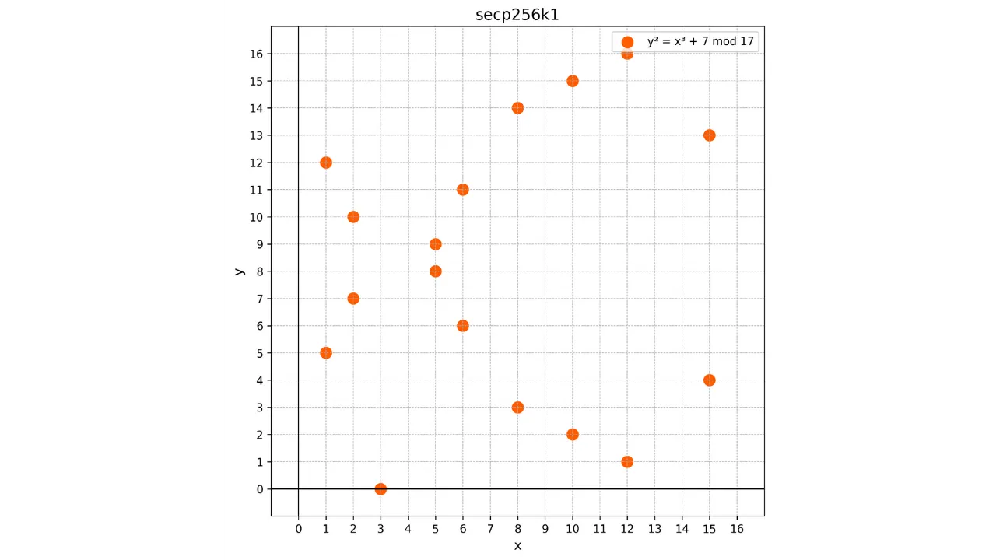

Slide 17
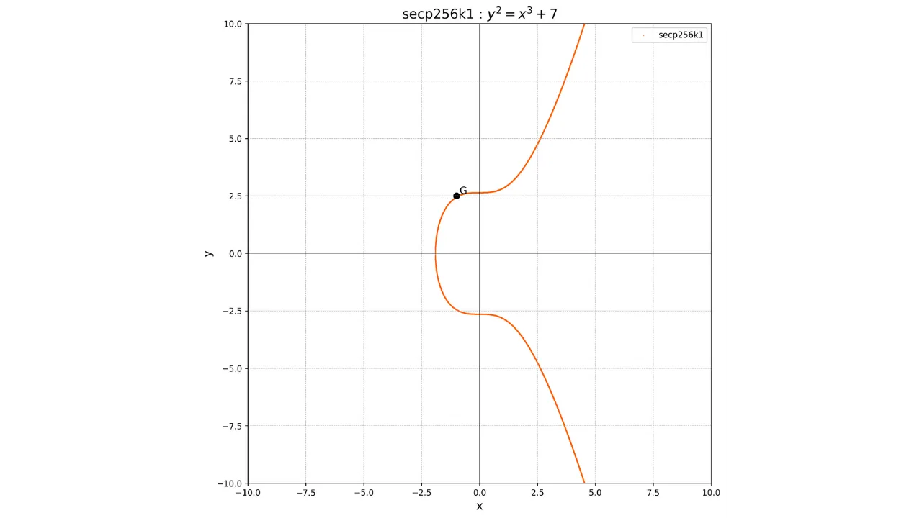

Slide 18


Slide 19
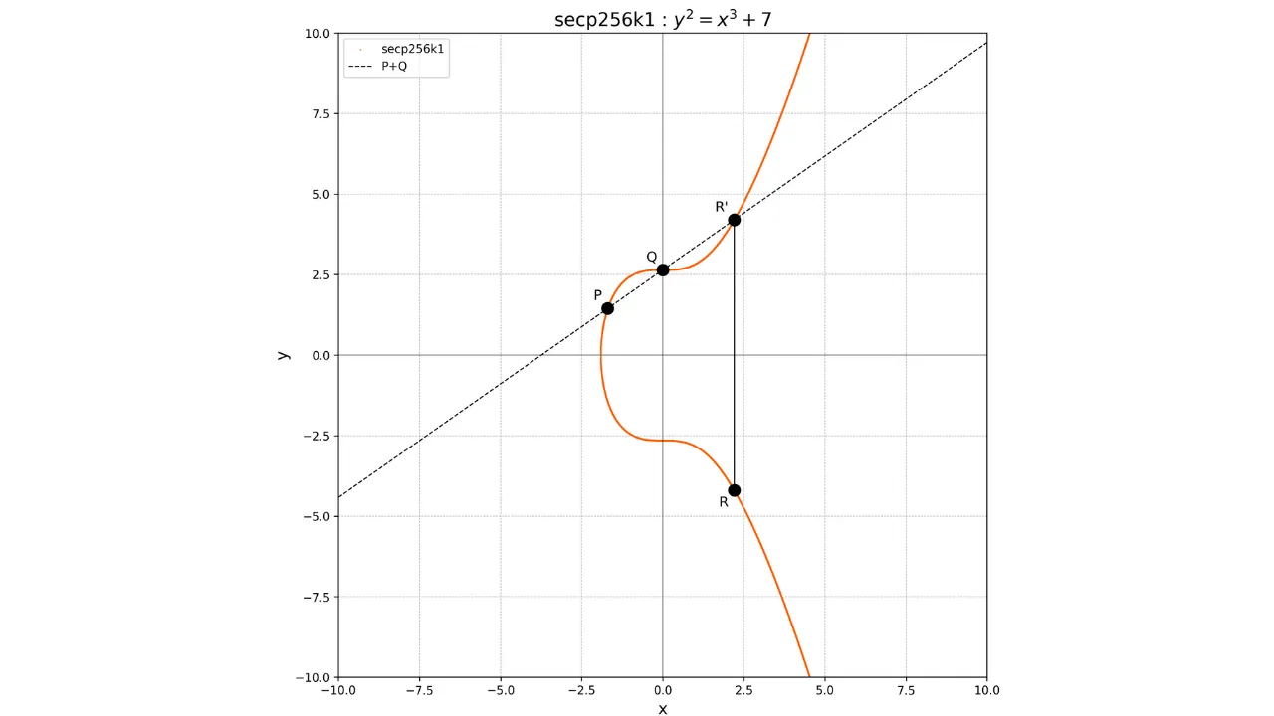

Slide 20
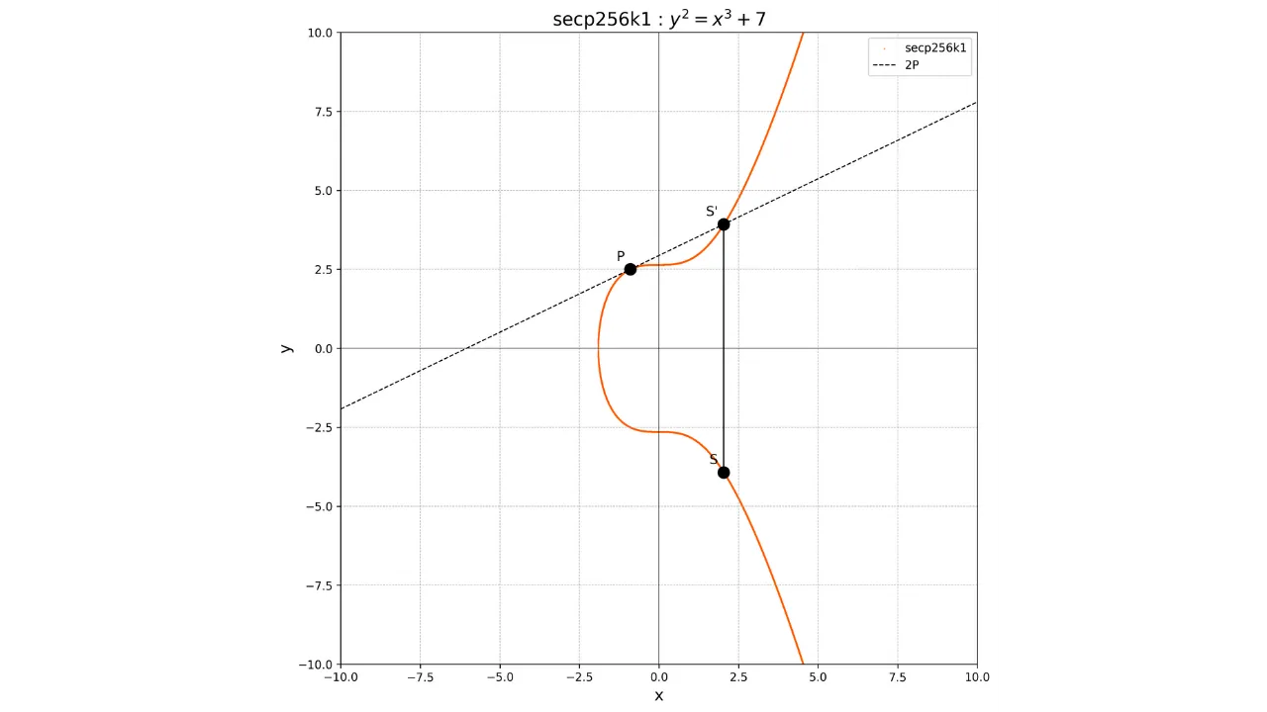

Slide 21
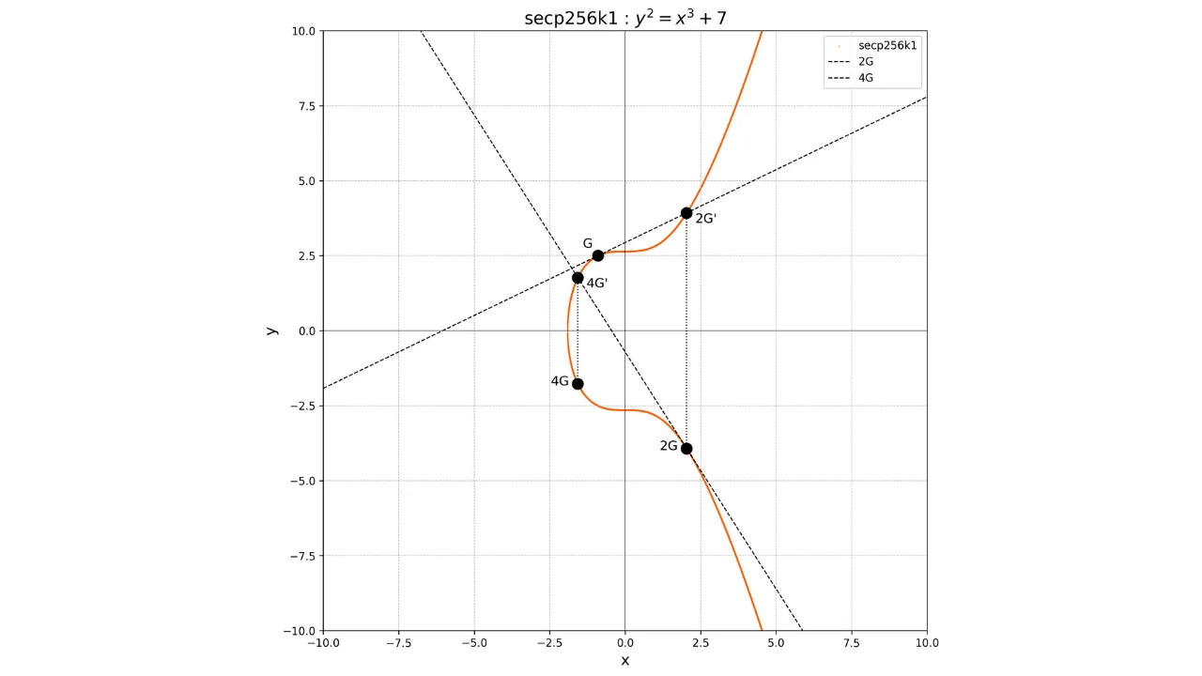

Slide 22
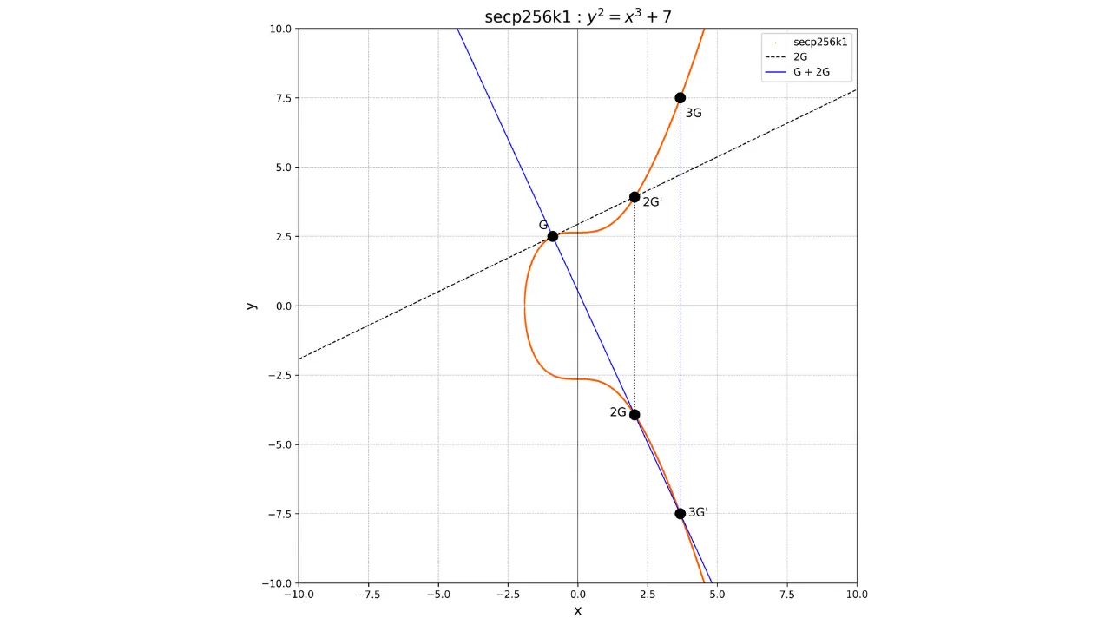

Slide 23
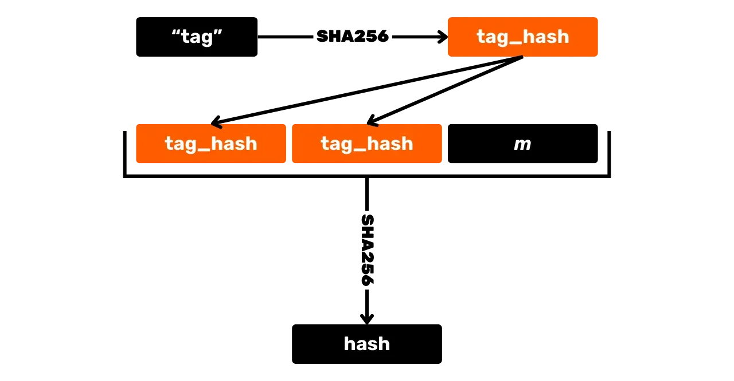
"tag"
"tag_hash"
"tag_hash"
"tag_hash"
Hash

Slide 24
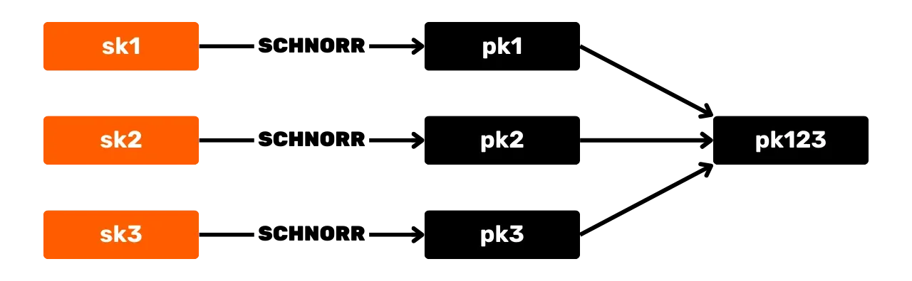

Slide 25
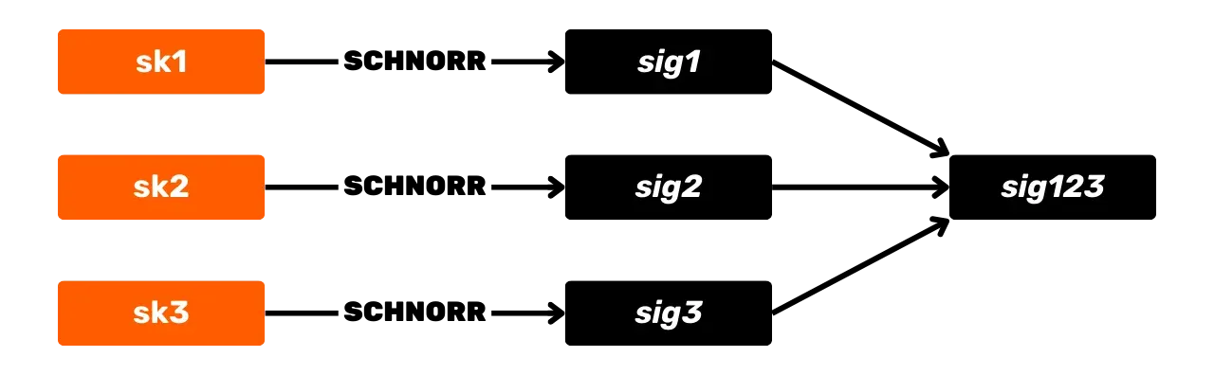

Slide 26
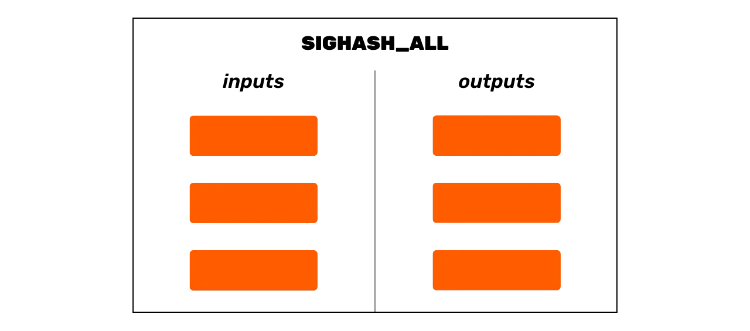
inputs
outputs

Slide 27
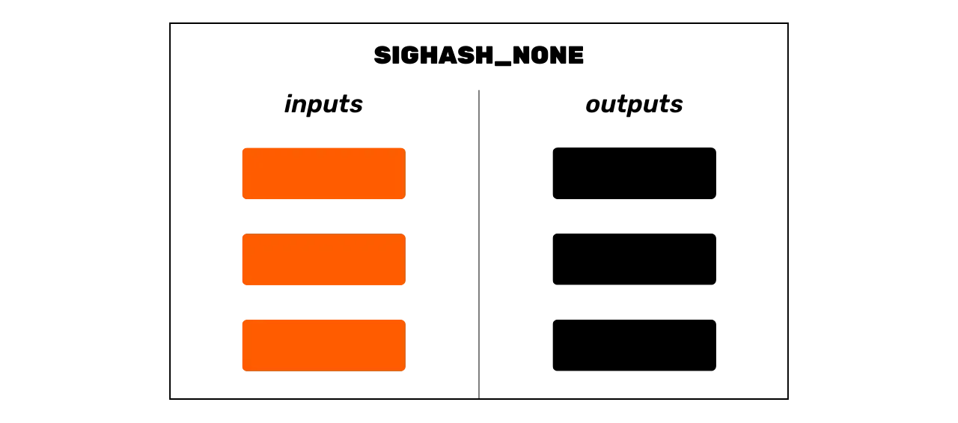
inputs
outputs

Slide 28
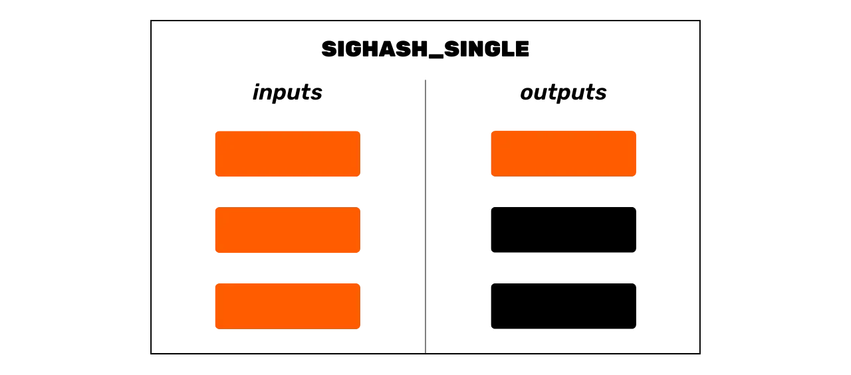
inputs
outputs

Slide 29
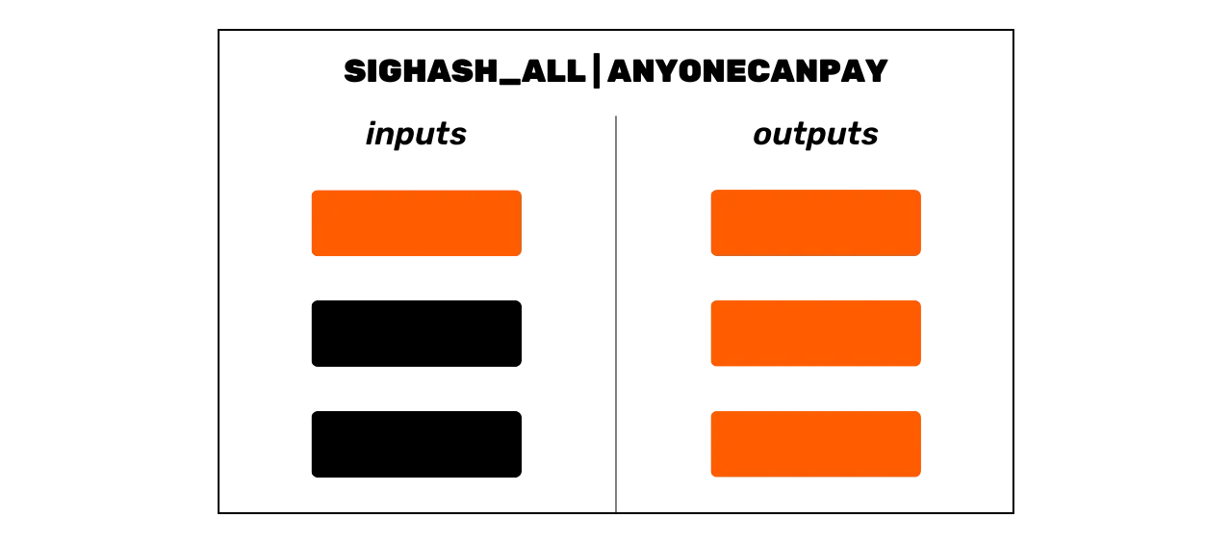
inputs
outputs

Slide 30
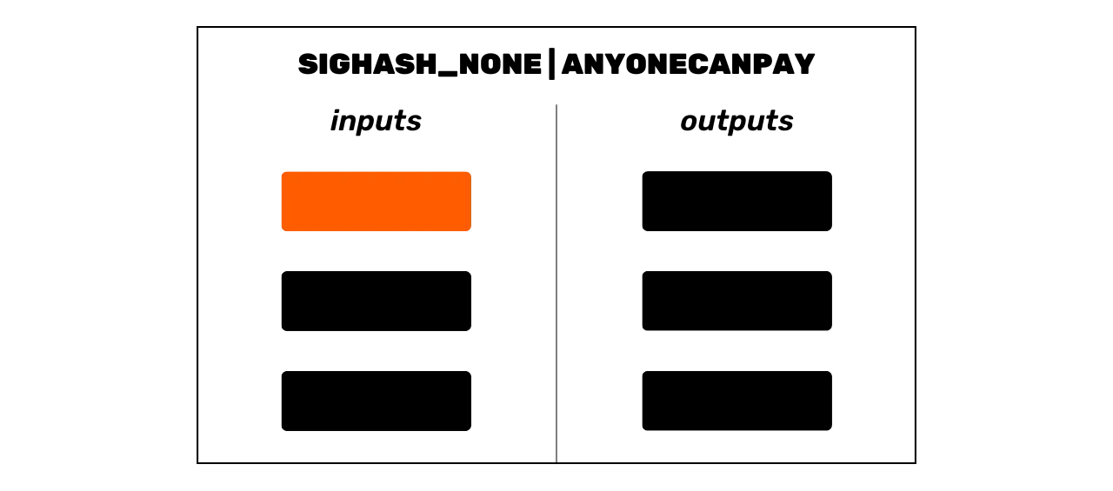
inputs
outputs

Slide 31
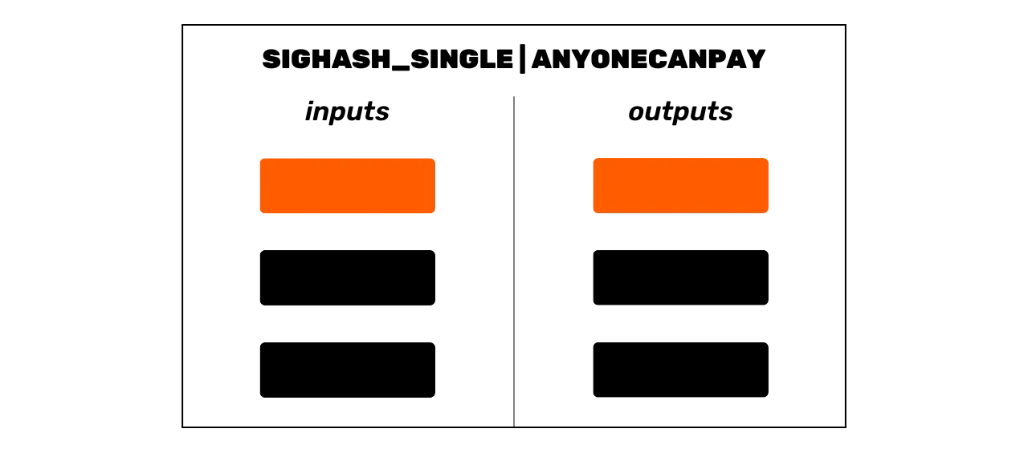
inputs
outputs

Slide 32
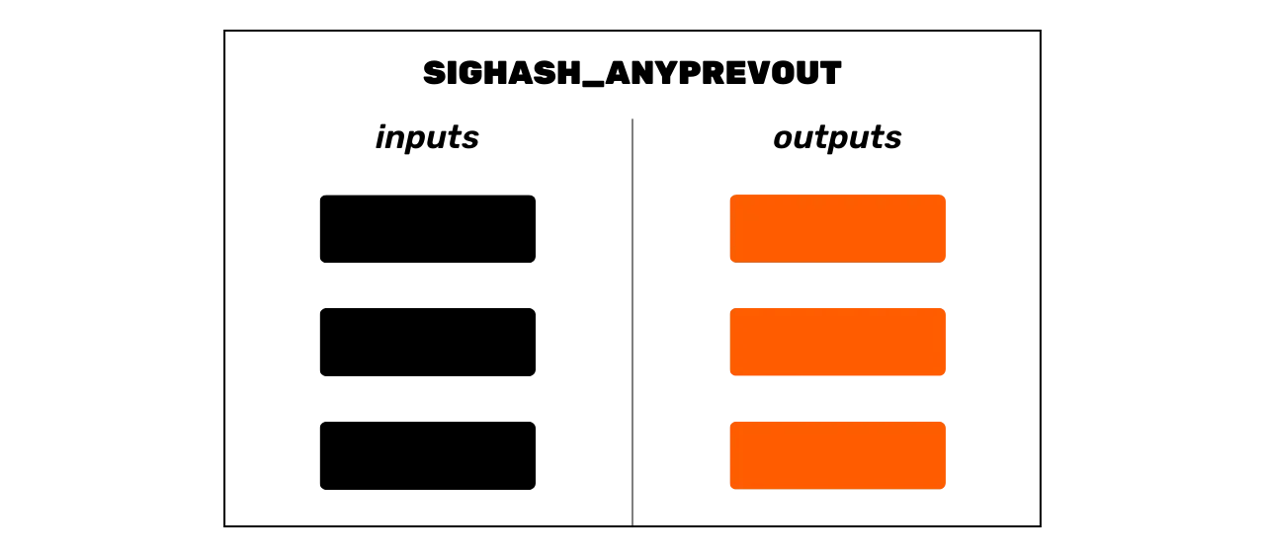
inputs
outputs

Slide 33
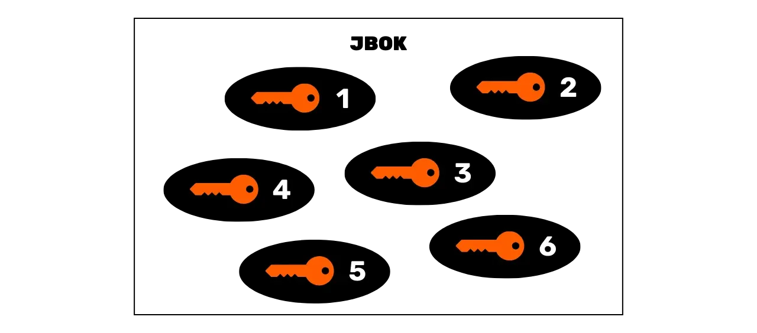

Slide 34
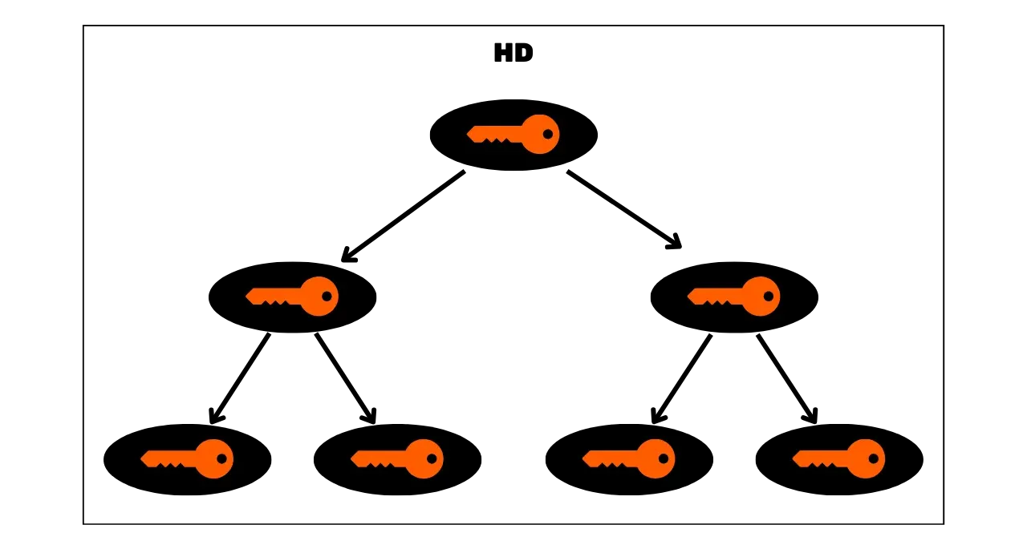

Slide 35
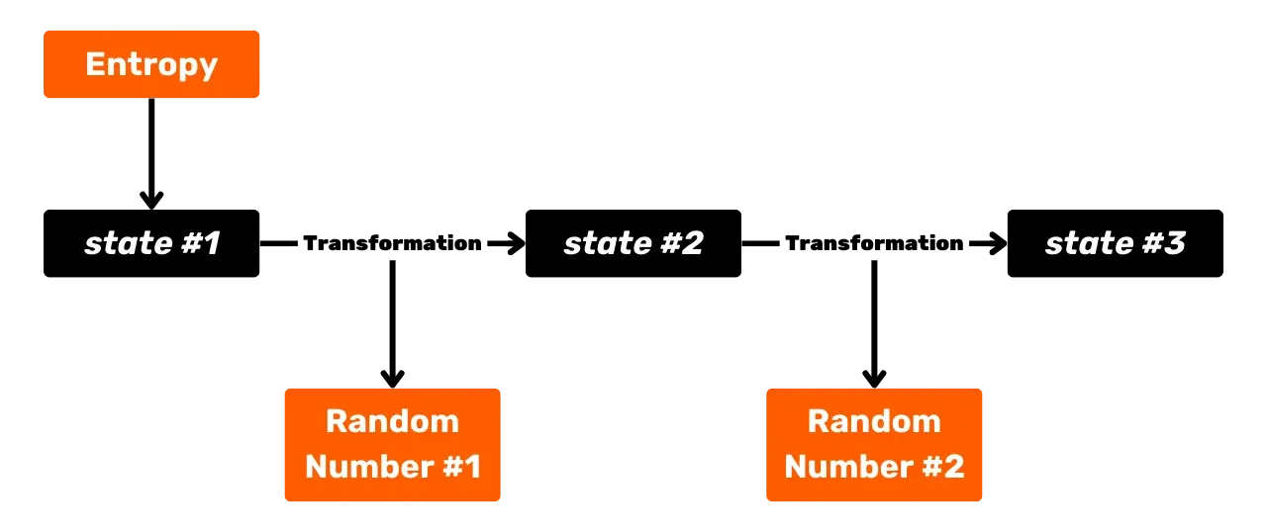
Entropy
state #1
Transformation
state #2
Transformation
state #3
Random Number #1
Random Number #2

Slide 36
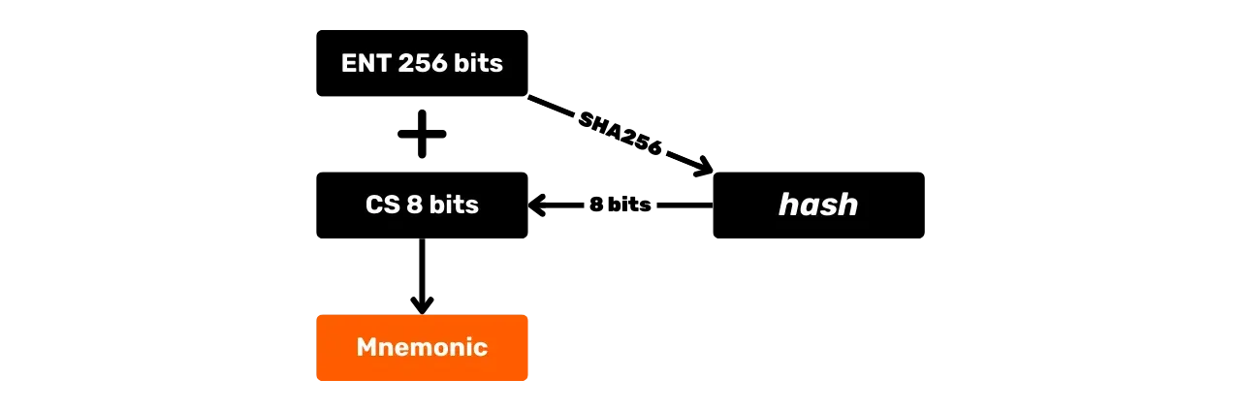
hash
Mnemonic

Slide 37
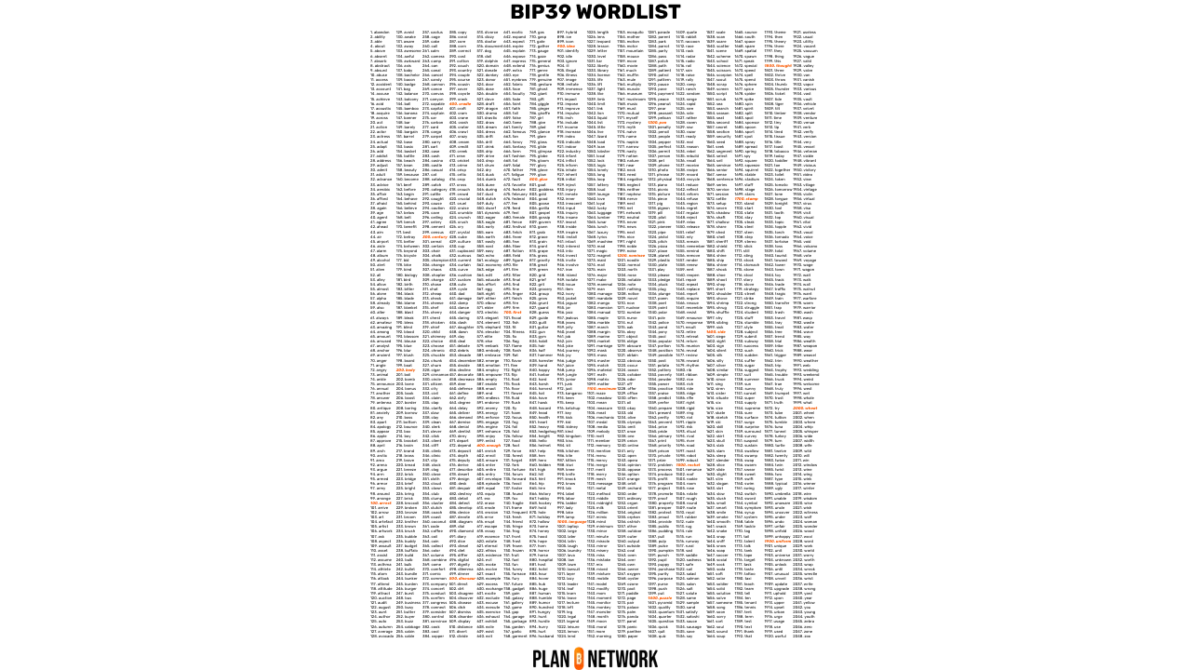
BIP39 WORDLIST

Slide 38
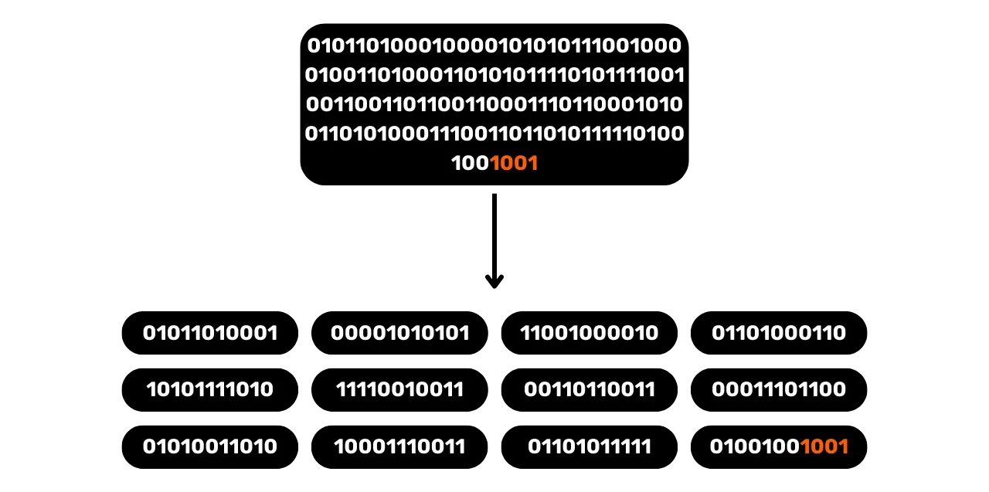

Slide 39
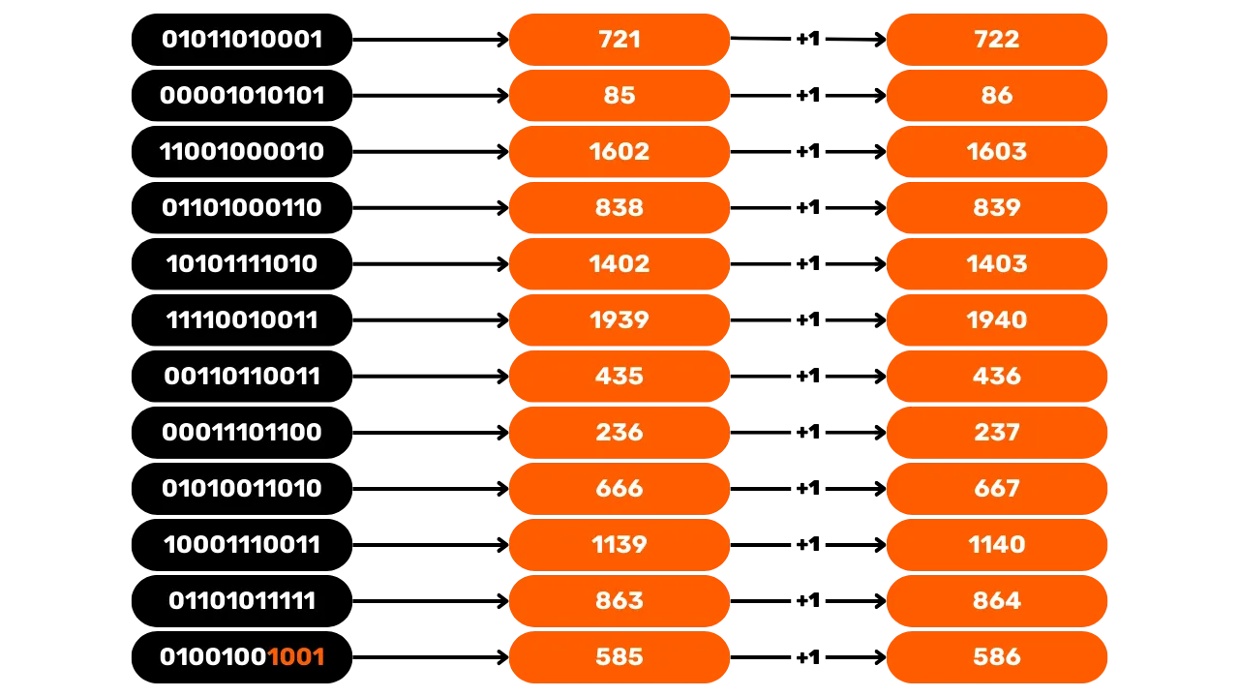

Slide 40
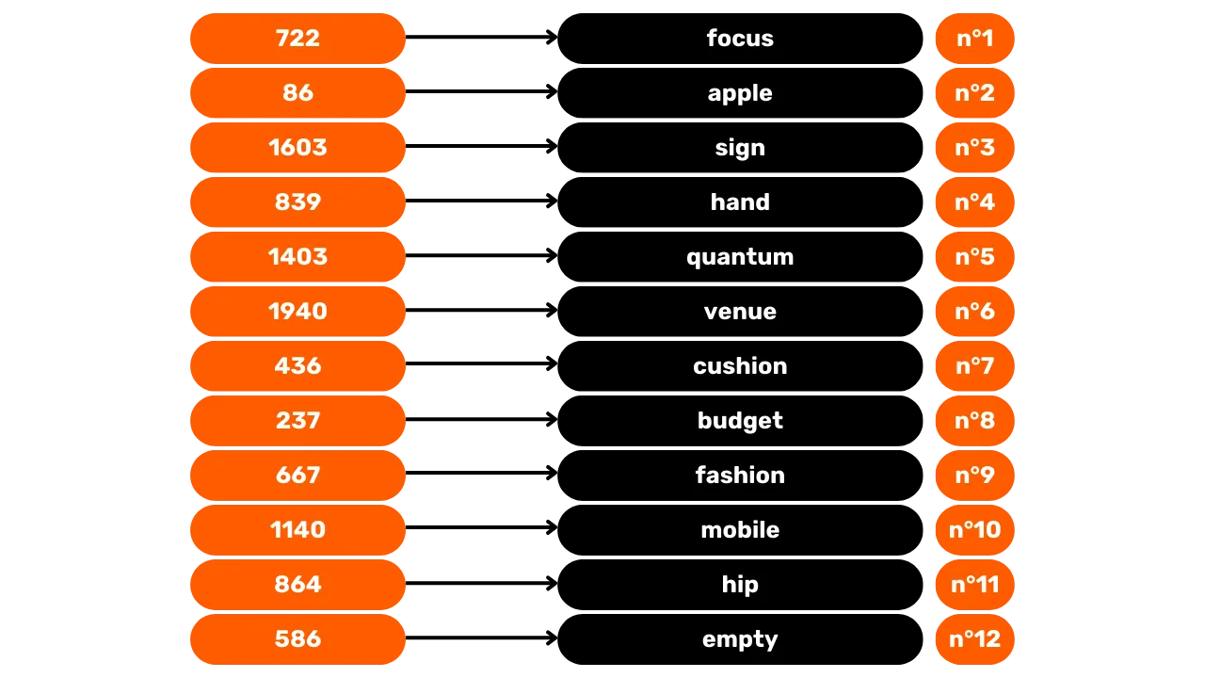
focus
apple
sign
hand
quantum
venue
cushion
budget
fashion
mobile
hip
empty

Slide 41
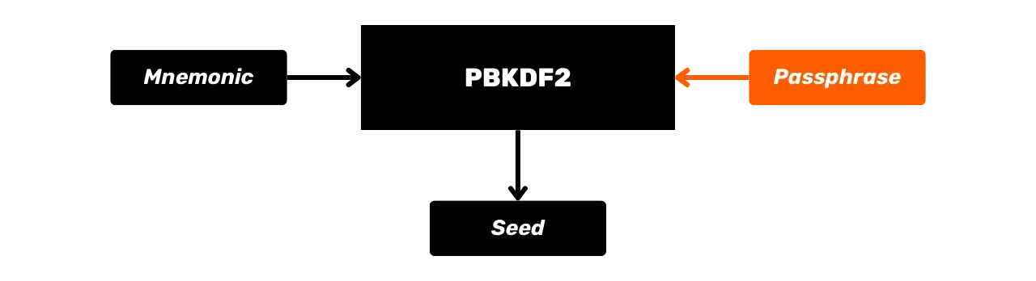
Mnemonic
Passphrase
Seed

Slide 42
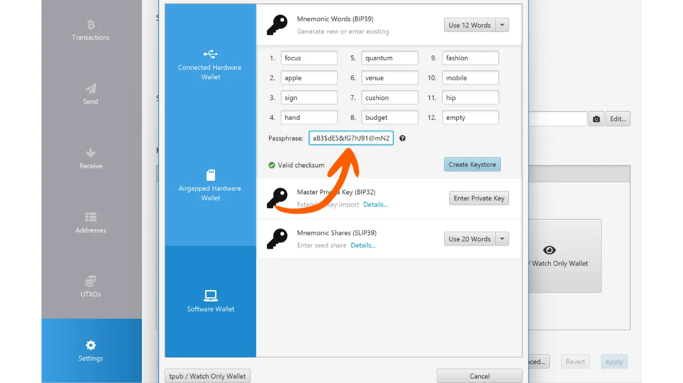
Mnemonic Words (BIP39)
Transactions
Generate new or enter existing
focus
quantum
fashion
Connected Hardware
Wallet
apple
venue
mobile
Send
sign
cushion
hip
hand
budget
empty
Receive
Airgapped Hardware
Wallet
Addresses
Mnemonic Shares (SLIP39)
Enter seed share Details...
UTXOs
Software Wallet
Settings

Slide 43
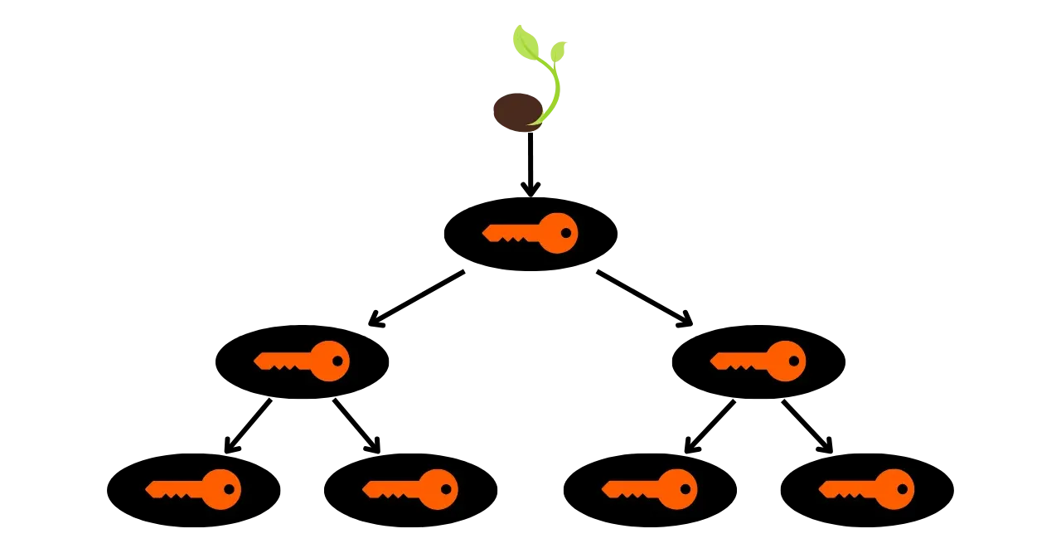

Slide 44
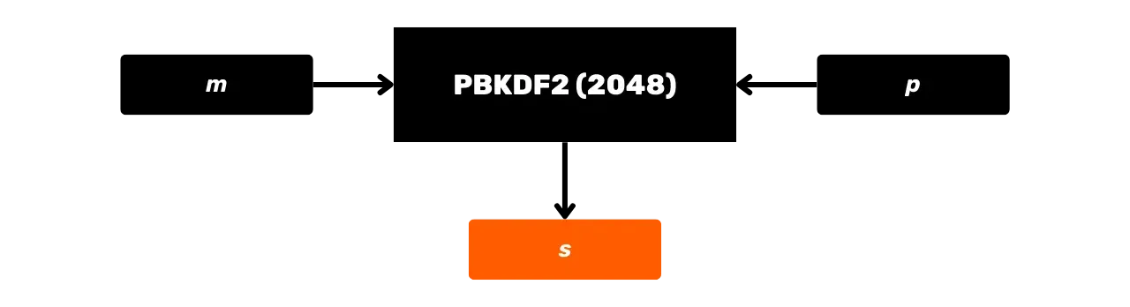

Slide 45
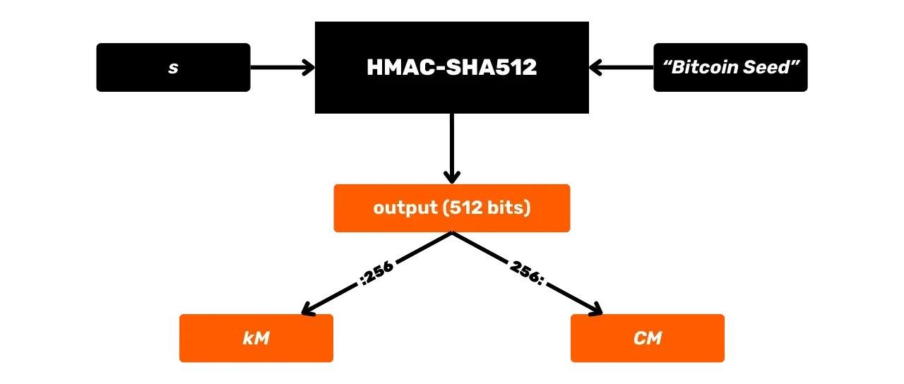
"Bitcoin Seed"
output (512 bits)

Slide 46
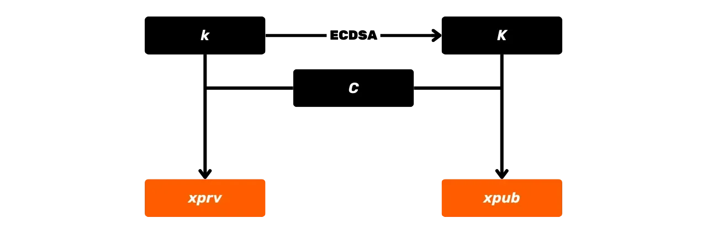

Slide 47
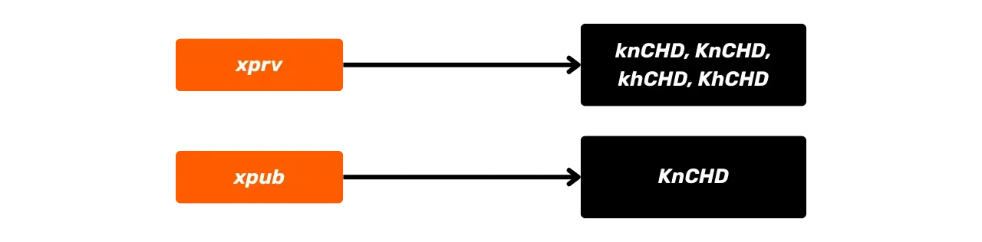

Slide 48
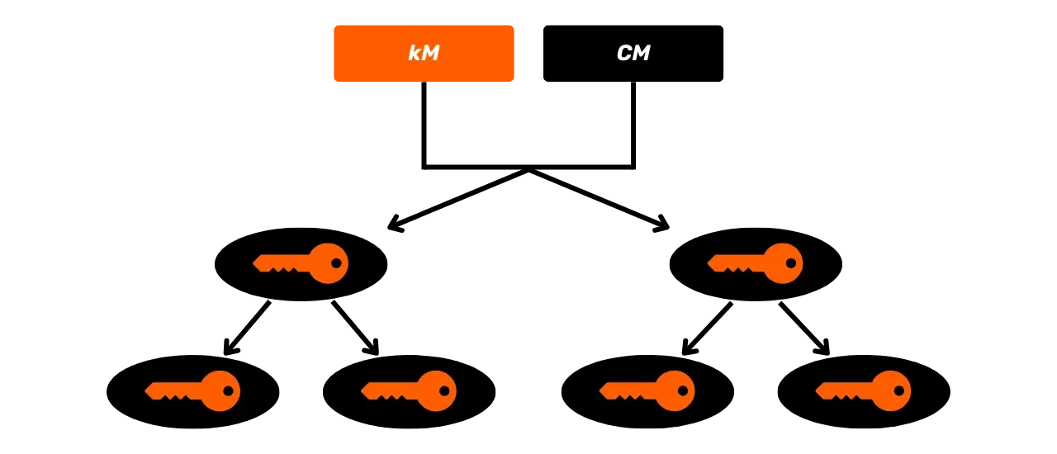

Slide 49
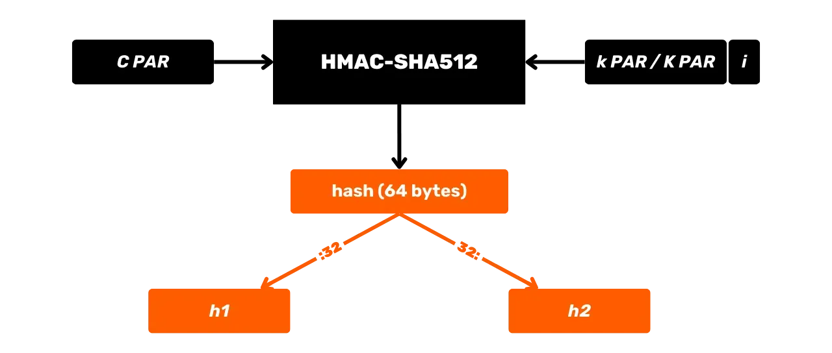
hash (64 bytes)

Slide 50
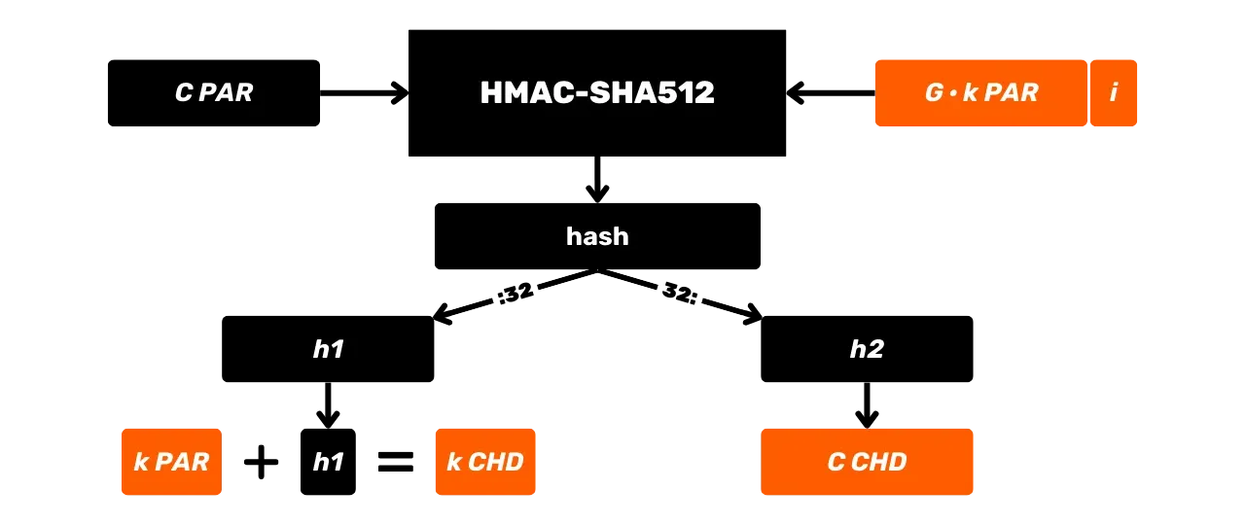
hash

Slide 51
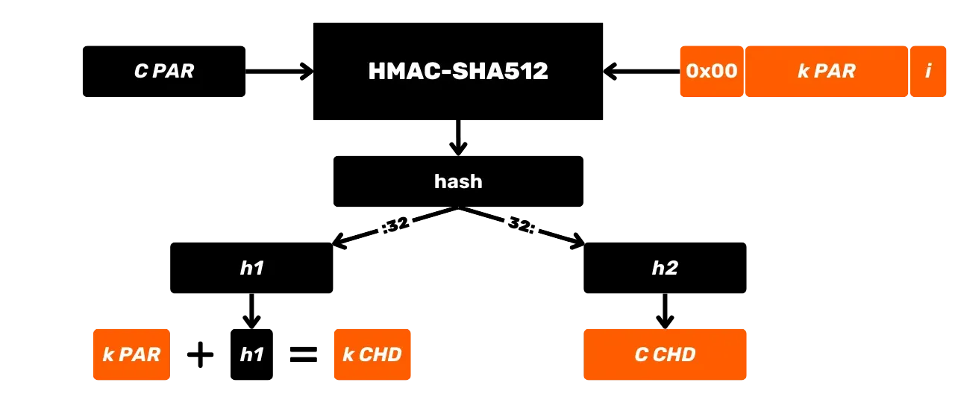
hash

Slide 52
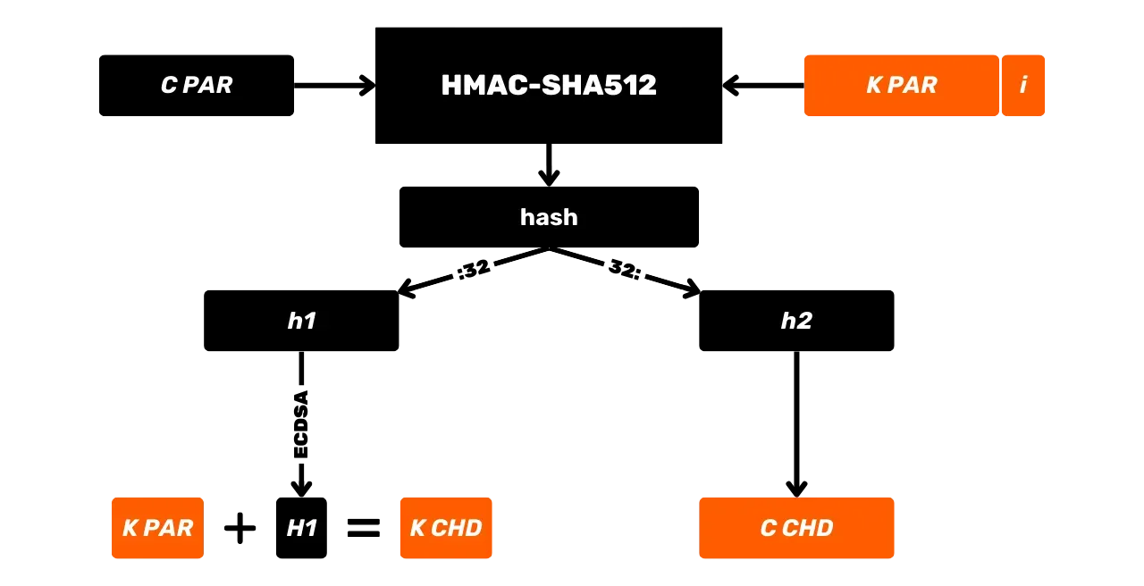
hash

Slide 53
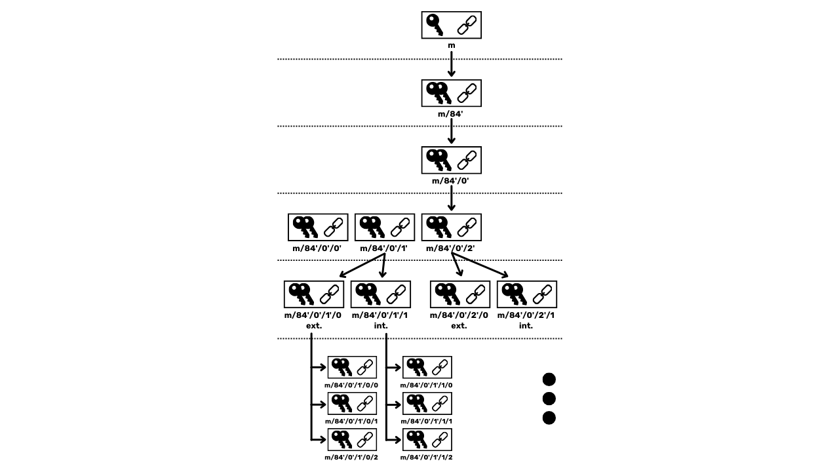

Slide 54
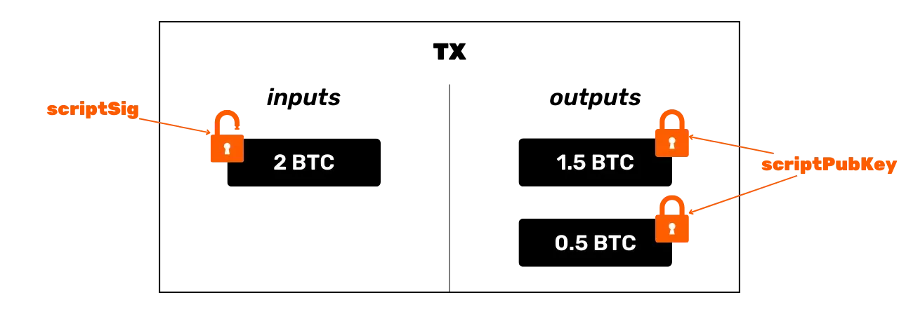
inputs
outputs
scriptSig
scriptPubKey

Slide 55

signature
public key
public hash
HASH160
CHECKSIG
DUP
EQUALVERIFY
scriptSig
scriptPubKey
Stack

Slide 56

public hash
HASH160
CHECKSIG
DUP
EQUALVERIFY
scriptSig
scriptPubKey
public key
signature
Stack

Slide 57

public hash
HASH160
EQUALVERIFY
CHECKSIG
scriptSig
scriptPubKey
public key
DUP
public key
signature
Stack

Slide 58

public hash
EQUALVERIFY
CHECKSIG
scriptSig
scriptPubKey
HASH160
public hash
public key
signature
Stack

Slide 59

EQUALVERIFY
CHECKSIG
scriptSig
scriptPubKey
public hash
public hash
public key
signature
Stack

Slide 60

CHECKSIG
scriptSig
scriptPubKey
public hash
EQUALVERIFY
public hash
public key
signature
Stack

Slide 61

scriptSig
scriptPubKey
public key
CHECKSIG
signature
Stack

Slide 62

scriptSig
scriptPubKey
Stack

Slide 63

TWEAK
script 1
script 2
script 3
script 4

Slide 64


Slide 65

pubkey
pubkey hash
address

Slide 66

TWEAK
leaf 1
leaf 2
leaf 3
leaf 4

