Slide 1


Slide 2

Bitcoin Standard
Hyperbitcoinization
Takeoff
Market Share Percentage
Cypherpunks
Innovators
Early adopters
Early majority
Followers
Latecomers

Slide 3
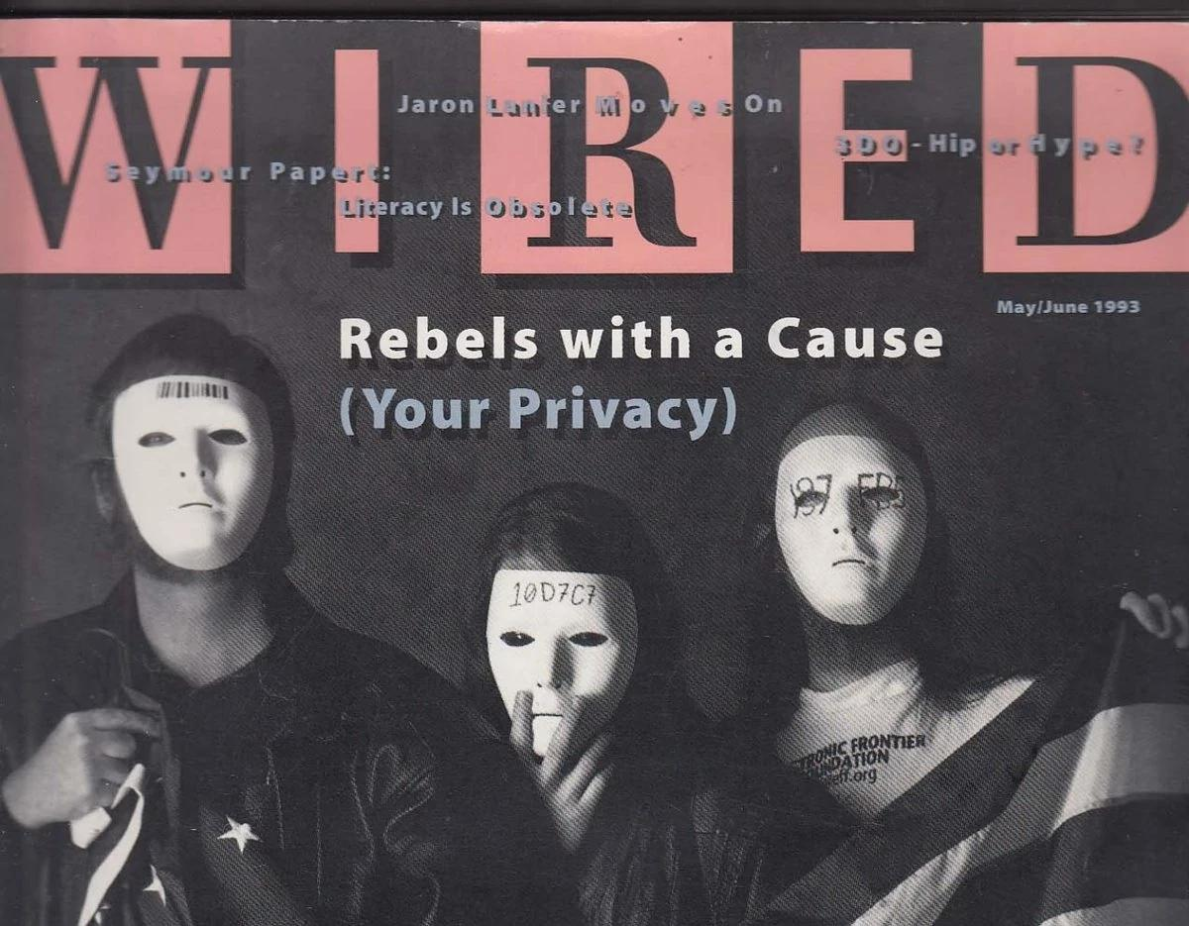
Wired Magazine. (1993, May/June). Rebels with a Cause (Your Privacy). Wired, 1(4).

Slide 4

May, T. C. (1988). The Crypto Anarchist Manifesto.
Barlow, J. P. (1996). A Declaration of the Independence of Cyberspace.
Hughes, E. (1993). A Cypherpunk’s Manifesto.

Slide 5

Image source: cliffr2, Bitcoin and the Rise of Cypherpunks (Infographic).

Slide 6


Slide 7


Slide 8

I want to buy your carrots for gold. Then, you could keep the gold as a store of value for future goods.

Slide 9

I hope someone wants to barter my carrots before they rot. Perhaps I can exchange them for gold, which will not spoil!

Slide 10

Who wants some good carrots? Only 1 gold piece per carrot!

Slide 11

Store of value
Medium of exchange
Unit of account

Slide 12

Monetary printing
Purchasing power

Slide 13


Slide 14


Slide 15


Slide 16


Slide 17


Slide 18

Loss of trust
Currency collapse
Higher inflation
Reconstruction

Slide 19

“We are hungry!”

Slide 20


Slide 21
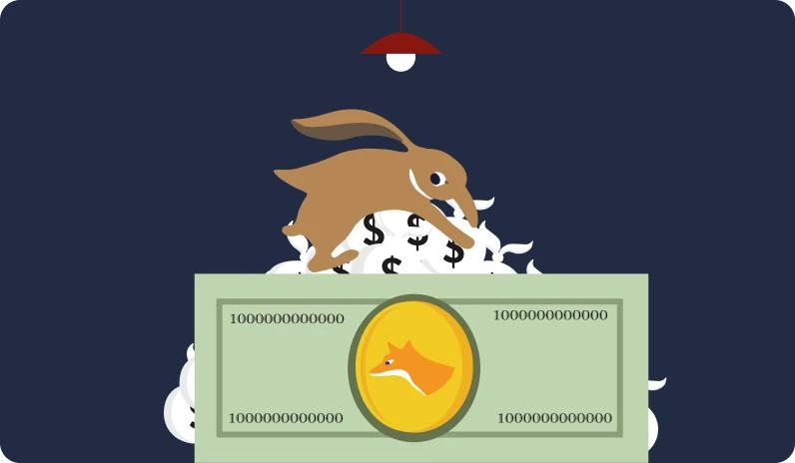

Slide 22

Number of bitcoins in circulation
Monetary creation per block
Years
Bitcoins (millions)
Blocks (thousands)

Slide 23


Slide 24

more miners
more blocks
10 min/block again
h(Bn) < diff
less time x block
less blocks
more difficulty

Slide 25


Slide 26
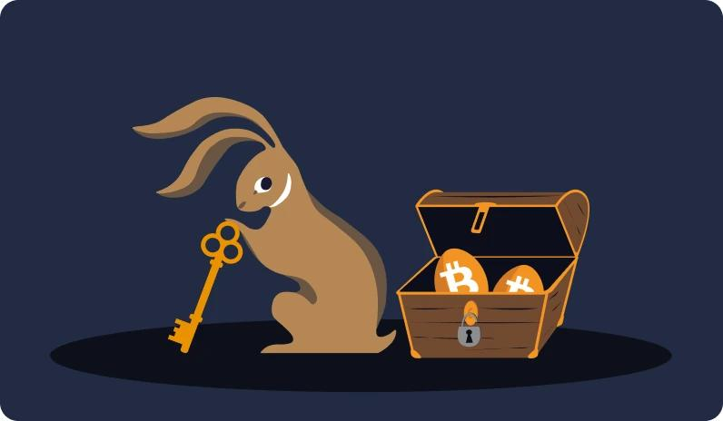

Slide 27

Bitcoin address:

Slide 28


Slide 29

~10^-78

Slide 30
High Risk of Theft
ETF
Custodial wallets/exchanges
1-of-2 Multisig
Single-sig
Low Risk of Theft
High Risk of Theft
3-of-5 Multisig
2-of-2 Multisig
2-of-3 Multisig
Single-sig with passphrase
Miniscript wallet (with timelocks)
Low Risk of Theft

Slide 31


Slide 32


Slide 33


Slide 34


Slide 35


Slide 36


Slide 37


Slide 38

I am preparing an inheritance plan for my grand children!

Slide 39

Source: Nakamoto, S. (2008, October 31). "Bitcoin P2P e-cash paper," Cryptography Mailing List.

Slide 40

Nakamoto, S. (2008). Bitcoin: A Peer-to-Peer Electronic Cash System

Slide 41

Bitcoin Genesis Block (Block 0), mined by Satoshi Nakamoto on January 3, 2009. See: https://www.blockchain.com/explorer/blocks/btc/0

Slide 42

The Times. (2009, January 3). Chancellor on brink of second bailout for banks. The Times (London), p. 1.

Slide 43

Finney, H. [@halfin]. (2009, January 11). Running bitcoin [Tweet]. Twitter.
https://twitter.com/halfin/status/1110302988

Slide 44

Hanyecz, L. [laszlo]. (2010, May 18). Pizza for bitcoins? Bitcointalk.org.
https://bitcointalk.org/index.php?topic=137.0

Slide 45


Gergely, R., & Gilly, T. (2021). Satoshi Nakamoto statue [Statue]. Graphisoft Park, Budapest, Hungary
« Satoshi Nakamoto » by Valentina Picozzi from Satoshigallery. Lugano, Switzerland

Slide 46

Transaction:

Slide 47


Slide 48


Slide 49


Slide 50


Slide 51


Slide 52


Slide 53

Various exemple of bitcoin node

Slide 54

Worldwide distribution of Bitcoin Nodes.

Slide 55


Slide 56
more miners
more blocks
10 min/block again
h(Bn) < diff
less time x block
less blocks
more difficulty

Slide 57

bitmain S9 miner by Bitman & a mining facility

Slide 58

Total Hash Rate (TH/s)
Total Hash Rate
Market Price (USD)
Hashrate
Year

Slide 59


Slide 60

10 min / 1 block
7 days / 1000 blocks
time/blocks

Slide 61

Traitor
Traitor
Traitor
Traitor
Coordinated Attack Leading to Victory
Uncoordinated Attack Leading to Defeat

Slide 62

An S9 miner transformed as a home heater. ‘Attakaï’ project by DecouvreBitcoin

Slide 63
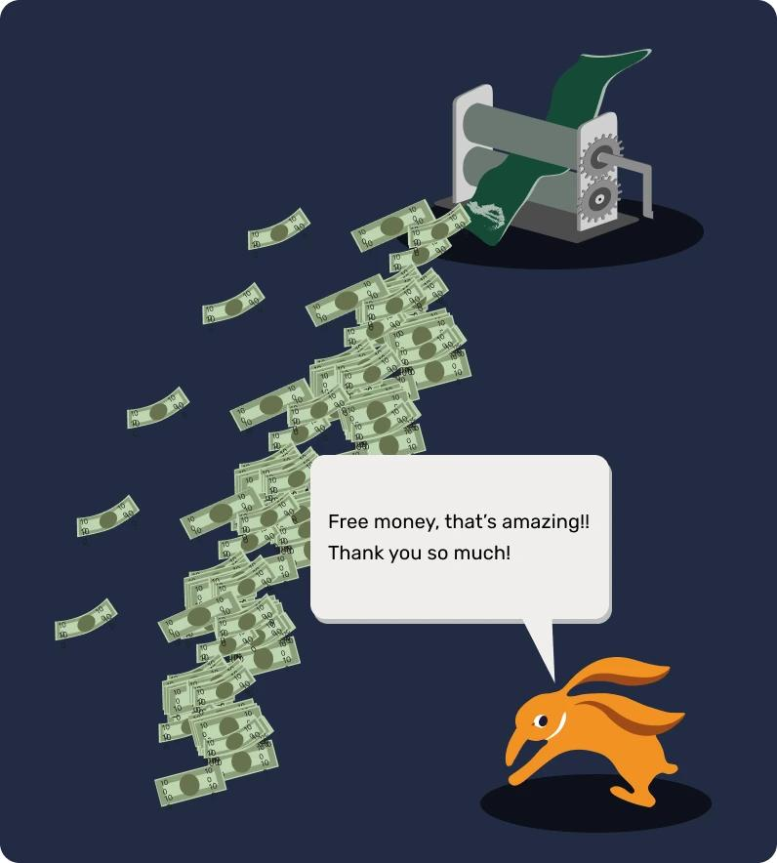
Free money, that’s amazing !! Thank you so much!

Slide 64

Wait! Where do you get all that money from?
Slow down!

Slide 65

Are you kidding me? This is insane!

Slide 66


Slide 67

Street art in Paris

Slide 68


Slide 69


Slide 70

60-Day Bitcoin Volatility Index
Standard Deviation
of Daily returns
BTC/USD Volatility
Gold/USD Volatility
EUR/USD Volatility
Year

Slide 71


Slide 72

IT’S A BUBBLE.
IT’S A BUBBLE.
IT’S A BUBBLE.
IT’S A BUBBLE.

Slide 73

BTCmap merchant accepting Bitcoin

Slide 74

Donations
Circular Economy in BTC
Merchants
Entrepreneurs
Salaried workers

Slide 75


Slide 76


Slide 77


Slide 78
Bitcoin Standard
Hyperbitcoinization
Takeoff
Market Share Percentage
Cypherpunks
Innovators
Early adopters
Early majority
Followers
Latecomers

Slide 80

TCP
IP
FTP
Transmission Control Protocol
Internet Protocol
File Transfer Protocol
SMTP
HTTP
UDP
E-mail Transmission Protocol
Web Browser Protocol
User Datagram Protocol
DNS
TLS/SSL
BTC
Domain Name System
Crypto-graphic Security
Money Protocol

Slide 81

Alice and Bob’s channel exchanges
LN Channel Opening
LN Channel Closure

Slide 82

Decentralization
Security
Scalability

Slide 83

Routing hops
Routing Node

Slide 84

Channel status at the opening
Channel status at the closure

Slide 85


Slide 86

Game Entry: 500 Sats

Slide 87

Consultancy
Premium
Questions!

Slide 88

Lightning Network also allows us to do many things from remote.
Send me a message for 1 sat. No more spam!

