Slide 1

Cleartext
Ciphertext
Cleartext
Ciphertext
Bitcoin
Bitcoin
Encryption with public key
Encryption
with public
key
Sending
Sending
Bitcoin
Decryption
with private
key
Decryption with private key

Slide 2

Message
Signature
Signing with private key
Sending
OK
Verifying with public key

Slide 3


Slide 4
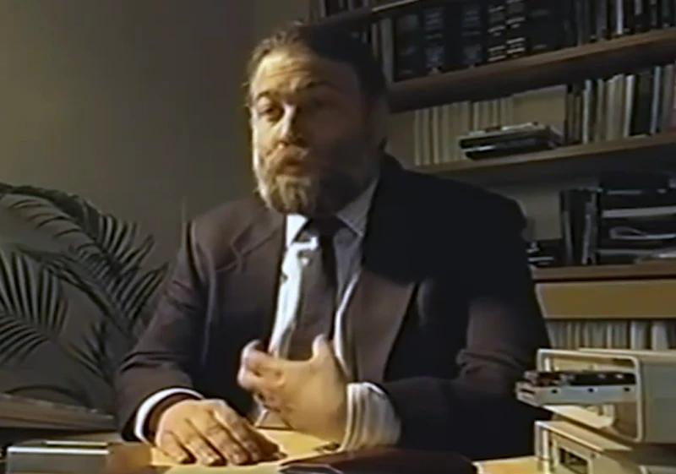

Slide 5

send
send
credits
Bank 1
Bank 2
record of spent banknotes

Slide 6
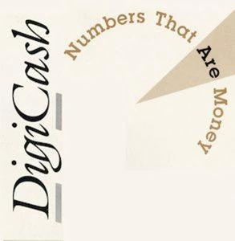

Slide 7


Slide 8


Slide 9


Slide 10


Slide 11


Slide 12

Link
Station
Centralisation
Decentralized
Distributed networks.

Slide 13

Loyal General
Traitor
Defeat
Victory

Slide 14

Trusted timestamping
Within a company
Timestamping Authority (TSA)
Calculate hash
Send hash to TSA
Timestamp
Data
Calculate hash
This is a digital signature of the hash concatenated to the timestamp
Apply private key of the TSA
Signed timestamp and hash are returned to requester
Timestamp
Data
Timestamp
Store together

Slide 15


Slide 16

References

Slide 17
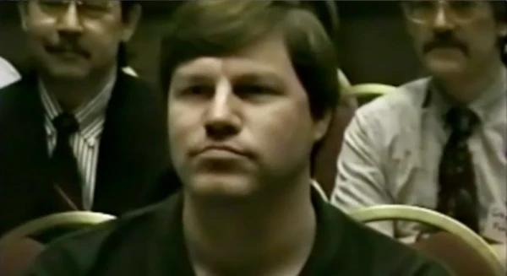

Slide 18


Slide 19


Slide 20


Slide 21


Slide 22


Slide 23


Slide 24


Slide 25
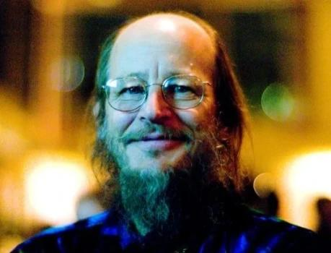

Slide 26

Satoshi Nakamoto’s Page - Never received any gift

Slide 27


Slide 28
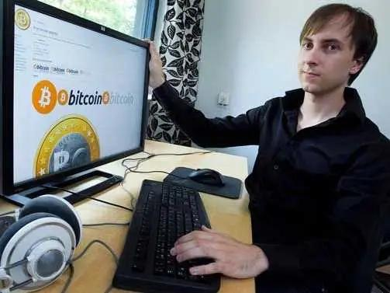

Slide 29

Bitcoin Forum

Slide 30


Slide 31


Slide 32


Slide 33


Slide 34


Slide 35


Slide 36


Slide 37

Patoshi Blocks & Inverted Timestamps (Block number/ExtraNonce)

Slide 38

Estimate of Satoshi’s percentage of the network
Percentage of network

Slide 39

Estimate of Satoshi’s hashrate
Hashrate
Daily average hashrate
Linear hashrate model

Slide 40


Slide 41


Slide 42


Slide 43


Slide 44


Slide 45


Slide 46
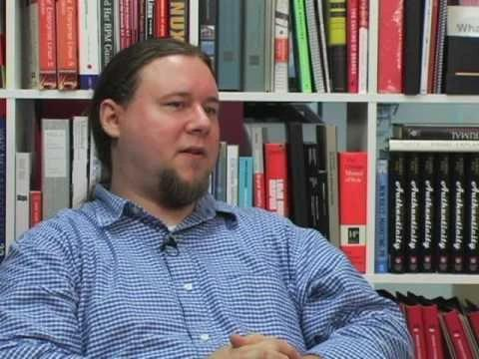

Slide 47


Slide 48


Slide 49

ExtraNonce
Date

Slide 50


Slide 51


Slide 52

"Article: Do you know about bitcoins?"
Bitcoin is an electronic currency designed in 2009 by someone named Satoshi Nakamoto. This currency stands out from other electronic currencies due to its fully decentralized peer-to-peer nature and its clever use of basic cryptographic concepts. It relies on software written in C++ and published under the MIT open-source license.

Slide 53


Slide 54

Bitcoin the rise of the machines.

Slide 55


Slide 56


Slide 57


Slide 58


Slide 59


Slide 60


Slide 61


Slide 62


Slide 63


Slide 64


Slide 65


Slide 66


Slide 67


Slide 68


Slide 69
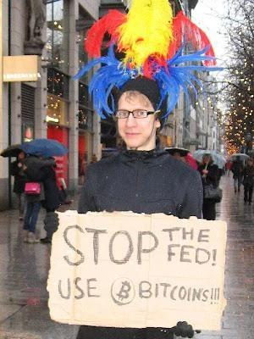

Slide 70

Bitcoin Price in US Dollars

