Slide 1

Umwandiko utomoye
Umwandiko w'ibanga
Umwandiko utomoye
Umwandiko w'ibanga
Bitcoin
Bitcoin
Ububiko n'urufunguzo rwa bose
Gushiramwo amakuru
na bose
urufunguzo
Kurungika
Kurungika
Bitcoin
Gusobanura
n'ivy'ibanga
urufunguzo
Gusobanura n'urufunguzo rwihariye

Slide 2

Ubutumwa
Isinyuro
Gusinya ukoresheje urufunguzo rwihariye
Kurungika
VYIZA
Gusuzuma n'urufunguzo rwa bose

Slide 3


Slide 4
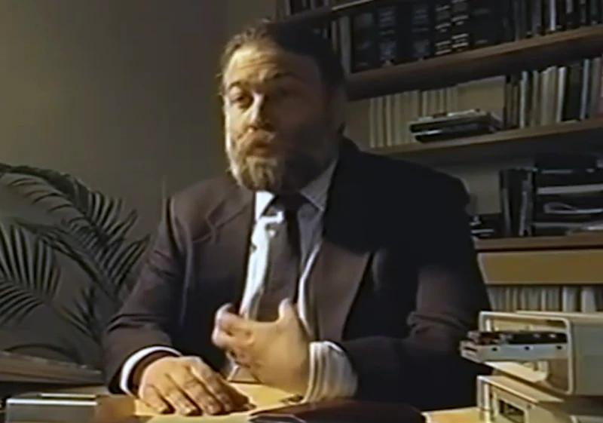

Slide 5

kurungika
kurungika
inguzanyo
Banki 1
Banki 2
inyandiko y'amafaranga yakoreshejwe

Slide 6
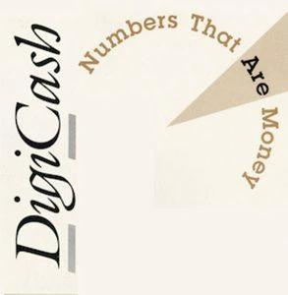

Slide 7


Slide 8


Slide 9


Slide 10


Slide 11


Slide 12

Urubuga
Ikigo
Gushira hamwe
Kwegereza ubutegetsi
Inzira zikwiragijwe.

Slide 13

Umujenerali w'intahemuka
Umuhemu
Gutsindwa
Intsinzi

Slide 14

Igihe cizewe
Muri sosiyete
Ubuyobozi bwo Gushiraho Ikidodo c'Igihe (TSA)
Guharura hash
Wohereze hash kuri TSA
Ikidodo c'isaha
Amakuru
Guharura hash
Iyi ni umukono wa digitale wa hash ifatanye n'ikidodo c'igihe
Gukoresha urufunguzo rwihariye rwa TSA
Ikidodo c'igihe cashizweko umukono na hash birasubirwamwo ku wusaba
Ikidodo c'isaha
Amakuru
Ikidodo c'isaha
Bibike hamwe

Slide 15


Slide 16

Ibisobanuro

Slide 17
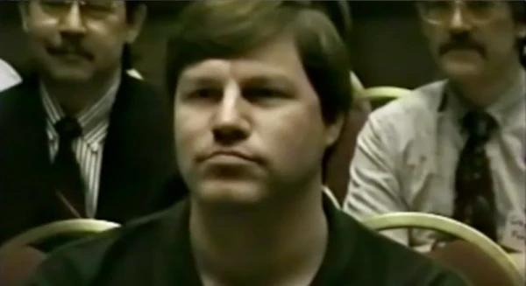

Slide 18


Slide 19
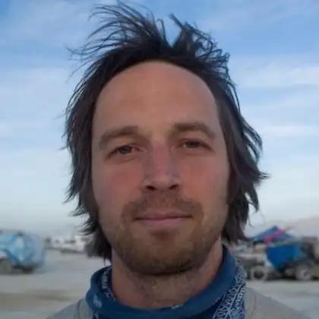

Slide 20
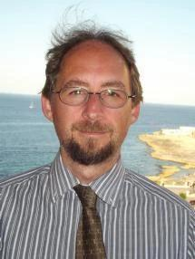

Slide 21


Slide 22
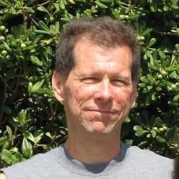

Slide 23


Slide 24


Slide 25
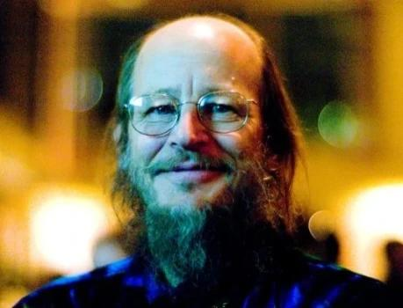

Slide 26

Urupapuro rwa Satoshi Nakamoto - Nta ngabirano n’imwe yigeze aronka

Slide 27


Slide 28
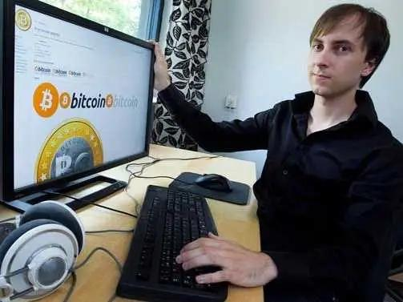

Slide 29

Ihuriro rya Bitcoin

Slide 30


Slide 31


Slide 32


Slide 33


Slide 34


Slide 35


Slide 36
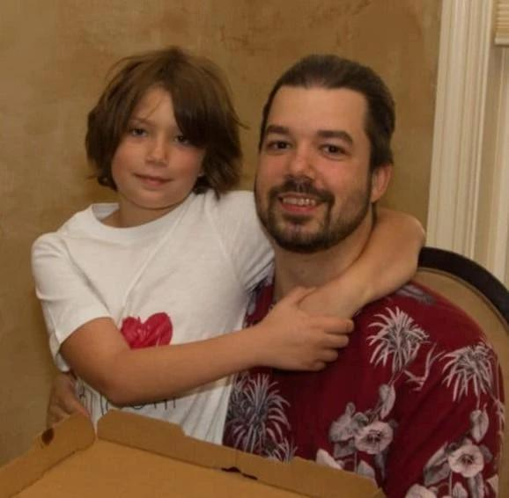

Slide 37

Amabuye ya Patoshi n'Ibimenyetso vy'Igihe Bihinduwe (Igitigiri c'Ibuye/ExtraNonce)

Slide 38

Igereranyo ry'ijanisha rya Satoshi ry'urubuga
Ijanisha ry'urubuga

Slide 39

Igereranyo ry'igipimo ca Satoshi
Hashrate
Hashrate y'umusi
Igishushanyo c'umurongo

Slide 40


Slide 41


Slide 42


Slide 43


Slide 44
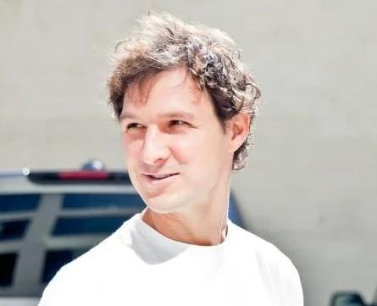

Slide 45


Slide 46
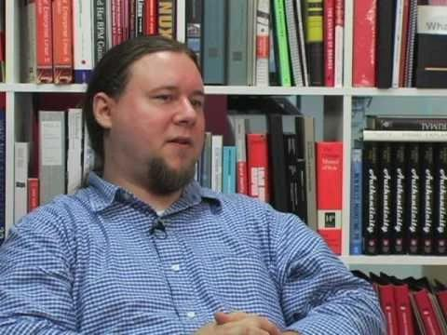

Slide 47


Slide 48


Slide 49

Ibindi
Itariki

Slide 50
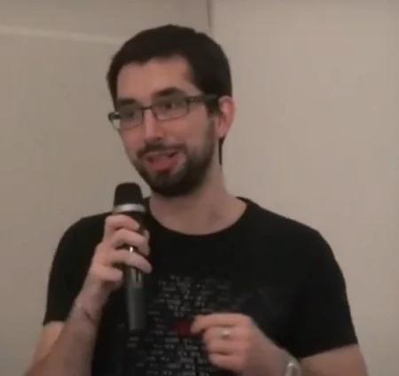

Slide 51


Slide 52

"Ingingo: Woba uzi ivy'ama bitcoins?"
Bitcoin ni amafaranga y’ubuhinga bwa none yakozwe mu mwaka w’2009 n’umuntu yitwa Satoshi Nakamoto. Iryo faranga ritandukanye n’ayandi mafaranga y’ubuhinga bwa none kubera ubuhinga bwaryo bwo gukorana n’abandi mu buryo bushitse kandi rikoresha neza ivyiyumviro vy’ishimikiro vy’ubuhinga bwa none. Ishingiye kuri porogarama zanditswe mu rurimi rwa C++ kandi zisohotse hakurikijwe uruhusha rwa MIT.

Slide 53


Slide 54

Bitcoin ivyuka vy’amamashini.

Slide 55


Slide 56


Slide 57


Slide 58


Slide 59


Slide 60
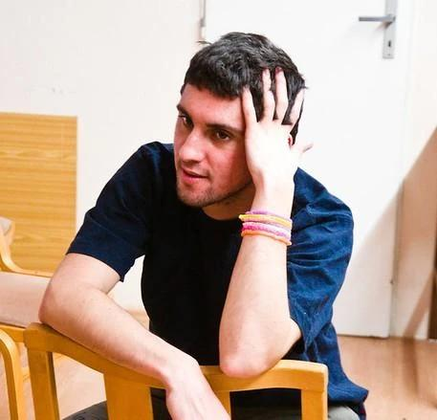

Slide 61


Slide 62


Slide 63


Slide 64


Slide 65


Slide 66


Slide 67


Slide 68


Slide 69
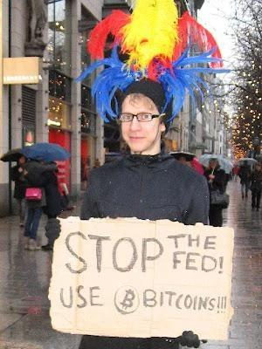

Slide 70

Igiciro ca Bitcoin mu madolari y'Amerika

