Slide 1

Scene of rural life in the 19th century, attributed to Louis-Léopold Boilly

Slide 2


Portrait of the Duc de Sully
Memoirs of the Duc de Sully, Minister of Henri IV

Slide 3

Jean-Baptiste Colbert, General Controller of Finances under Louis XIV

Slide 4

18th-century feather-maker's workshop

Slide 5

Port of Bordeaux in the 18th century by Vernet

Slide 6

Robin hood of the State - taxes or death

Slide 7

Uncle Scrooge

Slide 8


Portrait of Vauban
Lille Citadel by Vauban

Slide 9

Vauban, “Royal tithe project”

Slide 10

Population census

Slide 11


Tocqueville, “The Old Regime and the Revolution”
The three orders

Slide 12

Pierre Lepesant de Boisguilbert

Slide 13
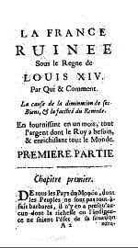

Boisguilbert, “Ruined France under Louis XIV”
Map of Port Royal des Champs

Slide 14

Gustave Caillebotte - "Upward Path”

Slide 15

Murray Rothbard, “An Austrian perspective on the History of Economic Thought”

Slide 16


Richard Cantillon, “Essay on the Nature of Commerce”
John Law

Slide 17

Law's bank bill

Slide 18

The Abbot of Saint-Pierre

Slide 19


Portrait of Gustave de Molinari
The Abbot of Saint-Pierre by Molinari

Slide 20

The Abbot of Saint-Pierre, “Project to Restore Peace in Europe”

Slide 21


Louis XIV
Versailles, Hall of Mirrors

Slide 22

French Academy

Slide 23

18th-century French pamphlet proposing reforms to commerce and finance, reflecting early debates on trade and economic policy.

Slide 24


Marquis d'Argenson
Laissez-faire, laissez-passer

Slide 25

Pin Manufacture, “Encyclopédie” by Diderot and d'Alambert

Slide 26

Portrait of Adam Smith

Slide 27
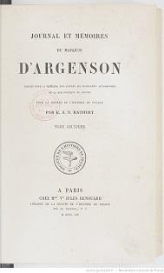
Marquis d'Argenson, “Diary and Memoirs”

Slide 28

Benoît Malbranque, “Vincent de Gournay”

Slide 29



A treatise on trade Josiah Child
Text dated June 26, 1715, written by M. de Gourgan, merchant
Official report on the Compagnie des Indes

Slide 30

Portrait of Turgot

Slide 31
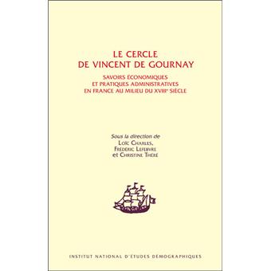
Vincent de Gournay's circle

Slide 32

Portrait of David Hume

Slide 33


Essay on the general grain policy (1755)
Abbé Gabriel-François Coyer
“La Noblesse commerçante”

Slide 34
Richard Cantillon, “Essay on the nature of commerce”

Slide 35

Study on economic publishing in France, 1566-1789.

Slide 36

Abbé Gabriel-François Coyer, “Chinki”

Slide 37

Debate at the Estates-General, France, 1789

Slide 38


Portrait of Mirabeau
Mirabeau, “L'ami des hommes”

Slide 39
Richard Cantillon, “Essay on the nature of commerce”

Slide 40

Economic and social doctrines
of the Marquis de Mirabeau

Slide 41

François Quesnay

Slide 42


Mirabeau, “Theory of taxation”
Pierre Samuel Dupont de Nemours

Slide 43


François Quesnay
Economic chart by François Quesnay

Slide 44

François Quesnay

Slide 45

Encyclopedia
Dupont de Nemours,
“Theory of taxation”

Slide 46

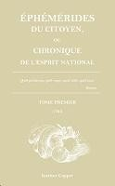
“Physiocracy”, collection of articles by Quesnay, 1768
“Ephémérides du Citoyen”, official journal of the Physiocrats

Slide 47


Boisguilbert, “Detail of France”
Cantillon, “Essay on the nature of commerce”

Slide 48
Quesnay
Quesnay's economic chart
Mirabeau, “Theory of Taxation”

Slide 49

Marquess de Pompadour

Slide 50
Ephémérides du Citoyen, official journal of the Physiocrats

Slide 51

Enlightenment economists

Slide 52

Physiocracy, collection of articles by Quesnay, 1768

Slide 53

Jean-François Millet, “Peasants”

Slide 54
Tocqueville, “The Old Regime and the Revolution”

Slide 55

Louis XVI

Slide 56

Millet, “Angelus”

Slide 57

The port of Bordeaux in the 18th century

Slide 58

Charles Frederick, “Grand Duke of Baden”

Slide 59

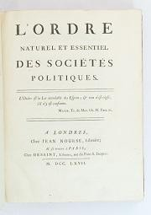
Catherine II of Russia
Mercier de la Rivière, “The natural and essential order of political societies”

Slide 60
Portrait of Turgot

Slide 61

Royal Edict

Slide 62

Summoning of the Estates General at Versailles in 1789

Slide 63


Joseph Rambaud, “History of economic doctrines”
Adam Smith, “Wealth of Nations”

Slide 64

Entreprise Dupont
Dupont de Nemours

Slide 65
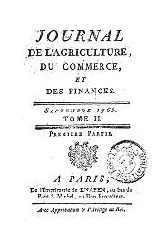
Marquis de Mirabeau
Journal of agriculture, trade and finance

Slide 66
Quesnay
Journal des Physiocrates

Slide 67

Physiocracy, collection of texts by Quesnay
Turgot

Slide 68


Capture of the Tuileries Palace in 1792
Joseph Schumpeter,” History of economic analysis”

Slide 69
Adam Smith
Encyclopedia

Slide 70

Denis Diderot

Slide 71
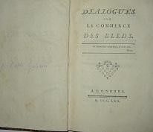
Citizen's ephemerides
Dialogue on the wheat trade, by Galiani

Slide 72

Voltaire

Slide 73

Voltaire, “L'homme aux quarante écus”

Slide 74

Turgot
Montesquieu
“The Spirit of Laws”
Encyclopedia

Slide 75

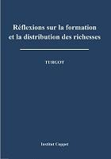
Turgot, “Praise for Gournay”
Turgot, “Reflections on the formation and distribution of wealth”

Slide 76


Turgot and Smith,
”A strange closeness”
Turgot, “Letters on the freedom of grain trade”

Slide 77

Turgot, “Mémoire sur les prêts d'argent”

Slide 78

Friedrich A. Hayek

Slide 79
Turgot

Slide 80

J.F. Millet, “The Gleaners”, 1857

Slide 81

The militia draw

Slide 82

Grievance book of the baillage of Nemours
Edit du Roy

Slide 83


Voltaire
Louis XVI

Slide 84


Michel de Montaigne
Étienne Bonnot de Condillac

Slide 85

Condillac, Trade and Government

Slide 86

Jean-Baptiste Say

Slide 87

Nicolas de Condorcet

Slide 88

Anne Robert Jacques Turgot

Slide 89

Galiani, “Letters on the grain trade”

Slide 90

Champagney, “List of Grievances”
Summoning of the Estates General at Versailles, May 5, 1789

Slide 91
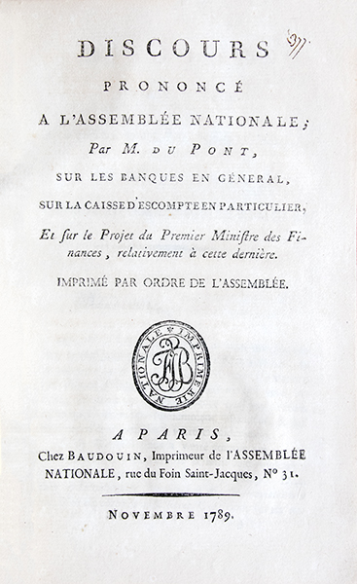
Dupont de Nemours, “Speech to the National Assembly”, 1789

Slide 92

Dupont de Nemours, “Effect of Assignats on the Price of Bread”

Slide 93

Assignat of 100

Slide 94

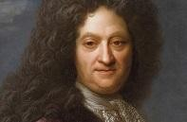
Pierre Le Pesant de Boisguilbert
Cantillon, “Essay on the nature of commerce in general”
Josiah Child, “A treatise on trade”

Slide 95

D'Argenson
Quesnay
Condillac

