Slide 1

Ivyabaye mu buzima bwo mu misozi mu kinjana ca 19, bivugwa ko vyakozwe na Louis-Léopold Boilly

Slide 2


Igishushanyo ca Duc de Sully
Ivyiyumviro vya Duc de Sully, umushikiranganji wa Henri IV

Slide 3

Jean-Baptiste Colbert, Umugenzuzi Mukuru w’Ivy’Imari ku ngoma ya Ludoviko XIV

Slide 4

Amahugurwa y'abahinguzi b'amababa yo mu kinjana ca 18

Slide 5

Icibutso ca Bordeaux mu kinjana ca 18 cakozwe na Vernet

Slide 6

Robin hood wa Leta - imisoro canke urupfu

Slide 7
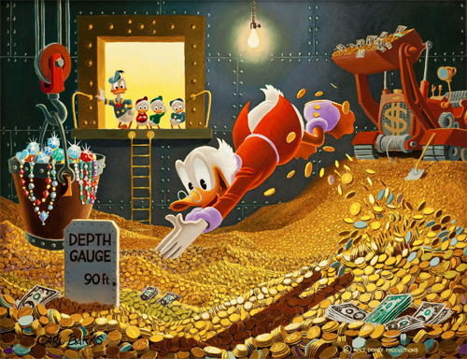
Marume Sikuruge

Slide 8


Igishushanyo ca Vauban
Igisagara ca Lille cakozwe na Vauban

Slide 9

Vauban, “Umugambi w’ic’icumi w’Ubwami”

Slide 10

Ibarura ry'abanyagihugu

Slide 11


Tocqueville, “Intwaro ya kera n’Impinduka”
Amategeko atatu

Slide 12

Piyeri Lepesanti de Boisguilbert

Slide 13
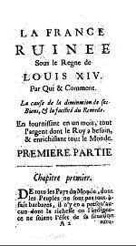

Boisguilbert, “Ubufaransa bwasambutse ku ngoma ya Ludoviko wa XIV”
Ikarata y'Ikivuko ca Royal des Champs

Slide 14

Gustave Caillebotte - "Inzira ija hejuru"

Slide 15

Murray Rothbard, “Iciyumviro c’Abanyaotirishiya ku bijanye n’amateka y’ivyiyumviro vy’ubutunzi”

Slide 16
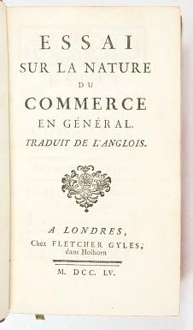

Richard Cantillon, “Inyandiko yerekeye kamere y’ubudandaji”
Yohani Itegeko

Slide 17

Itegeko rya banki

Slide 18

Umukuru w'idini ry'i Saint-Pierre

Slide 19

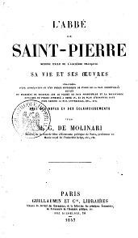
Igishushanyo ca Gustave de Molinari
Umukuru w'idini ry'i Saint-Pierre yanditswe na Molinari

Slide 20

Umukuru w’Ishengero ry’i Saint-Pierre, “Umugambi wo kugarukana amahoro mu Buraya”

Slide 21


Ludoviko XIV
Versailles, Ingoro y'Indorerwamo

Slide 22

Ishure ry'igifaransa

Slide 23

Agatabu k’igifaransa ko mu kinjana ca 18 kasaba ko habaho ihinduka mu vy’ubudandaji no mu vy’amahera, kagaragaza impaka za kera ku bijanye n’ubudandaji be n’ingingo mfatirwako z’ubutunzi.

Slide 24


Umukuru w'igihugu
Ukwirekura, kwirekura-uguca

Slide 25

Igikoresho co gukora amapine, “Igitabo c’inkoranyabumenyi” canditswe na Diderot na d’Alambert

Slide 26

Ishusho ya Adamu Smith

Slide 27
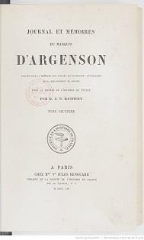
Mariki d’Argenson, “Igitabo c’ivya kera n’ivy’ivyiyumviro”

Slide 28

Benoit Malbranque, “Vincent de Gournay”

Slide 29



Igitabo kivuga ku bucuruzi Yosiya Umwana
Ivyanditswe vyo ku wa 26 Ruheshi 1715, vyanditswe na M. de Gourgan, umucuruzi .
Raporo yemewe ku bijanye n'Ishirahamwe ry'Abanyagihugu

Slide 30

Igishushanyo ca Turgot

Slide 31
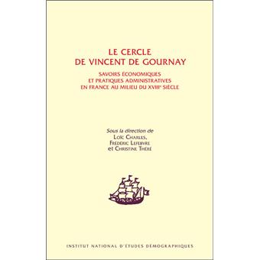
Uruziga rwa Vincent de Gournay

Slide 32

Igishushanyo ca Dawidi Hume

Slide 33


Inyandiko ku vyerekeye politike rusangi y'intete (1755)
Abbé Gaburiyeli-François Coyer
“Umucuruzi w’icubahiro”

Slide 34
Richard Cantillon, “Igitabo kivuga ku kamere k’ubudandaji”

Slide 35

Ivyigwa ku bijanye n’ugusohora ibitabu vy’ubutunzi mu Bufaransa, 1566-1789.

Slide 36

Abbé Gabriel-François Coyer, “Chinki”

Slide 37

Impaka zabereye mu nama nkuru y’igihugu, mu Bufaransa, mu 1789

Slide 38

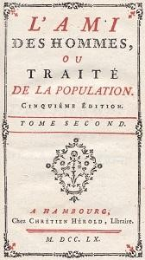
Igishushanyo ca Mirabeau
Mirabeau, “Umugenzi w'abantu”

Slide 39
Richard Cantillon, “Igitabo kivuga ku kamere k’ubudandaji”

Slide 40

Inyigisho z'ubutunzi n'imibano
y'Umukuru w'Igihugu

Slide 41

Fransuwa Kwesine

Slide 42


Mirabeau, “Ivyiyumviro vyerekeye imisoro”
Pierre Samweli Dupont de Nemours

Slide 43


Fransuwa Kwesine
Igishushanyo c'ubutunzi cakozwe na François Quesnay

Slide 44

Fransuwa Kwesine

Slide 45

Inkoranyamagambo
Umukuru w'igihugu,
“Ivyiyumviro vyerekeye imisoro”

Slide 46

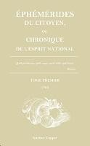
“Ubutegetsi bw’umubiri”, igitabu c’ingingo zanditswe na Quesnay, mu 1768
“Ephémérides du Citoyen”, ikinyamakuru cemewe c’abahinga mu vy’umubiri .

Slide 47


Boisguilbert, “Ivyiyumviro vy’Ubufaransa”
Cantillon, “Inyandiko yerekeye kamere y’ubudandaji”

Slide 48
Ikibazo
Imbonerahamwe y'ubutunzi ya Quesnay
Mirabeau, “Ivyiyumviro vy’Imisoro”

Slide 49

Umwamikazi wa Pompadour

Slide 50
Ephémérides du Citoyen, ikinyamakuru cemewe c’abahinga mu vy’umubiri

Slide 51

Abahinga mu vy'ubutunzi b'umuco

Slide 52

Ivy’ubuhinga bw’umubiri, ihuriro ry’ingingo za Quesnay, 1768

Slide 53

Jean-François Millet, “Abarimyi”

Slide 54
Tocqueville, “Intwaro ya kera n’Impinduka”

Slide 55

Ludoviko XVI

Slide 56

Umuceri, “Umumarayika”

Slide 57

Icibutso ca Bordeaux mu kinjana ca 18 .

Slide 58

Charles Frederick, “Umwami Mukuru wa Baden”

Slide 59

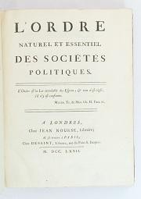
Catherine wa kabiri w'Uburusiya
Mercier de la Rivière, “Urutonde rw’ibinyabuzima kandi rw’ingenzi rw’imibano ya politike”

Slide 60
Igishushanyo ca Turgot

Slide 61

Itegeko ry'Umwami

Slide 62

Guhamagara abakuru b'ibihugu i Versailles mu 1789

Slide 63
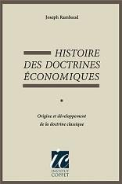

Joseph Rambaud, “Amateka y’inyigisho z’ubutunzi”
Adamu Smith, “Ubutunzi bw’Amahanga”

Slide 64

Ubucuruzi bwa Dupont
Dupont de Nemours

Slide 65
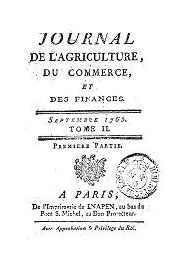
Umukuru w'igihugu
Ikinyamakuru c'uburimyi, ubudandaji n'ivy'imari

Slide 66
Ikibazo
Ikinyamakuru ca Fiziyokarate

Slide 67

Fiziyokarasi, ihuriro ry'ivyanditswe na Quesnay
Turgot

Slide 68


Ingoro ya Tuileries yafashwe mu 1792
Yozefu Schumpeter,” Amateka y’ugusesangura ubutunzi”

Slide 69
Adamu Smith
Inkoranyamagambo

Slide 70

Deni Dideroti

Slide 71
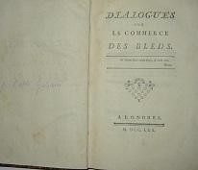
Ivy'abanyagihugu
Ikiganiro ku bijanye n’ubudandaji bw’ingano, canditswe na Galiani

Slide 72

Voltaire

Slide 73

Voltaire, “Umuntu w'ibanga”

Slide 74

Turgot
Monteskiye
“Impwemu y’amategeko”
Inkoranyamagambo

Slide 75

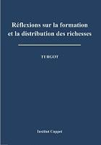
Turgot, “Ishimwe rya Gournay”
Turgot, “Ivyiyumviro ku bijanye n’uguhingura no gusangira ubutunzi”

Slide 76


Turgot na Smith,
”Ukwegerana kudasanzwe”
Turgot, “Amakete yerekeye umwidegemvyo wo gucuruza intete”

Slide 77

Turgot, “Ivyiyumviro vyerekeye ivyiza vy’ifeza”

Slide 78

Firidiri A. Hayeki

Slide 79
Turgot

Slide 80

J.F. Millet, “Abanyabuhinga”, 1857

Slide 81

Abasirikare baratsinda

Slide 82

Igitabo c'ibirego c'abanya Nemours
Guhindura du Roy

Slide 83


Voltaire
Ludoviko XVI

Slide 84


Misheli de Monteni
Étien Bonnot wa Kondilaki

Slide 85

Condillac, Ubucuruzi na Leta

Slide 86

Jean-Batista aravuga

Slide 87

Nikola de Kondorseti

Slide 88

Anne Robert Yaki Turgot

Slide 89

Galiani, “Amakete yerekeye ubudandaji bw’intete”

Slide 90

Champagney, “Urutonde rw’Ivyidodombo”
Guhamagara abakuru b’ibihugu i Versailles, ku wa 5 Rusama 1789

Slide 91
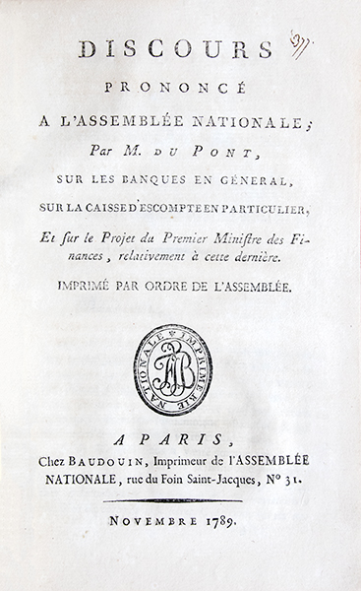
Dupont de Nemours, “Ijambo yashikirije Inama Nkuru y’Igihugu”, 1789

Slide 92

Dupont de Nemours, “Ingaruka z’Ibikorwa ku Giciro c’Umukate”

Slide 93

Gushinga 100

Slide 94

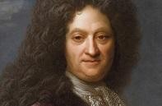
Piyeri Le Pesanti wa Boisguilbert
Cantillon, “Inyandiko yerekeye kamere y’ubudandaji muri rusangi”
Yosiya Umwana, “Igitabu kivuga ivy’ubudandaji”

Slide 95

D'Arjenisoni
Ikibazo
Kondilaki

