Slide 1


Slide 4


Slide 6
Igishushanyo ca OSI
Igishushanyo ca TCP/IP
7. Gusaba
Gusaba
6. Ugushikiriza
5. Igihe
4. Ugutwara abantu n'ibintu
Ivyunguruza
3. Urubuga
Internet
2. Ihuza ry'amakuru
Ukwinjira ku rubuga
1. Ivy'umubiri

Slide 7


MTU = 4000
MTU = 1500
Umuyoboro

Slide 8
Gusaba
Ivyunguruza
Internet
Ukwinjira ku rubuga

Slide 9
Amakuru y'ikoreshwa
Gusaba
Umutwe
Umurima w'amakuru
Igipande ca IP
Igishushanyo c'amakuru ya IP
Gusuzuma urutonde
Umutwe
Umurima w'amakuru y'akadiri
MAC igice gito
Akadiri (Ethernet)

Slide 10

Uguhanahana amakuru hagati y'urunganwe
Gupfuka
Gukuraho igipfukisho
Hello
Hello
Gushira mu ngiro.
Umuzigo
Gushira mu ngiro.
Umutwaro w'inyungu
Ivyunguruza
Amakuru
Ivyunguruza
Amakuru
Internet
Igice
Internet
Igice
Kwinjira
Ipakete
Kwinjira
Ipakete
Ishusho
Ishusho
1001000011001100100111011011011010101010010
101010101010101010101010101011010110101001
1001000011001100100111011011011010101010010
101010101010101010101010101011010110101001
Umugezi wa kabiri

Slide 11
Ishure:
Umubare munini w'imirongo mito :
Umubare munini w'abashitsi ku rubuga :
31
24
23
16
15
8
7
0
A
0
netid
hostid
2^24
2^7
B
10
netid
hostid
unicast
2^14
2^16
C
110
netid
hostid
2^8
2^21
D
1110
multicast
E
11110
reserved

Slide 12
10
netid
hostid
subnetid

Slide 13
Segment 1
ACK 1
Imashini yo gutanga amakuru
Imashini yo kwakira
Segment 2

Slide 14
Segment 1
Igihe
Segment 1
Imashini yo gutanga amakuru
Imashini yo kwakira
ACK 1

Slide 15
SYN Sequence = C
SYN ACK = C+1 Sequence = S
Imashini yo gutanga amakuru
Imashini yo kwakira
ACK = S+1
Sequence = C+1

Slide 16
1 2 3 4 5 6 7 8 9
Imashini yo gutanga amakuru
Imashini yo kwakira

Slide 17




Ndarungitse iryo kete
Gutanga utwigoro twiza
Ndarungitse iryo kete
Ndakira iryo kete

Slide 18
Igipande (N + 1)
Ukoresha wa
Ikigaragara c'uruzitiro
(Nta)/(Nta + 1)
Ibikorwa (N)
Uwutanga
Igipande (N)
Ukoresha wa
Ikigaragara c'uruzitiro
(Nta - 1)/(Nta)
Ibikorwa (N - 1)
Uwutanga
Igipande (N - 1)

Slide 19
Umushitsi A
Uwakira B
Ivyumba vyo hejuru
Ibikorwa vya kera (N)
Igipande (N)
Igipande (N + 1)
Ikigo (N)
Ikigo (N)
Ibikorwa vya kera
(N - 1)
Ivyumba vyo hasi

Slide 20
Sisitemu A
Sisitemu B
Igipande (N+1)
Ibikorwa vy'urugero N
Ukwinjira kwa serivisi
Igipande (N)
ikigo A
ikigo B
Ibikorwa vy'urugero N-1.
Igipande (N-1)

Slide 21
172
16
254
1
10101100
00010000
11111110
00000001
Bayiti 1
=
8 ibice
32 (4 * 8), canke 4 bayiti

Slide 22
8 ibice
8 ibice
8 ibice
8 ibice
8 ibice
8 ibice
Indangamuntu y'umuhinguzi
Aderesi y'aho uba: 1 / Aderesi yihariye: 0
Itangazo: rusangi 1 / iyobowe 0

Slide 23
172
16
254
1
10101100
00010000
11111110
00000001
Bayiti 1
=
8 ibice
32 (4 * 8), canke 4 bayiti

Slide 24

Serveri ikoresha inzira n'ugushikira kure
INTERNET
192.168.20.1
192.168.20.120
157.54.130.1
192.168.20.122
Urubuga rwihariye
192.168.20.121

Slide 25
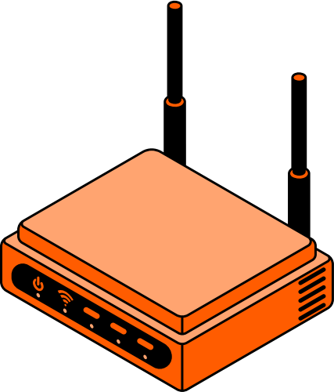
Serveri y'urubuga
Aderesi IP 192.168.1.20
Icuma ca HTTP: 80
Serveri y'urubuga rwo hanze
Aderesi IP 192.168.1.30
Icuma ca HTTP: 80
Serveri ya interineti
Aderesi IP 192.168.1.40
Icuma ca HTTP: 80
INTERNET
192.168.1.254
85.152.44.14
Irembo
(umurongozi canke uruhome rw'umuriro)
Mudasobwa y'ishirahamwe
192.168.1.201
Mudasobwa y'ishirahamwe
192.168.1.202
Ishirahamwe

Slide 26

eth0
eth1
ingwati0

Slide 27
00
1E
33
3B
5A
94
02
1E
33
FF
FE
3B
5A
94

Slide 28

Umutwe wa IPv6
Amahitamwo y'ugusimbuka ku gusimbuka - N bytes
Ubugyo
Uburebure
Umutwe ukurikira

Slide 29
Umutwe wa IPv6
Amahitamwo y'inzira - N bytes
Ubugyo
Uburebure
Igice
Umutwe ukurikira
Ubwoko

Slide 30
Umutwe wa IPv6
Amahitamwo yo guca ibice - 8 bytes
Indangamuntu
Vyabikiwe
Umutwe ukurikira
Gukuraho - ibice 13
Bibitswe - ibice 2
M - 1 gato

Slide 31
Umutwe wa IPv6
Ihitamwo ryo kwemeza - N bytes
SPI
Urutonde
ICV
Uburebure
Umutwe ukurikira
Vyabitswe

Slide 32
Umutwe wa IPv6
Ihitamwo ry'aho uja - N bytes
Ubugyo
Uburebure
Umutwe ukurikira

Slide 33


Slide 34


Slide 35


