Slide 1
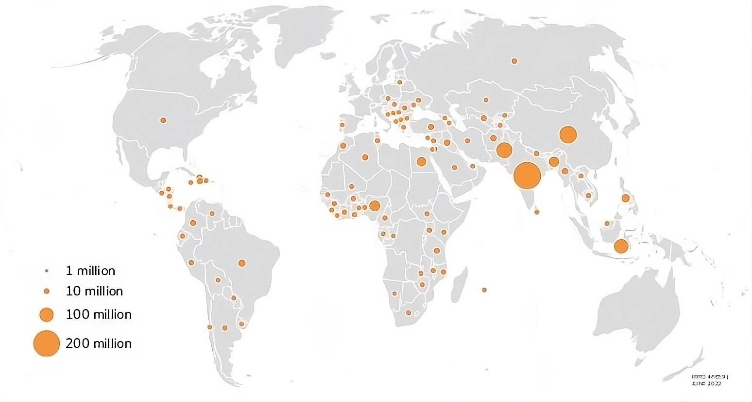
1 million
10 million
100 million
200 million

Slide 2
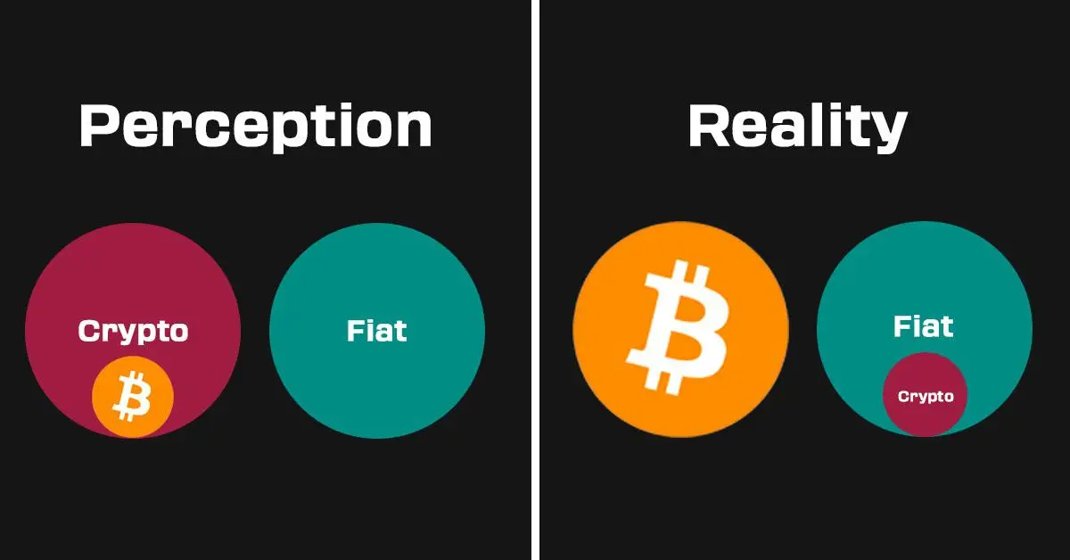
Perception
Reality

Slide 3


Slide 4


Slide 5


Slide 6
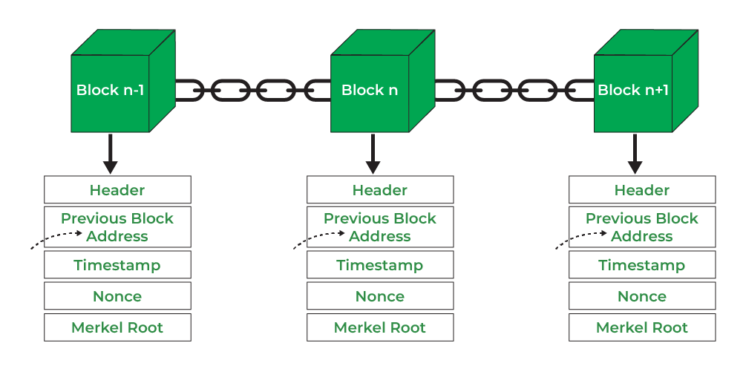

Slide 7

Usability
Security

Slide 8


Slide 9


Slide 10
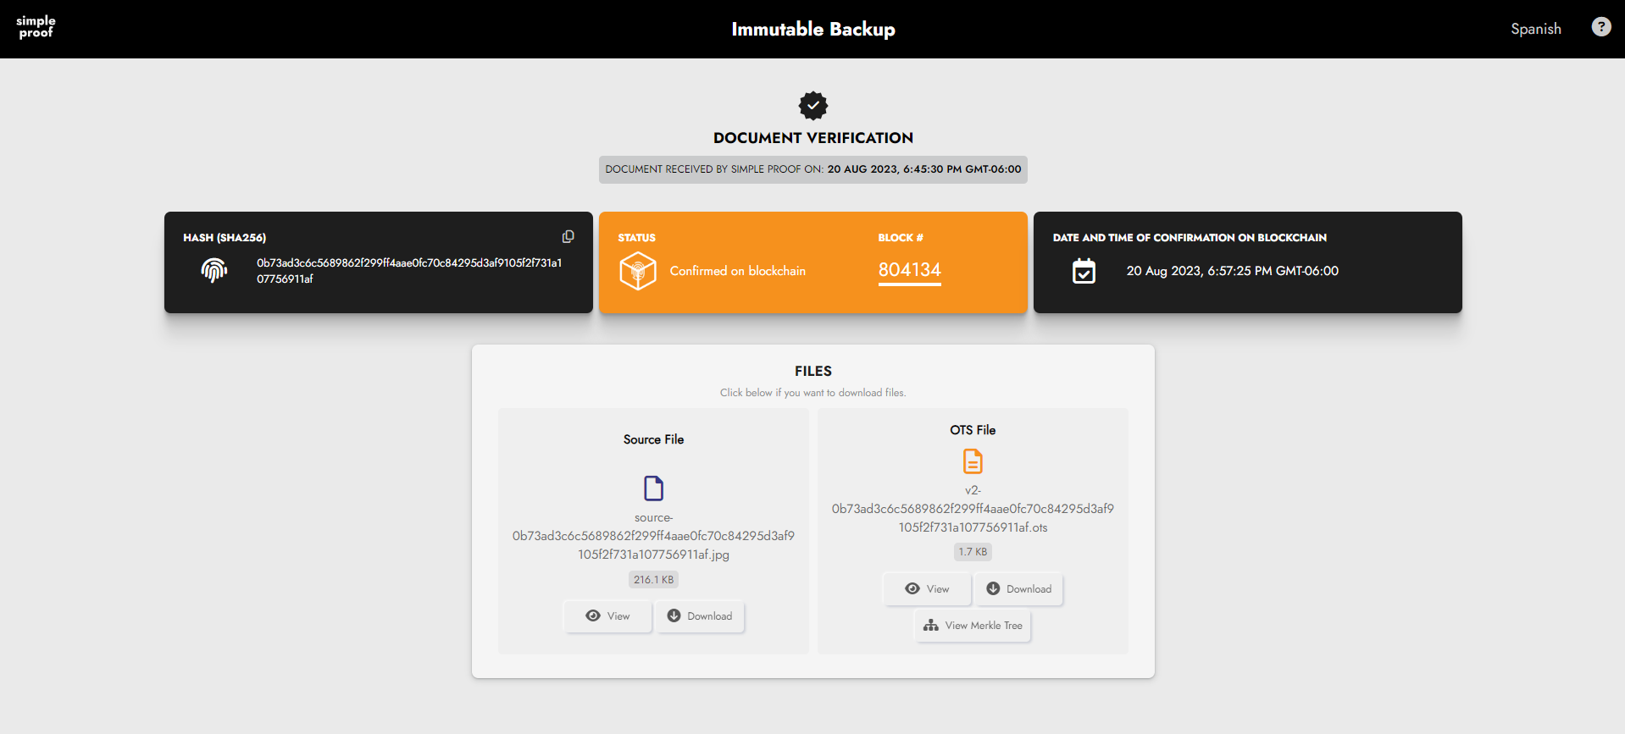

Slide 11


Slide 12


Slide 13
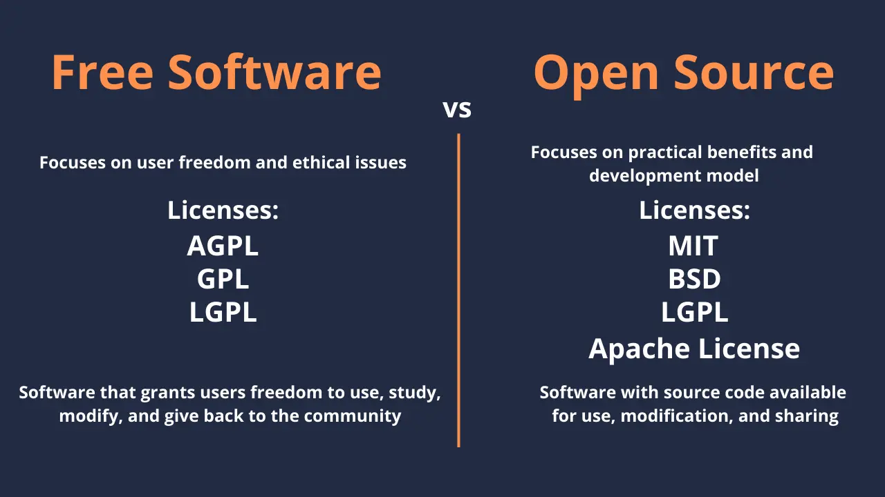
Free Software
Open Source
Focuses on user freedom and ethical issues
Focuses on practical benefits and development model
Licenses:
Licenses:
Licenses:
Software that grants users freedom to use, study, modify, and give back to the community
Software with source code available for use modification, and sharing

Slide 14
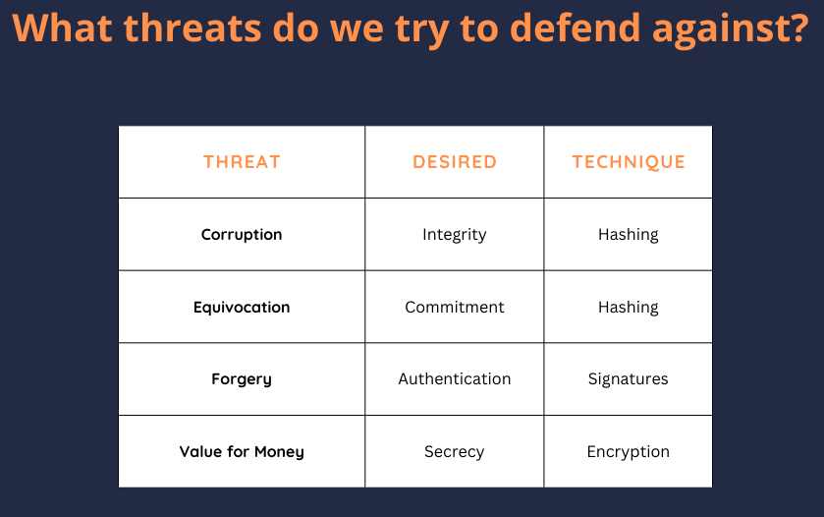
What threats do we try to defend against?
THREAT
DESIRED
TECHNIQUE
Corruption
Integrity
Hashing
Equivocation
Commitment
Hashing
Forgery
Authentication
Signatures
Value for Money
Secrecy
Encryption

Slide 15
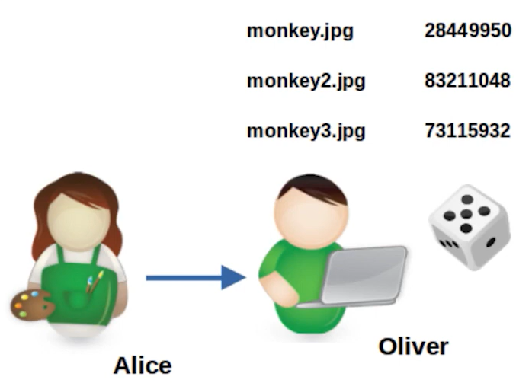

Slide 16
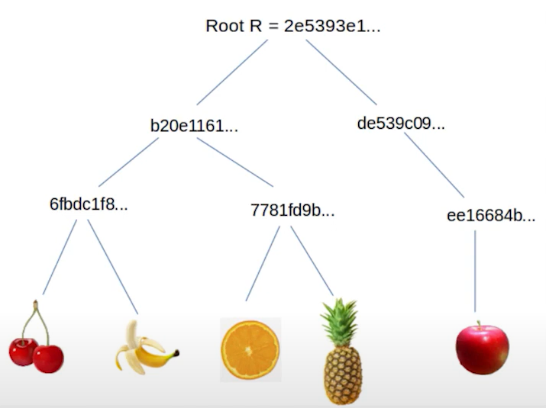

Slide 17
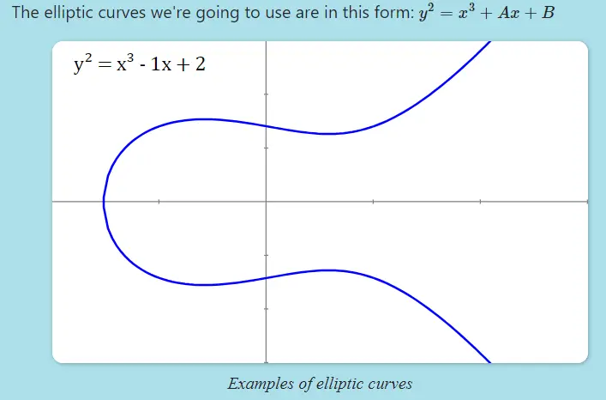
The elliptic curves we’re going to use are in this form:
Examples of elliptic curves

Slide 18
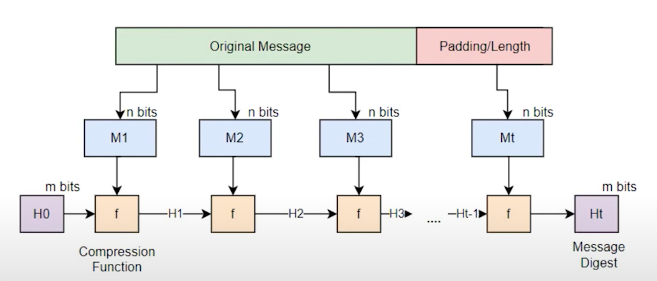
Original Message
Padding/Length
Compression
Function
Message
Digest

Slide 19
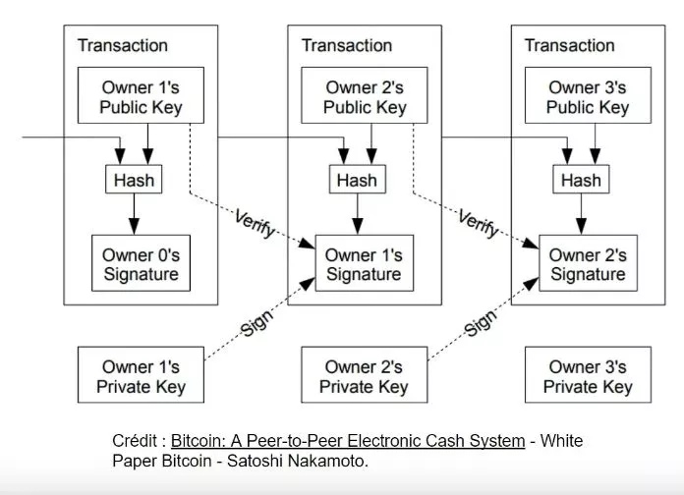
Transaction
Transaction
Transaction
Owner 1’s
Public Key
Owner 2’s
Public Key
Owner 3’s
Public Key
Owner 0’s
Signature
Owner 1’s
Signature
Owner 2’s
Signature
Owner 1’s
Private Key
Owner 1’s
Private Key
Owner 1’s
Private Key

Slide 20
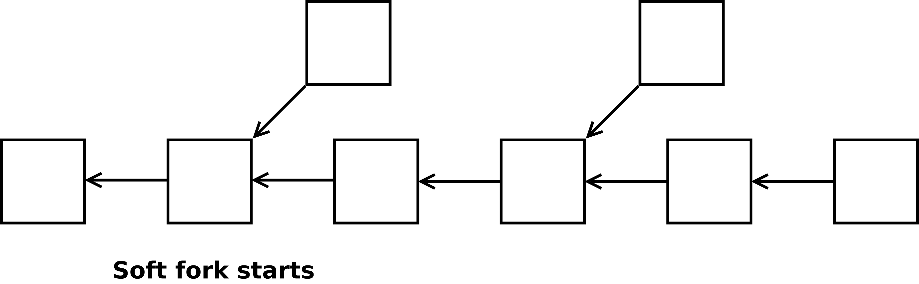
Soft fork starts

Slide 21
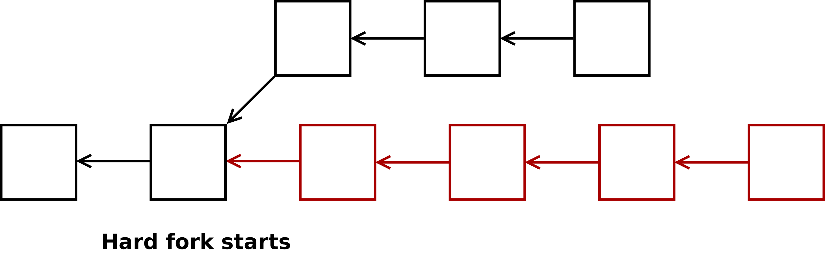
Hard fork starts

Slide 22


Slide 23
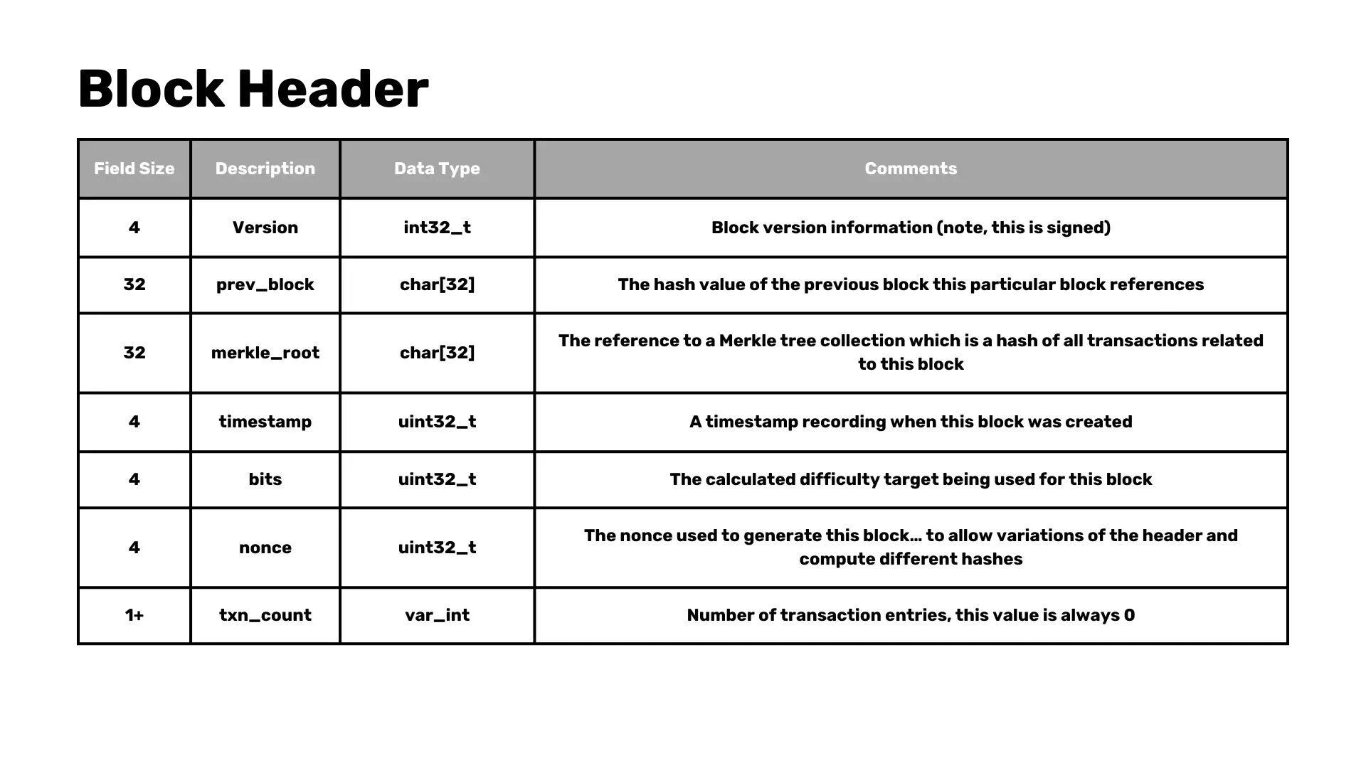
Field Size
Description
Data Size
Comments
Block version information (note, this is signed)
The hash value of the previous block this particular block references
The reference to a Merkle tree collection which is a hash of all transactions related to this block
A timestamp recording when this block was created
The calculated difficulty target being used for this block
The nonce used to generate this block… to allow variations of the header and compute different hashes
Number of transactions entries, this value is always 0

Slide 24
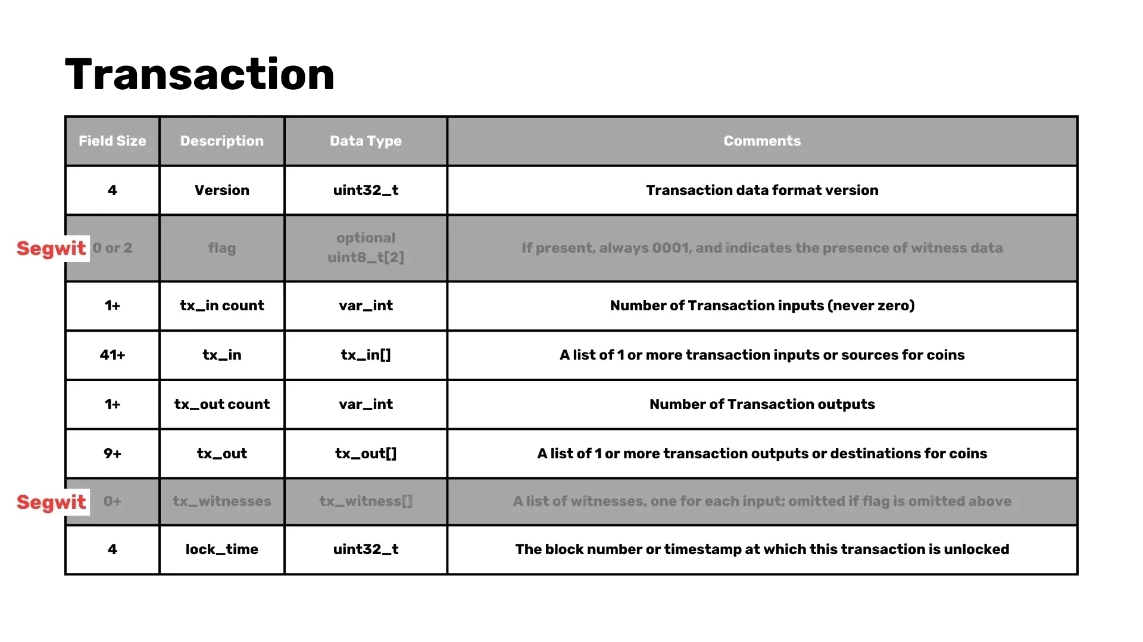
Field Size
Description
Data Size
Comments
Transaction data format version
If present, always 0001, and indicates the presence of witness data
Number of Transaction inputs (never zero)
A list of 1 or more transaction inputs or sources for coins
Number of Transaction outputs
A list of 1 or more transaction outputs or destinations for coins
A list of witnesses, one for each input; omitted if flag is omitted above
The block number or timestamp at which this transaction is unlocked

Slide 25
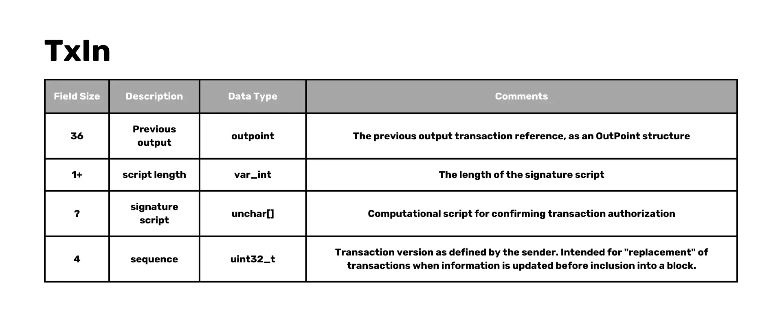
Field Size
Description
Data Size
Comments
The previous output transaction reference, as an OutPoint structure
The length of the signature script
Computational script for confirming transaction authorization
Transaction version as defined by the sender, Intended for “replcement” of transactions when information is updated before inclusion into a block.

Slide 26
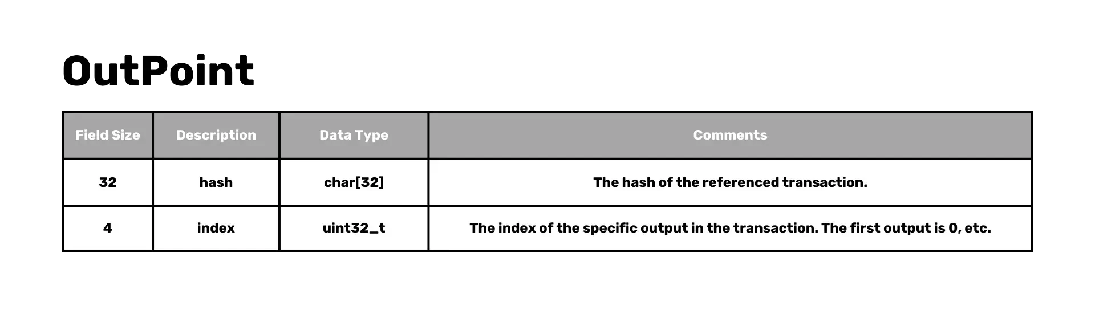
Field Size
Description
Data Size
Comments
The hash of the referenced transaction.
The index of the specific output in the transaction. The first output is 0, etc.

Slide 27
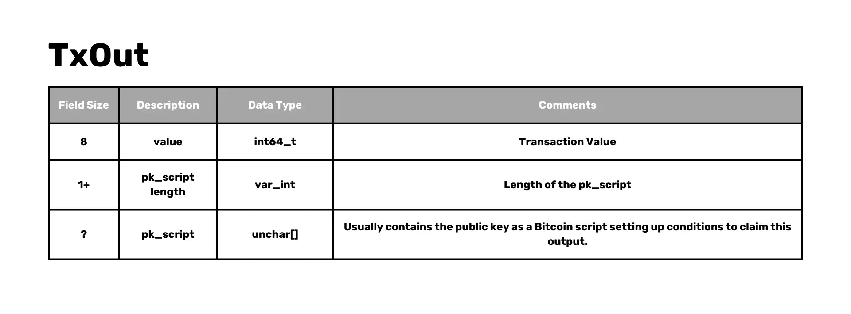
Field Size
Description
Data Size
Comments
Transaction Value
Length of the pk_script
Usually contains the public key as a Bitcoin script setting up conditions to claim this output.

Slide 28
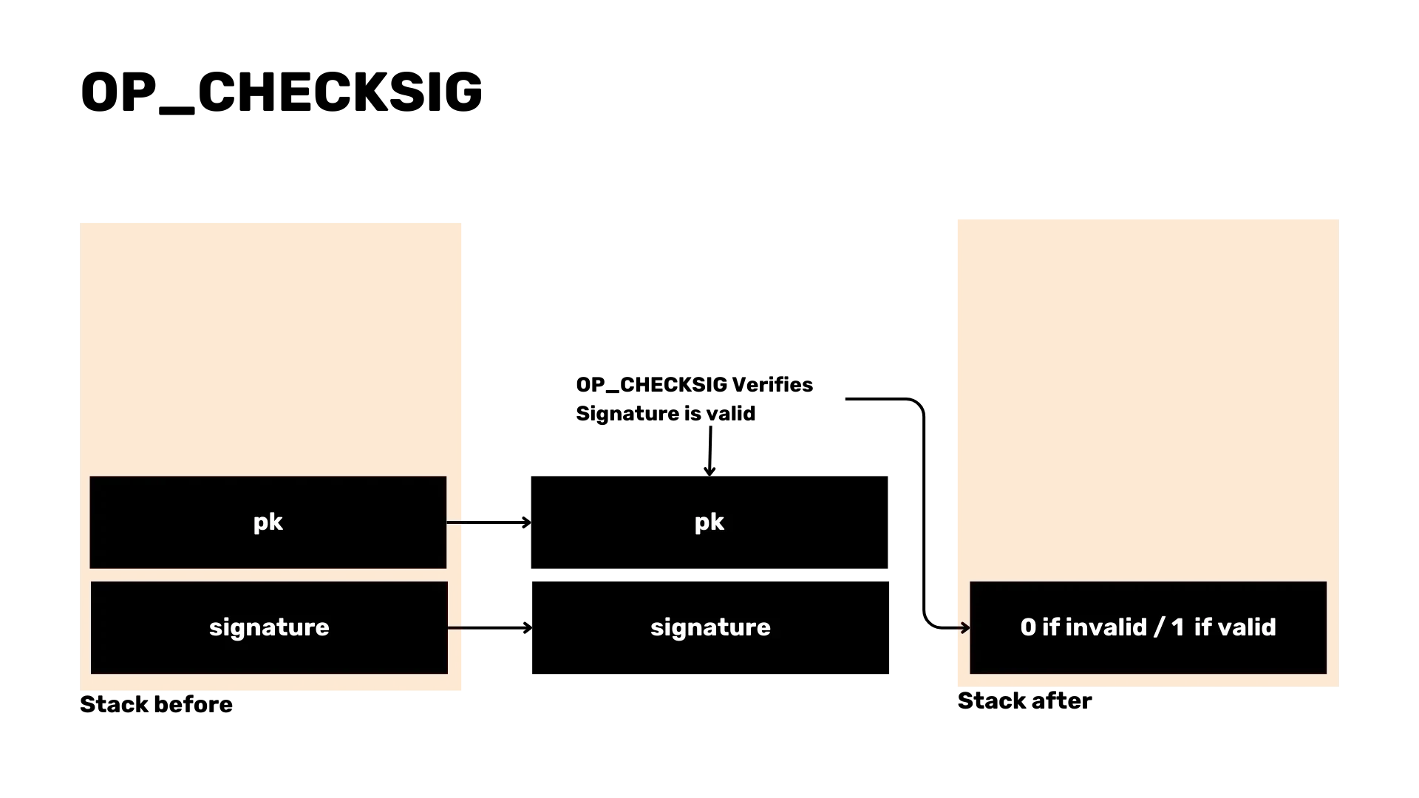
OP_CHECKSIG Verifies Signature is valid

Slide 29
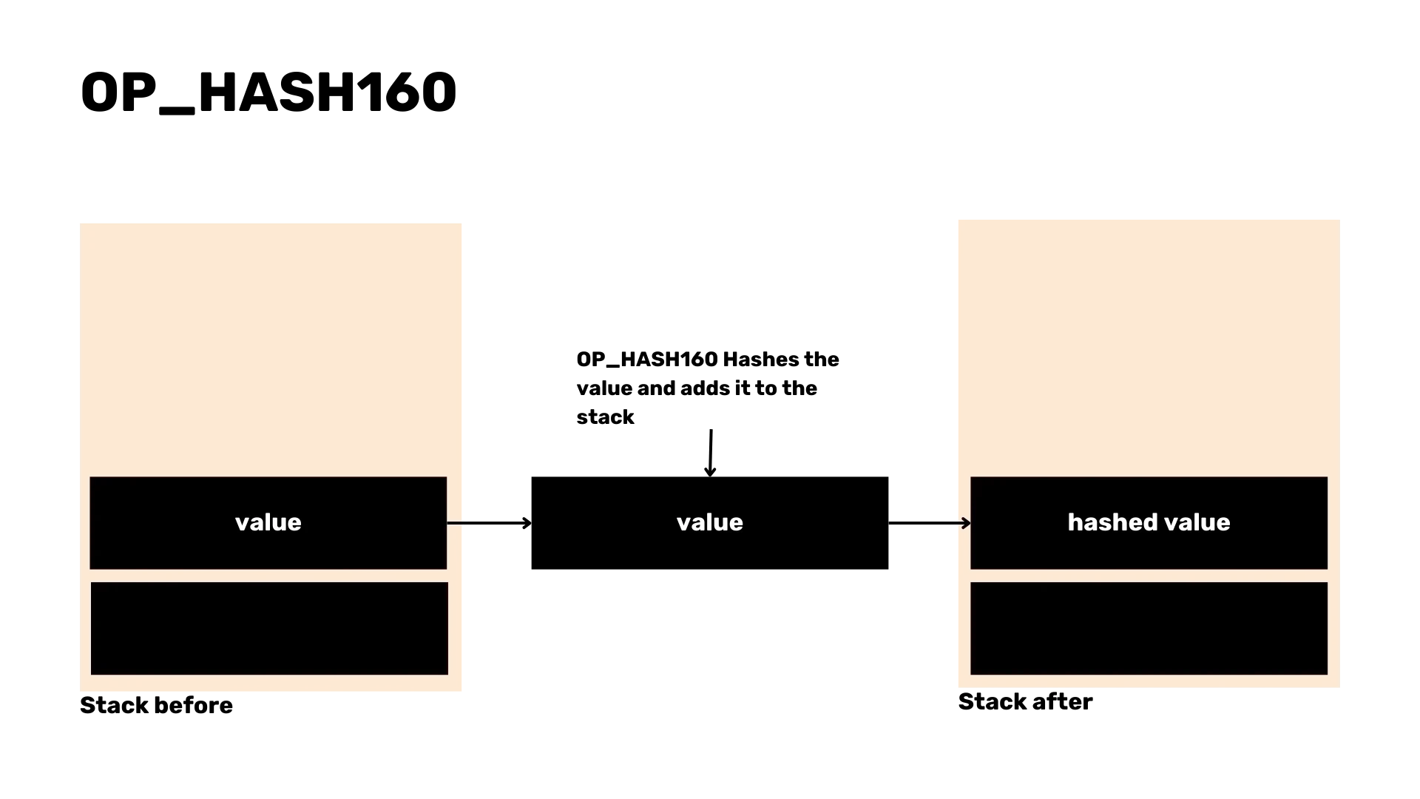
OP_HASH160 Hashes the value and adds it to the stack

Slide 30
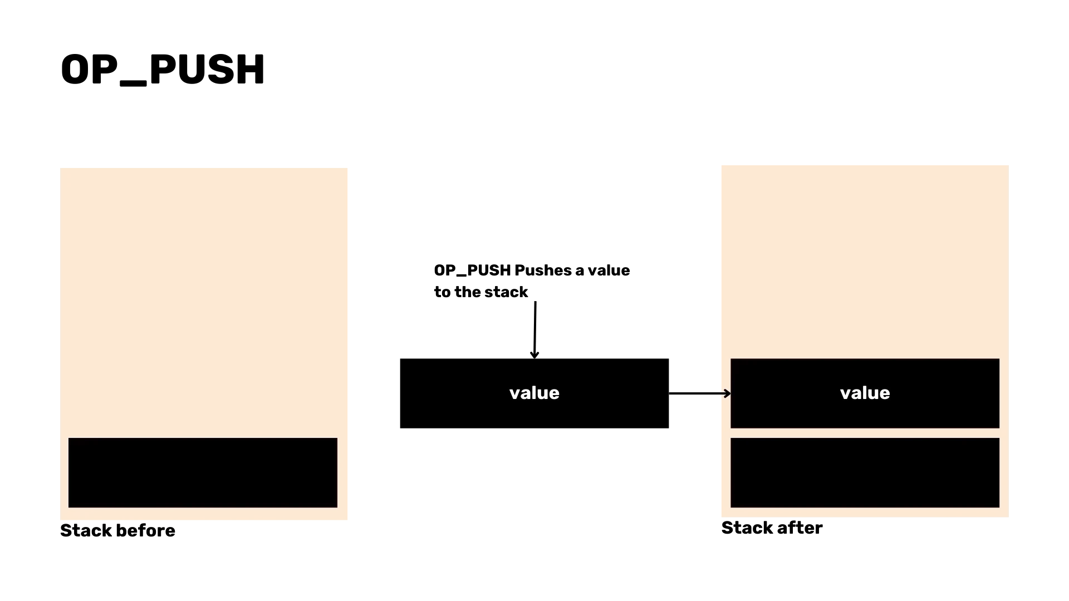
OP_PUSH Pushes a value to the stack

Slide 31


Slide 32
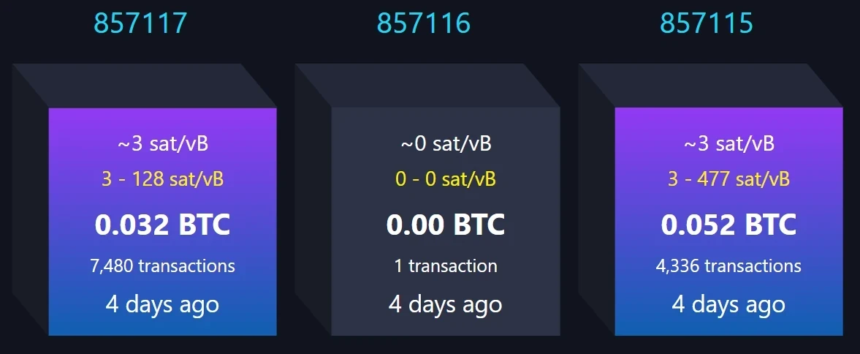

Slide 33
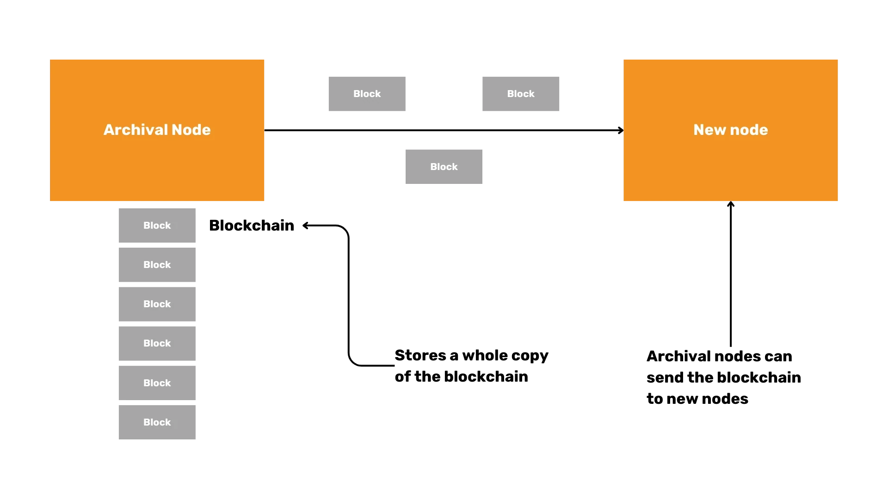
Stores a whole copy of the blockchain
Archival nodes can send the blockchain to new nodes

Slide 34
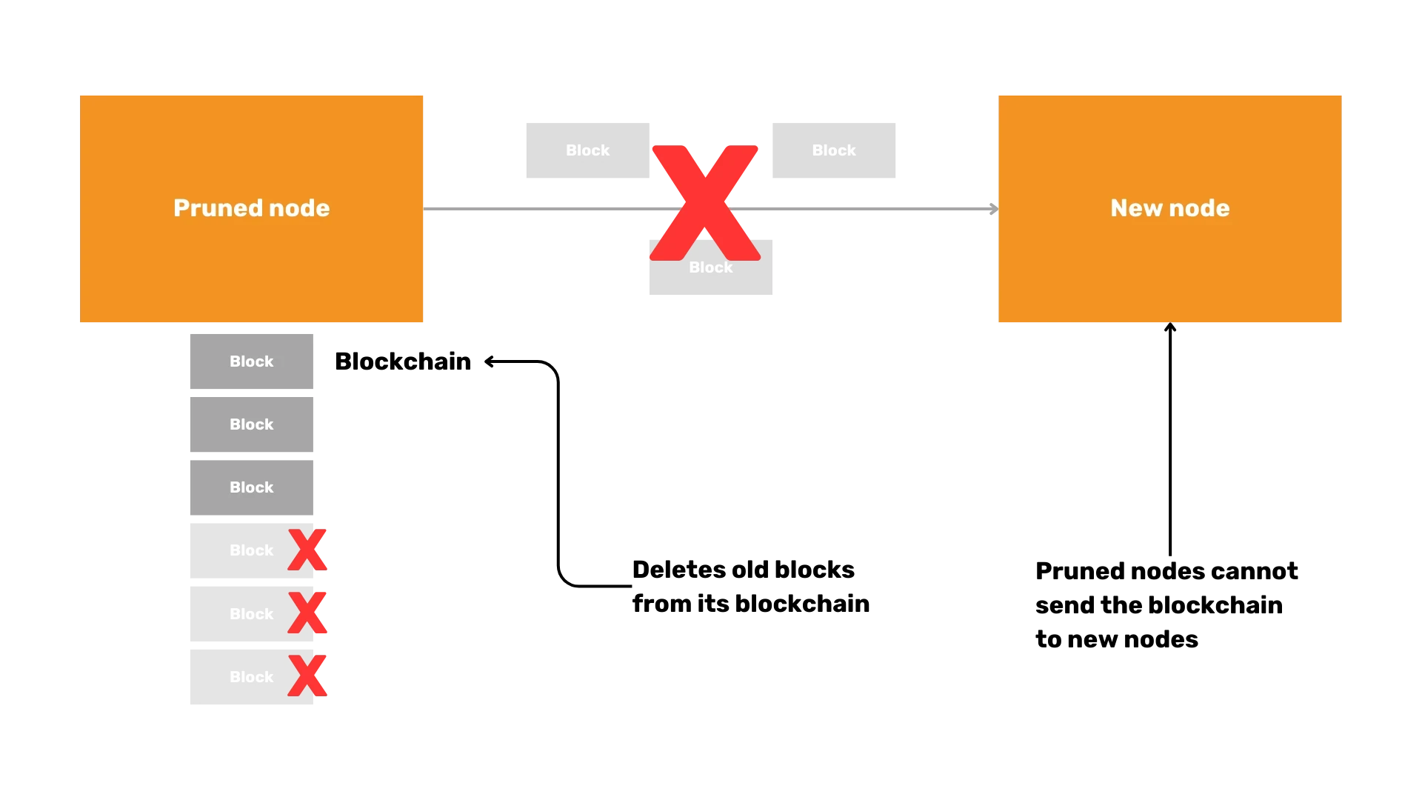
Deletes old blocks from its blockchain
Pruned nodes cannot send the blockchain to new nodes

Slide 35
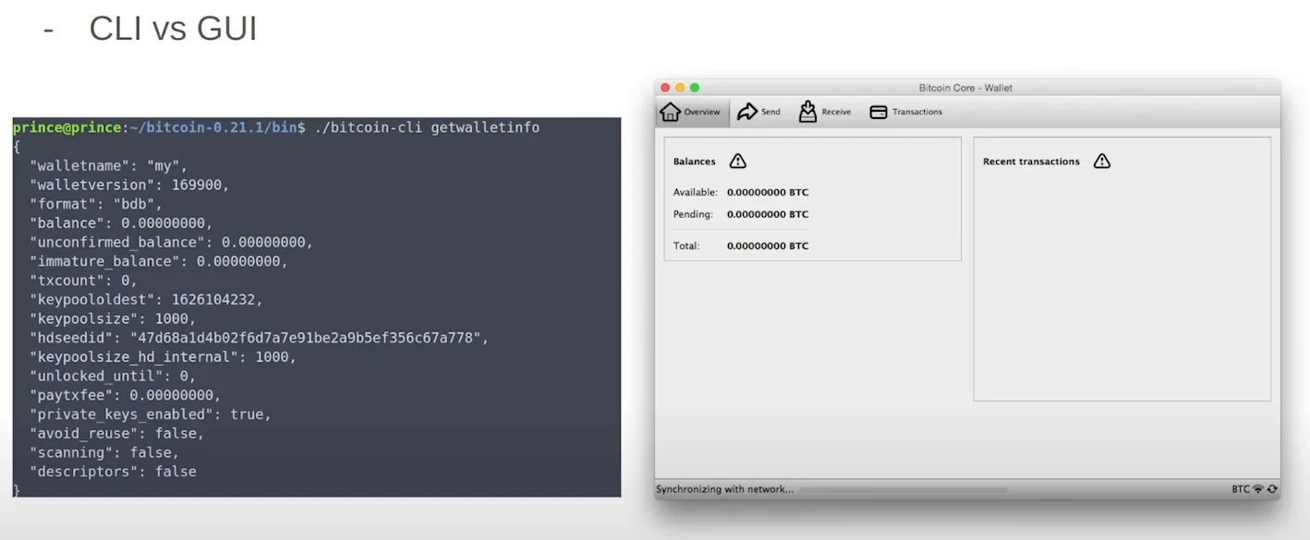

Slide 36
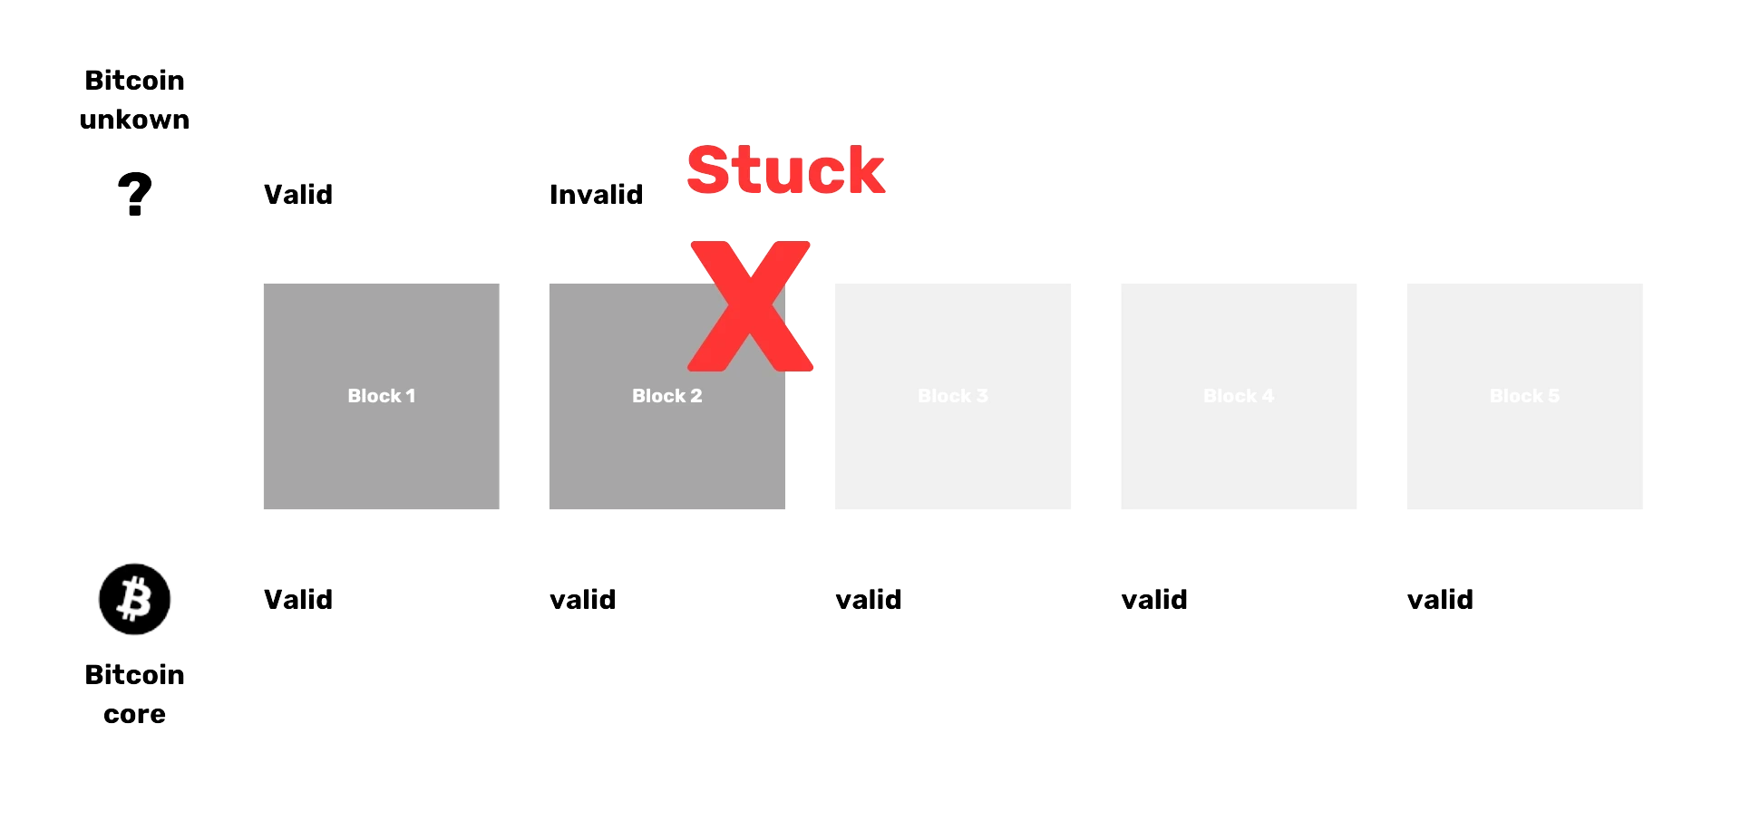

Slide 37
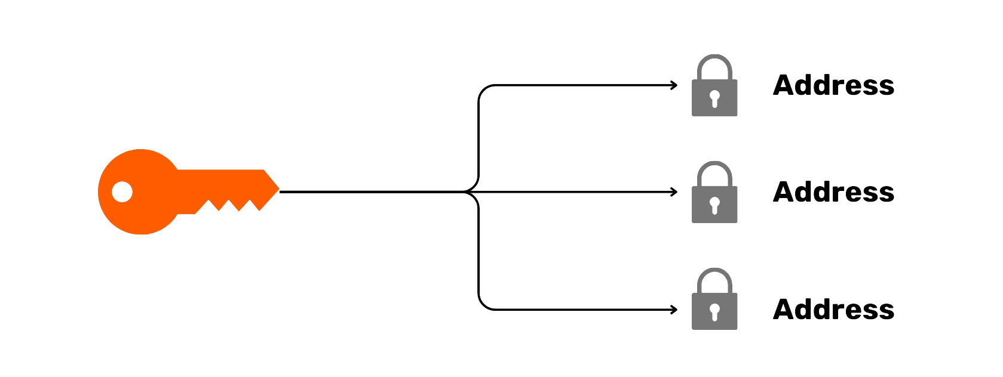
Address
Address
Address

Slide 38
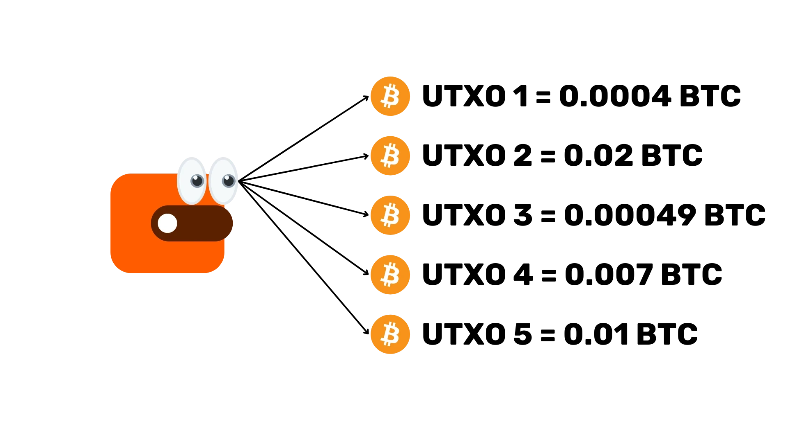

Slide 39
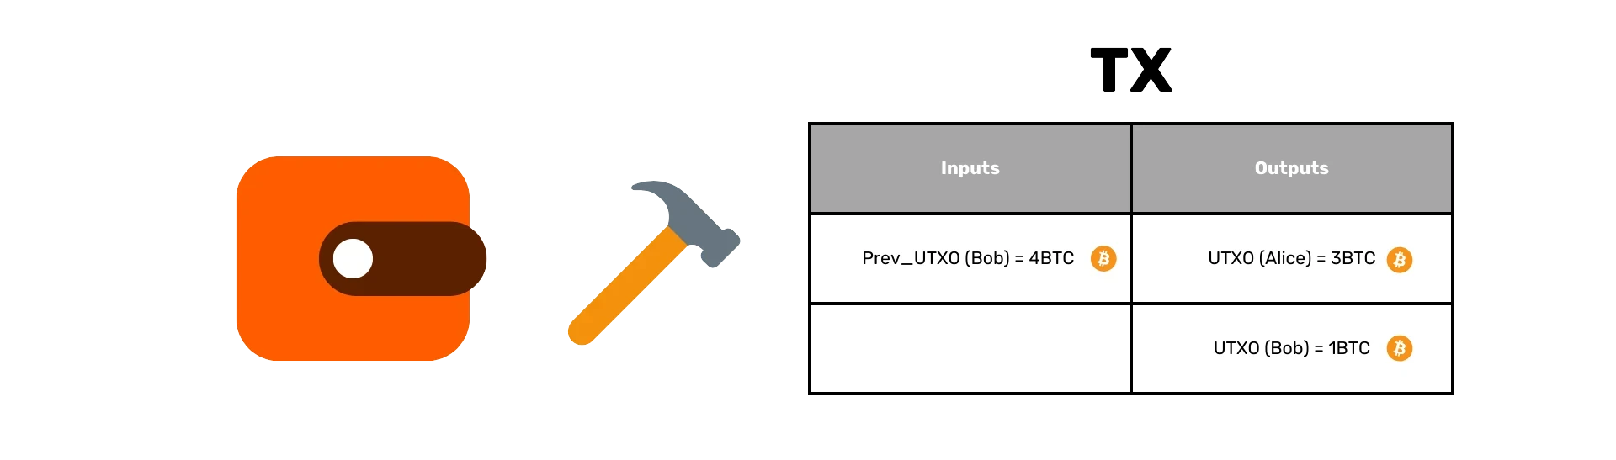

Slide 40
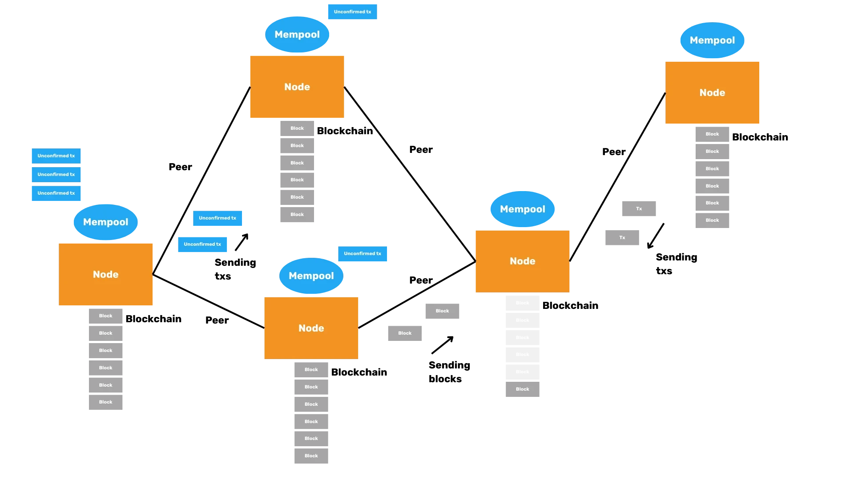

Slide 41
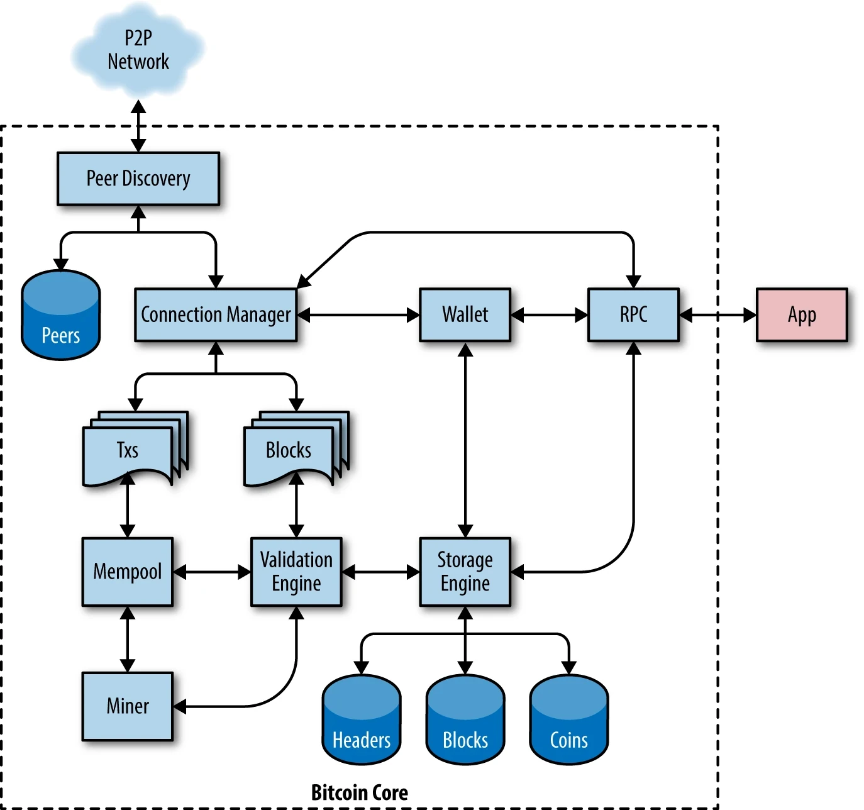

Slide 42
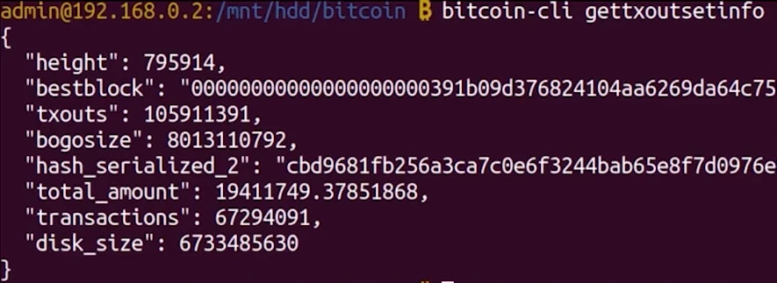

Slide 43
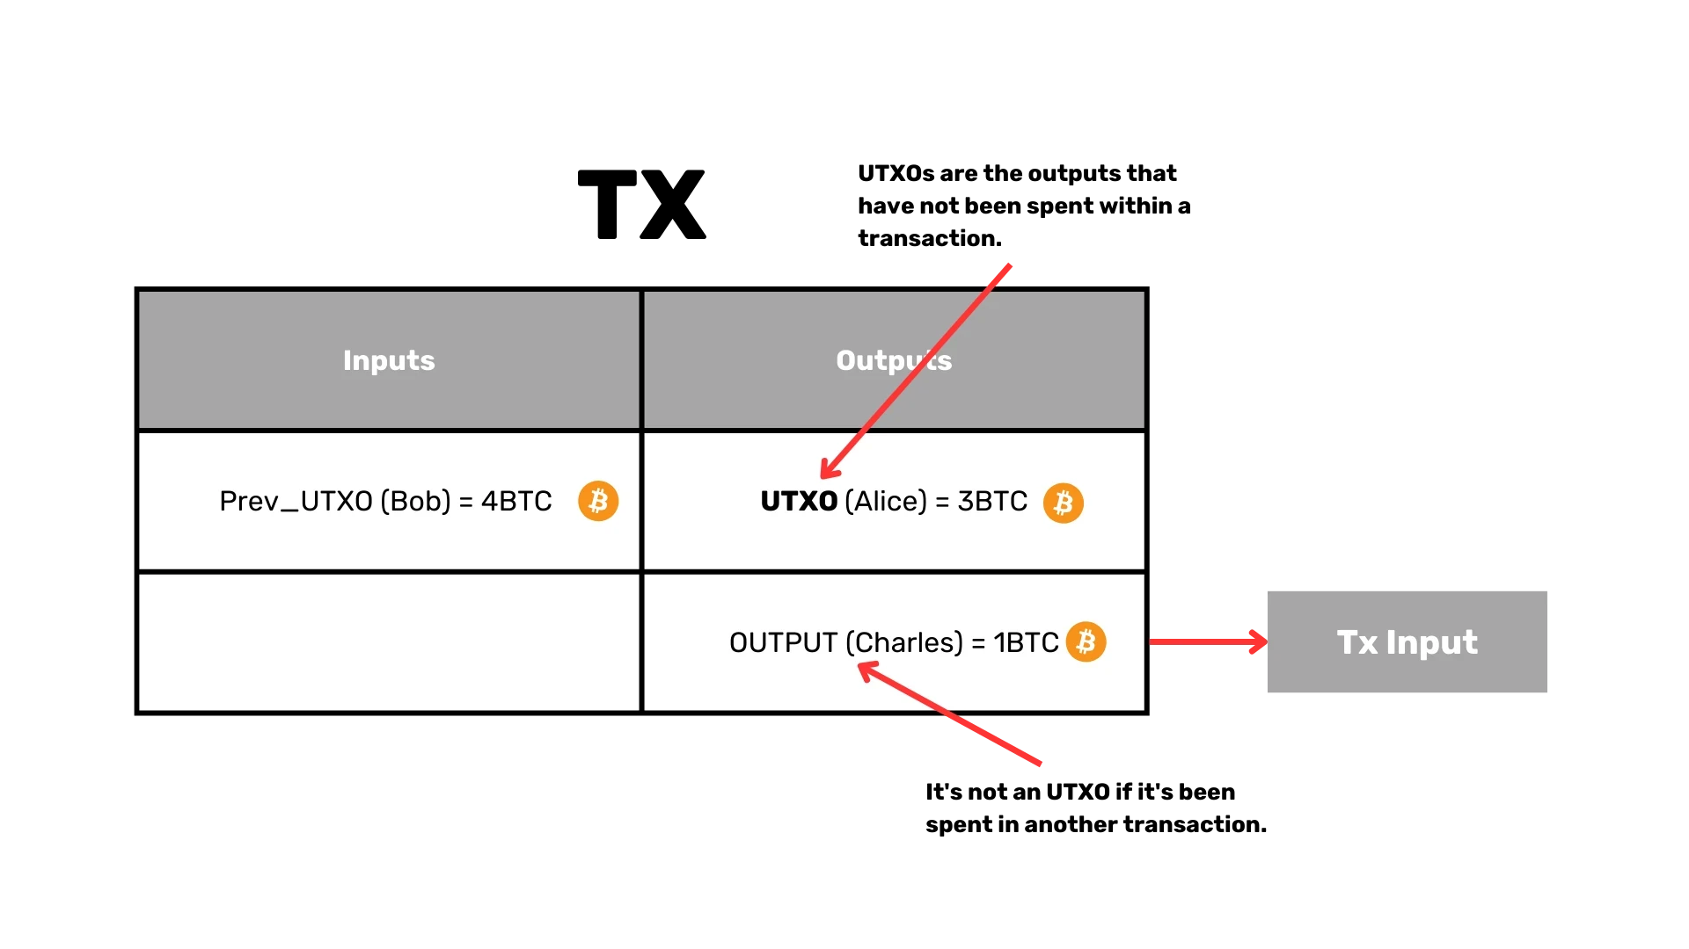
UTXOs are the outputs that have not been spent within a transaction
It's not an UTXO if it's been spent in another transaction

Slide 44
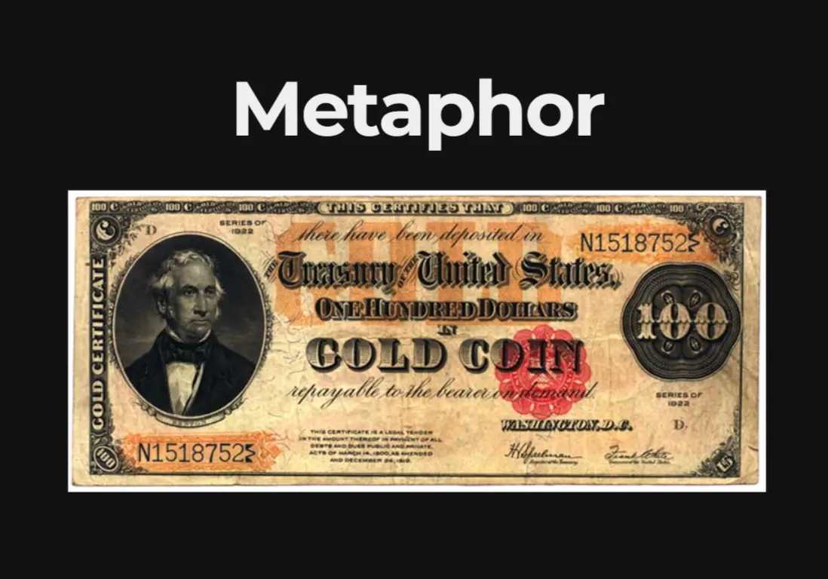

Slide 45
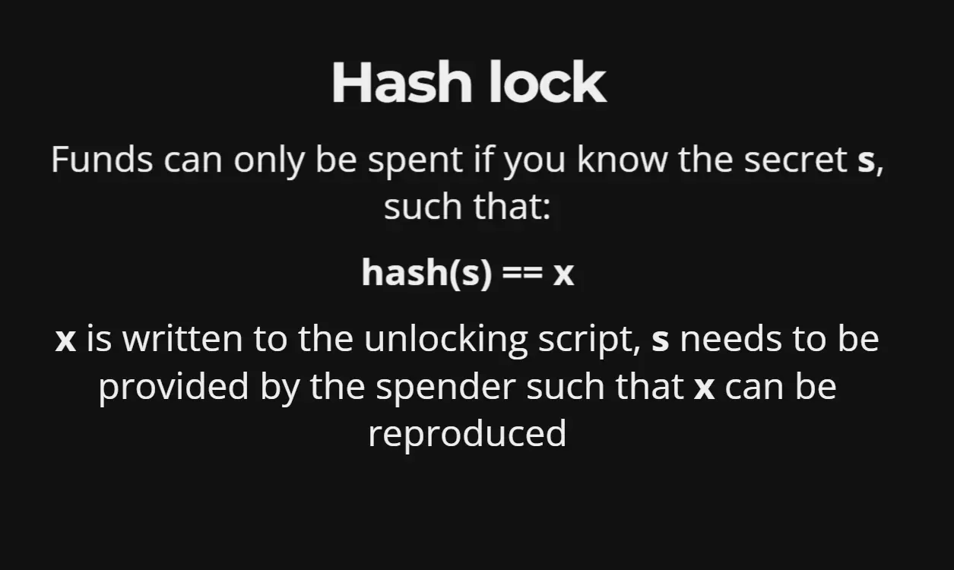
Funds can only be spent if you know the secret s, such that:
x is written to the unlocking script, s needs to be provided by the spender such that x can be produced

Slide 46

Combine restrictions

Slide 47
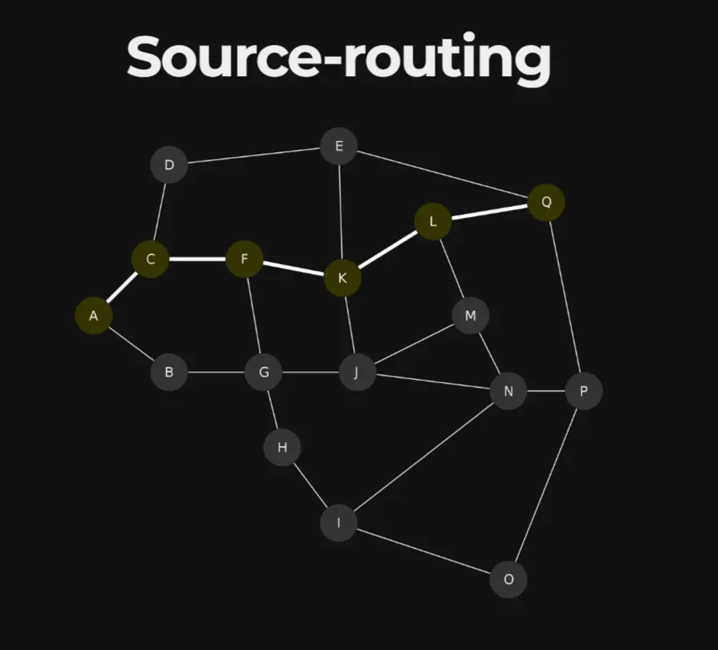
Source-routing

Slide 48
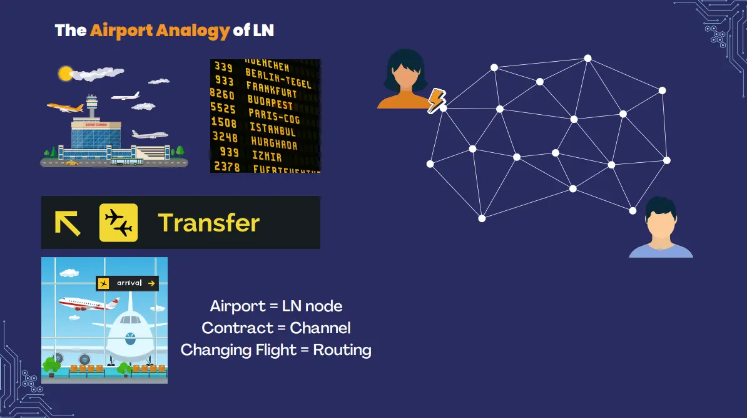
The Airport Analogy of LN
Airport = LN node
Contract = Channel
Changing Flight = Routing

Slide 49
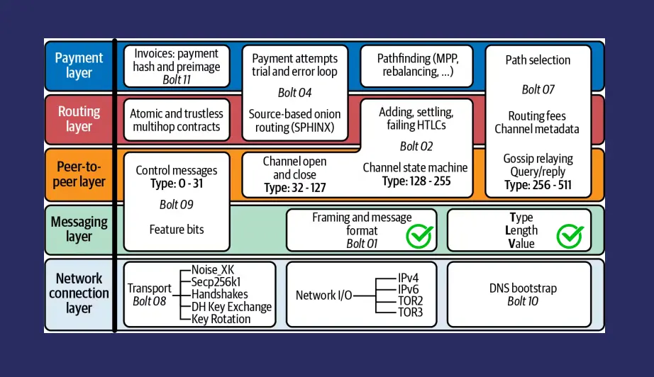

Slide 50
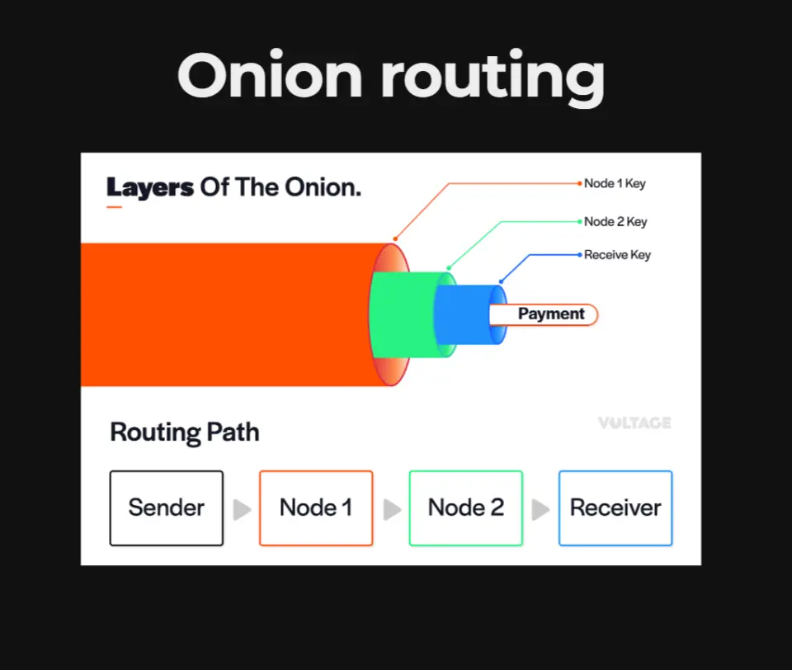
Onion routing
Layers Of The Onion.
Payment
Routing Path
Sender
Receiver

Slide 51
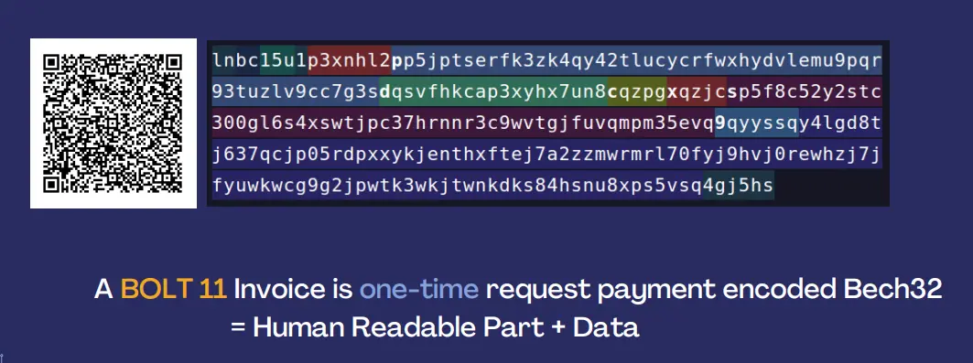
A BOLT 11 Invoice is one-time request payment encoded Bech32 = Human Readable Part + Data

Slide 52
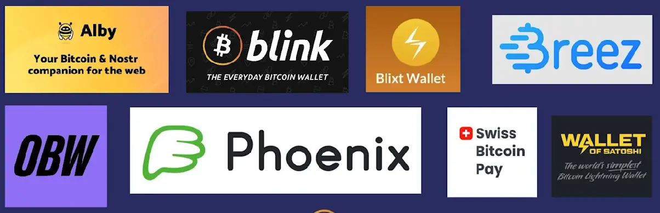

Slide 53
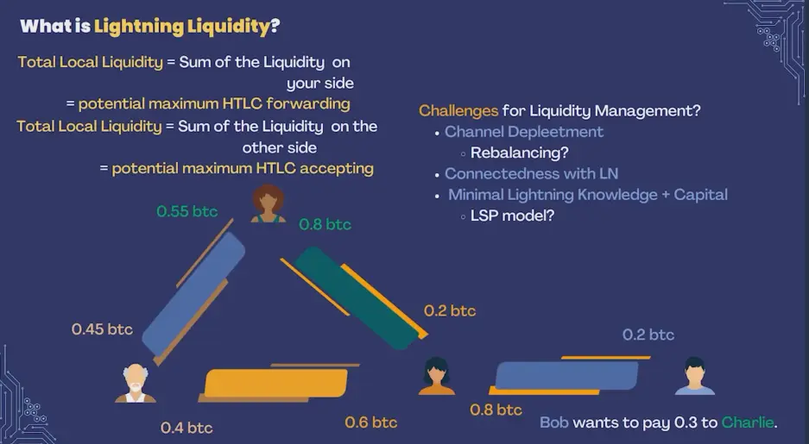
What is a Lightning Liquidity?
Total Local Liquidity = Sum of the Liquidity on your side = potential maximun HTLC forwarding
Total Local Liquidity = Sum of the Liquidity on the other side
= potential maximum HTLC accepting
Challenges for Liquidity Management?
Channel Depleetment
Rebalancing?
Connectedness with LN
Minimal Lightning Knowledge + Capital
LSP model?

Slide 54
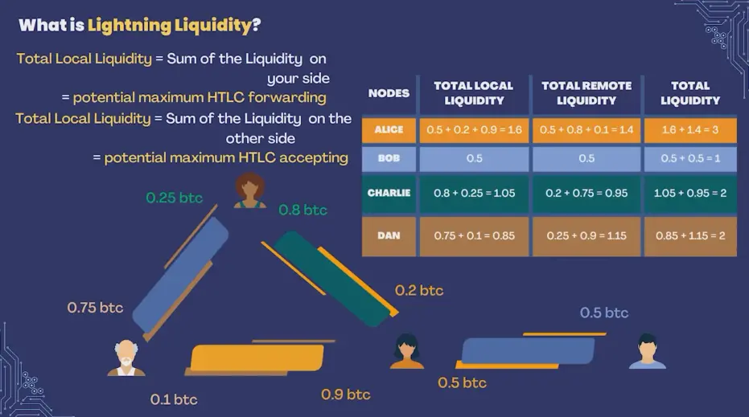
What is a Lightning Liquidity?
Total Local Liquidity = Sum of the Liquidity on your side = potential maximun HTLC forwarding
Total Local Liquidity = Sum of the Liquidity on the other side
= potential maximum HTLC accepting

Slide 55
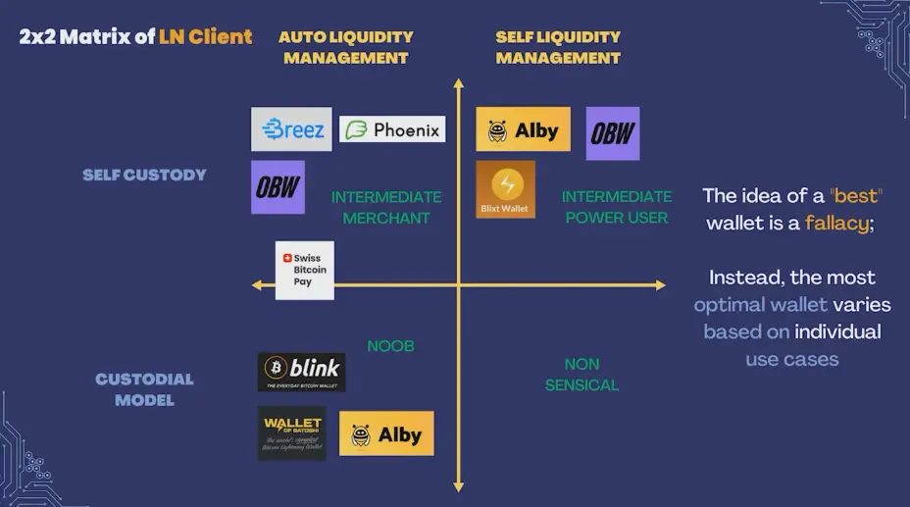
AUTO LIQUIDITY
MANAGEMENT
SELF LIQUIDITY
MANAGEMENT
The idea of a “best”
Wallet is a fallacy;
INTERMEDIATE
MERCHANT
INTERMEDIATE POWER USER
Instead, the most optimal wallet varies based on individual use cases
NOOB
NON
SENSICAL

Slide 56


Slide 57
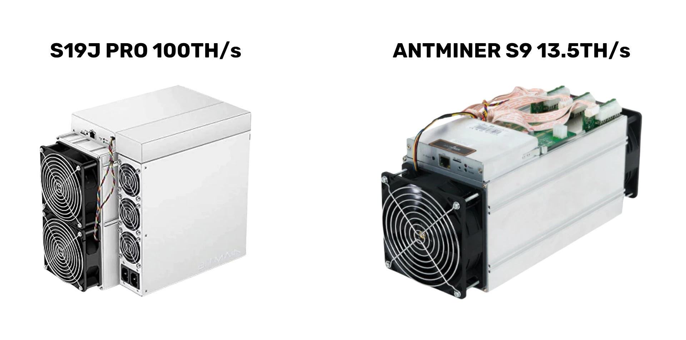

Slide 58
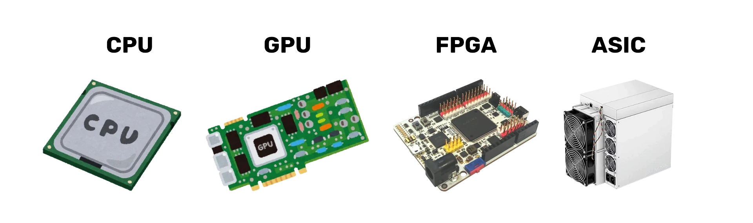

Slide 59
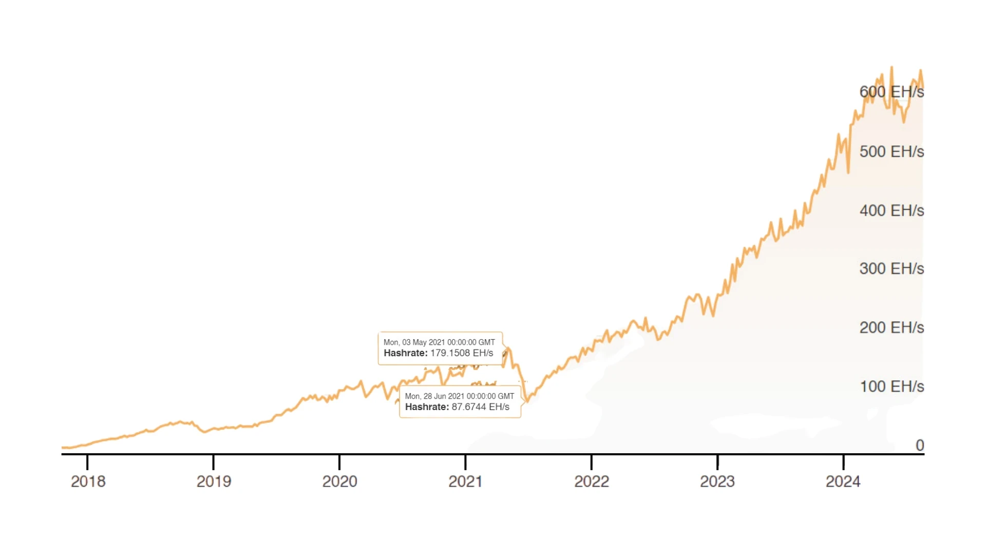

Slide 60
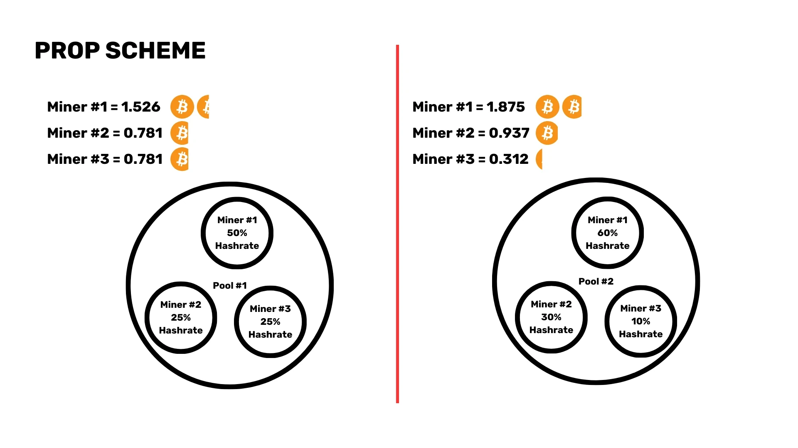
PROP SCHEME

Slide 61
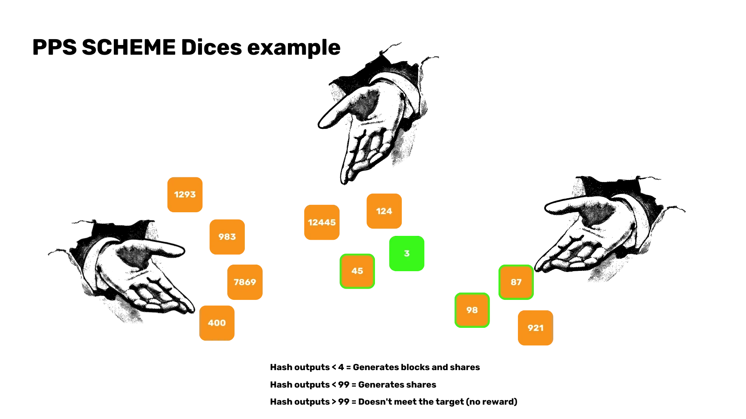
PROP SCHEME Dices example
Hash outputs <4 = Generates blocks and shares
Hash outputs < 99 = Generates shares
Hash outputs < 99 = Does not meet the target (no reward)

