Slide 1
Smart Energy and Overcurrent Management System
Smart Load Reduction Using AI
Presented by: Roaa Darwish, Fatima Fakih
Presented for: Dr. Muhammad AOUDE

Slide 2
Contents
1. Introduction
2. Problem Statement
3. System Overview
4. Key Functionalities
5. Circuit Diagram
6. Machine Learning Integration
7. Database
8. Deployment with Uvicorn
9. Python Virtual Environment
10. Challenges Faced
11. Future Work
12. Conclusion

Slide 3
Introduction
- Rising demand for smart energy usage in homes and facilities
- Our system monitors and manages circuit loads
- Acts preemptively before main breaker trips

Slide 4
Problem Statement
- Traditional breakers act only after fault
- No intelligence in load reduction
- Our solution:
- Real-time monitoring
- Load classification
- Smart shutdown of low-priority loads

Slide 5
System Overview (Hardware)
Hardware:
- Arduino Uno
- INA219 Sensors (4x)
- Relay Modules (4-channel)
- NPN Transistors, Resistors
- Load Simulators
- Proteus for simulation
Software Used:
- Python 3, SQLite
- Scikit-learn (ML)
- Rule-based Agent
The system uses both traditional AI techniques (rule-based and decision tree classification) and can be extended with generative AI for natural language interfaces or automatic reporting.
We integrated a lightweight local Large Language Model (LLM) using Ollama.

Slide 6
Data Flow
1. INA219 sensors collect data
2. Arduino sends data to Python
3. Python logs to SQLite
4. AI agent decides shutdown actions

Slide 7
Key Functionalities
- Data Logging: Voltage, current, power readings
- Circuit Classification: Rule-based and ML
- AI Agent: Prevents overload by switching off non-critical circuits

Slide 8
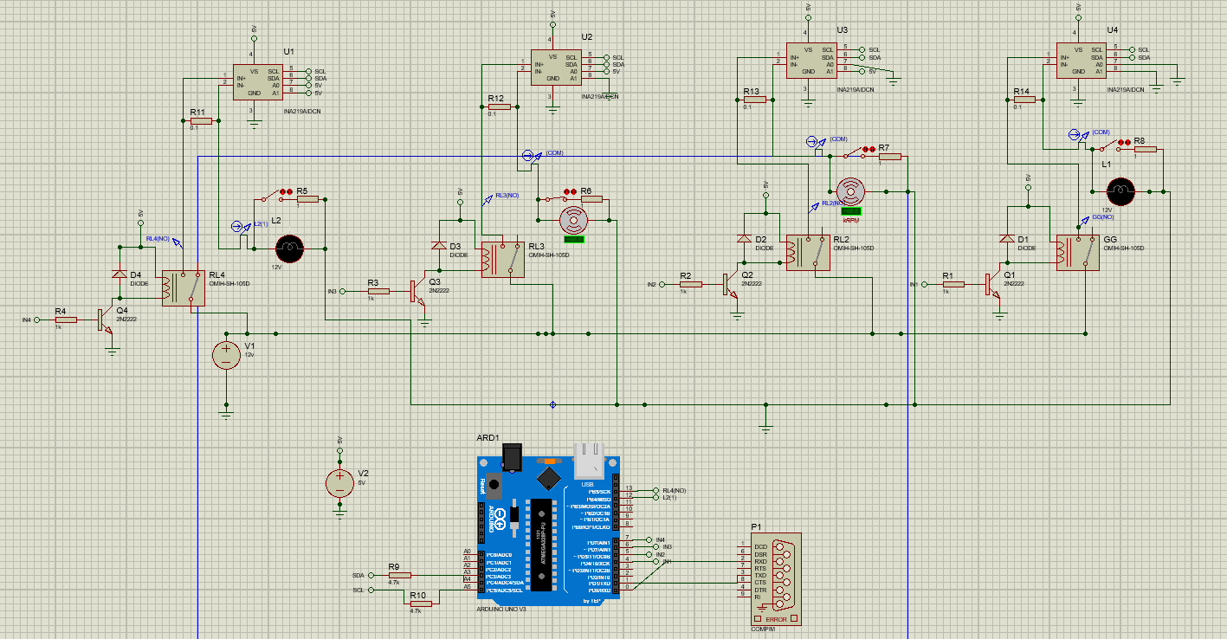
Circuit Diagram

Slide 9
Machine Learning Integration
Features
Priority
Criticality
Running time
Temperature
Avg/Max consumption
- Trained decision tree model
- Based on UK-DALE dataset
- Performed data cleaning and feature engineering

Slide 10
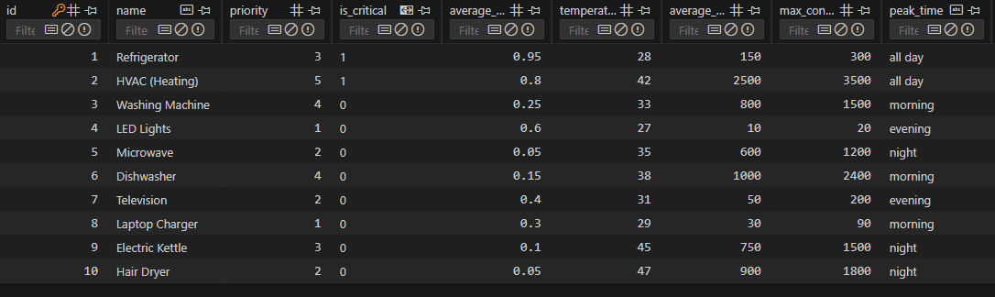
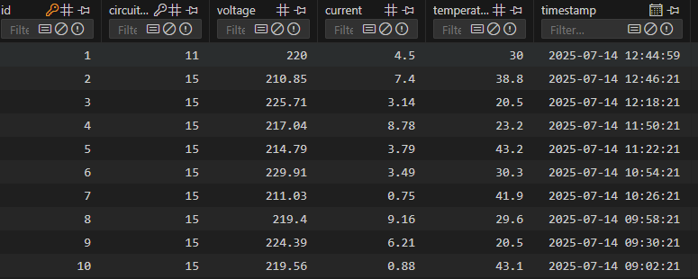
Database Design
- Circuits Table: Stores features, IDs
- Sensor Readings: Logs real-time data
- Observation: Temporary table for new circuits

Slide 11
Deployment with Uvicorn
- FastAPI used as backend
- Uvicorn = Fast ASGI server
- Benefits:
- High speed
- Async handling
- Easy to run: `uvicorn main:app --reload`

Slide 12
Python Virtual Environment
- Clean package management
- Steps:
- `python -m venv env`
- `source env/bin/activate`
- `pip install -r requirements.txt`
- Dependencies:
- fastapi, uvicorn, pyserial, sklearn, pandas, sqlite3

Slide 13
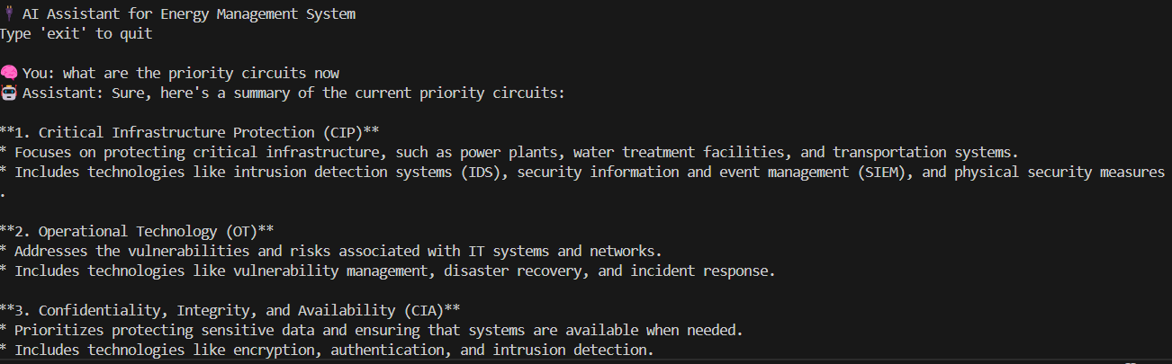
Generative AI Assistant Integration
To extend the intelligence and usability of our AI-Controlled Energy Management and Overcurrent Protection System, we integrated a lightweight local Large Language Model (LLM) using Ollama. This enabled us to add natural language interaction to the system through a simple command-line assistant powered by the Gemma 2B model.

Slide 14
Challenges Faced
- Limited INA219 sensors
- Arduino-Python link via Proteus COM
- Sensor saturation with high current
- Lack of national-level appliance data

Slide 15
Future Work
- Build live GUI dashboard
- Add mobile alerts + remote control
- Suggest energy-saving actions
- Use more sensors and real-time alerts

Slide 16

Conclusion
- AI-based system enhances energy efficiency
- Reduces risk of overloads
- Supports smarter, sustainable homes
- A solid foundation for future IoT-based power management

Slide 17
Thank You
Questions?

