Slide 1
Mockup guide:
If things aren’t highlighted, they are aspects of the software. Things that are highlighted will not show up in the software.
Things that are highlighted yellow are comments / explanations.
Things that are highlighted cyan are what pages each things go to (e.g., if there's a button and a 17 next to it, pressing that button would take you to page 17.)
The number highlighted in purple is the page number.

Slide 2
Flappy Plane
2
Play
5
Controls
4
Credits
3
Quit
Closes the software
Disappears after a button is pressed
Control using arrow keys and Space or Enter!

Slide 3
3
Credits
Osha
Enda
Jaxon
Special thanks to You for playing our game!

Slide 4
Controls
4
If you want to change them, select them, then press your new keybinding
Up – Up Arrow
Down – Down arrow
Left – Left arrow
Right – Right arrow
REST TO DEFAULTS

Slide 5
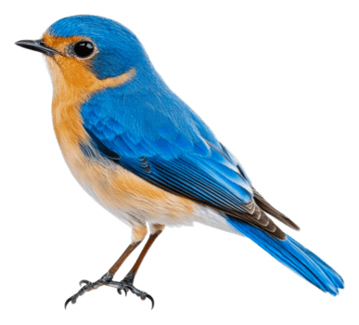
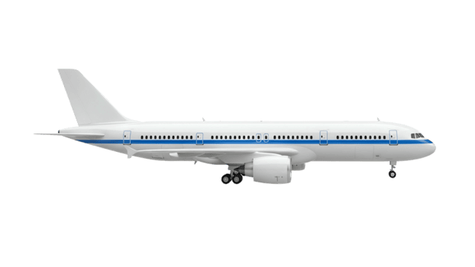
Tutorial
5
Fly around using [Controls] to doge birds and planes,
Try to last as long as you can!
Press enter to begin!
6

Slide 6
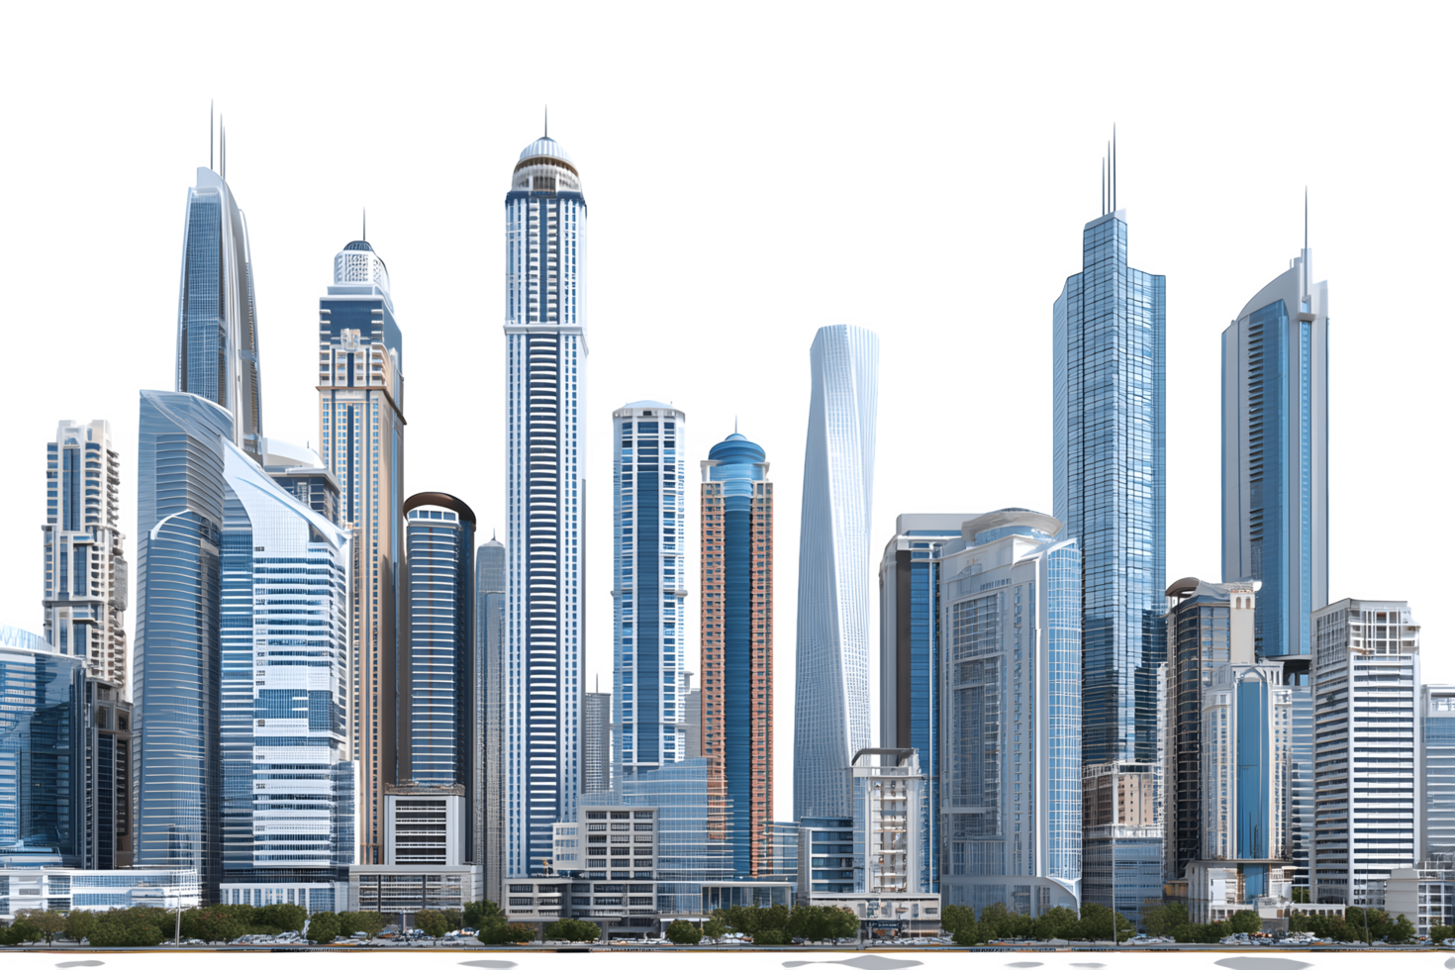
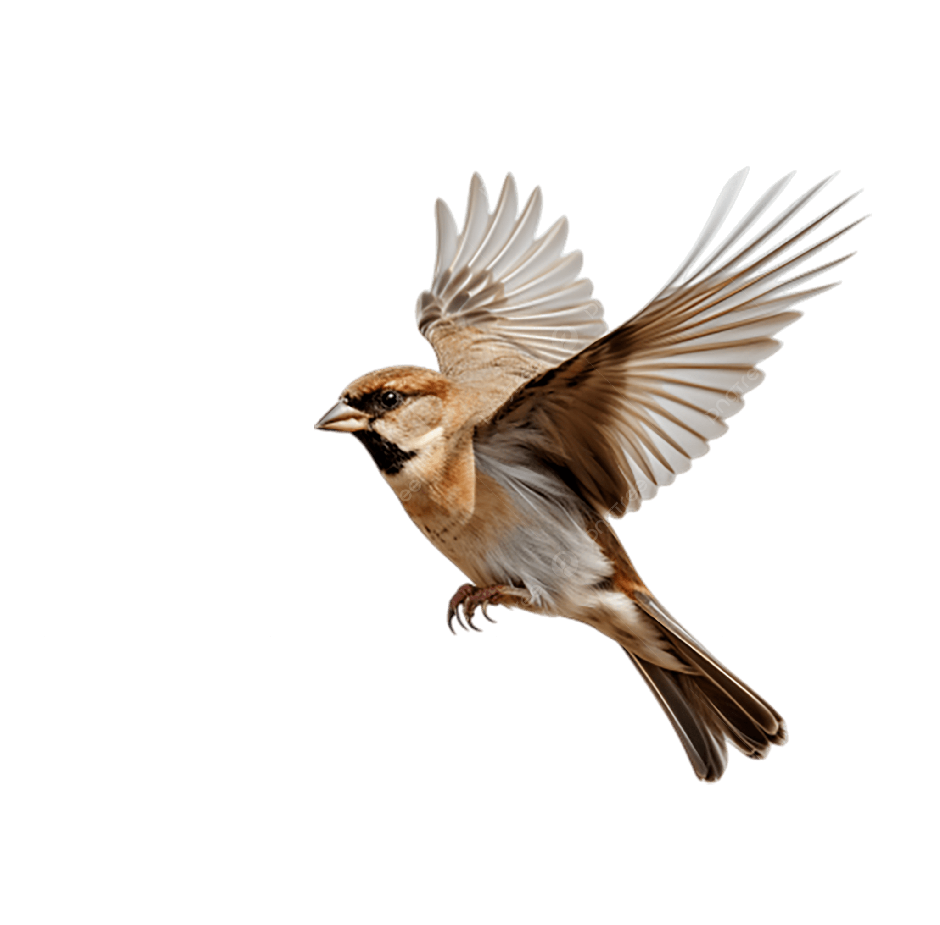
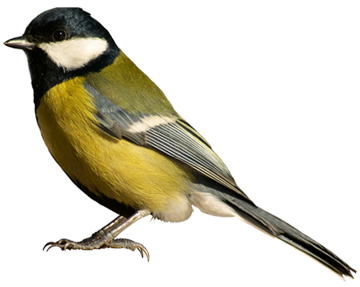
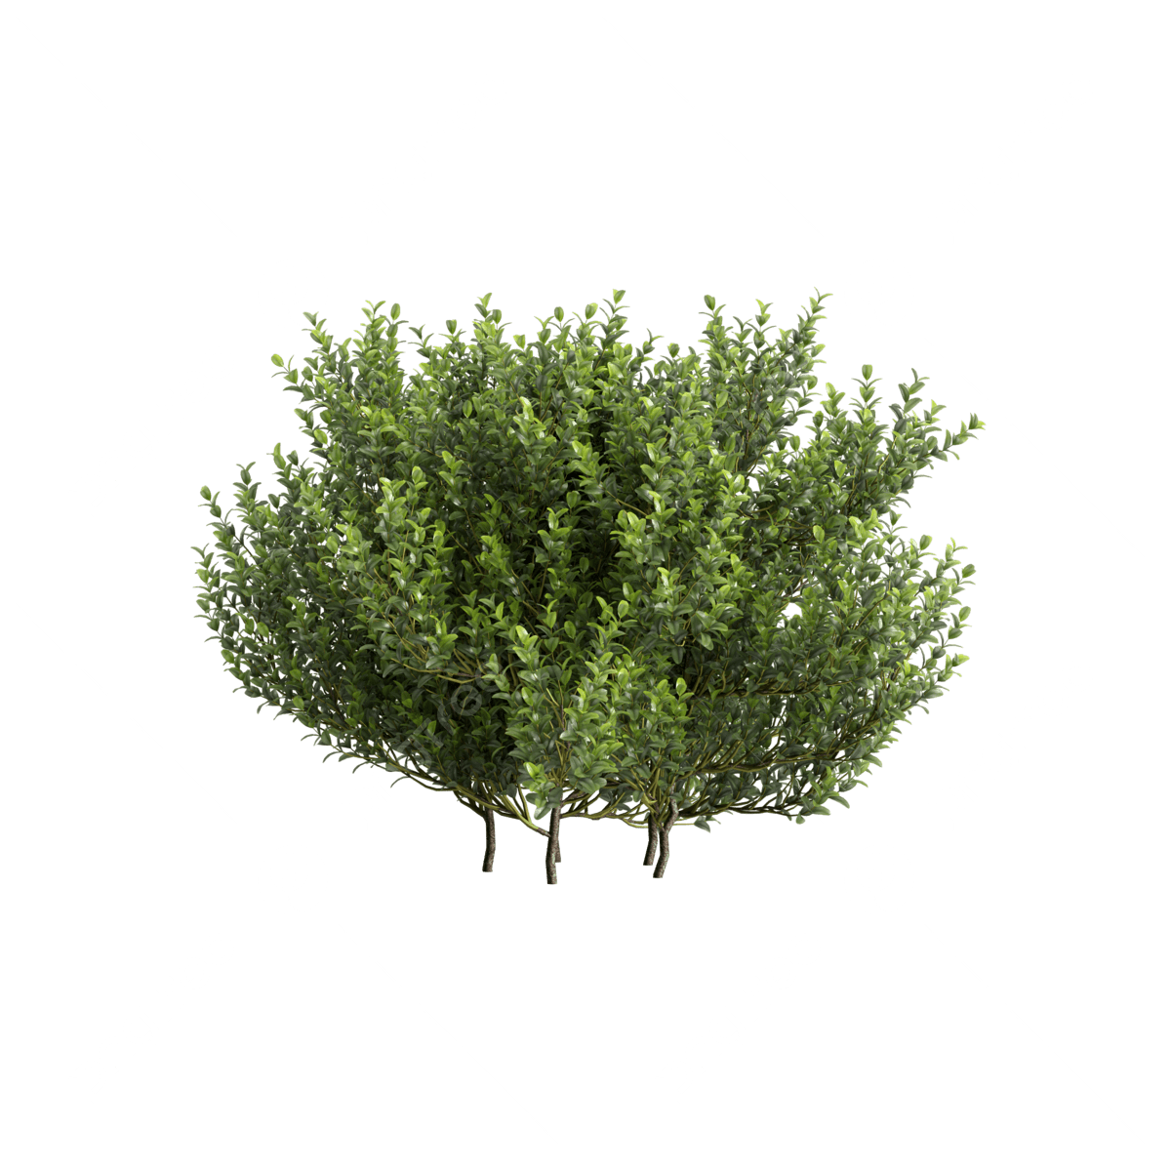
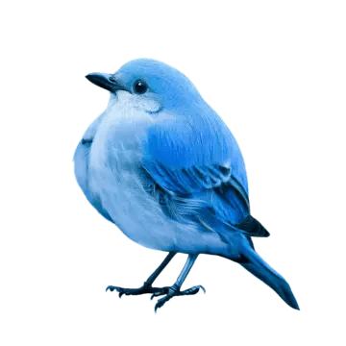
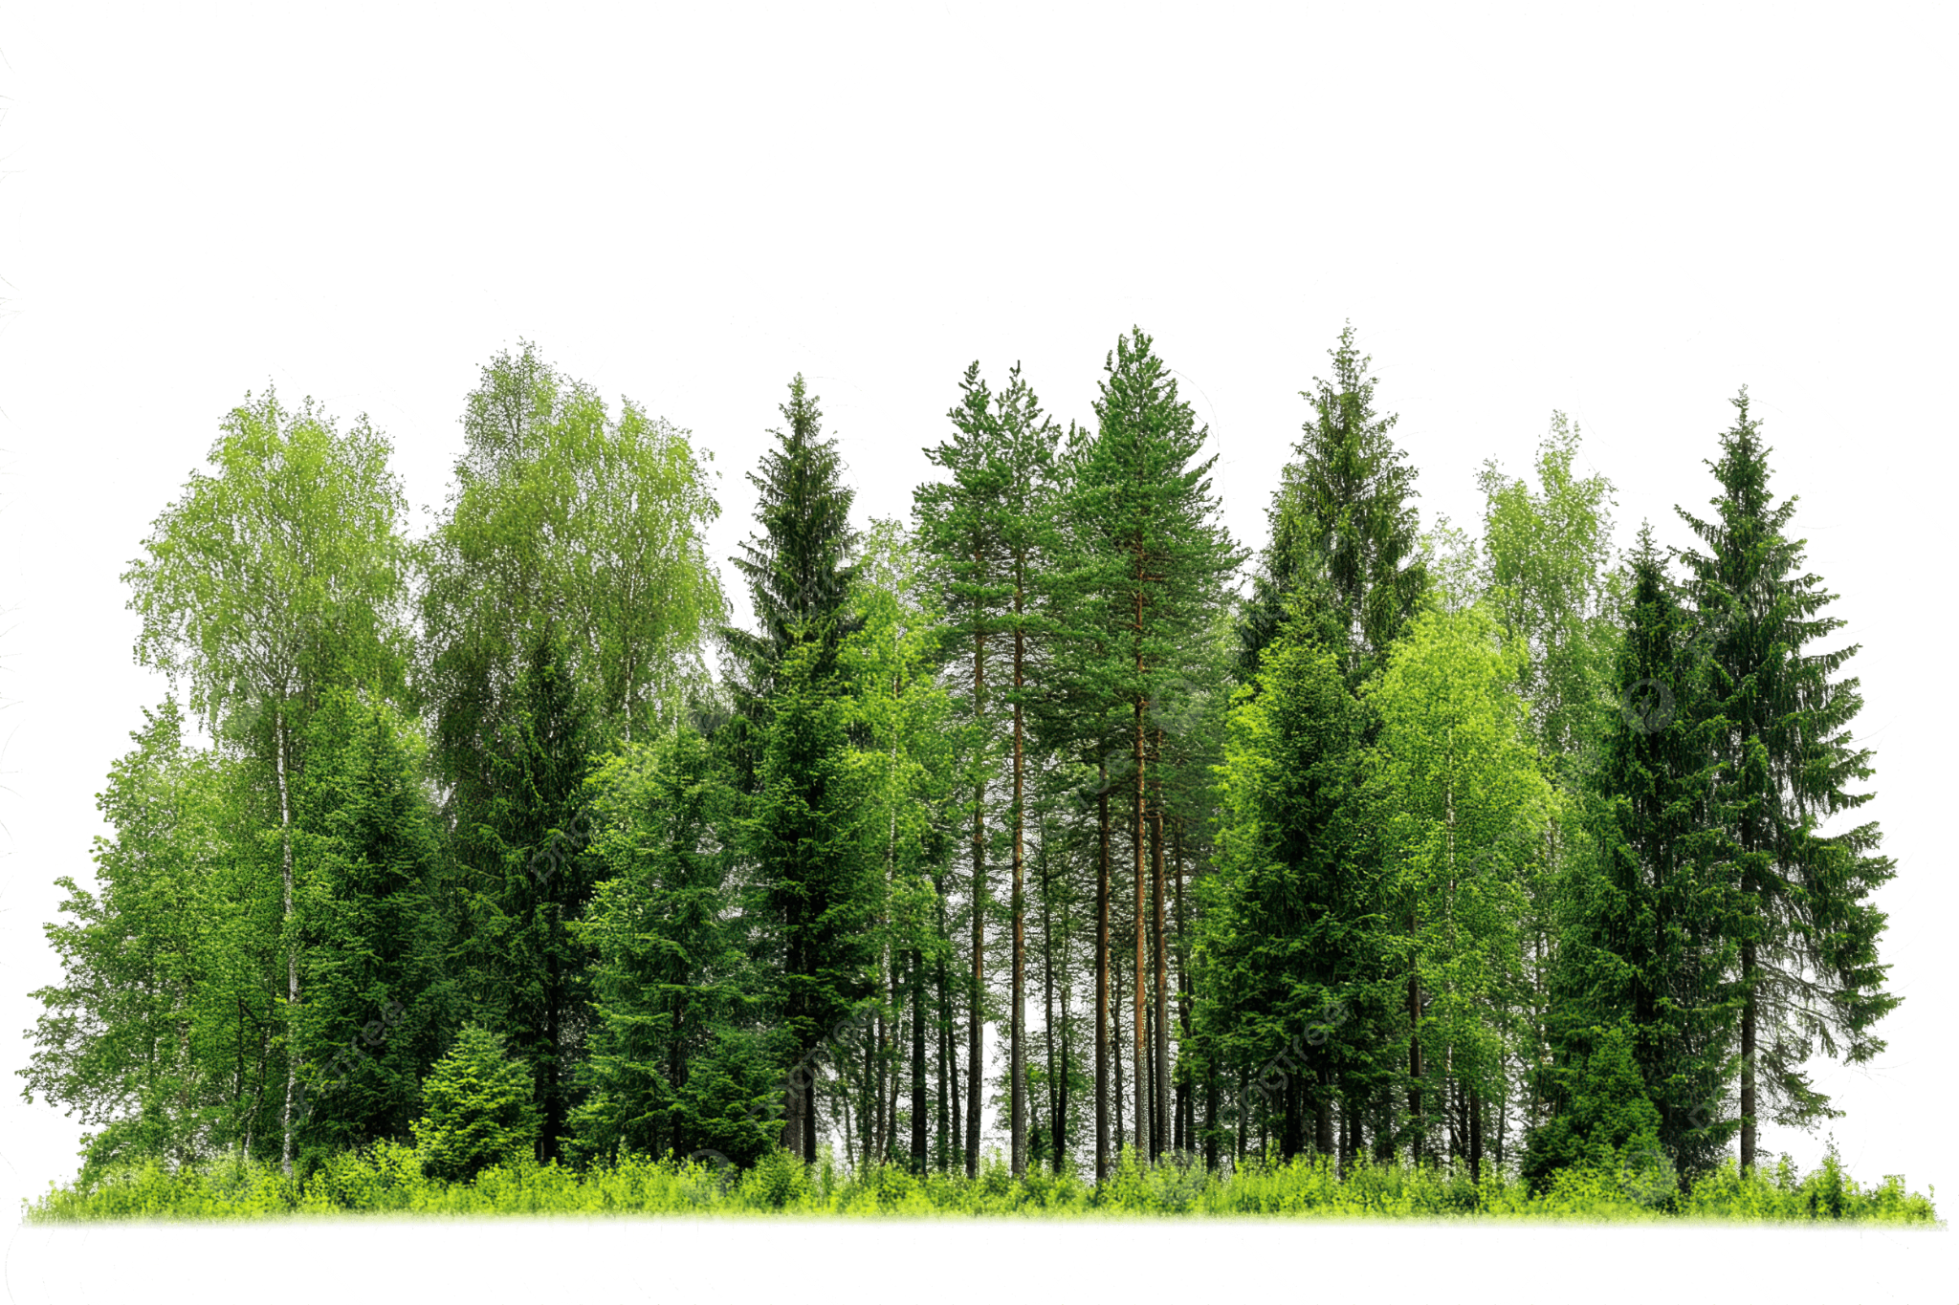
[Score]
6

Slide 7
7
After you loose
You died :(
[Score]
[Highscore]
Press enter to try again
Press Backspace to go to the menu
6
2

