Slide 1
F`Software Framework A Small Scale Component Framework for Space
Jet Propulsion Laboratory,
California Institute of Technology
5/29/2017
© 2009-2017 California Institute of Technology. Government sponsorship acknowledged.
Any commercial use must be negotiated with the Office of Technology Transfer at the California Institute of Technology.
The research was carried out at the Jet Propulsion Laboratory, California Institute of Technology,
under a contract with the National Aeronautics and Space Administration.
This software has been approved for open source release under NTR #49404.

Slide 2
Background
F` was developed as part of a technology task at JPL
Explore new flight hardware
Explore new software approaches
Targeted at smaller projects like instruments, Cubesats, and Smallsats
Sparser processor resources (e.g. 2MB memory, 128K program space)
TI MSP430, ARM-M*, LEON3
Clusters of interconnected processors
Goals were to show:
Goal | Explanation
Reusability | Frameworks and adaptations readily reusable
Modularity | Decoupled and easy to reassemble
Testability | Components easily isolated for testing
Adaptability | Should be adaptable to new contexts and bridge to inherited
Portability | Should be portable to new architectures and platforms
Usability | Should be easily understood and used by customers
Configurability | Facilities in the architecture should be scalable and configurable
Performance | Architecture should perform well in resource constrained contexts. Should be very compact.

Slide 3
F`: A Component Architecture
Definition: The F` Component Architecture is a design pattern based on an architectural concept combined with a software architectural framework.
Not just the concepts, but framework classes and tools are provided for the developer/adapter.
Implies patterns of usages as well as constraints on usage.
Centered around the concept of “components” and “ports”
Uses code generation to produce code to implement common framework logic
Developer specifies in XML
Developer writes implementation classes to implement interfaces.
1
2
2
1
3
3
1
2
= some state
machine in the component
1
2
3
3

Slide 4
Characteristics of Components
Encapsulates behavior
Components are not aware of other components
Localized to one compute context
Interfaces are via strongly typed ports
Ports are formally specified interfaces
No direct calls to other components
Context for threads
Executes commands and produces telemetry
Component
2
1
3
Port 1
Port 2

Slide 5
Characteristics of Ports
Encapsulates typed interfaces in the architecture.
Think C++ class with one interface method
Point of interconnection in the architecture.
Ports are directional; there are input and output ports
Direction is direction of invocation, not necessarily data flow. Ports can retrieve data.
Ports can connect to 3 things:
Another typed port
Call is made to method on attached port
A component
Incoming port calls call component provided callback
A serialized port
Port serializes call and passes as data buffer (more to come)
All arguments in the interface are serializable, or convertible to a data buffer. There are built-in types supported by the framework; user can write custom types. (see later slides).
Ports can have return values, but that limits use
Only return data when component has synchronous interface
No serializable connections since serialization passes a data buffer but does not return one (see later slides for explanation)
Pointers/references allowed for performance reasons
Multiple output ports can be connected to a single input port
Component
2
1
3
serialize()

Slide 6
A Component Topology
Component 1
Component 2
2
2
1
1
3
3
Port 1
Port 2
Port 1
Port 2
Components are instantiated at run time
They are then connected via ports into a Topology, or a specific set of interconnected components
There are no code dependencies between components, just dependencies on port interface types
Alternate implementations can easily be swapped
E.g. simulation versions
Port 1
Port 2
2
1
3
Component 3

Slide 7
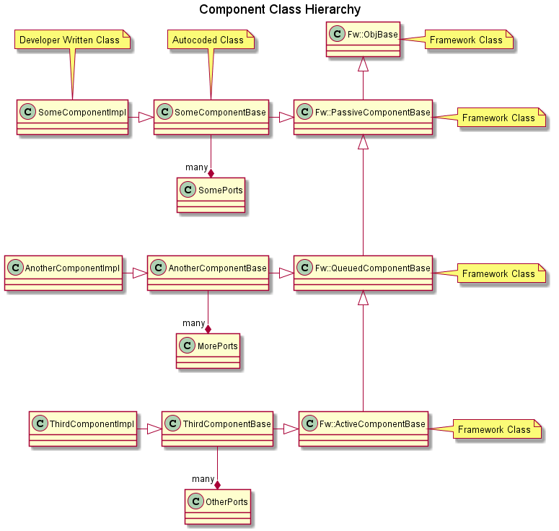
Component Type Hierarchy
Hierarchy consists of:
core framework classes
generated classes that implement architecture features
Developer written classes that implement interfaces and project-specific logic

Slide 8
Component Types
User specifies type of component in XML. Types are:
Passive Component
No thread
Port interface calls are made directly to user derived class methods
Queued Component
No thread
A queue is instantiated, and asynchronous port calls are serialized and placed on queue.
Implementation class makes call to base class to dispatch calls to implementation class methods for asynchronous ports
Can be made from any implementation class function
Thread of execution provided by caller to a synchronous port
Active Component
Component has thread of execution as well as queue
Thread dispatches port calls from queue as it executes based on thread scheduler
Calls to output port are on thread of implementation functions
Thread making call is dependent on port type (see next slide)

Slide 9
Port Characteristics
The way incoming port calls are handled is specified by the component XML.
Input ports can have three attributes:
Synchronous – port calls directly invoke derived functions without passing through queue
Guarded – port calls directly invoke derived functions, but only after locking a mutex shared by all guarded ports in component
Asynchronous – port calls are placed in a queue and dispatched on thread emptying the queue.
A passive component can have synchronous and guarded ports, but no asynchronous ports since there is no queue. Calls execute on the thread of the calling component.
A queued component can have all three port types, but it needs at least one synchronous or guarded port to unload the queue and at least one asynchronous port for the queue to make sense.
An active component can have all three varieties, but needs at least one asynchronous port for the queue and thread to make sense.
Designer needs to be aware of how all the different call kinds interact (e.g. reentrancy)
Output ports are invoked by calling generated base class functions from the implementation class.
Code Generated Active Base Class
func1()
Task
func2()
Asynchronous
func4()
Synchronous
func3()
Guarded
virtual func1()=0
func3() {…}
func2() {…}
func1() {…
func4()
}
Developer Written Implementation Class

Slide 10
Serialization
Serialization is a key concept in the framework
Definition: Taking a specific set of typed values or function arguments and converting them in an architecture-independent way into a data buffer
Port calls and commands and their arguments are serialized and placed on message queues in components
Command arguments and telemetry values are passed and encoded/decoded into this form
Components that store and pass data can use this form and not require knowledge of underlying types
User can define arbitrary interface argument types and framework automatically serializes
User can define complex types in XML and code generator will generate classes that are serializable for use internally and to and from ground software

Slide 11
Serialization Ports
A special optional port that handles serialized buffers
Takes as input a serialized buffer when it is an input port, and outputs a serialized buffer when it is an output port.
Can be connected to *any* typed port (almost).
For input port, calling port detects connection and serializes arguments
For output port, serialized port calls interface on typed port that deserializes arguments
Not supported for ports with return types
Useful for generic storage and communication components that don’t need to know type
Allows design and implementation of C&DH (command and data handling) components that can be reused.
Comp1
Typed port
Serialized port
Comp2
Serialized port
Typed port
Comp3

Slide 12
Commands, Telemetry, Events and Parameters
The code generator provides a method of implementing commands, telemetry, events (AKA EVRs), and parameters.
Component XML specifies arguments and types.
Data for service is passed in serialized form.
The code generator parses arguments and types and generates code to convert arguments to serialized data or vice versa.
Calls implementation functions with deserialized arguments (commands) or provides base class functions to implement calls (telemetry, events and parameters)
Code generator uses port types that are specified in XML themselves. These ports can be then used in components that provide interfaces for transporting or storing data for those services.
Since data is handled in serialized form, don’t need to know specific argument types

Slide 13
Commands
Component command XML specifies:
Opcode, mnemonic, and arguments
Arguments can be any built-in type or external XML complex type
Complex type can be a single argument
Can define enumerations
Synchronization attribute
Sync, async, or guarded
Same meaning as ports
Async can specify message priority
Implementation class implements function for each command
Framework code deserializes arguments from argument data buffer
Autocoder automatically adds ports for registering commands, receiving commands and reporting an execution status.

Slide 14
Events
Component event XML specifies:
ID, name, severity and arguments
Arguments can be any built-in type or XML complex type
Complex type can be a single argument
Can define enumerations
Format specifier string
Used by ground software and optional on-board console to display message with argument values
Follows C format specifier syntax
Code generated base class provides function to call for each event with typed arguments
Provides stronger type checking at compile time than MER/MSL EVR macros
Called by implementation class
Code generator automatically adds ports for retrieving time tag and sending event
Two independent ports for sending events
A binary version with serialized arguments for transport to ground software
A text port that sends a string version of the event (using the format specifier) that can be sent to a console
Can be globally disabled via architecture configuration macros to save execution time and code space

Slide 15
Telemetry
Component telemetry XML specifies channels that have:
ID, name, and data type
Data type can be any built-in type or external XML complex type
Can define enumerations
Format specifier string
Used by ground software and optional on-board console to display message with argument values
Code generated base class provides function to call for each channel with typed argument
Called by implementation class
Code generator automatically adds ports for retrieving time tag and sending channelized data

Slide 16
Parameters
Parameters are traditional means of storing non-volatile state
Framework provides code generation to manage, but user must write specific storage component
Component XML specifies parameters that have:
ID, name, and data type
Data type can be any built-in type or external XML complex type
Can define enumerations
Optional default value
In the event the parameter cannot be retrieved, assigns default value to parameter
Code generator automatically adds port for retrieving parameters
During initialization, a public method in the class is called that retrieves the parameters and stores copies locally
Can be called again if parameter is updated
Code generated base class provides function to call for each parameter to retrieve stored copy
Implementation class can call whenever parameter value is needed

Slide 17
Architectural patterns
Over time, tested C&DH components can be developed that implement typical non-mission-specific flight functions that are specified in the XML
Commands, Events, Telemetry, Parameters
Design them so small-scale projects can live with sufficient implementations out of the box
Includes:
Command dispatcher
Command sequencer
Event log (binary and console)
Telemetry database
File-based parameter storage and updating
Active rate groups
Define interfaces for facilities that would support the existing component implementations
Uplink/Downlink packet types
Input/Output of ground system and C&DH components
Uplink/Downlink ports
Project would have specific uplink downlink hardware

Slide 18
Example Component Pattern - Rate Group
Rate group is a container of run() ports.
Calls ports in order
Since is a list of run ports, doesn’t know (or care) which destinations are in active components or not
Rate Group is an active component
Rate
Group
run()
run()
active
run()
….
run()
run()

Slide 19
Example Component Pattern - Command Dispatcher
Command dispatcher receives raw buffer containing command and arguments
Command opcode is extracted, and lookup is made
Table maps opcode to port
Multiple opcode entries per component
Argument buffer is passed to component
Command dispatcher is a passive component
buffer
Dispatcher
Mod1
command
OC
register
status
ModN
status

Slide 20
Example Component Pattern - Command Sequencer
Command sequencer loads file from file system
Sends command and waits for response for each command in the file
A failed response terminates the sequence, passed response moves to the next command
Active component
Sequencer
Dispatcher
1. command
2. status
File

Slide 21
Example Component Pattern – Event Log
Component implementation calls function to generate event
Base class function (code-generated) retrieves time tag from time source component (project-specific).
Component sends event to Event Log component
Event log component places event on message queue. Thread of component then sends downlink packet with event
Active component
Component
Event Log
3. event
4. downlink
Msg Q
2. time
1. event()
Time
Component

Slide 22
Component Pattern – Telemetry Database
Telemetry database has double-buffered array of telemetry buffers
Implementation class calls base class function with telemetry channel update
Base class function retrieves time tag from time source component.
Component writes updated value to telemetry database component
Telemetry database writes value to active buffer
Run port is called periodically by rate group. Swaps active buffer
Run call copies updated values to downlink
Passive component
Telemetry Database
Component
run
3. value
downlink
2. time
1. write()
Time
Component

Slide 23
Component Pattern – Parameter Manager
Parameter Manager loads file containing parameters from file system during initialization
Initialization subsequently calls loadParameters() on all components with parameters. Can also be called after
Uplinked parameter updates update the stored value of parameter
Component can refresh parameters by implementing command to reload
Manager can save updated values to file system via command
loadParameters()
Parameter Manager
Component
get parameter
update
File

Slide 24
Multi-node
Hub pattern
Hub is a component with multiple serialization input and output ports
Typed ports on calling components are connected to serialized ports (see earlier slides)
Each hub instance is responsible for connecting to a remote node
Input port calls are repeated to corresponding output ports on remote hub
Single point of connection to remote node, so central point of configuration for transport.
Node 1
Node 2
Producer
Component1
Hub
Hub
Consumer
Component1
Producer
Component2
Consumer
Component2
Transport (Socket, ARINC Channel, UART, IPC)

Slide 25
Code Scaling
Framework code is very compact
Generated code is also compact
Demo application for TI microcontroller was about 15K
Native type sizes can be configured
e.g. some microcontrollers have 16-bit/8-bit only support
Features can be added or removed depending on resources
Object naming
Port execution tracing
Serialization of ports
Single node systems don’t really need
This is not data serialization but the use of serialized ports
Object naming/registry
Component connection tracing
Text logging
For very compact processors with no OS, developers can choose non-active components

Slide 26
Status
Framework released as open source
Earlier JPL version flown on RapidScat, an ISS radar experiment
Has been ported to:
Linux, MacOS, Windows (Cygwin), VxWorks, ARINC 653, RTEMS, Bare Metal (No OS)
PPC, Leon3, x86, ARM (A15/A7), MSP430
Mature set of C&DH components
Following flight processes such as code inspections, static analysis, and full-coverage unit testing
Version being developed as companion for JPL hardware project for Cubesat missions
Will include platform driver components and other peripherals
Available on JPL GitHub:
https://github.jpl.nasa.gov/FPRIME/fprime-sw.git
Hubs demonstrated on:
Sockets
ARINC 653 Channels
High-speed hardware bus between nodes
UARTs between nodes in an embedded system

