Slide 1

Summer 2018 Review
Aaron Doubek-Kraft
Mentors: Len Reder, Garth Watney

Slide 2
Outline
Background/Interests
F′ OpenMCT Server
F′′ Reference Application
COSMOS GseApi
Takeaways

Slide 3

Background and Interests
Senior Computer Science/Astrophysics double major at UC Santa Cruz
Go Slugs
CS Experience
Front-end web development
Graphics and visualization
Scientific computing
Interests
Quantum Computing
Machine Learning
Applications of computer science to problems in science and aerospace
Hobbies
Jazz trumpet
President, UCSC Racquetball Club

Slide 4
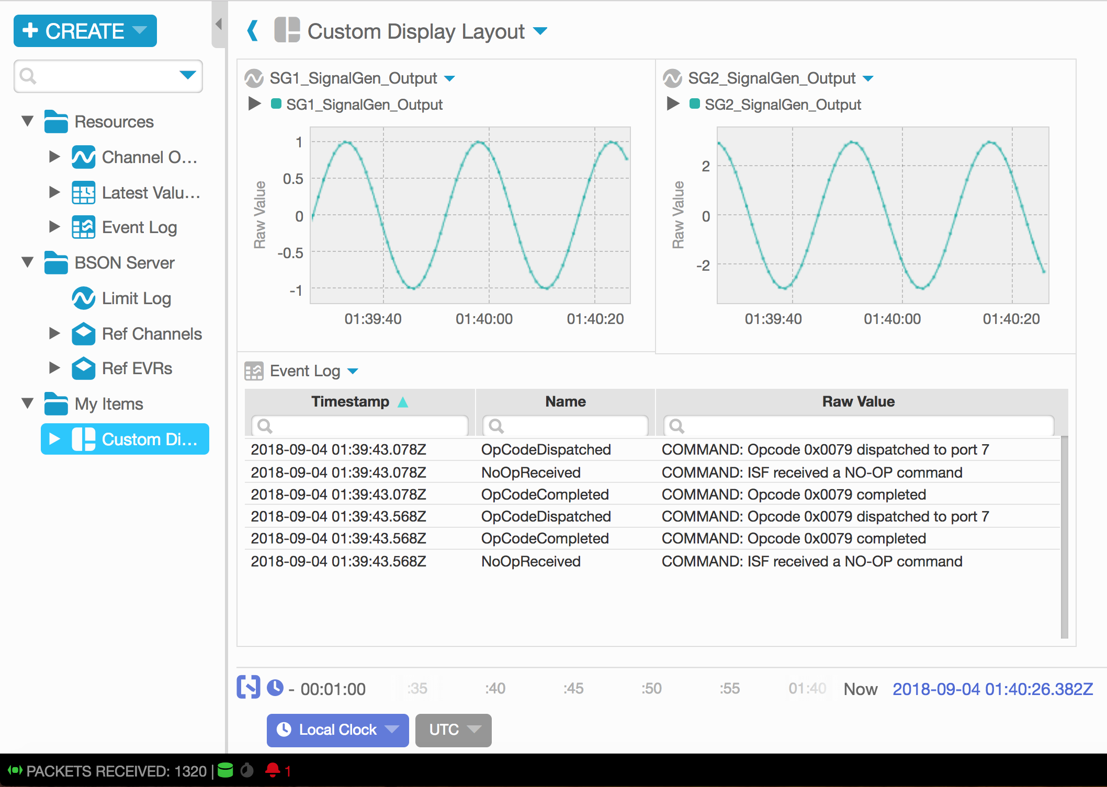
F′ OpenMCT Server
OpenMCT: Open source web framework for building mission control applications
Client web application
Real-time and historical plotting
User-customizable layouts
APIs to extend framework features
Node.js Telemetry Server
Consumes streaming data
Stores telemetry histories
Serves web application content
Notes:
Developed at Ames Research Center
API’s extend functionality in various ways - API’s to work with telemetry data, custom object types/views, interfaces to customize framework features, etc.

Slide 5
OpenMCT: Architecture
F′ Application
ThreadedTCPServer
Other GSE applications…
Binary Packets Over TCP
Binary Packets Over TCP
JSON over HTTP, TCP
Web Client
F′ OpenMCT Server
CouchDB
Server
Web Client
Web Client

Slide 6
OpenMCT: Previous Work
Adapted OpenMCT telemetry server to accept streams of F′ binary packets
OpenMCT server expects to receive BSON packets with certain fields
Adapter converts F′ binary to BSON packets
Server configured per deployment with scripts
Python autocoder uses XML parsers to generate JSON dictionaries
Node.js scripts create configuration which defines dictionaries for OpenMCT
Object persistence with CouchDB
OpenMCT saves configuration of custom objects (e.g. layouts) in a database
Configured OpenMCT client to use CouchDB server with existing plugin
Wrote scripts to get/set object configuration from CouchDB over HTTP

Slide 7
OpenMCT: Object Persistence
Setting up CouchDB inconvenient for local use
Embedded database allows object persistence without external service
Extended telemetry server with embedded LevelDB database, accessed through HTTP
Implemented PersistenceService interface in OpenMCT client for the embedded database
Now uses embedded database by default, process to set up a CouchDB server is documented
Before
After
Web Client
Web Client
OpenMCT Telemetry Server
CouchDB
Server
OpenMCT Telemetry Server
Web Client
Web Client
Web Client
Web Client

Slide 8

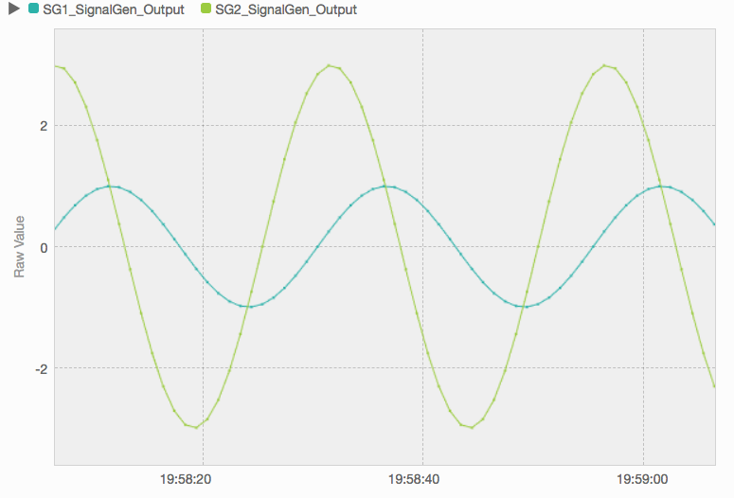
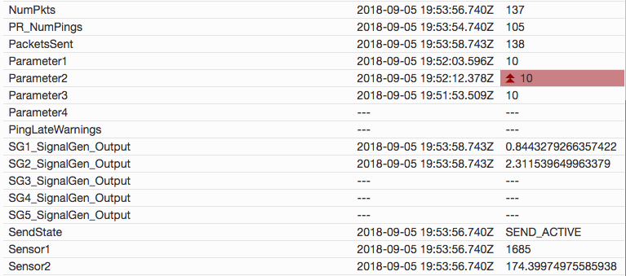
OpenMCT: Other Features
Latest Value Table with all channels
Server status indicator in client
Command-line options to overlay channels on startup
Basic support for telemetry with Serializable values
Examples of custom visualization types, using OpenMCT telemetry APIs with open source graphing libraries

Slide 9
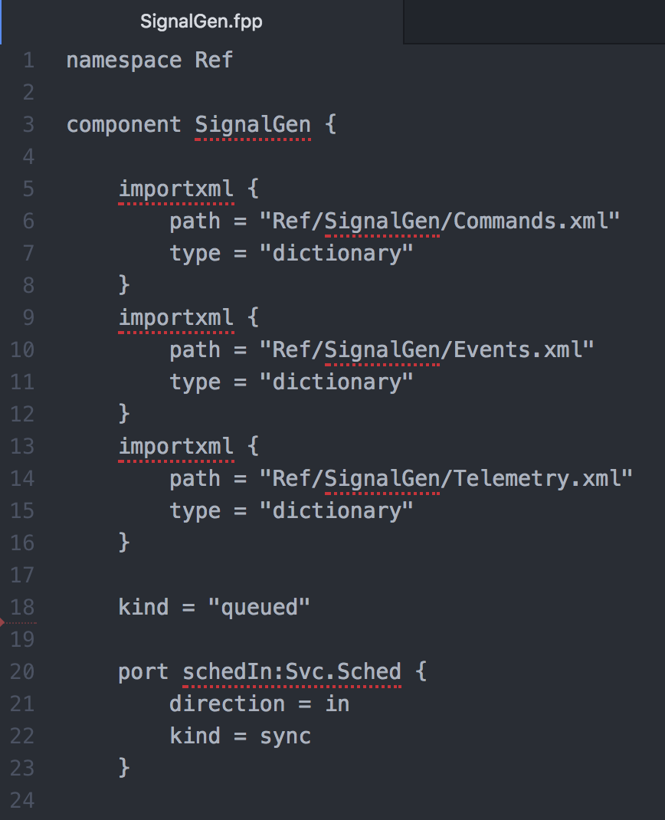
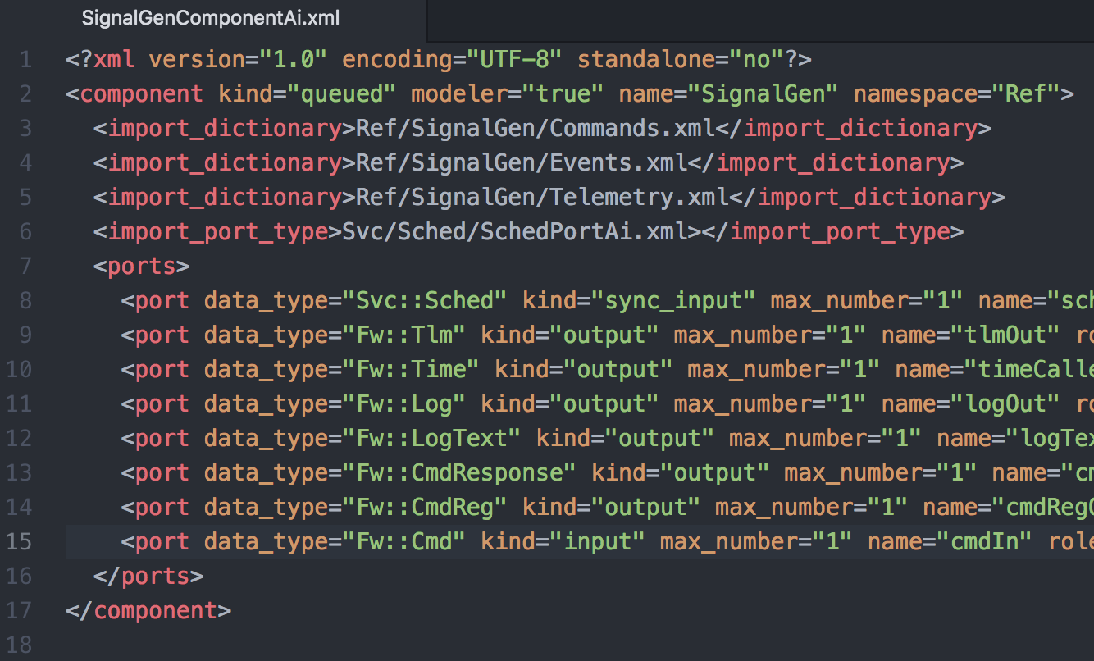
F′′
Wrote Ref application in F′′
Discovered a number of bugs/issues in the F′′ compiler and generated legacy XML
Attempted to conduct fpp -> F′ application end-to-end test, but outstanding issues with generated legacy XML caused errors in F′ autocoders

Slide 10
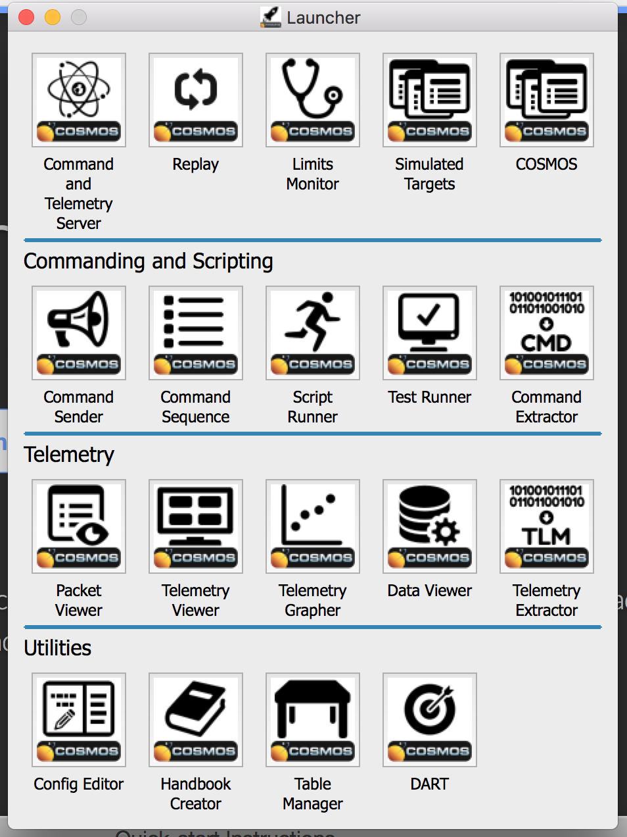
COSMOS
Open source Ruby GSE software for embedded systems
Command and Telemetry server allows sending commands and receiving telemetry over HTTP or TCP
Includes standalone clients for:
Viewing telemetry tables
Basic plotting of values
Sending commands

Slide 11
COSMOS GseApi
Implemented GseApi interface to run against the COSMOS telemetry server instead of the existing GSE
Interchangeable with existing GseApi
Queries server’s HTTP API to construct all necessary dictionary information and configuration
Interacts with a remote queue on COSMOS server to fetch data over HTTP
Python proxy classes abstract out HTTP interactions
Could be used to provide real-time telemetry or commanding functionality to other client applications at a higher level
Notes:
Only needs lists of available telemetry/commands, maps of telemetry id->name, command opcodes and arguments, and descriptions of binary packets
Decoupled from any local configuration
Can explain remote queue in greater detail

Slide 12
COSMOS: Integration w/ OpenMCT
Modified COSMOS Autocoders to add Router
Redirects binary data stream from a given target
Modified OpenMCT Server to accept a data stream from either ThreadedTCPServer or COSMOS Telemetry server
Created script to read COSMOS binary log files and send them to OpenMCT server as BSON packets

Slide 13
OpenMCT + COSMOS
GseApi
HTTP
F′ Application
COSMOS Telemetry Server
COSMOS Clients
Binary Packets Over TCP
Binary Packets Over TCP
JSON over HTTP, TCP
Web Client
COSMOS Binary Logs
F′ OpenMCT Server
Web Client
Web Client

Slide 14



What I Learned
Full-stack JavaScript in practice
Python in a software engineering context
Open source ground support and systems modeling tools

