Slide 1

Summer 2018 Review
Aaron Doubek-Kraft
Supervisor: Jeff Levinson
Mentors: Len Reder, Garth Watney

Slide 2

Background and Interests
Senior Computer Science/Astrophysics double major at UC Santa Cruz
Go Slugs
CS Experience
Front-end web development
Graphics and visualization
Scientific computing
Interests
Quantum Computing
Machine Learning
Applications of computer science to problems in science and aerospace
Hobbies
Jazz trumpet
President, UCSC Racquetball Club

Slide 3
Outline
Background/Interests
F′ OpenMCT Server
F′′ Reference Application
COSMOS GseApi
Takeaways

Slide 4
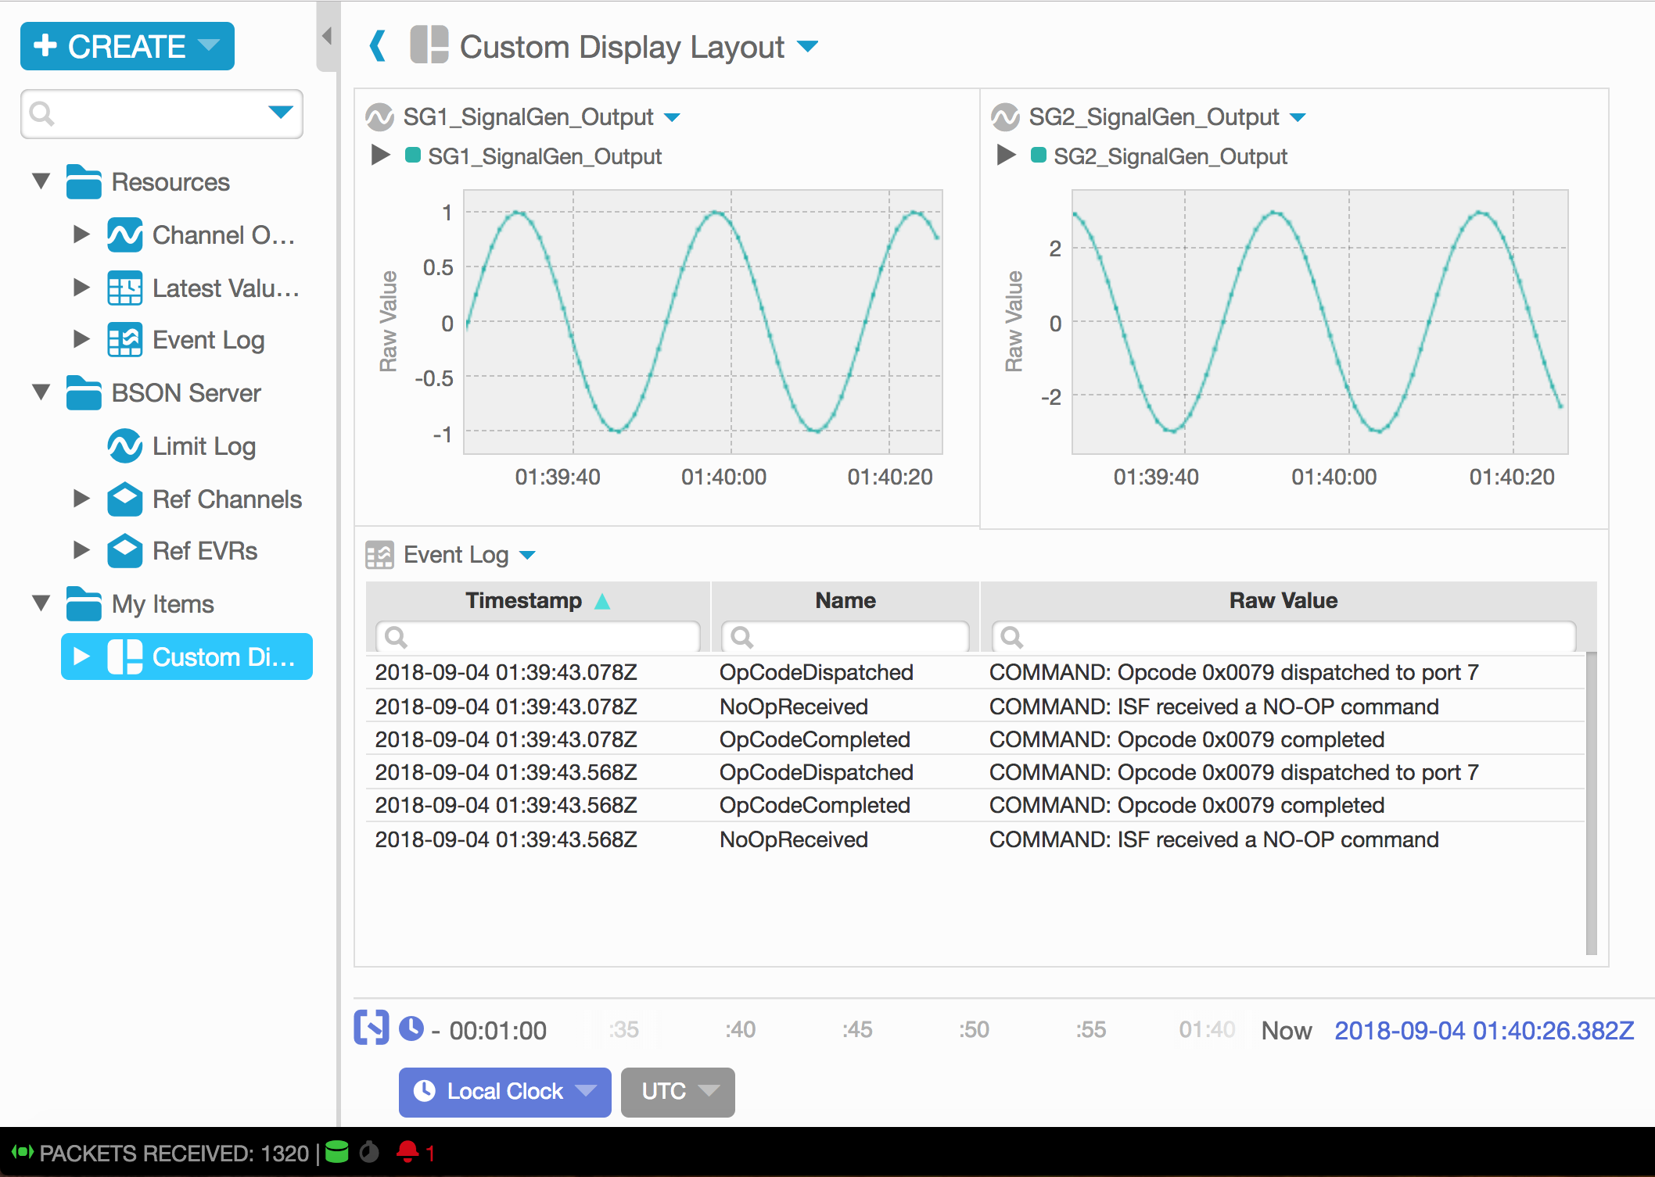
F′ OpenMCT Server
OpenMCT: Open source web framework for building mission control applications
Client web application
Real-time and historical plotting
User-customizable layouts
APIs to extend framework features
Node.js Telemetry Server
Consumes streaming data
Stores telemetry histories
Serves web application content
Notes:
Developed at Ames Research Center
API’s extend functionality in various ways - API’s to work with telemetry data, custom object types/views, interfaces to customize framework features, etc.

Slide 5
F′ OpenMCT Server
Adapted existing Node.js telemetry server to accept streams of F′ binary data
Wrote scripts to generate server’s JSON configuration from F′ deployment XML
Extended client-side and server-side functionality, including:
Embedded database on server, client object persistence plugin to use server’s database
Indicator for telemetry server status
Pre-configured client resources
Custom object types
JSON over HTTP, TCP
Web Client
OpenMCT Telemetry Server
Web Client
F′ Application
ThreadedTCPServer
(or COSMOS Telemetry Server)
Binary Packets Over TCP
Web Client
Binary Packets Over TCP
Other GSE applications…
Notes:
Needs dictionaries to interpret the data stream

Slide 6
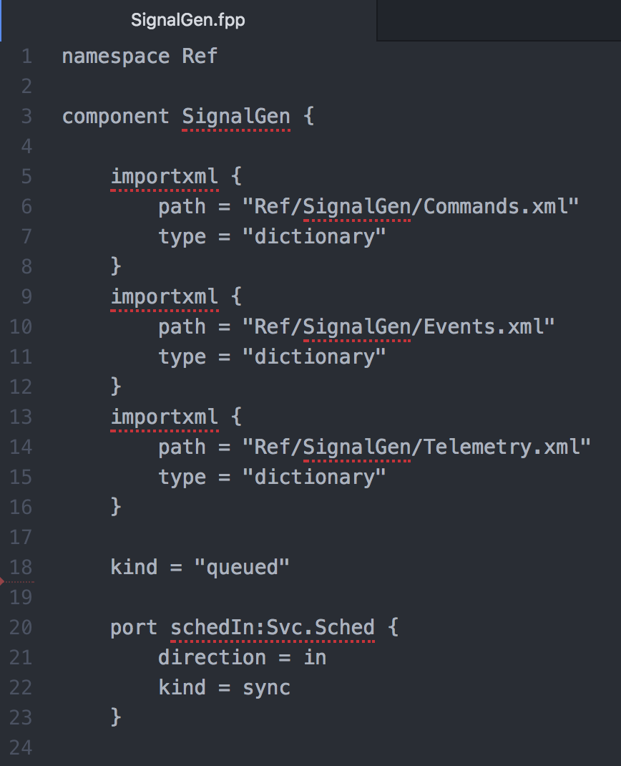
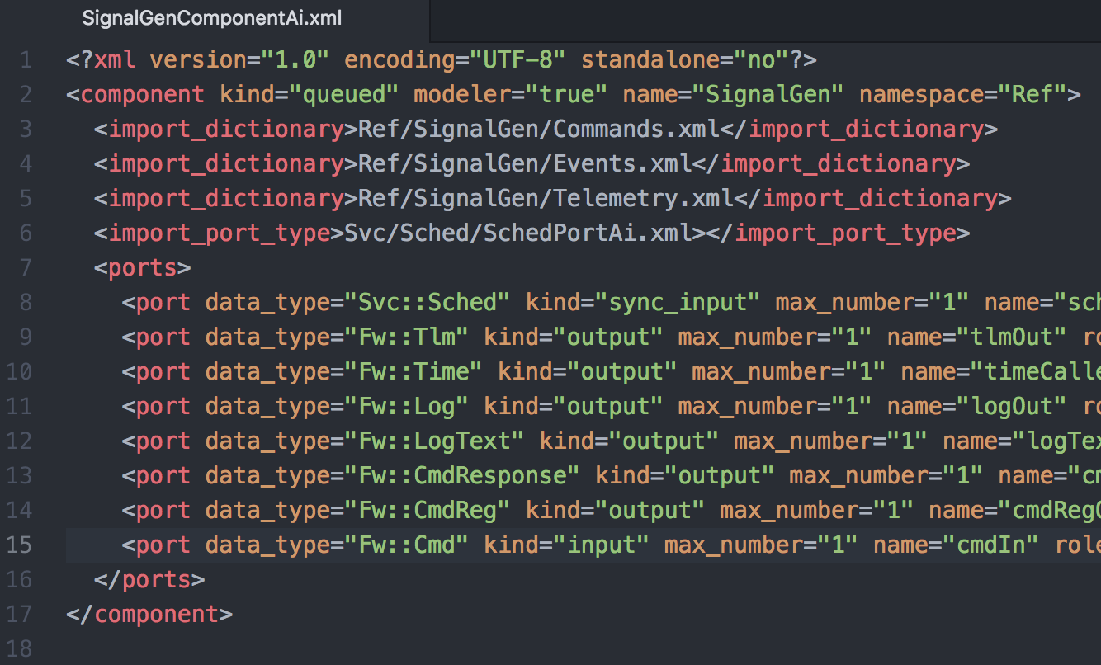
F′′ Reference Application
Domain-specific language to model F′ applications
Rewrote existing reference application in F′′
Provides example to test F′′ toolchain, from .fpp to compiled C++
Notes:
Revealed a number of issues, passed along to another intern working on the compilers

Slide 7
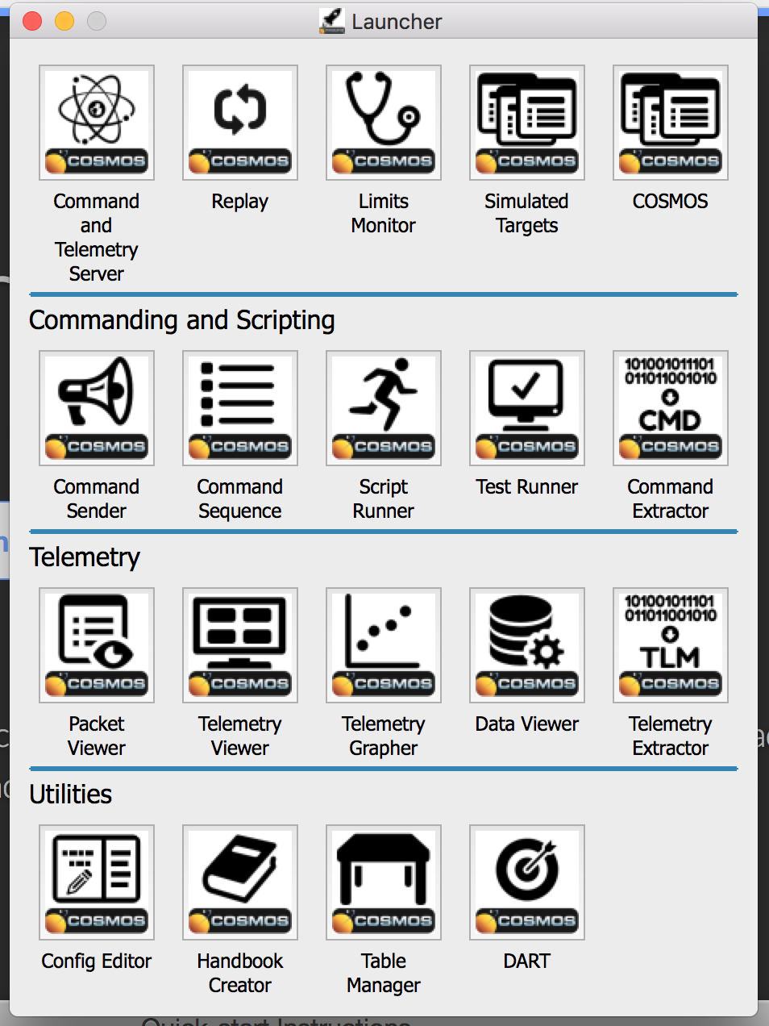
COSMOS
Open source Ruby GSE software for embedded systems
Command and Telemetry server allows sending commands and receiving telemetry over HTTP or TCP
Includes standalone clients for:
Viewing telemetry tables
Basic plotting of values
Sending commands

Slide 8
COSMOS
Implemented COSMOS version of a GSE API interface in Python
GseApi provides high-level commanding and telemetry streaming
Used to write integration tests
New version runs against COSMOS server’s HTTP API instead of existing GSE
Integrated COSMOS with OpenMCT
Support for binary data streams from COSMOS
Script to read COSMOS binary logs into OpenMCT history

Slide 9



What I Learned
Full-stack JavaScript in practice
Python in a software engineering context
Open source ground support and systems modeling tools

