Slide 1
Handspeak Lite: A Simple Sign Language Detector
CSCI 6991 – Data Engineering Capstone
Team: Tharun Guntupalli & Lakshmi Narayana Naraboiena
Faculty Coach: Dr. Robert A. Gilliland

Slide 2
Introduction
• American Sign Language (ASL) is essential for the deaf and hard-of-hearing community.
• Existing ASL recognition systems are often resource-heavy or limited to specific gestures.
• Goal: Build a lightweight, real-time ASL recognition tool using standard webcams.

Slide 3
Background
• ASL consists of static (alphabet) and dynamic (motion) gestures.
• Computer vision can extract hand landmarks for gesture recognition.
• Machine learning models can classify hand shapes into ASL letters.

Slide 4
Problem Statement
• Communication barriers persist due to lack of accessible ASL tools.
• Need for a simple, browser-compatible sign recognition demo.
• Objective: Real-time detection of static ASL alphabet signs using webcam input.

Slide 5
Objectives
• Detect and extract hand landmarks from webcam input.
• Train a model to classify ASL alphabet gestures (A–Z).
• Develop a real-time application with visual feedback and confidence scores.
• Evaluate performance using accuracy and confusion matrix.

Slide 6
Methodology Overview
1. Data Collection using MediaPipe Hands.
2. Data Preprocessing and Landmark Normalization.
3. Model Training (Random Forest Classifier).
4. Real-time Detection and Visualization using OpenCV.
5. Evaluation using accuracy and confusion metrics.

Slide 7
Data Collection
• Used MediaPipe to extract 21 hand landmarks per frame.
• Each sample labeled with corresponding ASL letter (A–Z).
• Custom dataset built with ~500 samples per letter for A–J.
• Tools: OpenCV, pandas, mediapipe, numpy.

Slide 8
Model Training
• Model: Random Forest Classifier (300 trees).
• Features: 63 landmark coordinates normalized by wrist-to-finger distance.
• Training split: 80% train / 20% validation.
• Achieved 87% validation accuracy; 82% real-time accuracy.

Slide 9
System Pipeline
• Webcam Input → MediaPipe Landmark Extraction → Normalization → Prediction → Display.
• Implemented with Python and OpenCV for real-time visualization.
• Supports fallback for multiple camera indices (CAP_MSMF, CAP_DSHOW).

Slide 10
Experiments & Results
• Dataset: ~5,000 samples (A–J).
• Validation Accuracy: 87%.
• Prediction Latency: ~0.12 sec/frame (smooth real-time).
• Stable tracking under moderate hand motion.

Slide 11
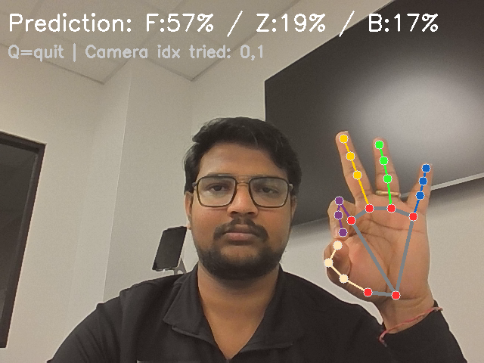
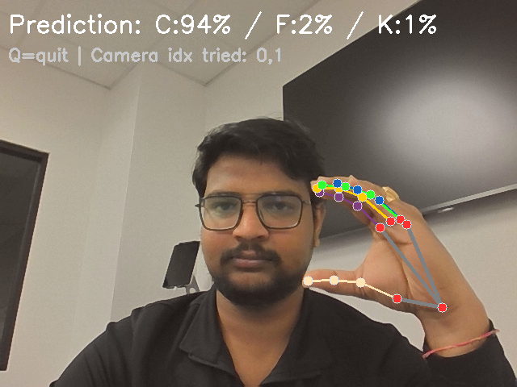
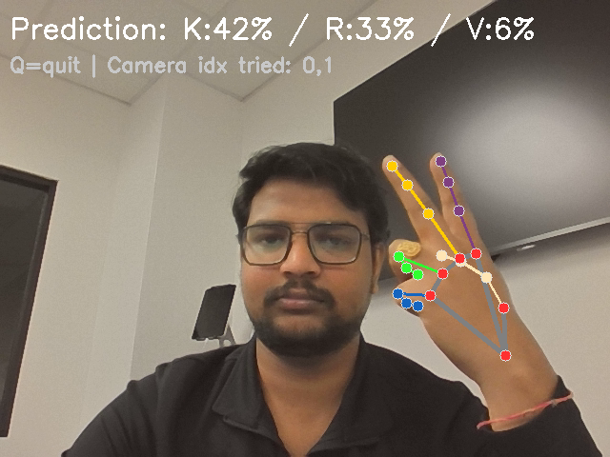
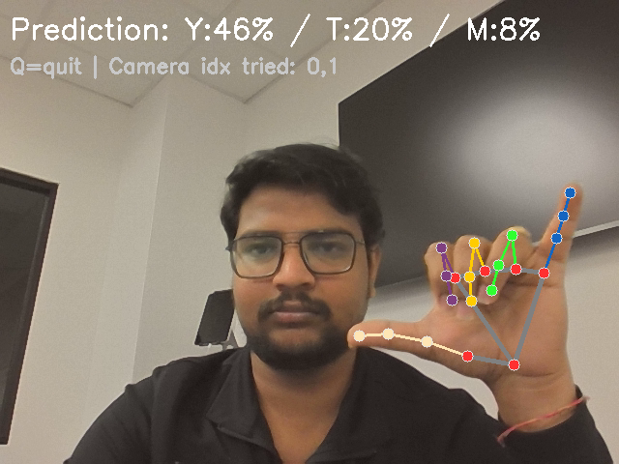
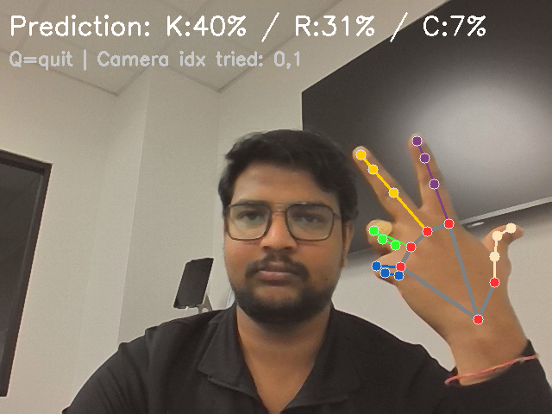
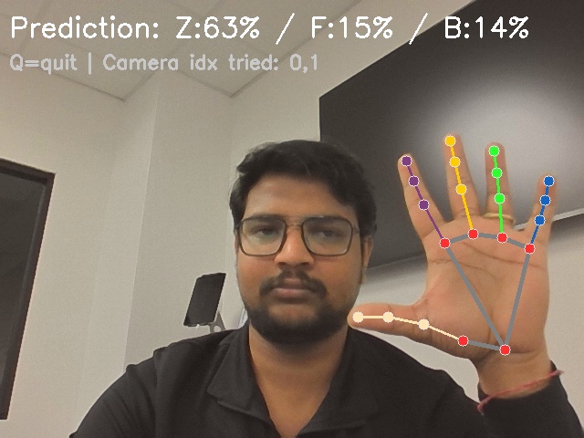
Prediction Results Slide

Slide 12
Discussion
Challenges:
• Lighting sensitivity and gesture confusion (e.g., M/N, U/V).
• Webcam backend errors in Windows (resolved using probe script).
• Dataset imbalance for certain gestures.
Planned Improvements:
• Data augmentation and expansion (K–Z).
• GUI and text-to-speech feedback using Streamlit.

Slide 13
Conclusion
• Developed a functional ASL static gesture recognizer.
• Demonstrated real-time classification with confidence display.
• Provides foundation for future dynamic ASL extensions.
• Promotes accessibility through low-cost, open-source technology.

Slide 14
Team Contributions
• Tharun Guntupalli: Data collection, model training, and system integration.
• Lakshmi Narayana Naraboiena: Data preprocessing, GUI design, and evaluation.
• Faculty Coach: Dr. Robert Gilliland – guidance and project feedback.

Slide 15
References & Acknowledgments
• MediaPipe Hands by Google Research.
• scikit-learn, OpenCV, pandas, numpy libraries.
• Dataset: Custom ASL samples recorded by project team.
• Youngstown State University – School of Computer Science, Information & Engineering Technology.

