Slide 1
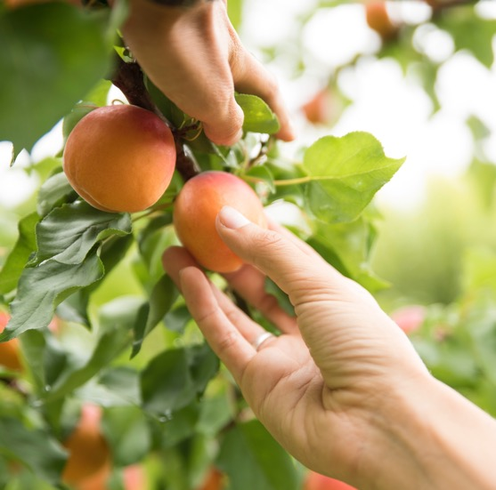
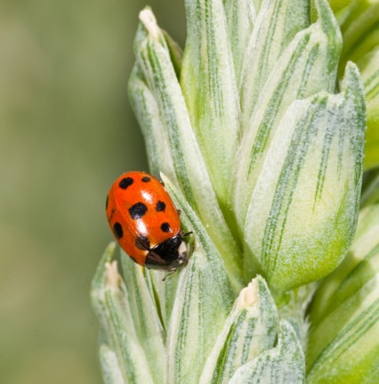

calisim: A toolbox for the calibration and evaluation of simulation models
James Bristow, Hana Liang, Jingjing Zhang, Matthieu Vignes, David Hayman, Chris Van Houtte
Notes:
Select one cover option and delete the unused variations.

Slide 2
Overview
Calisim
Examples
JFruit2
Agent-Based Modelling
Discussion

Slide 3
Terminology: Calibration
What is model calibration?
Model fitting; parameter estimation; inverse modelling
Systems-focused
Functional form is regularised
Simulate mechanistic processes of a complex system
Data-focused
Example: Data-driven machine learning (e.g. random forest)
Typically less regularised functional form
Data-focused
Tune model parameters using observed data
Improve predictive accuracy

Slide 4
Calisim
Module | Supported libraries
Optimisation | 4
Sensitivity analysis | 2
Surrogate modelling | 2
Approximate Bayesian Computation | 2
Fully Bayesian Calibration | 2
History matching | 2
Evolutionary algorithms | 2
Simulation-Based Inference | 2
Uncertainty analysis | 3
Risk analysis | 1
Active learning | 1
Optimal experimental design | 1
Bayesian quadrature | 1
Toolbox for calibrating simulation models
Streamlined workflow with standardised interface: 13 modules and 19 libraries
Open-source Python library: https://github.com/Plant-Food-Research-Open/calisim

Slide 5
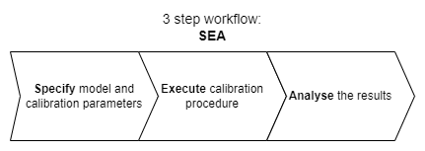
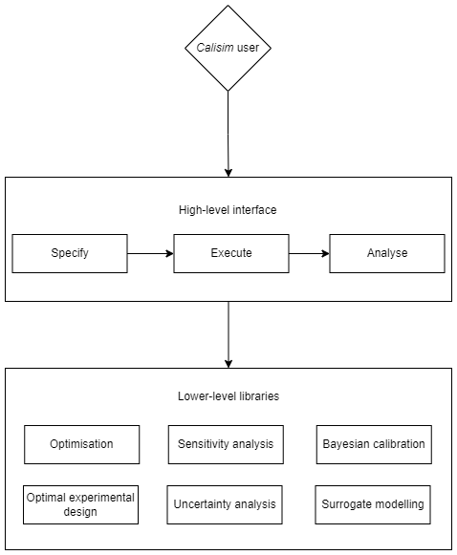
Calisim
Three step workflow
Specify
Execute
Analyse
Standardised high-level interface for all 13 modules
Encapsulation of 19 lower-level libraries
Object-oriented programming
Complex custom workflows

Slide 6

Calisim Workshop
Two demonstration models
JFruit2: A mechanistic fruit model for simulating fruit traits of interest such as fruit fresh weight.
GeoSIR: A geoversion of an agent-based compartmental SIR model, incorporating contact network inference.
How could calisim be used for your own modelling workflows?
After the workshop
Feedback and suggestions welcome

Slide 7
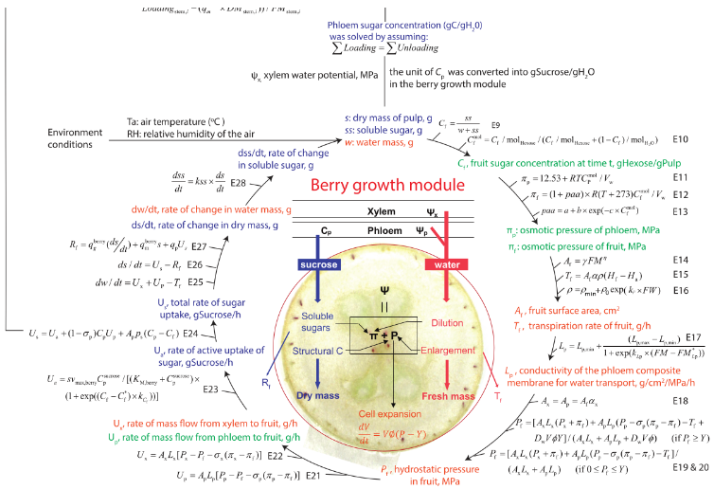
JFruit2 - A Fruit Growth Model
Developed by INRAe Avignon for peaches originally
Simulates key fruit traits: Fresh and dry weight, sugar metabolism etc.
Mechanistic and deterministic model built upon physical and biochemical principles
Parameters are physiologically meaningful
For demonstration purposes, easier to calibrate

Slide 8
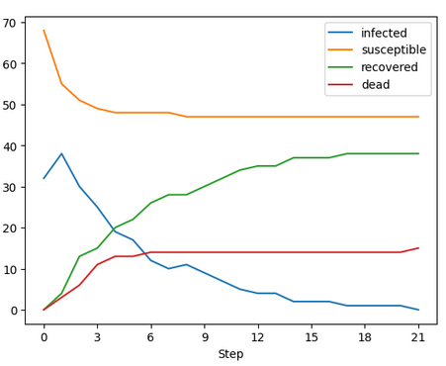
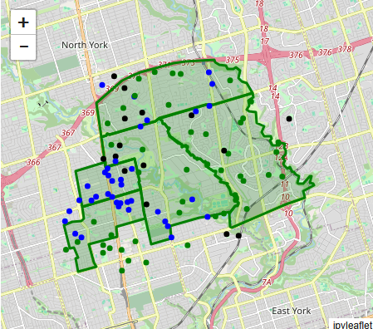
GeoSIR Epidemics Model
Mesa framework: https://mesa-geo.readthedocs.io/latest/examples/geo_sir.html
Epidemiological and spatiotemporal agent-based model
2 Agent types​
Person​
Neighbourhood
Modelling diffusion dynamics and contact network structure
4 compartments
Susceptible; Infected; Recovered; Dead
Dynamic contact network at the timestep level

Slide 9
Using calisim
GitHub - Plant-Food-Research-Open/calisim: A toolbox for the calibration and evaluation of simulation models.
Usage:
Pip
Docker
MyBinder

Slide 10
Discussion
A more standardised framework for calibrating models
New calibration opportunities for large complex simulation models
Open for collaboration
Feedback from audience
Future workshops

Slide 11

Acknowledgements
Funded by the New Zealand Ministry of Business, Innovation and Employment Strategic Science Investment Fund (contract number C11X1702) as part of the Digital Horticultural Systems Ngā Pou Rangahau, a Growing Futures™ programme of The New Zealand Institute for Plant and Food Research Limited (PFR).
BSI Staff who are working in the development of these platforms and those who have supported and worked in the programmes leading to this work

Slide 12
James.Bristow@plantandfood.co.nz
Yongqi.Liang@plantandfood.co.nz
Jingjing.Zhang@plantandfood.co.nz
M.Vignes@massey.ac.nz
D.T.S.Hayman@massey.ac.nz
Chris.VanHoutte@plantandfood.co.nz

