Slide 1



calisim: A toolbox for the calibration and evaluation of simulation models
James Bristow, Hana Liang, Jingjing Zhang, Ting-Hsuan Chen, Chris Van Houtte
Notes:
Select one cover option and delete the unused variations.

Slide 2
Overview
Calisim
Examples
Linear Regression
JFruit2
TEgenomeSimulator
Discussion

Slide 3
Terminology: Calibration
What is model calibration?
Model fitting; parameter estimation; inverse modelling
Systems-focused
Regularised functional form
Mechanistic processes
Data-focused
Example: Data-driven machine learning (e.g. random forest)
Typically less regularised functional form
Data-focused
Tune model parameters using observed data
Improve predictive accuracy

Slide 4
Calisim
Module | Supported libraries
Optimisation | 4
Sensitivity analysis | 2
Surrogate modelling | 2
Approximate Bayesian Computation | 2
Fully Bayesian Calibration | 2
History matching | 2
Evolutionary algorithms | 2
Simulation-Based Inference | 2
Uncertainty analysis | 3
Risk analysis | 1
Active learning | 1
Optimal experimental design | 1
Bayesian quadrature | 1
Toolbox for calibrating simulation models
Streamlined workflow with standardised interface: 13 modules and 19 libraries
Open-source Python library: https://github.com/Plant-Food-Research-Open/calisim

Slide 5
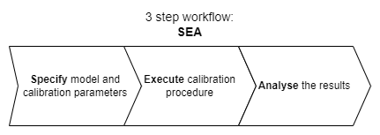
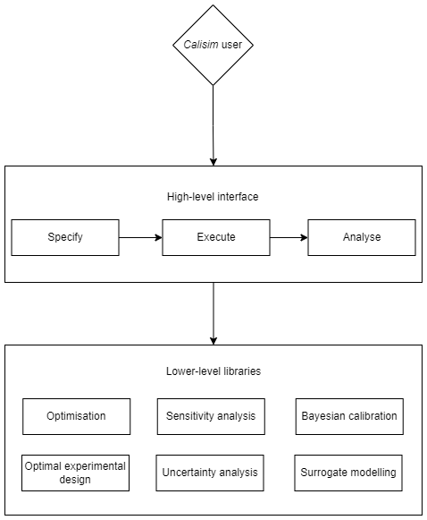
Calisim
Three step workflow
Specify
Execute
Analyse
Standardised high-level interface for all 13 modules
Encapsulation of 19 lower-level libraries
Object-oriented programming
Complex custom workflows

Slide 6

Calisim Workshop
Two demonstration models
JFruit2: A mechanistic fruit model for simulating fruit traits of interest such as fruit fresh weight.
TEgenomeSimulator: A tool to simulate TE mutation and insertion into a random-synthesised or user-provided genome.
How could calisim be used for your own modelling workflows?
After the workshop
Feedback and suggestions welcome

Slide 7
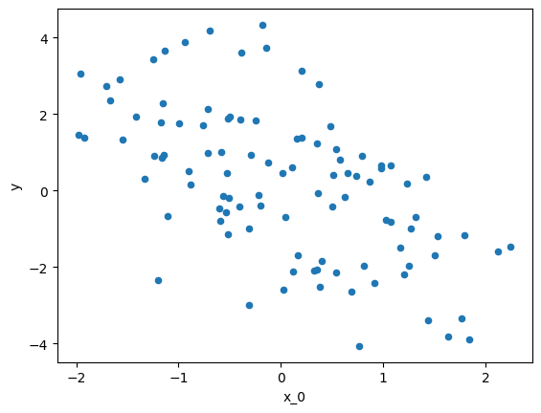
Linear Regression
A simple motivating example
Multiple linear regression
5 independent variables
Simulation study
Recover ground truth independent variable values

Slide 8
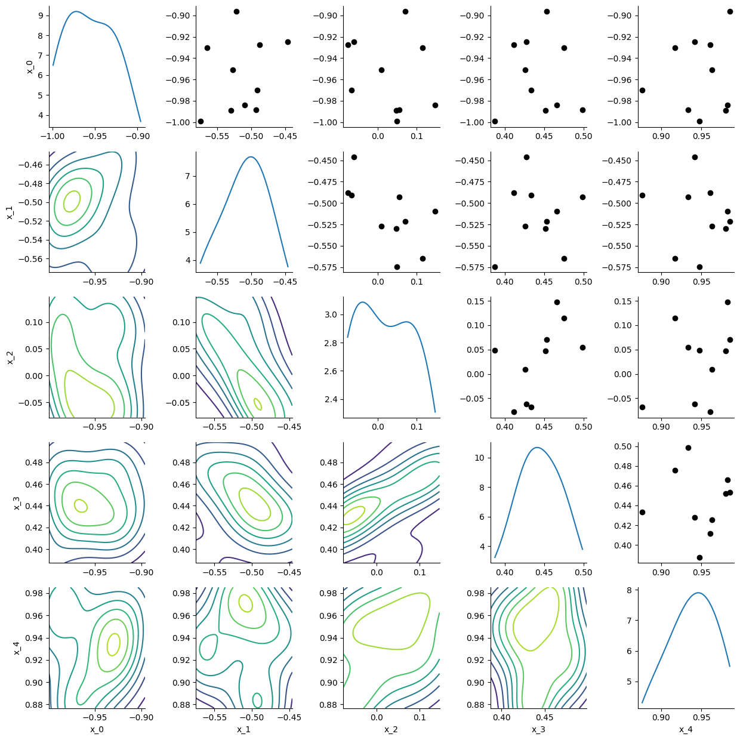
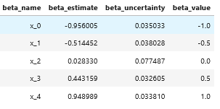
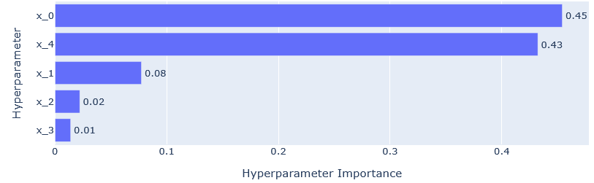
Linear Regression
Calibration procedures
Sensitivity Analysis
Black-box Optimisation
Bayesian Calibration
Usually not necessary for linear regression. Gradient-based optimisation using least squares
Beneficial for more complex models

Slide 9
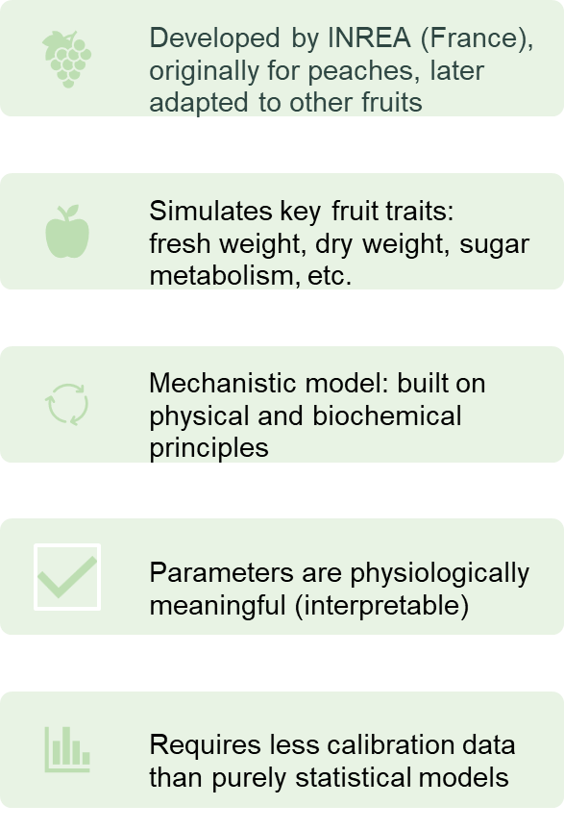
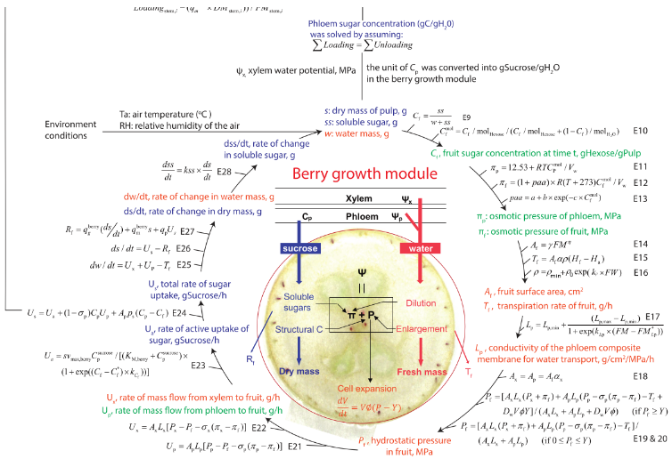
JFruit2 - A Fruit Growth Model (Zhu et al. 2019)

Slide 10
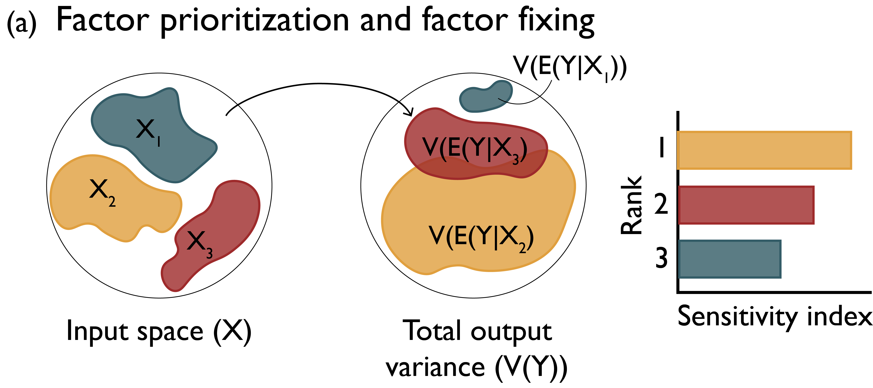
JFruit2 Sensitivity analysis
Sensitivity analysis associate the output variance to inputs via variance decomposition, and a common way is through quasi-random sampling (Saltelli)
Workflow: Define ranges → Sample → Run model → Compute S1/ST → Rank & act
Indices: S1 (main), ST (total), ST−S1 (interaction signal)
It helps modellers to understand model behaviour and improve model design
Reed, P.M., Hadjimichael, A., Malek, K., Karimi, T., Vernon, C.R., Srikrishnan, V., Gupta, R.S., Gold, D.F., Lee, B., Keller, K., Thurber, T.B, & Rice, J.S. (2022). Addressing Uncertainty in Multisector Dynamics Research [Book]. Zenodo. https://doi.org/10.5281/zenodo.6110623
https://uc-ebook.org/docs/html/3_sensitivity_analysis_the_basics.html
Sensitivity Analysis in Practice : A Guide to Assessing Scientific Models
https://www.andreasaltelli.eu/file/repository/SALTELLI_2004_Sensitivity_Analysis_in_Practice.pdf

Slide 11


Transposable elements (TEs)
Genome
Chromosome
Mutagenic insertions
Genome instability
Physiological dysfunction
Gene
TE
TE
Tissue-specific development
Environmental adaptation
Genome evolution
Jönsson et al. (2020) Transposable Elements: A Common Feature of Neurodevelopmental and Neurodegenerative Disorders. Trends in Genetics. 36, 610

Slide 12


Why is it difficult to accurately identify TEs in genomes?
Nested TEs: One TE can insert into another, making boundaries hard to define.
Variable nature: Mutations and truncations cause TEs to diverge, making older elements difficult to detect.
TE
TE
TE
TE
Novel TEs: Known-sequence methods miss entirely new TEs, while de novo approaches risk false positives.
Lineage-specific TEs: Many TE families are species-specific, so using distant references often misses them.
New TEs
TE database
TE database
Undetected new TEs

Slide 13
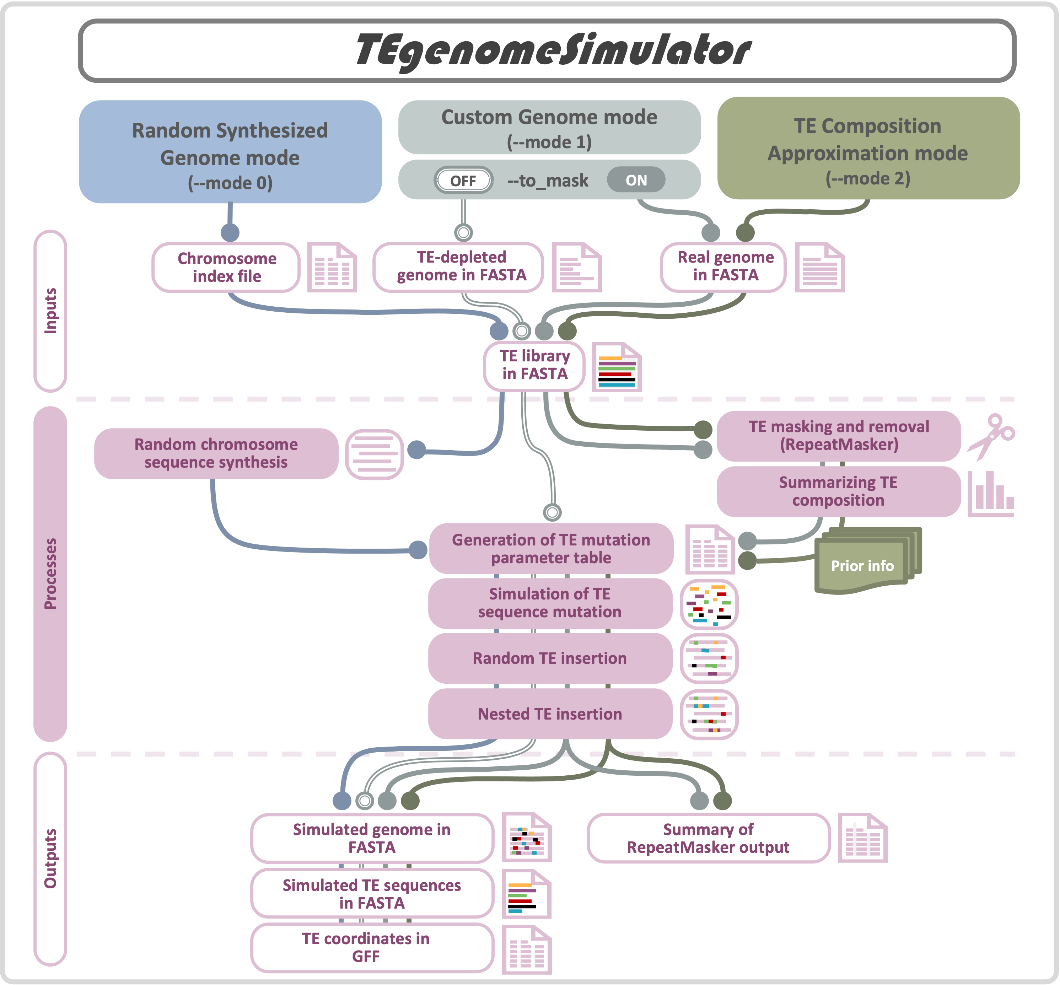
TEgenomeSimulator
A tool to simulate transposable element (TE) mutation and insertion into a random-synthesised or user-provided genome.
The resulting simulated genome can be used for benchmarking TE detection tools.
Three running modes:
Mode 0: Random Synthesized Genome mode.
Mode 1: Custom Genome mode.
Mode 2: TE Composition Approximation mode.
https://github.com/Plant-Food-Research-Open/TEgenomeSimulator
Funding: KRIP Genome Landscape Objective led by Susan Thomson

Slide 14
Using calisim
GitHub - Plant-Food-Research-Open/calisim: A toolbox for the calibration and evaluation of simulation models.
Usage:
pip
Docker
MyBinder

Slide 15
Discussion
A more standardised framework for calibrating models
New calibration opportunities for large complex simulation models
Open for collaboration
Feedback from audience
Future workshops

Slide 16

Acknowledgements
Funded by the New Zealand Ministry of Business, Innovation and Employment Strategic Science Investment Fund (contract number C11X1702) as part of the Digital Horticultural Systems Ngā Pou Rangahau, a Growing Futures™ programme of The New Zealand Institute for Plant and Food Research Limited (PFR).
BSI Staff who are working in the development of these platforms and those who have supported and worked in the programmes leading to this work

Slide 17
James.Bristow@plantandfood.co.nz
Yongqi.Liang@plantandfood.co.nz
Jingjing.Zhang@plantandfood.co.nz
Ting-Hsuan.Chen@plantandfood.co.nz
Chris.VanHoutte@plantandfood.co.nz

