Slide 1
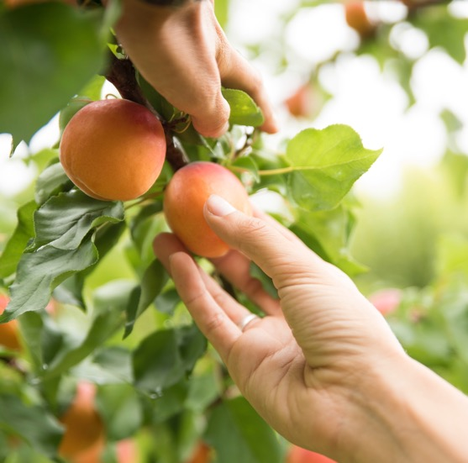
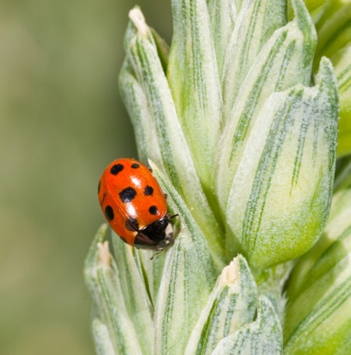

Pipeline development for R: Working with tidymodels
James Bristow, Jingjing Zhang, Hana Liang, Lindy Guo
Notes:
Select one cover option and delete the unused variations.

Slide 2
Overview
Introduction
Examples
tidymodels
H2O
vetiver
Docker
Kubernetes
Discussion

Slide 3




Introduction
Part 1: tidymodels, workflowsets, and H2O: Machine learning workflows
workflowsets and stacking
conformalisation with probably
Model interpretation with DALEX
AutoML with H2O
Part 2: vetiver and plumber over Kubernetes: MLOps
Model cards
S3
Containerisation
Deployment on Kubernetes

Slide 4


tidymodels
Framework in R with tidyverse principles
Ecosystem of R packages
Standardised machine learning workflows using common interface
workflowsets
Organise workflow objects
stacks
Construct stacking ensembles
probably
Calibration for classification
Non-parametric uncertainty quantification
DALEX
Model interpretability

Slide 5
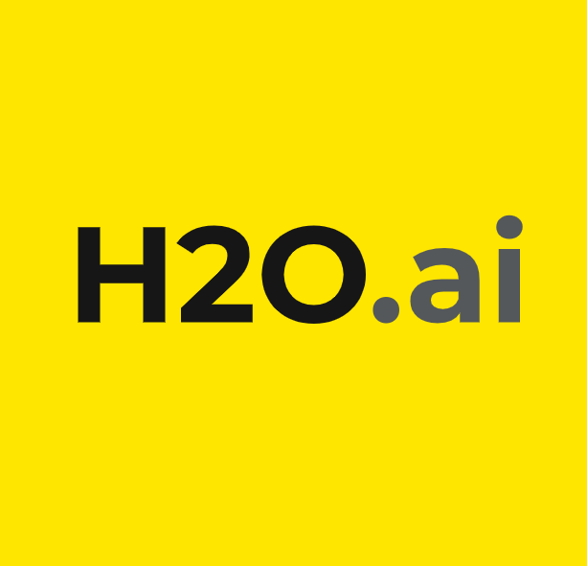
H2O
Machine learning platform
Supports many machine learning algorithms
AutoML
Train and compare many models
Interface in R
Integration with tidymodels, DALEX, and probably
Notes:
H2O is an open source machine learning platform you can use with R and the h2o package. What makes h2o special compared to caret and mlr is that h2o is designed for scalability. This means that the implementations of h2o's machine learning algorithms can be trained on distributed clusters. That's why you need to initiate an h2o cluster with the h2o.init()

Slide 6


vetiver and plumber
vetiver
MLOps: Model versioning, storage, monitoring, and deployment
Pins: Discover and share resources in S3
Model cards
Transparent model reporting
plumber
Web applications: REST APIs
Model deployment
Docker
Containerisation: Package, deploy, and run software
Kubernetes
Platform for the orchestration of containers

Slide 7
Machine Learning Pipeline
Data Splitting
Cross validation
Hyper-parameter optimisation
Stacking ensemble
Uncertainty Quantification
Model Interpretation
Partial Dependence
Residuals
Model versioning, sharing, and deployment
Model cards
Containerisation
Deployment on Kubernetes

Slide 8
Discussion
Attendee feedback
Where next for future workshops?
Questions from audience
Could this be useful for your own work?

Slide 9
Pipeline development for R: Working with Stan
Tom Moore, James Bristow
Notes:
Select one cover option and delete the unused variations.

Slide 10
Overview
Introduction
Examples
Causal inference
brms
cmdstanr
Docker
Kubernetes
Discussion

Slide 11


Introduction
Part 1: Causal inference with Stan
What is causal inference and why do we want it?
brms
cmdstanr
Part 2: vetiver and plumber over Kubernetes: MLOps
Model cards
S3
Containerisation
Deployment on Kubernetes

Slide 12
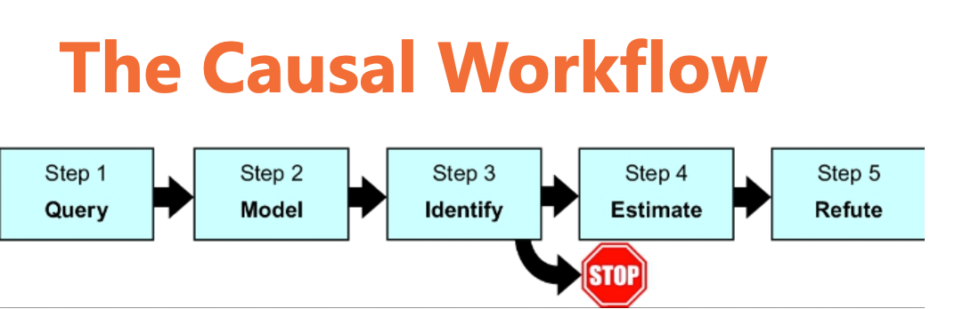
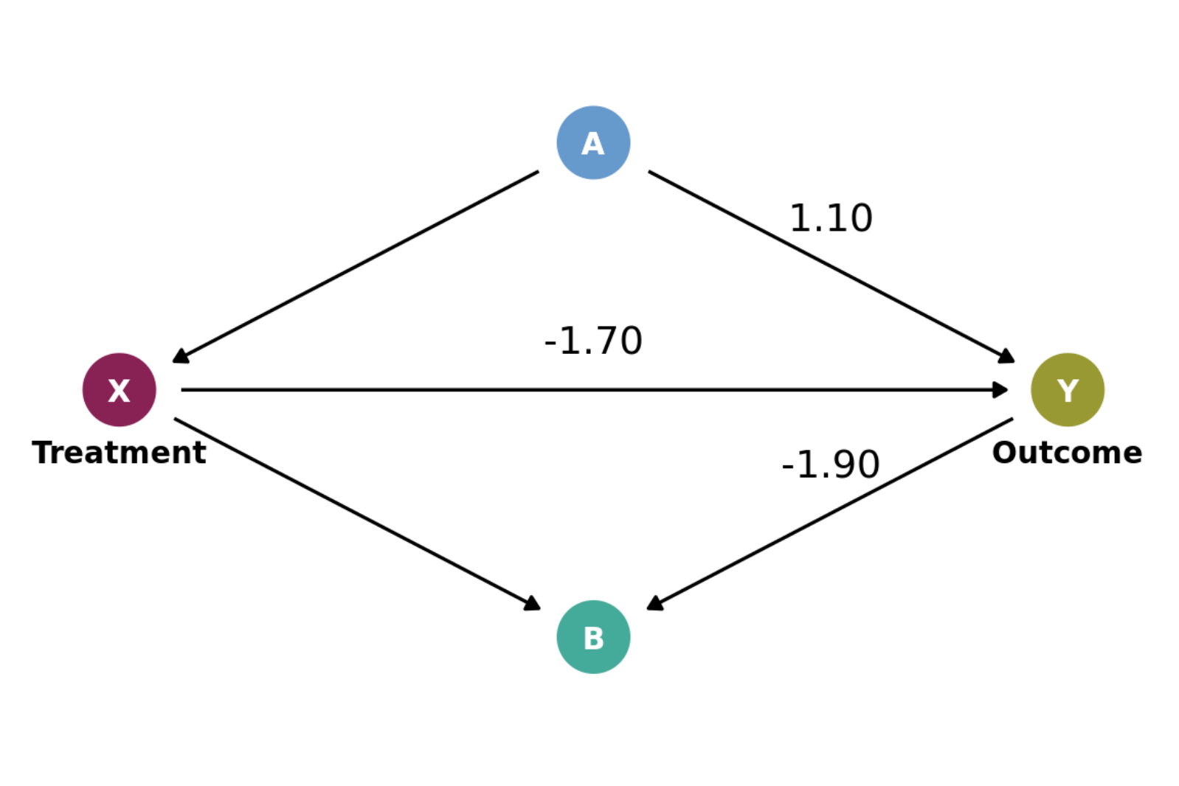
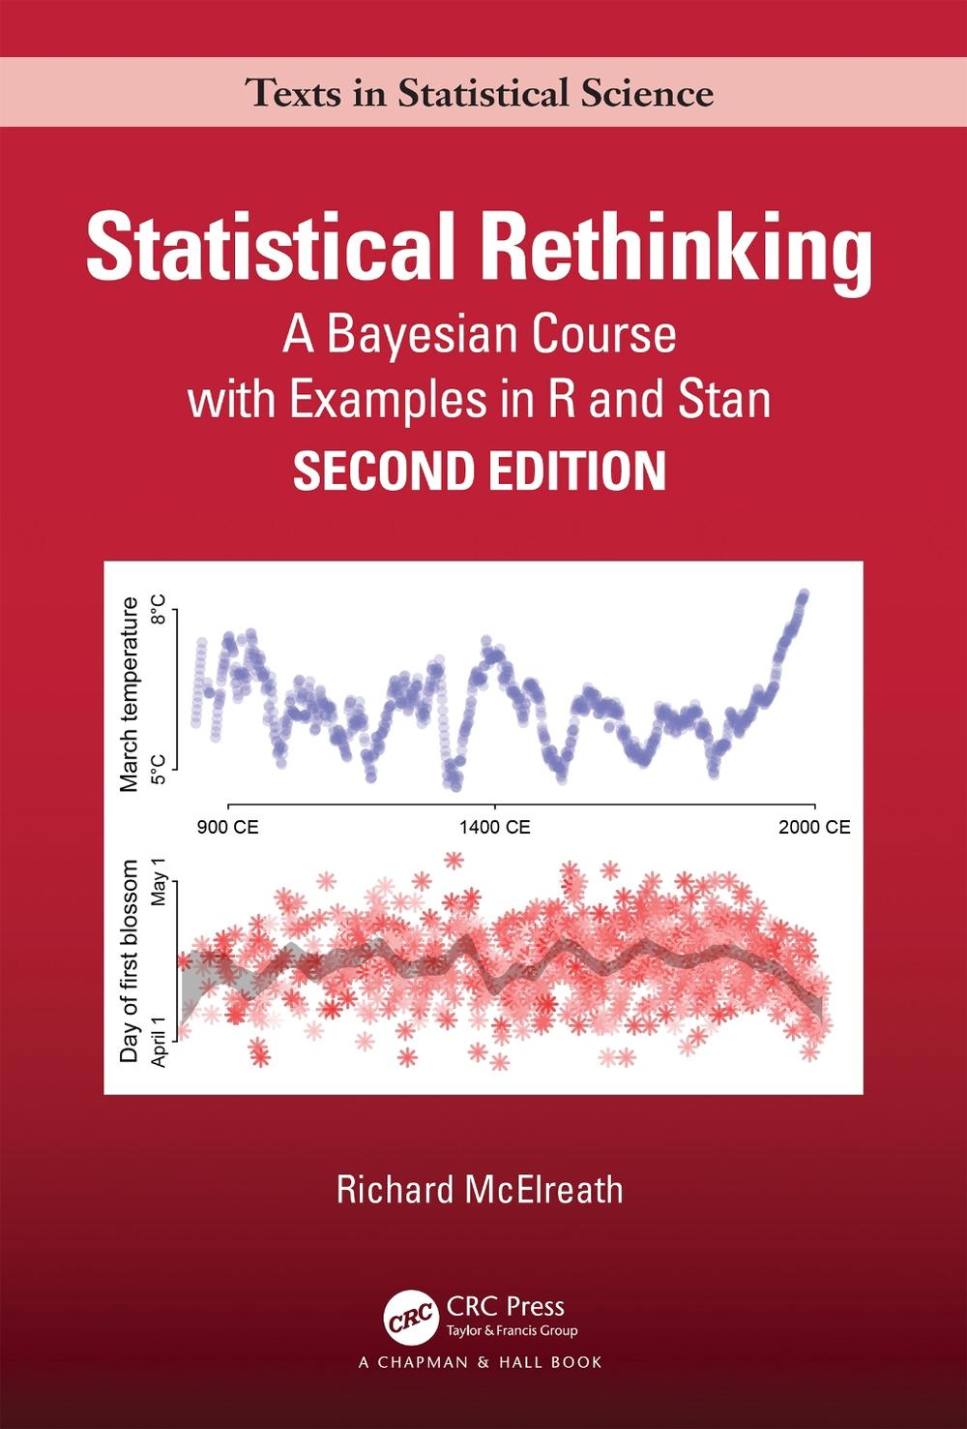


Causal inference
The case for causal inference
Applications and context
The Causal Hierarchy
The Causal Workflow
Why Bayes?
Structural Causal Models
Backdoor criterion (Daggity)
Estimation
Extensions
Commodification of causal identification and inference

Slide 13



Stan
Probabilistic programming language
Bayesian inference
Hamiltonian Monte Carlo and NUTS
brms
Higher-level R interface with lme4-like syntax
DoWhy
GPU
PyMC and Pyro

Slide 14
vetiver and plumber
vetiver
MLOps: Model versioning, storage, monitoring, and deployment
Pins: Discover and share resources in S3
Model cards
Transparent model reporting
plumber
Web applications: REST APIs
Model deployment
Docker
Containerisation: Package, deploy, and run software
Kubernetes
Platform for the orchestration of containers

Slide 15
Discussion
Attendee feedback
Where next for future workshops?
Questions from audience
Could this be useful for your own work?

Slide 16

Acknowledgements
Funded by the New Zealand Ministry of Business, Innovation and Employment Strategic Science Investment Fund (contract number C11X1702) as part of the Digital Horticultural Systems Ngā Pou Rangahau, a Growing Futures™ programme of The New Zealand Institute for Plant and Food Research Limited (PFR).
BSI Staff who are working in the development of these platforms and those who have supported and worked in the programmes leading to this work

Slide 17
James.Bristow@plantandfood.co.nz
Jingjing.Zhang@plantandfood.co.nz
Tom.Moore@plantandfood.co.nz
Yongqi.Liang@plantandfood.co.nz
Lindy.Guo@plantandfood.co.nz

