Slide 1


z
x
y
Causal Inference SLT presentation

Slide 2
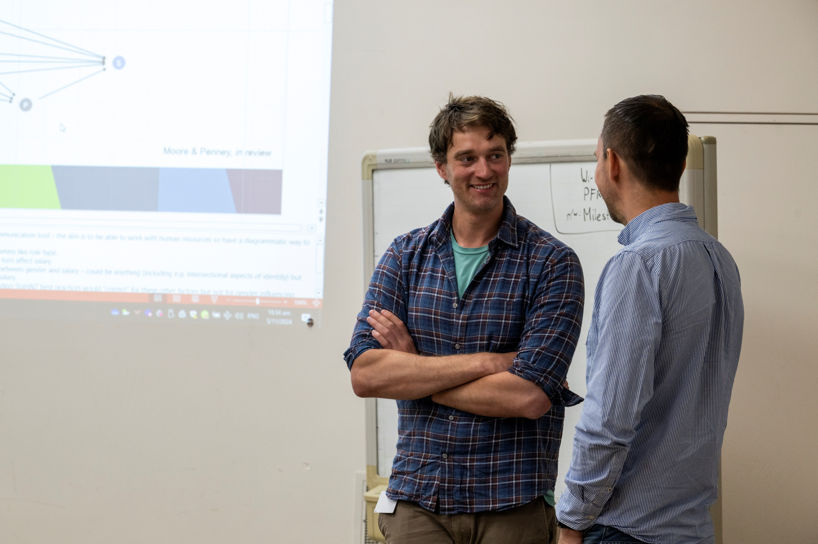


z
x
y
Causal Inference SLT presentation

Slide 3
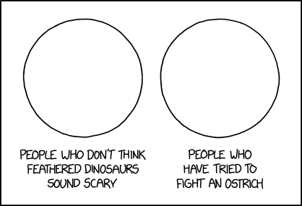
Causal Inference is part of the scientific endeavor
Without consideration of the causal structure of data, rifts form between science and statistics
People who know data
People who know stats

Slide 4
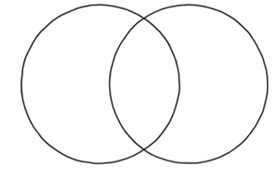
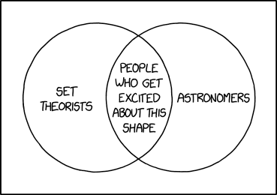
Causal inference =
1 Description
2 Prediction
3 Association
4
data
stats
People who know causal inference
Notes:
A goal of the scientific method
A language between domain experts and data people
Applicable to all data

Slide 5
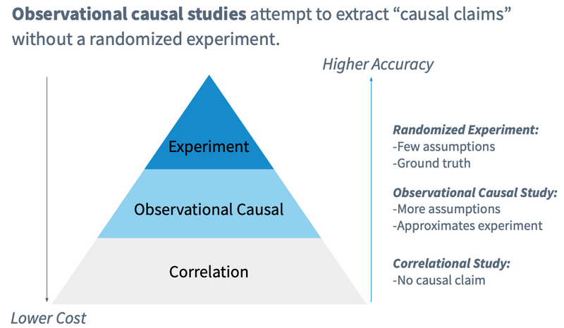
Correlation is not causation but…
Bojinov, I., Chen, A., & Liu, M. (2020). The Importance of Being Causal. Harvard Data Science Review.
Notes:
Correlation is not causation, but sometimes it is.
Experiments
Smoking – Unethical
Observational data

Slide 6
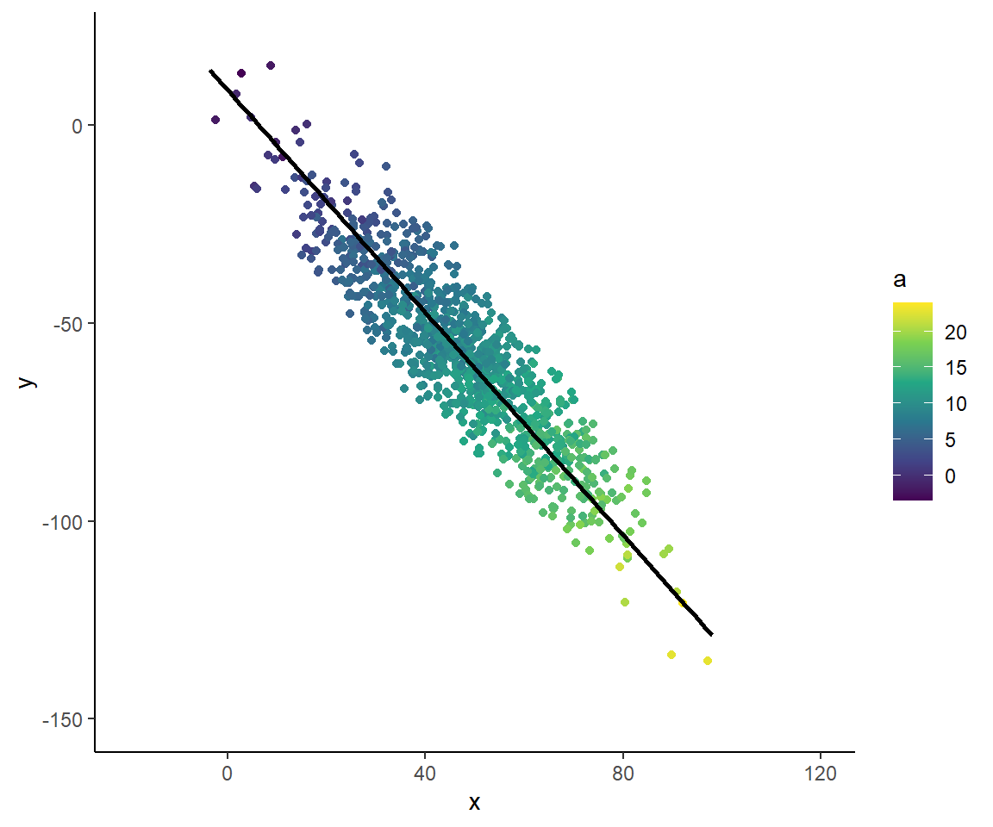


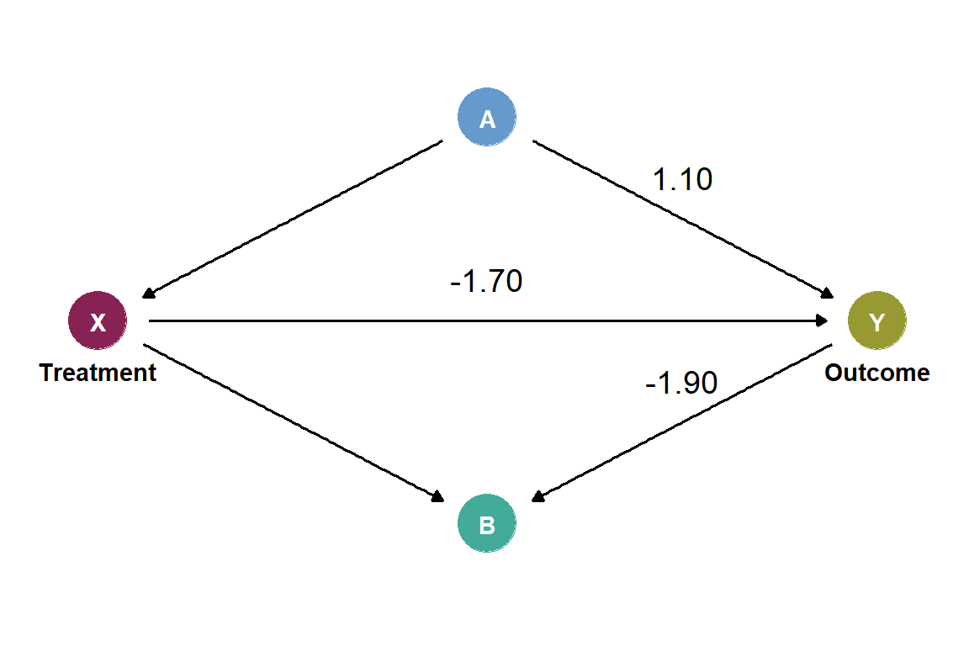

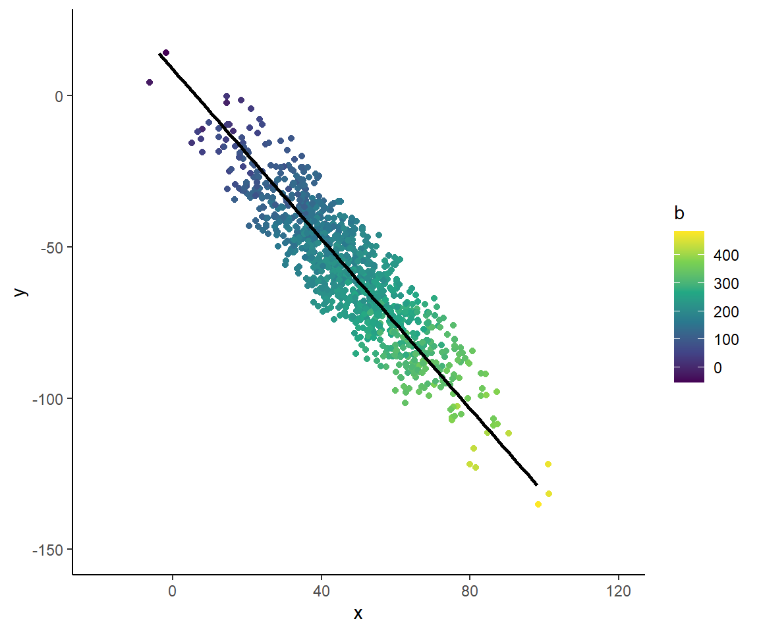

Relationships matter
N = 1000

Slide 7
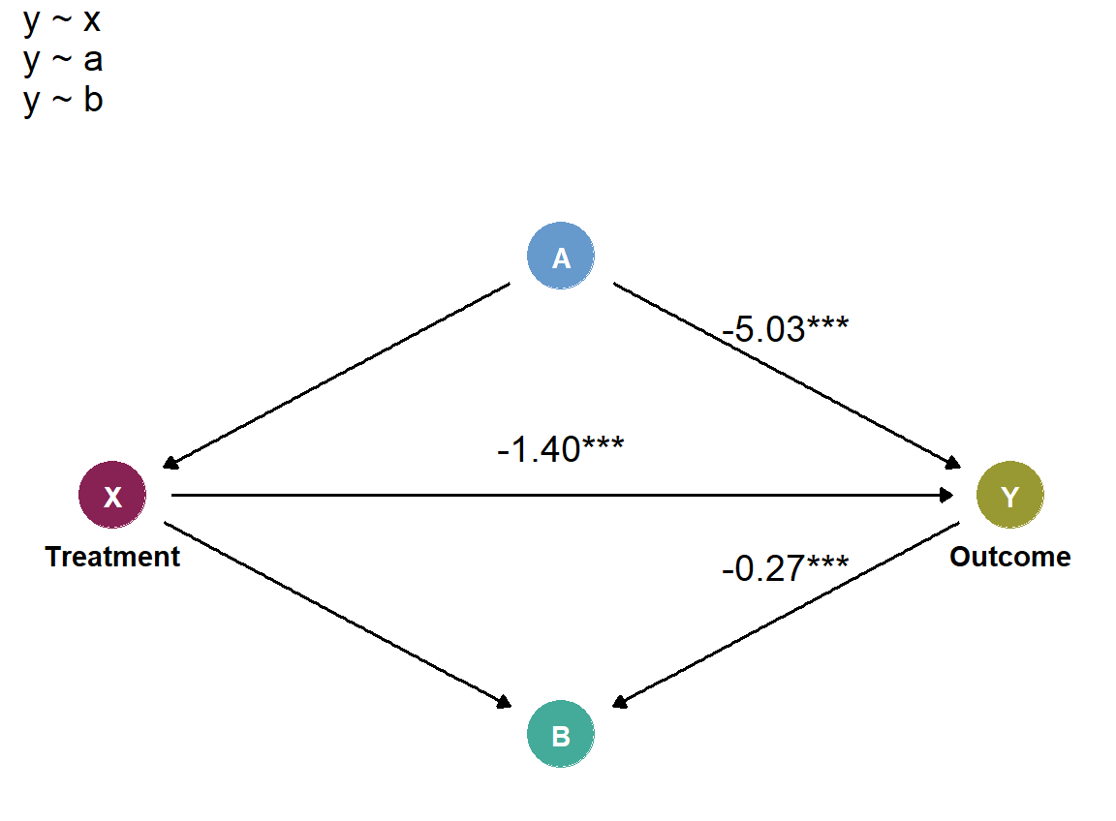
Kiwifruit rootstock stage 2
- One variable at a time
GLM Univariate approach: association only
# misleading p-values
Notes:
Out by about 17%

Slide 8
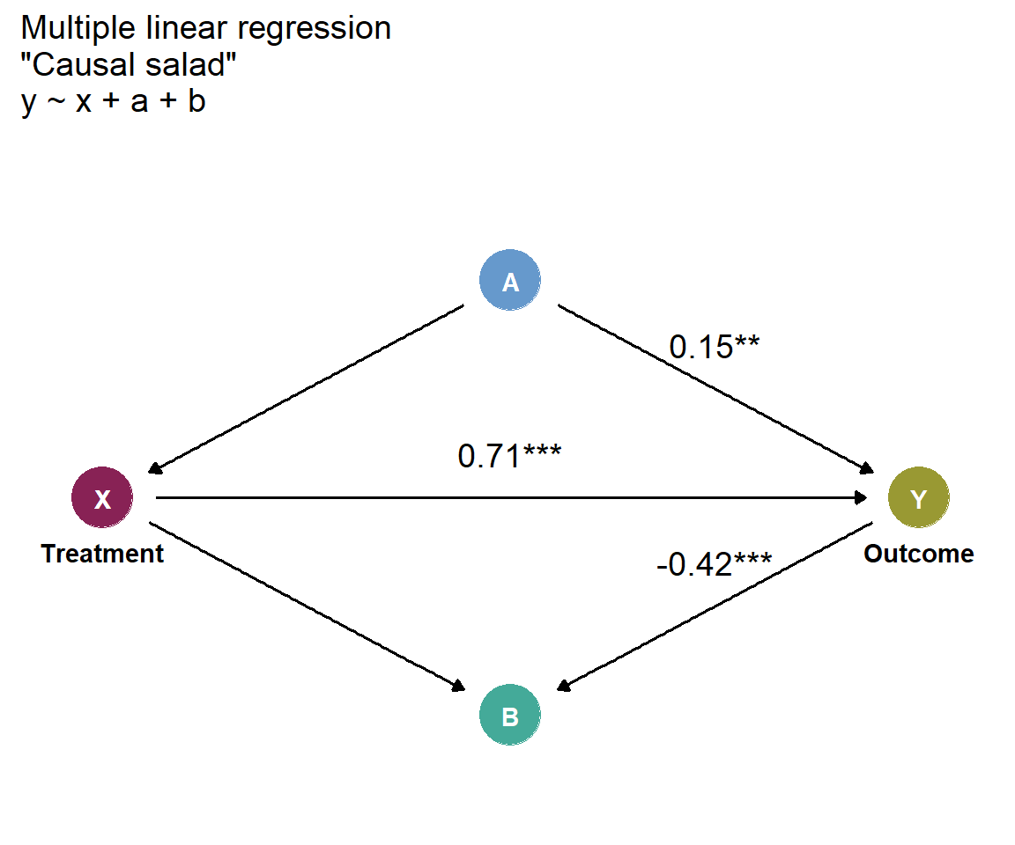
Causal salad
- All variables at a time
GLM Multivariate approach: prediction only
# Causal Salad # Table 2
Notes:
- Causal salad: lettuce, tomatoes, ranch dressing, crotons.

Slide 9
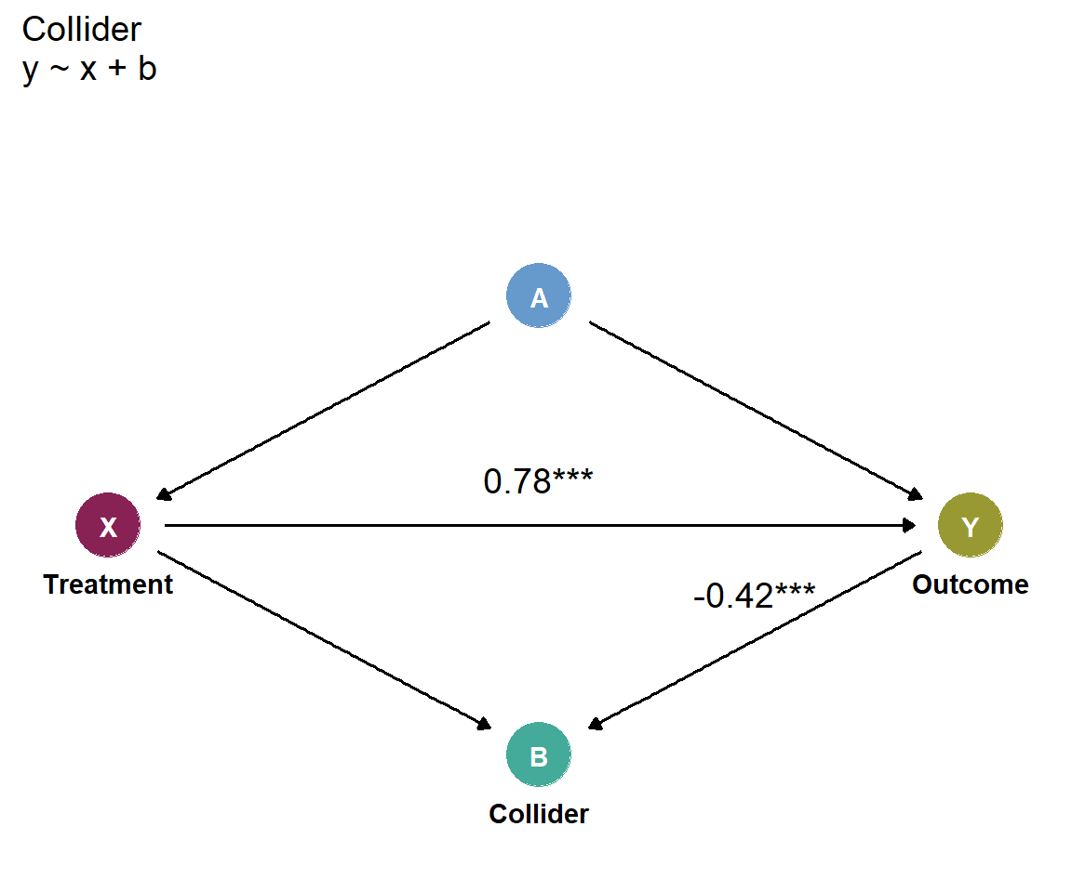
Collider
- Only B
Adjusted incorrectly

Slide 10

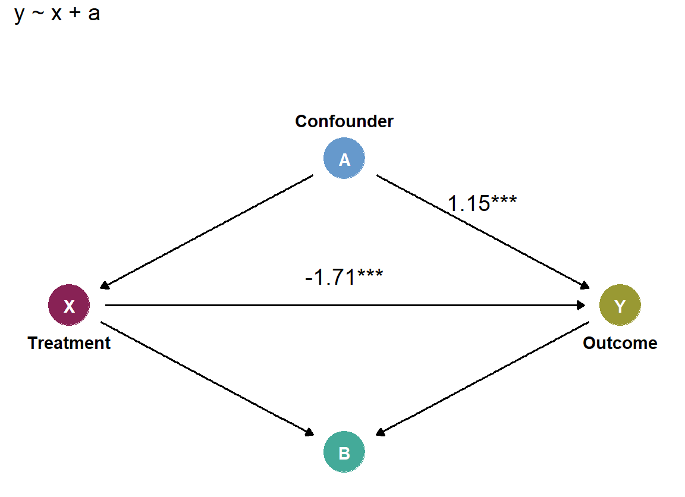
Confounder
- Only A
Adjusted correctly

Slide 11
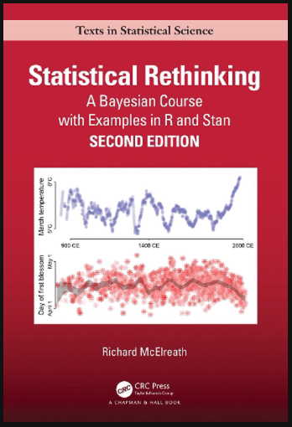
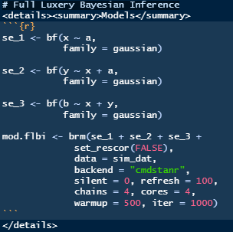
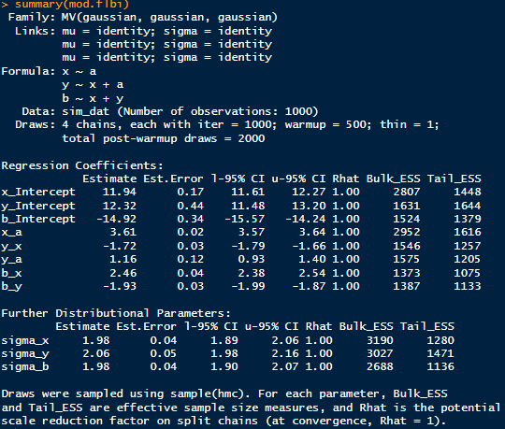
Full Luxury Bayesian Inference
- Include all variables but specify causal structure

Slide 12
Causal inference =
1 Mental model
2 Causal model
3 Statistical model
4
data
stats
People who know causal inference
Notes:
A goal of the scientific method
A language between domain experts and data people
Applicable to all data

Slide 13
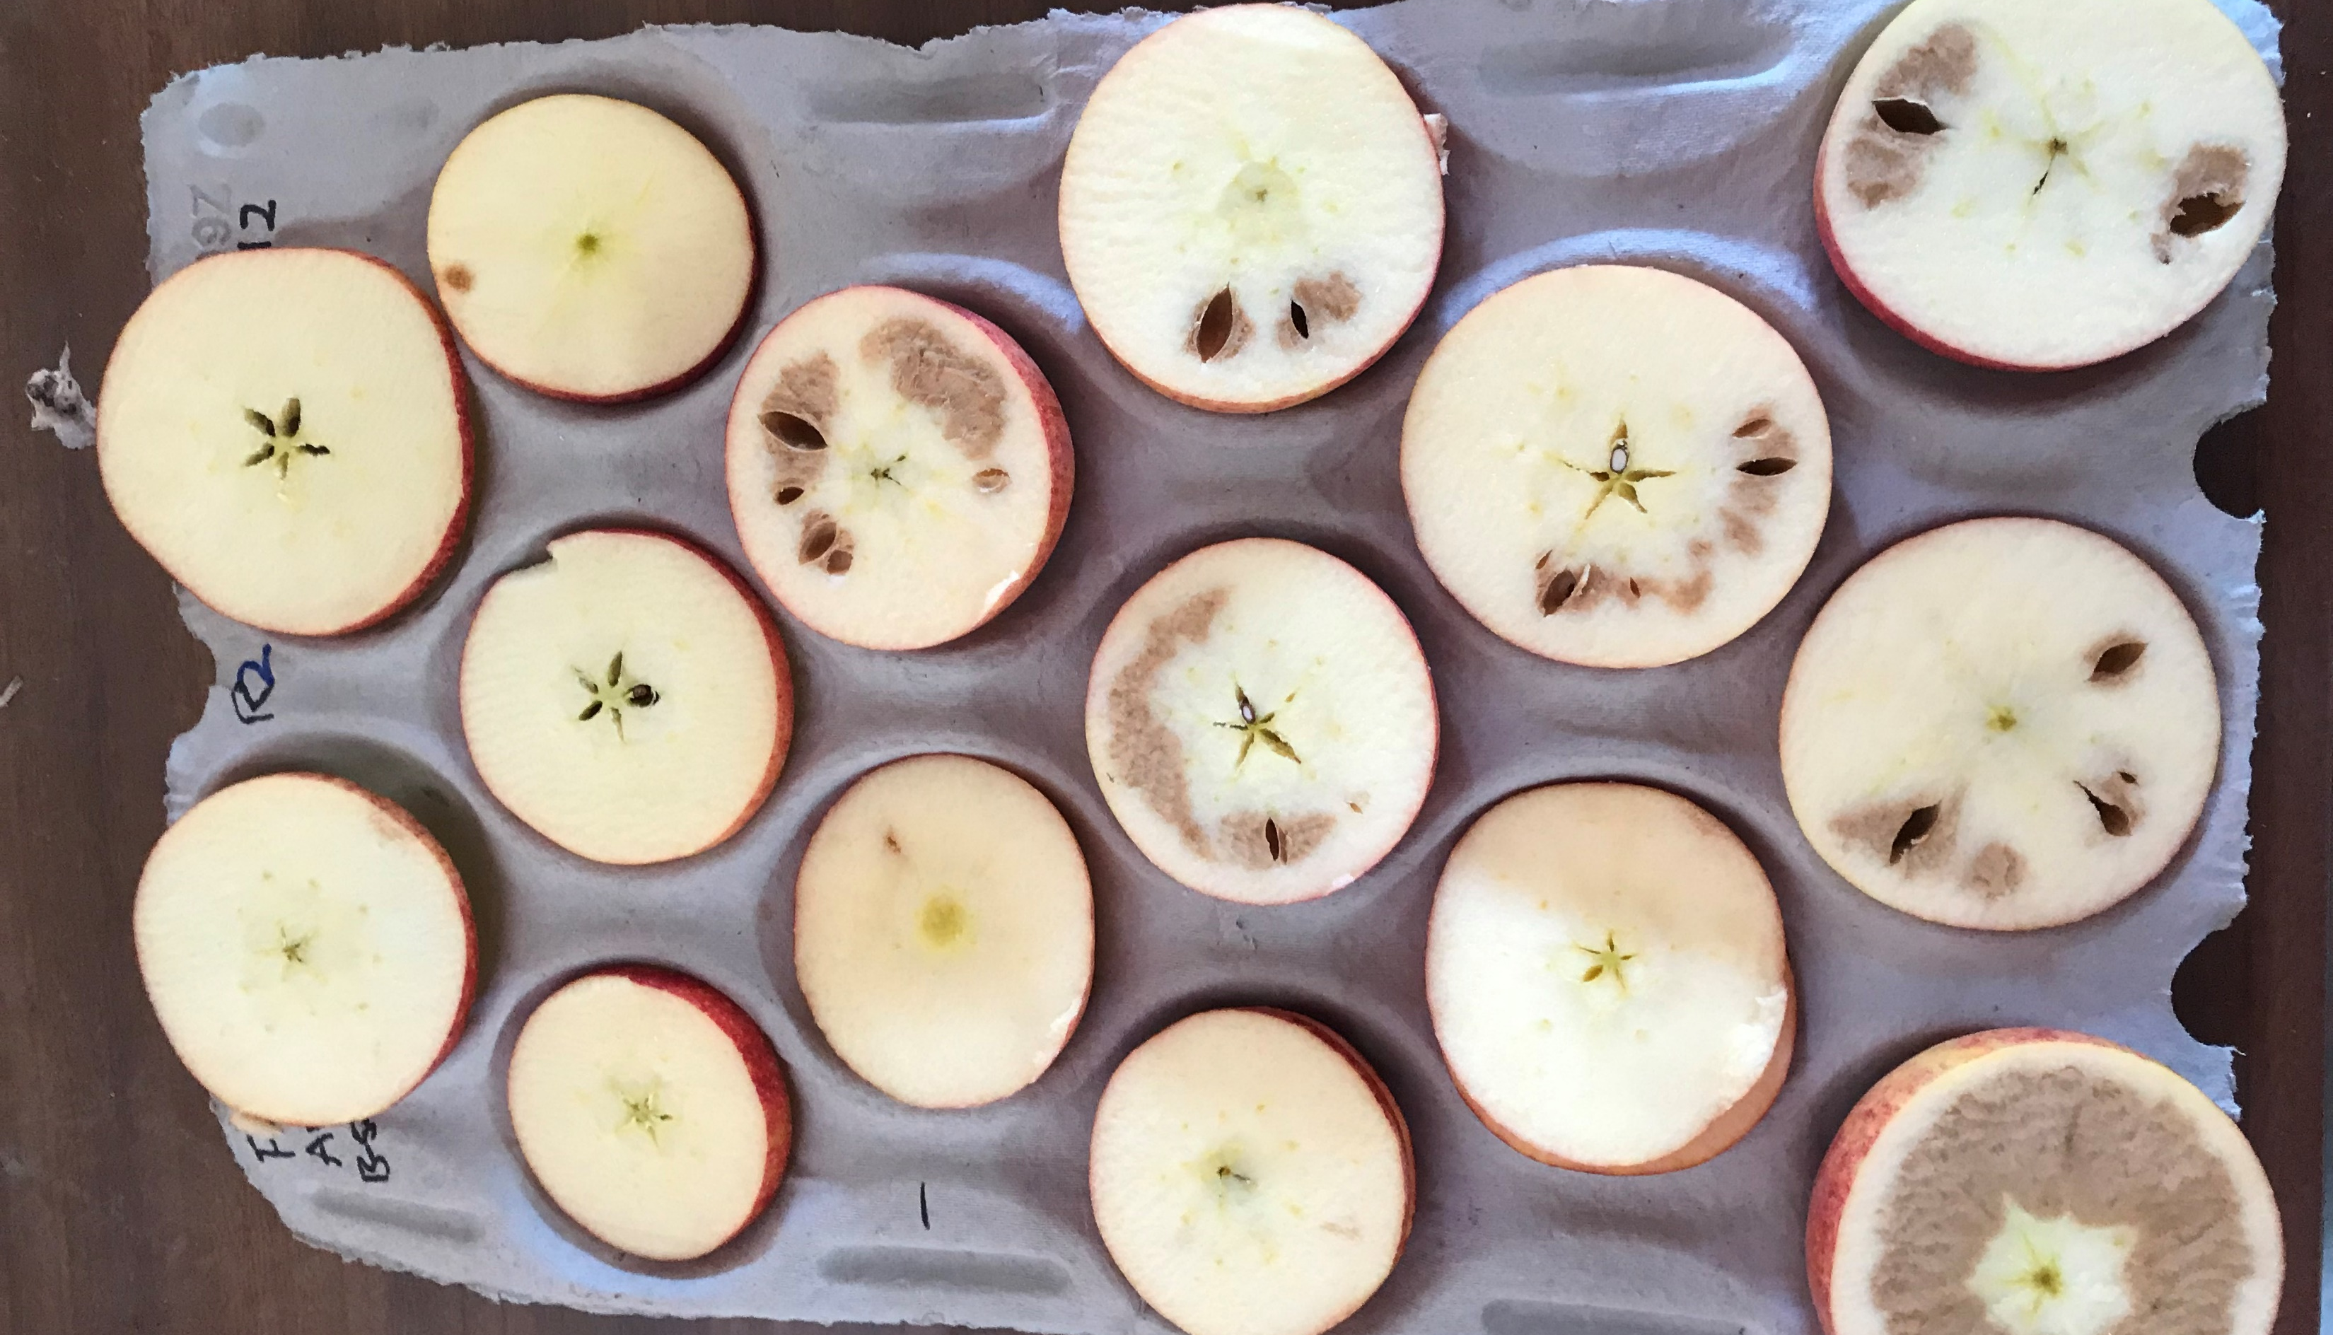
Internal browning disease in apples
Notes:
A goal of the scientific method
A language between domain experts and data people
Applicable to all data

Slide 14
z
x
y
Causal Inference SLT presentation

