Slide 1
Metaboanalyst steps

Slide 2
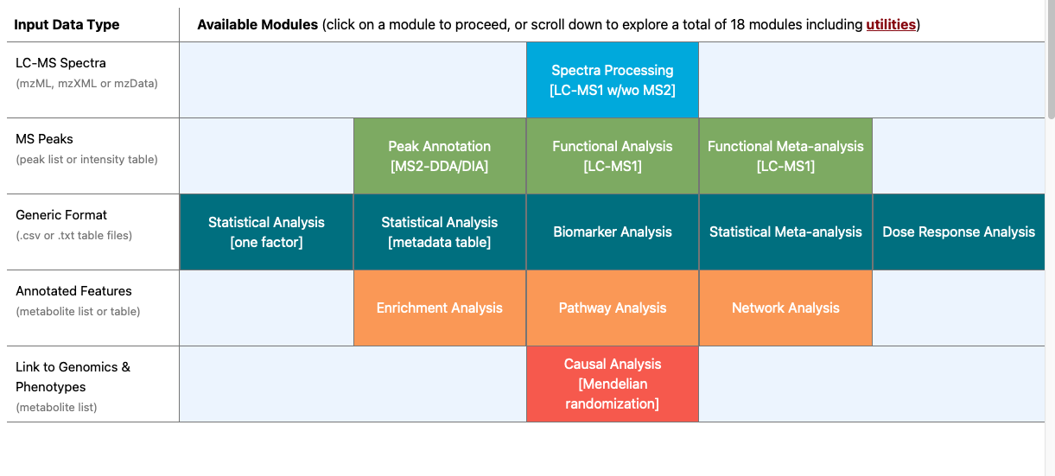
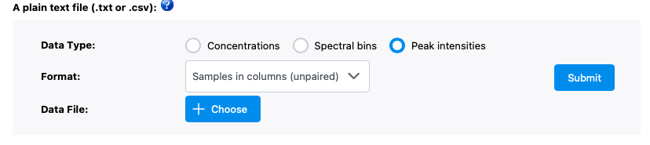

Slide 3
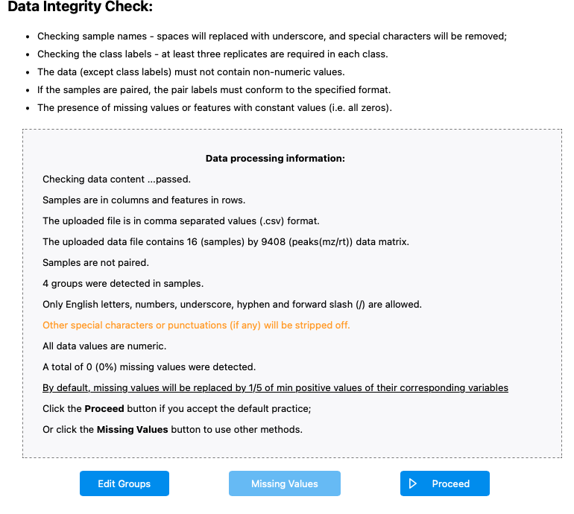

Slide 4
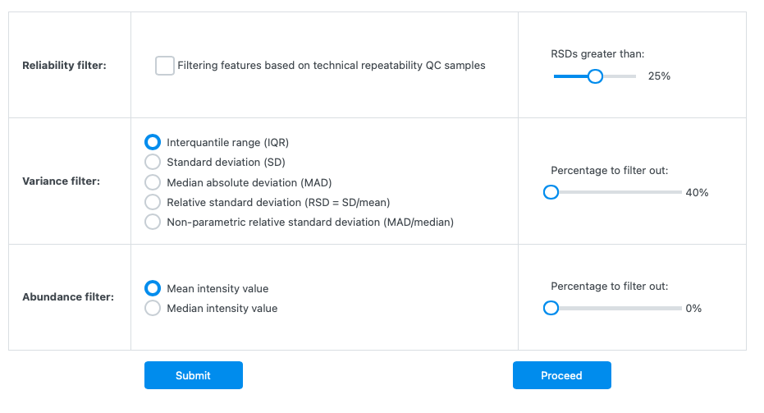

Slide 5
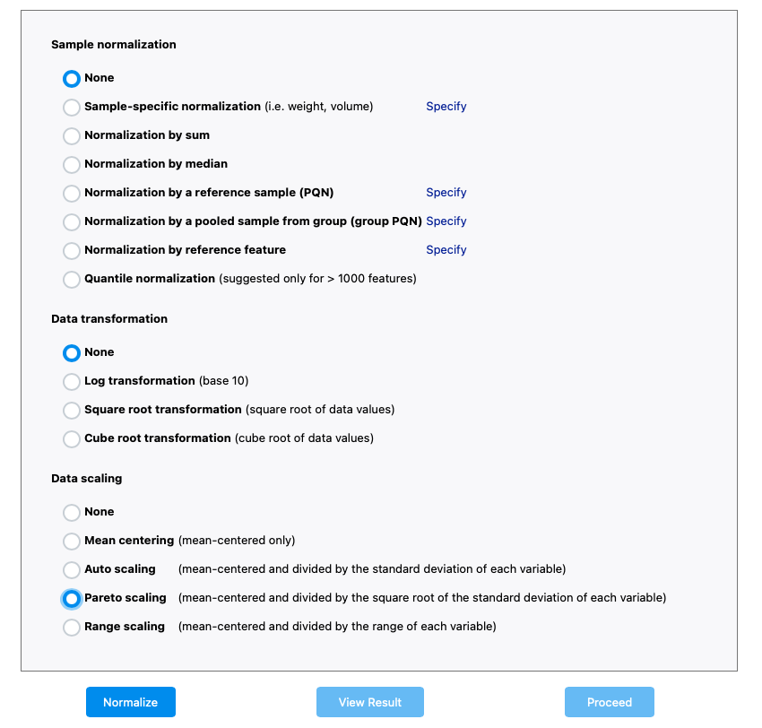

Slide 6
Colours:
"Mock_Water" = "#0000FF",
"Mock_BABA" = "#117733",
"Mock_JA" = "#AA4499",
"Mock_SA" = "#DDCC77",
"PM_Water" = "#33bbee",
"PM_BABA" = "#44AA99",
"PM_JA" = "#882255",
"PM_SA" = "#999933”
Shapes:
19 (circle) for mock
17 (triangle) for PM

Slide 7
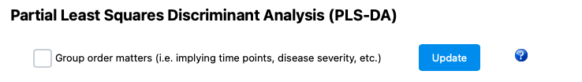
Have unticked this box as time-points are separate

Slide 8
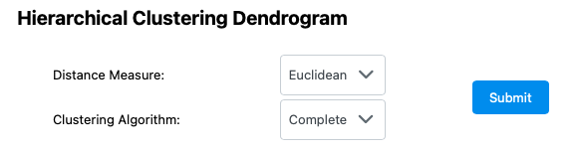
These options match those used in R for RNAseq data

Slide 9
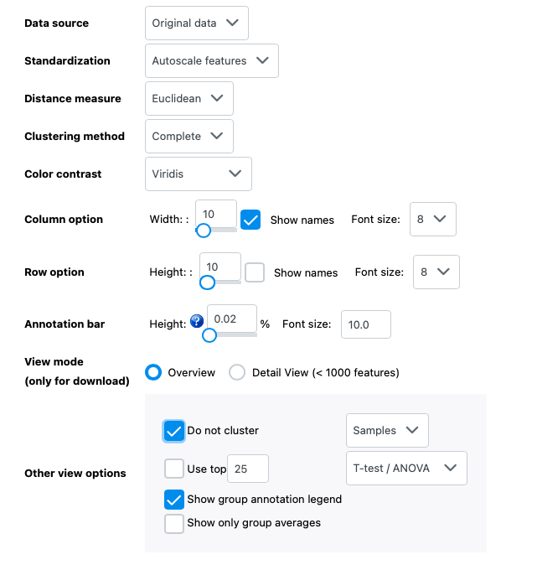
Use original data and autoscale to match transcriptomics heatmaps
Heatmap options
Note The maximum number of features can be displayed is 2000 features (selected based on IQR by default).

