Slide 1




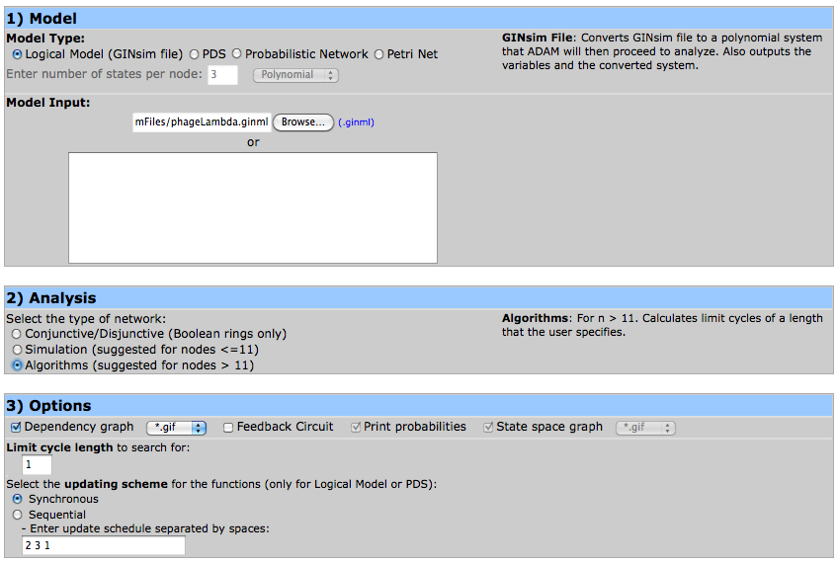
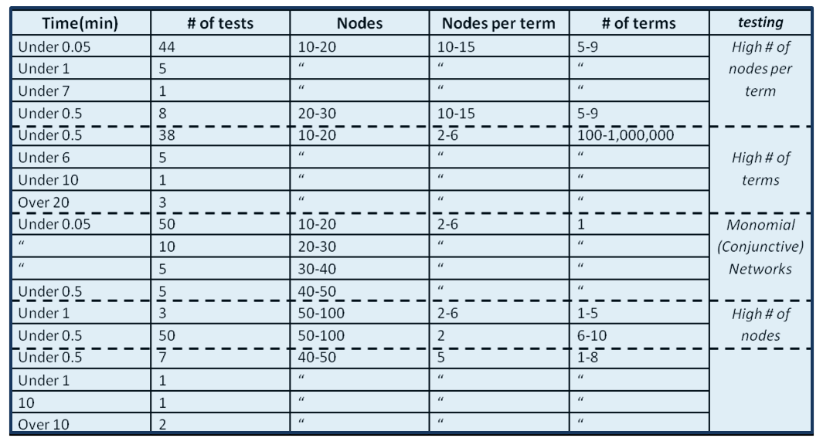
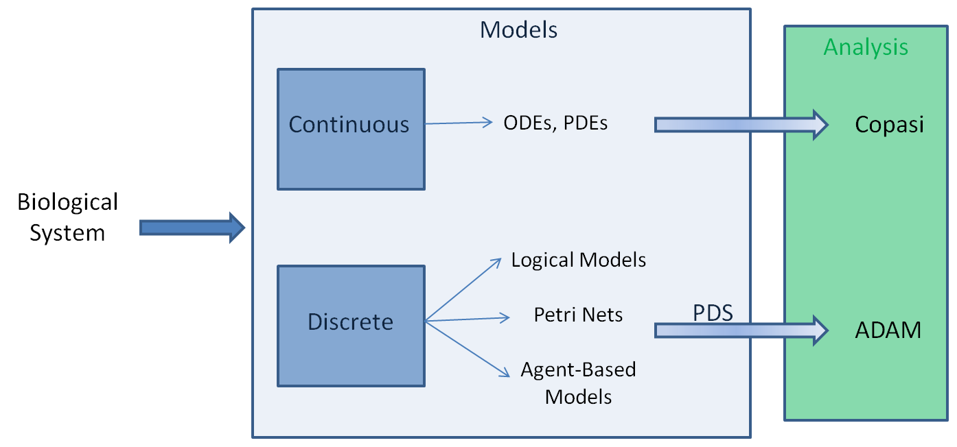
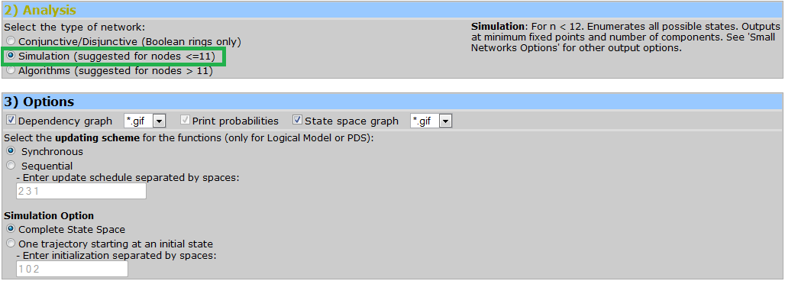
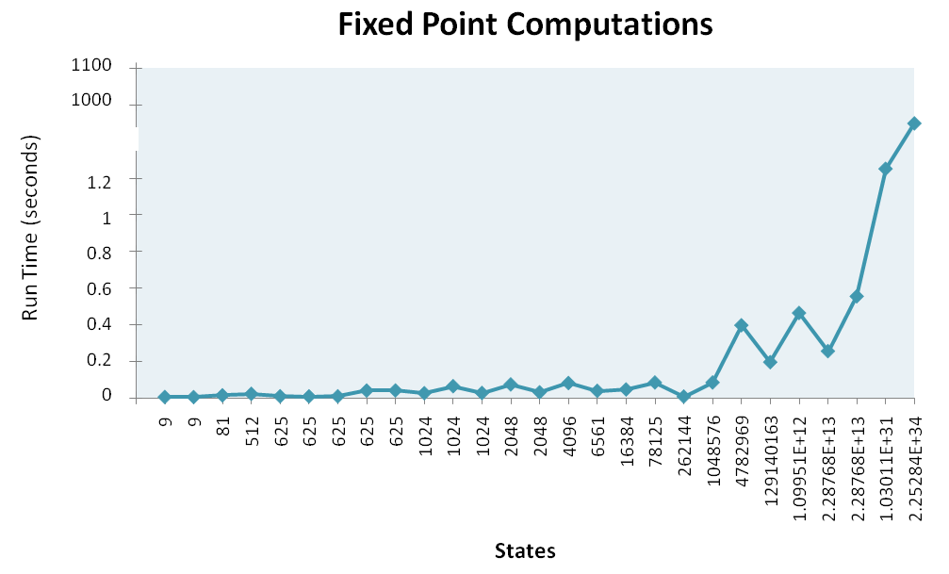
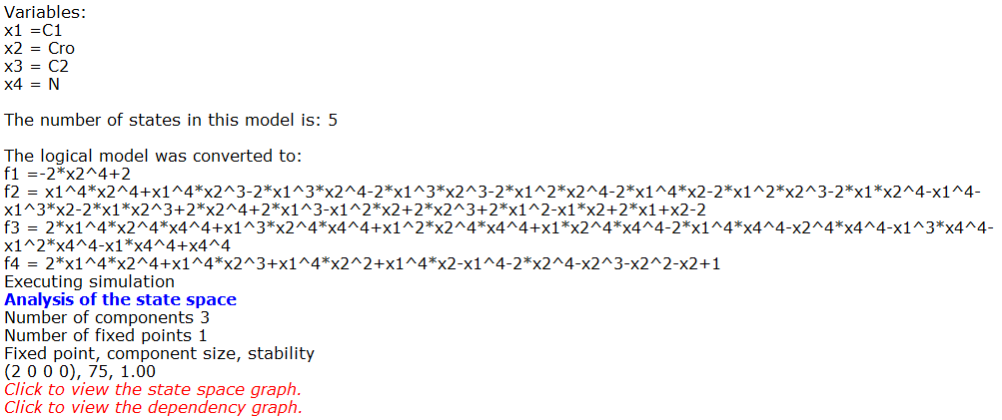

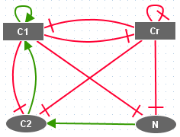
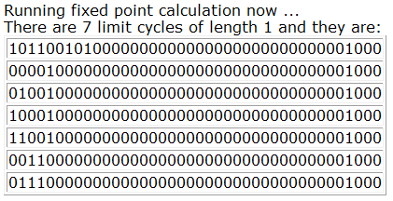
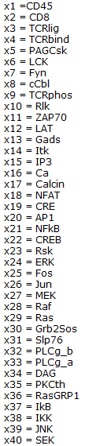

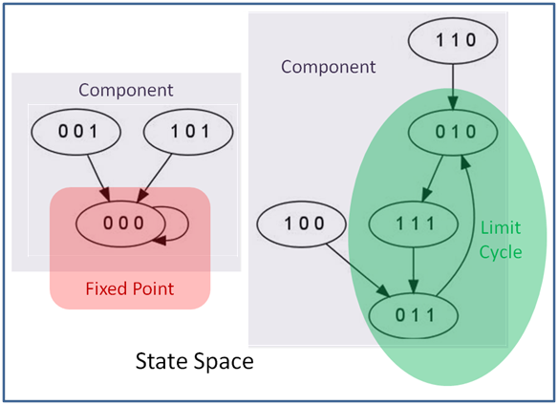
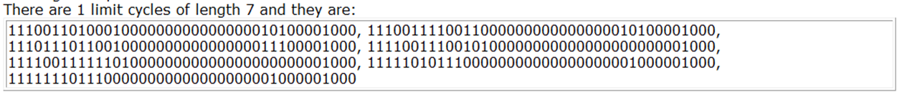
ADAM: Analysis of Discrete Models of Biological
Systems Using Computer Algebra
Franziska Hinkelmann^{de}, Madison Brandon^{a*}, Bonny Guang^{b*}, Rustin McNeill^{c*}, Alan Veliz-Cuba^{f}, Abdul S. Jarrah^{g}, Grigoriy Blekherman^{h}, Reinhard Laubenbacher^{de}
ªUniversity of Tennessee - Knoxville, Knoxville, TN 37996-2513, USA, ^{b}Harvey Mudd College, Claremont, CA 91711-5901, USA, ^{c}University of North Carolina - Greensboro, Greensboro, NC 27402-6170, USA, ^{d}Department of Mathematics, Virginia Polytechnic Institute and State University, Blacksburg, VA 24061-0123, USA, ^{e}Virginia Bioinformatics Institute, Blacksburg, VA 24061-0477, USA , ^{e}Department of Mathematics, University of Nebraska-Lincoln, Lincoln NE 68588-0619, ^{g}Department of Mathematics and Statistics, American University of Sharjah, Sharjah, United Arab Emirates, ^{h}Institute for Pure and Applied Mathematics, UCLA , Los Angeles, CA 90095-7121 . *These three authors contributed equally
Abstract
Many biological systems are modeled qualitatively with discrete models. Several different modeling types have established communities in the biological sciences, including probabilistic Boolean networks, logical models, bounded petri-nets, and agent-based models. These and other discrete model types can be translated into algebraic models. Using algebraic models as a representation for discrete models allows one to apply theory from algebraic geometry and tools from computational algebra to analyze the dynamic features of such systems. Simulation has become common practice for analyzing discrete models, but most real world biological systems are far too complex to be analyzed by simulation alone. We use various abstract algebra techniques to develop algorithms and software to analyze discrete models for key dynamic features of biological relevance. All algorithms and methods are available trough a web-interface <http://adam.vbi.vt.edu/>. Analysis of Dynamic Algebraic Models (ADAM) has a 'modeler friendly' interface that allows for fast analysis of large models while requiring no understanding of the underlying mathematics or installing software. By providing a user-friendly interface to fast analysis tools, we promote the use of discrete models to model large complex systems.
ADAM Web-interface
Methods
Any discrete model can be written as a polynomial dynamical system (PDS)^{[6][13]}. Hence we can use computational algebra to solve systems of polynomial equations to analyze the model's key dynamic features. Specifically, we simplify the analysis of large polynomial systems of equations by computing the Gröbner basis. The Gröbner basis is useful because its triangular structure allows one to solve the system via back substitution.
The algorithms were coded in the computer algebra system Macaulay2^{[9]}. Specifically we used
Macaulay2 to compute the Gröbner basis of input functions within a quotient ring.
Lambda Phage
You can upload the Lambda Phage Logical Model (from GINsim) into ADAM for analysis.
ADAM’s inputs
logical model generated with GINSim^{[5]}
Petri-net generated with Snoopy^{[15]}
Polynomial Dynamical System
Boolean network
Probabilistic network
Analysis:
Conjunctive/Disjunctive – for systems in which all functions involve only ANDs / ORs respectively. Analysis is done via algebra.
Algorithms – Uses algebra to solve for dynamics.
Simulation – An initial configuration of the system is iterated until all dynamics are found, i.e., checking every possible state as a solution.
Benchmark tests on Gröbner basis computations. Benchmark tests were run on randomly generated Boolean functions with different ranges of variables, terms per function, and a maximum number of variables per term.
Introduction
In biological systems, we are concerned with how different elements in the system interact with one another. One way to describe such interactions is by creating a discrete model – a qualitative description of the system. Discrete models are playing an increasing role in Mathematical Biology.
ADAM Analysis options for networks too large to simulate completely.
If Algorithms is selected, the user must specify a limit cycle length to search for.
We may choose to simulate the Lambda Phage example since it only involves four nodes.
If Simulation is selected more additional options appear.
The user may choose to output the state space graph in addition to the dependency graph.
The user may also specify other options such as updating schedule or generating single trajectories.
In biological systems, most nodes only have a few direct neighbors. For instance, in gene regulatory networks, genes are regulated by only a handful of regulators^{[7]}. This means the PDSs representing such biological networks are sparse, i.e., the support of each polynomial is a small set of variables. It has been shown that computing Gröbner bases from sparse polynomials is more efficient in a finite field^{[4]}. Based on benchmark tests on our algorithms which compute fixed points, we show that our algorithms are, in fact, fast on large sparse systems. All benchmark tests were run on a 2.27 GHz processor.
91% of Gröbner bases computations finished in less than 30 seconds.
Continuous Models:
Rely on exact parameter rates and other possibly hard to obtain information
Often not intuitive
Many tools available for analysis
Discrete Models:
Variables can only take on a finite number of states
Intuitive
Few mathematical tools available for analysis
We benchmarked 25 models from the GINsim repository.
Fixed points and limit cycles up to length 20 were computed for all models.
85 % of computations finished in less than 1 second.
Collectively all computations finished in under 30 minutes.
Different types of models used in biology along with examples of corresponding analytic software.
ADAM analysis options.
For discrete models, analysis is usually done by simulation which is inefficient and even impossible for some large networks. By translating discrete models into algebraic models, we are able to use algorithms from abstract algebra to analyze the dynamics of networks that are too large for simulation. We implemented several algorithms and made them available through a web-interface called Analysis of Dynamic Algebraic Models (ADAM)^{[2]}. Algebraic Models can be inferred from experimental time course data with Polynome^{[10]}.
ADAM’s Outputs:
All fixed points / number of fixed points
Limit cycles of the specified length when Algorithms is selected
All limit cycles when Simulation is selected
Number of Components
Number of states in the model
PDS for GINsim models with variable descriptions
Dependency graph
State space when Simulation is selected
(CI, Cro, CII, N)
Fixed point analysis for Logical Models in GINsim repository. Models have between 2 and 75 variables.
Definitions
One type of model we consider is Logical models. A Logical model is a set of vertices or nodes connected by edges which have some biological significance. There are two representations of a logical mode all: a wiring diagram and state space graph.
For networks with a special structure, conjunctive and disjunctive Boolean networks, ADAM uses the algorithm described in Jarrah et. al.^{[1]} which does not require a Gröbner basis computation and therefore can analyze larger systems. Conjunctive Boolean networks consist of functions containing only one monomial term, i.e. the functions use only the AND
operator. Conversely, disjunctive Boolean Networks consist of functions which use only
the OR operator. There is a closed formula to compute the cycle structure which depends solely on the wiring diagram.
Another type of discrete models that ADAM automatically converts are k-bounded petri-nets. A petri-net is a bipartite graph, where nodes represent places and transitions. Directed arcs describe which places are preconditions for transitions to fire.
Output from ADAM for analysis of Lambda Phage GINsim file when Algorithms is selected.
Conclusions
We can analyze discrete models, such as logical networks, petri-nets, or agent-based models by converting them into polynomial dynamical systems (PDS).
Once these models have an algebraic structure, we use tools from computational algebra to compute key dynamics.
The algorithms we developed are fast for sparse systems, a structure maintained by most biological systems.
All algorithms have been included in the software package ADAM, which is user-friendly and available as a free web service.
We hope to expand ADAM to an all-encompassing Discrete Toolkit which incorporates more analytical methods, better visualization, and automatic conversion for more model types.
Wiring diagram – a graph representing the static relationship between nodes or genes by directed edges.
The wiring diagram represents the interaction of four genes involved in the lysogenic cycle of the Lambda Phage virus.
  red arrows signify inhibition
  green arrows signify activation.
The Lambda Phage virus has been extensively studied as a model organism and is a useful tool in molecular biology.
ADAM generates a graph of the wiring diagram and the state space.
From ADAM’s output the lysogenic cycle of Lambda Phage virus has one fixed point at (2,0,0,0). Therefore when CI is at some medium concentration and the three other genes are off, the process is in a fixed or steady state.
TCR Signalization Pathway^{[11]}:
GINsim Boolean logical model with 40 nodes =>
2⁴⁰ = 1,099,511,627,776 states.
For a state space this large simulation is particularly inefficient. In fact, running the simulation on GINsim takes over an hour.
ADAM computes all 7 steady states in less than half a second.
The system was analyzed for limit cycles up to
length 20 with a total runtime of approximately 63 seconds.
The results show a limit cycle of length 7, which was not found in the original analysis^{[3]}.
Wiring Diagram of lysogenization by Lambda Phage virus. Model from GINsim^{[5]} repository.
Acknowledgements
This research was conducted during the Research Experience for Undergraduates (REU),
Modeling and Simulation in Systems Biology (MSSB) at Virginia Bioinformatics
Institute, Virginia Tech. Brandon, Guang, and McNeill were funded by the National
Science Foundation, Fund Number 0755322. Hinkelmann was supported by the U.S.
Army Research Office, Veliz-Cuba and Jarrah were supported by NSF Grant DMS-0908201.
Polynomial Dynamical Systems (PDS)
The current state of the system is described by a vector of concentrations.
Every gene can take on finitely many different states
Example: Lambda Phage:
- lowest concentration: 0
- highest concentration: 4
- a state is represented as (CI, CII, Cro, N)
- For example (1,0,0,3) means CI low, CII and Cro not expressed, N medium
Steady states of the TCR Signaling Pathway.
References
1. Jarrah A., Laubenbacher R., Veliz-Cuba A. (2008) The Dynamics of Conjunctive and Disjunctive Boolean Network Models. Bioinformatics.
2. Hinkelmann et al., ADAM Home. <http://adam.vbi.vt.edu>.
3. Naldi A., Thieffry D., Chaouiya C. (2007) Decision Diagrams for the Representation and Analysis of Logical Models of Genetic Networks. Lecture Notes in Bioinformatics
4. Brown W.S. (1971) On Euclid's Algorithm and the Computation of Polynomial Greatest Common Divisors. Journal of the ACM.
5. GINsim Home. <http://gin.univ-mrs.fr/>.
6. Hinkelmann F. et al. (2010) A Mathematical Framework for Agent Based Models of Complex Biological Networks. Quantitative Biology.
7. Leclerc R. (2008) Survival of the Sparsest: Robust Gene Networks are Parsimonious. Ecology and Evolutionary Biology.
8. Lidl R., Niederreiter H. (1997) Finite Fields, Encyclopedia of Mathematics and its Applications. Cambridge University Press, Cambridge.
9. Macaulay2 Home. Grayson D. and Stillman M. , Macaulay2, a software system for research in algebraic geometry. Available at <http://www.math.uiuc.edu/Macaulay2/>.
10. Polynome. <http://polymath.vbi.vt.edu:3002/>.
11. Klamt S., Saez-Rodriguez J., Lindquist J., Simeoni L., Gilles E. (2006) A methodology for the structural and functional analysis of signaling and regulatory networks. BMC Bioinformatics
12. ChenT., He H., Church G. (1999) Modeling Gene Expressions with Differential Equations. Genetics.
13. Veliz-Cuba A., Salam J., Laubenbacher R. (2010) Polynomial Algebra of Discrete Models in Systems Biology. Bioinformatics.
14. Dimitrova E. et al. (2010) Parameter estimation for Boolean models of biological networks. Theoretical Computer Science.
15. C Rohr, W Marwan, M Heiner: Snoopy - a unifying Petri net framework to investigate biomolecular networks; Bioinformatics 2010 26(7): 974-975.
State Space – a graph representing the
key dynamical features:
Fixed Points – may give the researcher info about what combination of gene states is a steady state.
Limit Cycles - limit cycles and their length can indicate recurring processes such as the cell cycle.
Components - typically a modeler expects small limit cycles with large component sizes.
Output from ADAM for limit cycles of length 7 of the TCR Signaling Pathway.
Variables and corresponding genes for TCR model.
Example state space of a model with three genes created with ADAM.
Notes:
Add beginning of genes of TCR on side…

