Slide 1
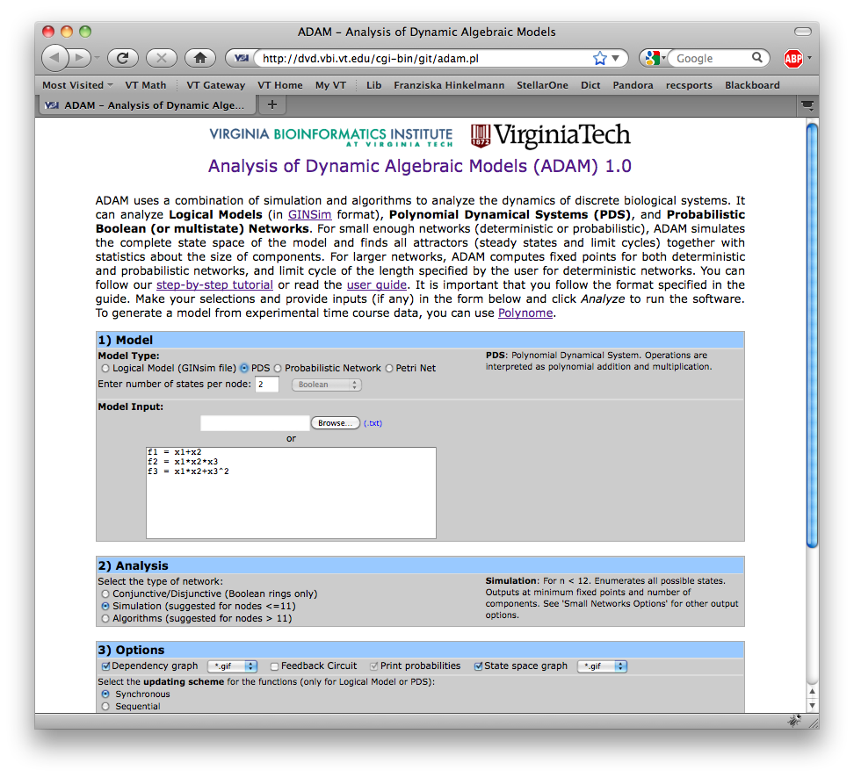
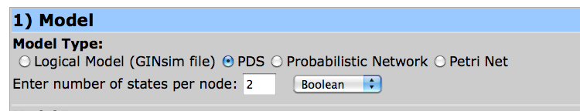
ADAM – Analysis of Dynamic Algebraic Models
http://dvd.vbi.vt.edu

Slide 2
ADAM – Analysis of Dynamic Algebraic Models
Attractor = solution to system of equations
ADAM uses computer algebra system Macaulay2
Gröbner basis computations
Worst case: doubly-exponential
Equations for biological systems are sparse: Gröbner basis computation work extremely well
Other algorithm for special networks like conjunctive networks
Daniel R. Grayson and Michael E. Stillman. Macaulay2, a soft- ware system for research in algebraic geometry. Available at http://www.math.uiuc.edu/Macaulay2/.
Abdul Salam Jarrah, Reinhard Laubenbacher, and Alan Veliz-Cuba. The dynamics of conjunctive and disjunctive boolean network models. Bull Math Biol, 2010.

Slide 3
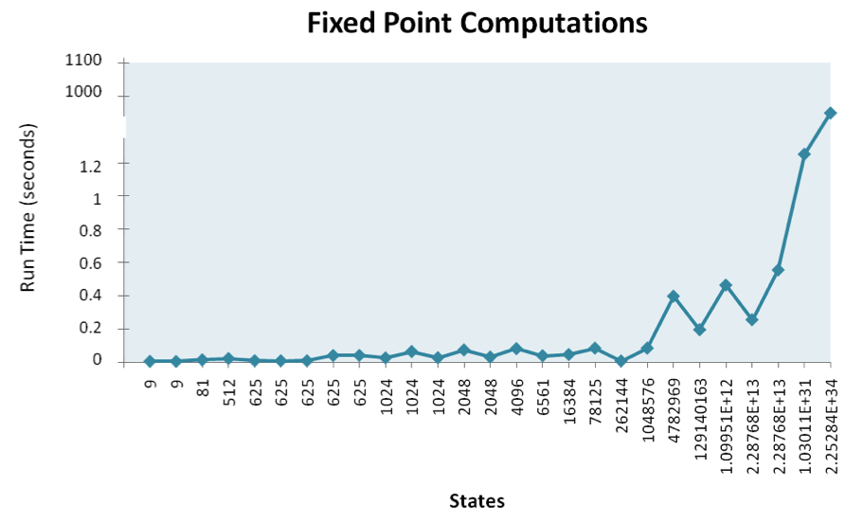
Gröbner Basis Computation Benchmarking
Logical Models of Biological systems from
http://gin.univ-mrs.fr/GINsim/model_repository.html

Slide 4
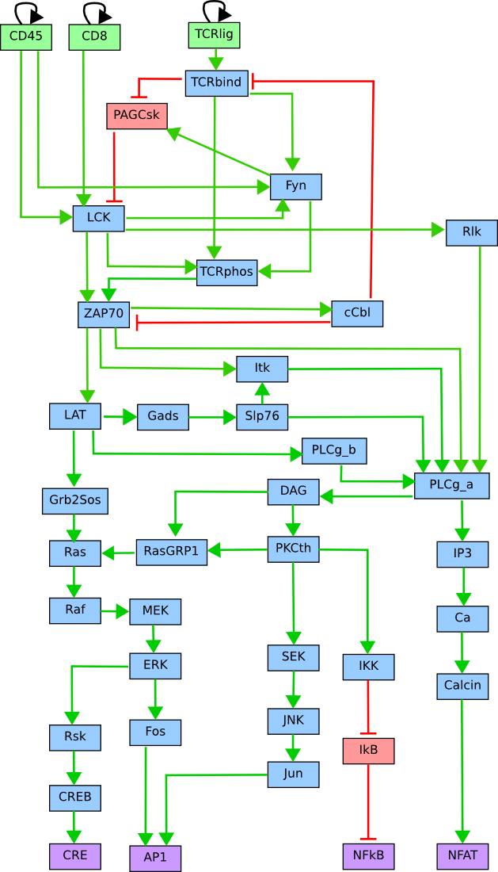
Gröbner Basis Computation Benchmarking
TCR Signaling Pathway
40 regulatory components
2⁴⁰ possible states
ADAM computes all seven steady states in less than 1 second

