Slide 1
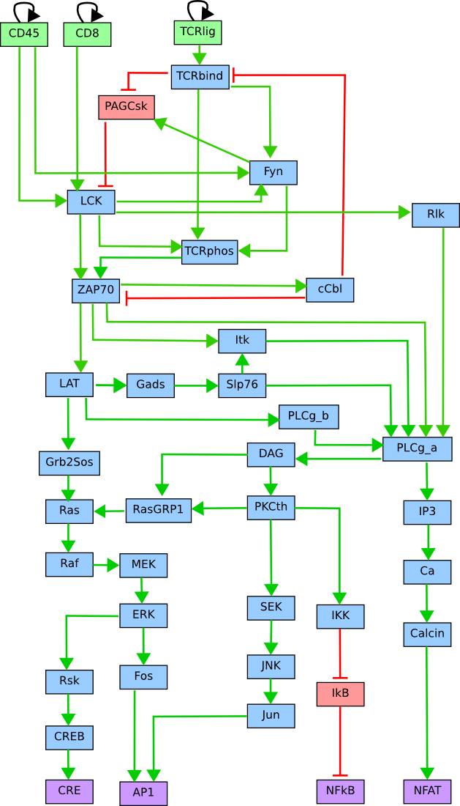
Gene Regulatory Network of TCR Signaling Pathway
40 key players
ON or OFF
2^40= 1 099 511 627 776 configurations
What are the stables states of this systems?

Slide 2
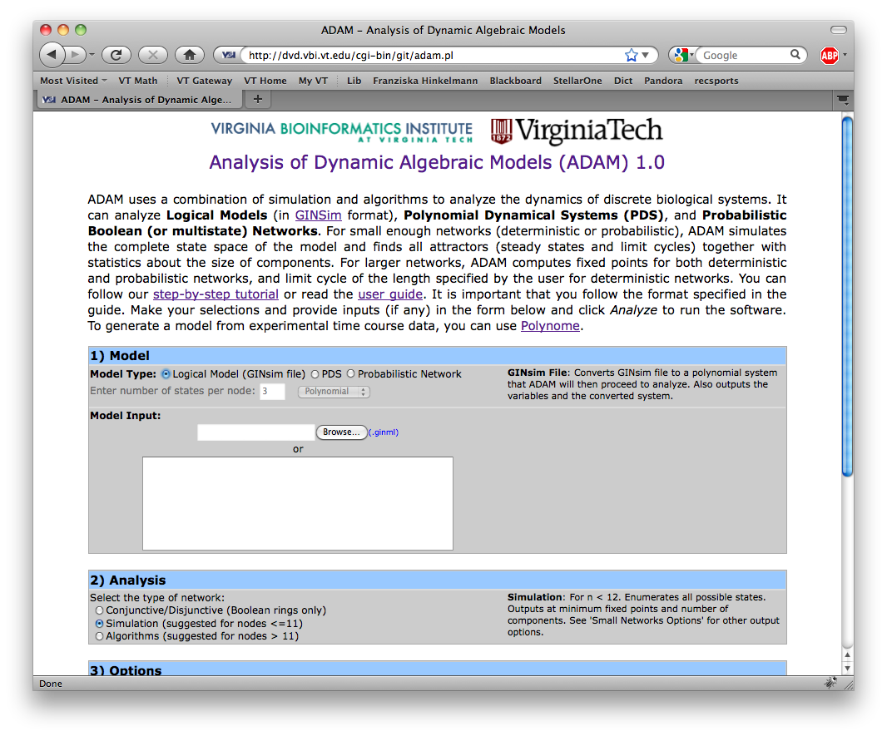
Solution: Computational Algebra
Less than 1 second!
http://dvd.vbi.vt.edu/
Variables: x1 =CD45 x2 = CD8 x3 = TCRlig x4 = TCRbind x5 = PAGCsk x6 = LCK x7 = Fyn x8 = cCbl
… x40 = SEK
The logical model was converted to: f1 =x1 f2 = x2 f3 = x3 f4 = x3*x8+x3 f5 = x4+1 f6 = x1*x2*x5+x1*x2 f7 = x1*x4*x6+x1*x4+x1*x6 f8 = x11 f9 = x4*x6*x7+x4*x6+x7
…
TCRsig40.ginml
Analyze
7 steady states:
1011001010000000000000000000000000001000
0000100000000000000000000000000000001000
…
Analysis of Discrete Models in Systems Biology using Computer Algebra
F. Hinkelmann et al., Virginia Bioinformatics Institute

