Slide 1
GO Ontology Editing Workshop:
Using Protege and OWL
Hinxton
Jan 2012

Slide 2
Workshop structure
Day 1
  Welcome and introduction
  Introductory OWL concepts
  Guided Protege tutorial and exercises
Day 2
  Ontology development
  Gathering requirements
  Strategizing for GO

Slide 3
How we used to think of editing the GO
Manually edit terms in 3 simple disconnected isa/partof DAGs
focus on terminological aspects
disconnected from annotation
Tools:
    DAG-Edit, then OBO-Edit
    ‘DAG Format’, then OBO-Format

Slide 4
Problems with original editing process
Doesn’t scale as ontology grows
Manual classification is tedious and error prone
  No way to check ontology consistency
  No way to leverage other ontologies for automated classification

Slide 5
OWL for GO
GONG (Wroe et al)
  Gene Ontology Next Generation
  Proposed using DAML+OIL (then OWL) to manage GO
OWL: Web Ontology Language
  Subset of first order logic
  Constructs for building ontologies
  One language, many syntaxes
    OWL-RDF/XML, OWL-XML, Manchester
  Supported by many tools, including reasoners
http://www.ncbi.nlm.nih.gov/pubmed/12603063

Slide 6
Example OWL (Manchester syntax)
Class:
‘mitochondrial chromosome’
EquivalentTo:
chromosome and ‘part of’ some mitochondrion
http://www.w3.org/TR/owl2-manchester-syntax/

Slide 7
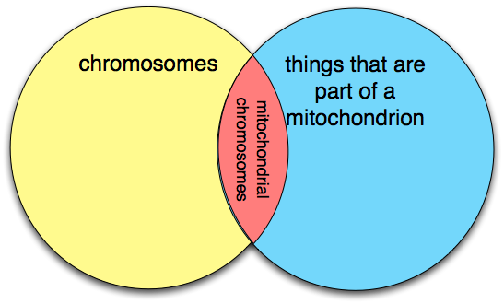
Example OWL (Manchester syntax)
Class:
‘mitochondrial chromosome’
EquivalentTo:
chromosome and ‘part of’ some mitochondrion

Slide 8
Core Terminology
An OWL ontology is a collection of axioms
  An axiom is simply a sentence or a statement
Axioms can be
  non-logical (aka “annotations”)
    E.g. GO_0000262 has synonym ‘mtDNA’
    opaque to reasoners
  logical
    well-defined semantics
    understood by reasoners
    Example: SubClassOf axioms
      Arguments can be classes or class expressions

Slide 9
Reasoners find entailed axioms
Input:
Class: ‘mitochondrial chromosome’
EquivalentTo:
chromosome and ‘part of’ some mitochondrion
Class: ‘cytoplasmic chromosome’
EquivalentTo:
chromosome and ‘part of’ some cytoplasm
Class: mitochondrion
SubClassOf: mitochondrion
Output:
‘mitochondrial chromosome’
SubClassOf: ‘cytoplasmic chromosome’

Slide 10
Phase1: Partial assimilation of OWL
Gradual incorporation of OWL language constructs and simple reasoning into OBO-Format and OBO-Edit
    genus-differentia definitions (equivalence axioms)
    disjointness (disjoint classes axioms)
    explicitly marking transitive relations
    relation chains (e.g. regulates . part_of -> part of)
    OE Rule Based Reasoner and ’assert implied links’ strategy
Resisted full migration to OWL
    Some important things missing from OWL v1
    Tool support wasn’t quite there yet
    RDF/XML tax
    Some hardcore logicians are allergic to OWL
http://www.geneontology.org/GO.format.obo-1_2.shtml

Slide 11
Phase 2: OBO and OWL finally tie the knot
Developments
    OWL2 plugs the gaps
    Matt develops alpha version of Protege 4
    OWL reasoners start getting really fast for GO-size ontologies
OBO-Format 1.4 formally becomes a syntax for a subset of OWL
    Based on Horrocks 2007 specification
    We implement bidirectional java converters
      now in OBO-Edit 2.1.1beta4
      Coming soon to Protege 4
http://purl.obolibrary.org/obo/oboformat

Slide 12
OBO and OWL2
OWL2
OWL RDF/XML
Manchester
Syntax
OWL XML
OBO Format

Slide 13
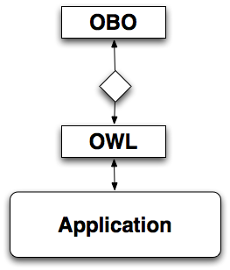
Current use of OWL in GO
All new ontology software developed by GO software group is OWL compliant and leverages 3rd party libraries
    OWLAPI
http://code.google.com/p/owltools/
http://owlapi.sf.net

Slide 14
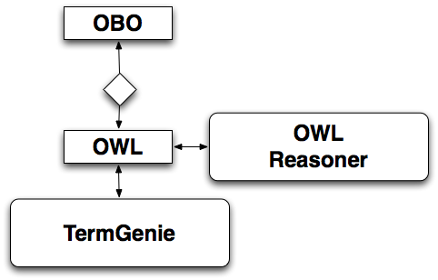
TermGenie makes full use of OWL
http://go.termgenie.org

Slide 15
Oort
OBO Ontology Release Tool
Makes obo-format and owl versions of an ontology
Runs an OWL reasoner
    classifies ontology
    writes report
    won’t release if there are logical problems
Integrated into GO Jenkins environment
Will be used for GO releases
http://code.google.com/p/owltools/wiki/OortIntro

Slide 16
Next phase
We are using OWL, but too reactively
    need to bring it to the foreground
OBO-Edit issues
    multiple ontologies is difficult
    reasoner outdated
    hard to layer on additional OWL constructs
    doesn’t handle existing OWL constructs well

Slide 17
What next?
Single editing environment vs mixed environment?
  Perfect world: Single unified environment that does everything....
  We’re already mixed (TG + OE)
Short term
  Add Protege 4 to current mix ASAP
  Doesn’t require wholesale switch
Then what?
  It’s up to you!

Slide 18
Incorporating Protege 4 immediately after workshop
Editing bridging axioms (Ontology extensions)
    taxon constraints
    external ontology “cross-product” definitions
Dual tool use
    Edit in OE, view implications in P4
    Edit in both?
Prototyping and design
    Thinking and speaking in OWL
    E.g. testing a new TG template
    ‘Annotation extensions’

Slide 19
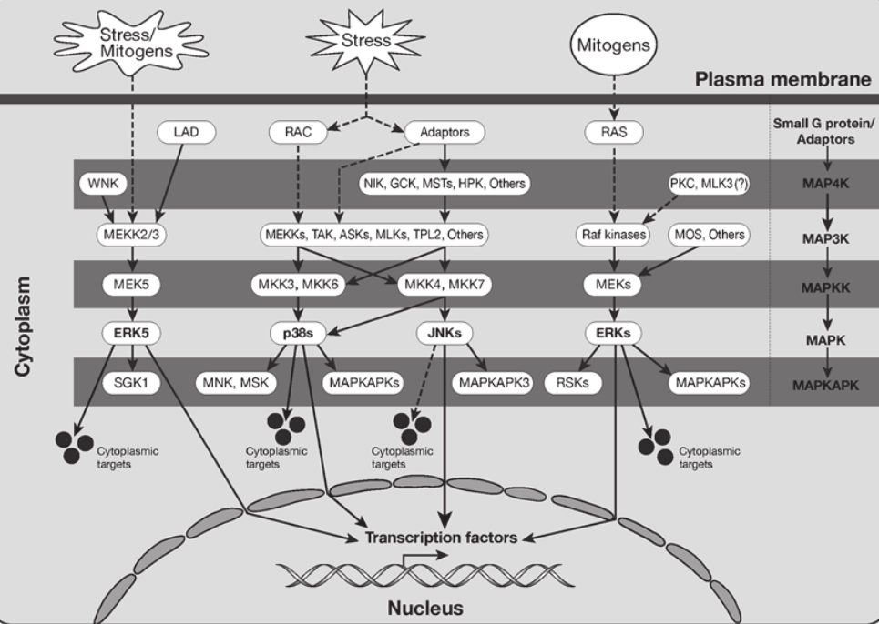
Bigger Picture: Logical Extension of the Gene Ontology
Change the existing GO model
Annotator vs ontology-editor role distinction doesn’t always work
OWL as a unified framework

Slide 20
Workshop structure
Day 1
  Welcome and introduction
  Introductory concepts
  Guided tutorial and exercises
Day 2
  Ontology development
  Gathering requirements
  Strategizing for GO
but first...

Slide 21
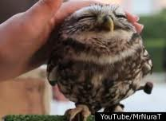
LOVELY
OWL

