Slide 1
Enhancing City-Scale Road Extraction via Diffusion-Based Inpainting
Niels Versteeg, Yanick Palmers, Group 7

Slide 2
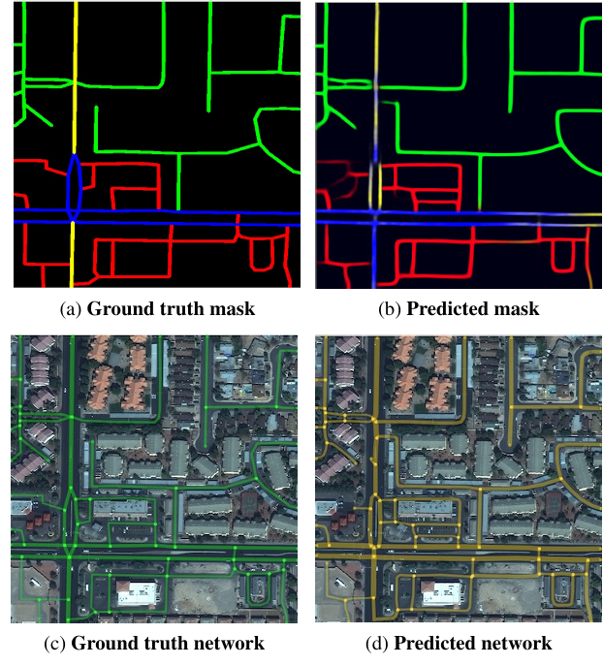
Context, Cresi
Extracts road networks from satellite imagery
Estimates travel times and speed limits
Resnet34 + U-Net

Slide 3
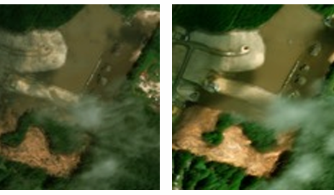
Problem Statement
The Problem: The "Perfect Image" Assumption
CRESIv2 performs well on clear imagery but struggles with occlusions: clouds, dense tree canopies, and building shadows

Slide 4
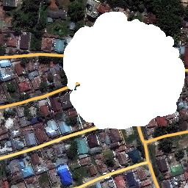
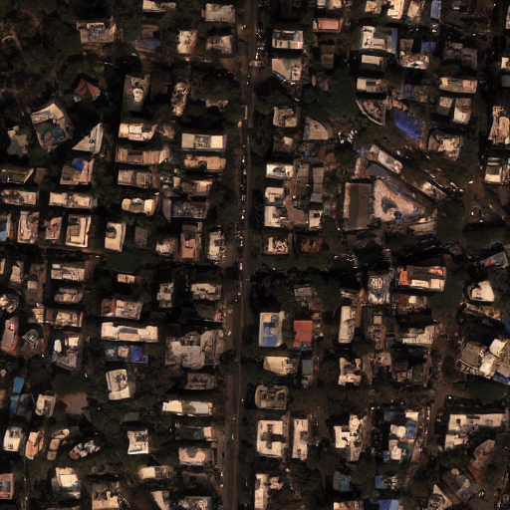
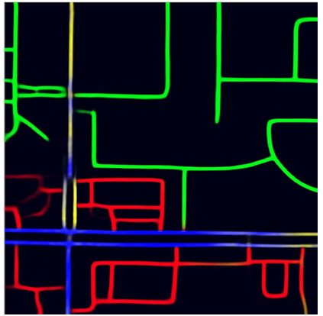
Proposal: Pre-processing via Inpainting.
We try to add a generative inpainting step prior to the segmentation network.
Reconstruct missing road geometry and texture to "repair" occlusions.

Slide 5
Methodology: The Pipeline
Original:
Input: Raw Satellite Image (potentially occluded).
Segmentation: Feed image into CRESIv2.
Graph Extraction: Extract road speeds and vectors
Our proposal
Input: Raw Satellite Image (potentially occluded).
Pre-processing:
Identify low-confidence/occluded regions (Mask Predictor).
Inpaint using Generative Diffusion Model.
Segmentation: Feed cleaned"image into original CRESIv2.
Graph Extraction: Extract road speeds and vectors

Slide 6
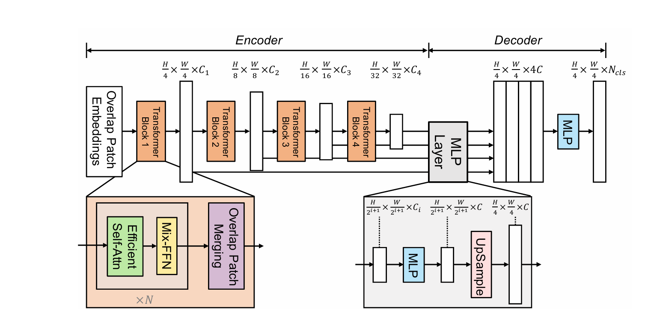
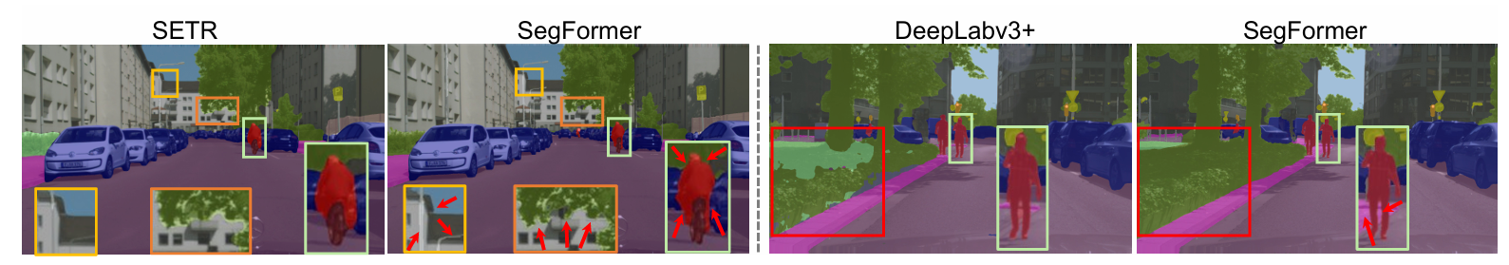
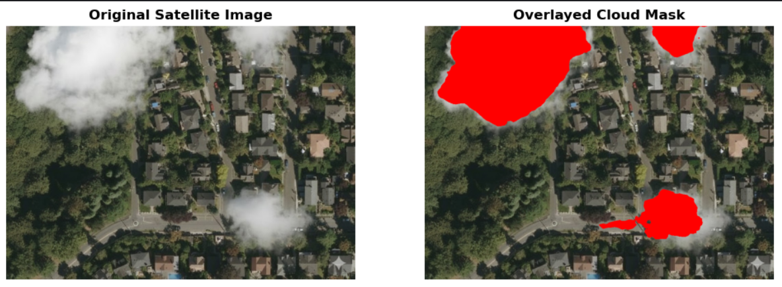
Methodology cloud masks
NVIDEA segformer, a pre-trained general segmentation model
Advantage: Able to generalize to other occlusions, like trees, shadows, etc.

Slide 7
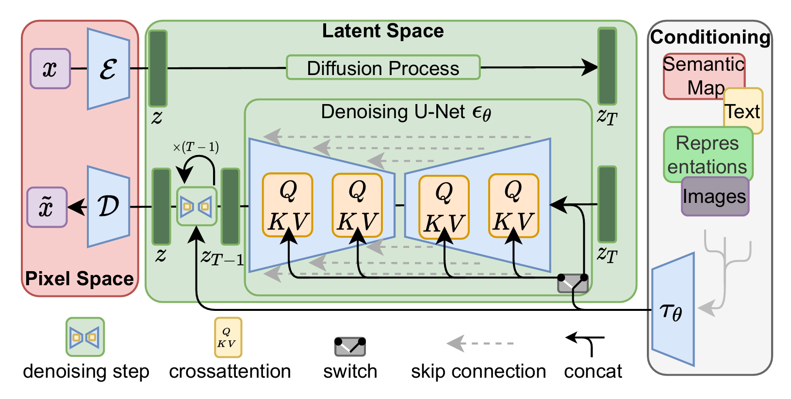
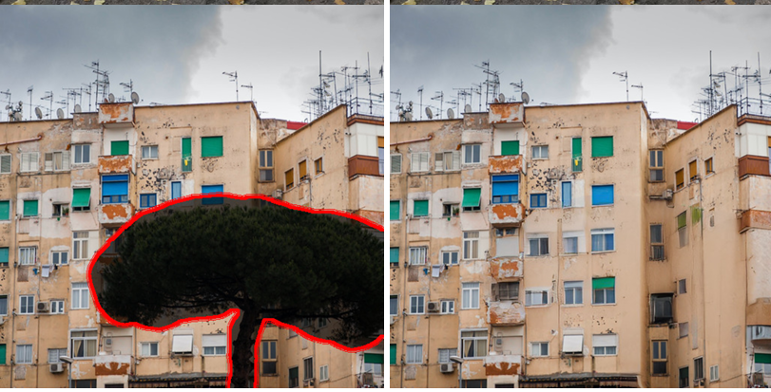
Methodology in-painting
Current Approach: DiffusionSat (Diffusion Model)
Trained for satellite imagery
Add image,mask, and prompt

Slide 8
Current Progress
Diffusion network
Implemented and running
Containerized setup
Cloud mask model
Working
Todo
Cloud mask output to in-paint model
Feed the output into CresiV2
Analyze performance

Slide 9
Metrics
Metrics (same as Cresiv2 Paper):
APLS (Average Path Length Similarity):
Measures physical connectivity.
TOPO: Measures local graph topology.
Datasets:
SpaceNet 3: loads of satellite images.
Comparison: We will compare Original CRESIv2
vs. Inpainted + CRESIv2.

Slide 10
Next steps
Phase 1 (done)
Literature review, env setup, diffusion model working
Phase 2 (doing now)
Add mask predictor
Test in-paining on SpaceNet examples
Phase 3 (coming weeks)
Integrate in-paining results to Cresiv2
Run benchmarks
report

Slide 11
summary
Road extraction is difficult with occluded images
Remove occlusions from images by in paining
Expected outcome: higher accuracy on predicted road networks

Slide 12
Questions?

