Slide 1
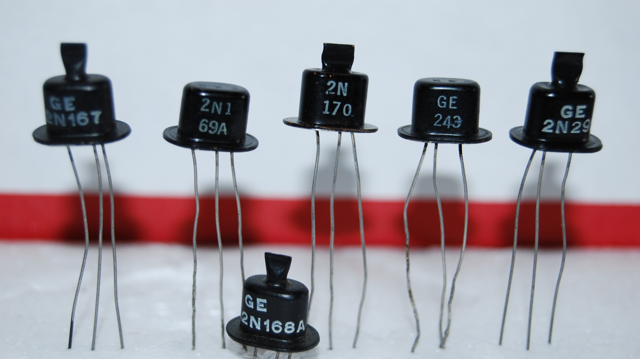
Semiconductors
What are they?

Slide 2
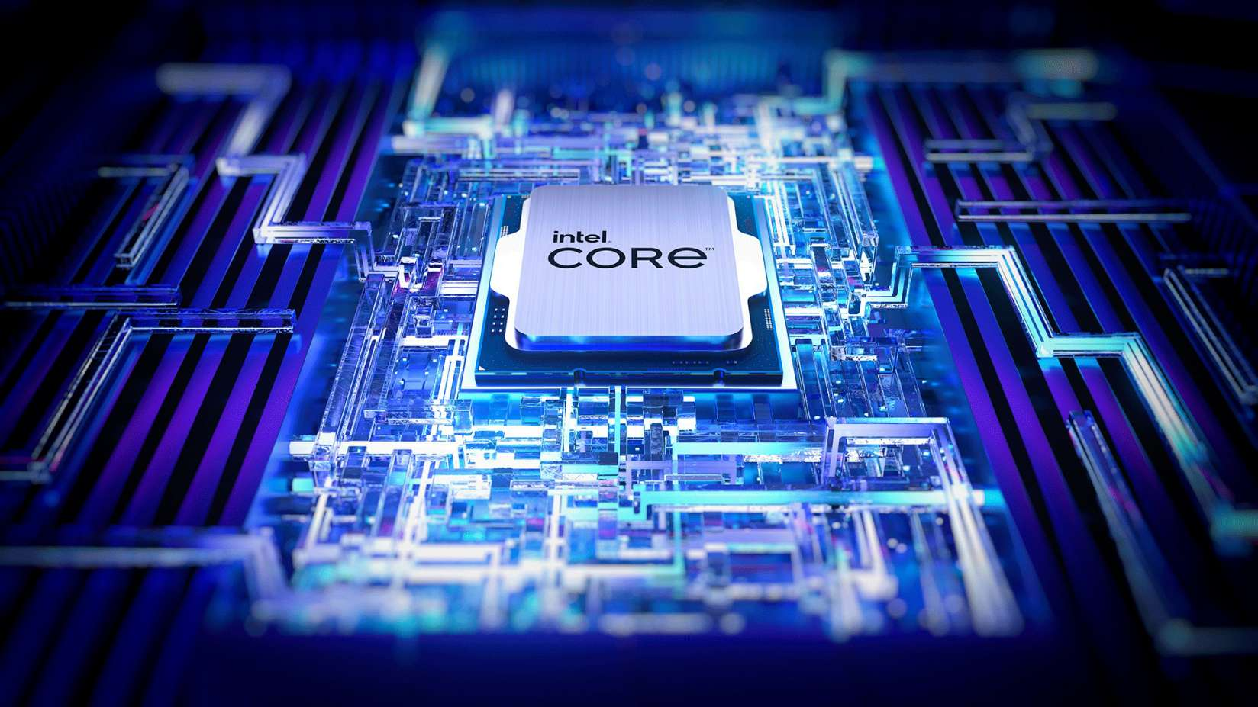
What are semiconductors and why they work the way they are?

