Slide 1
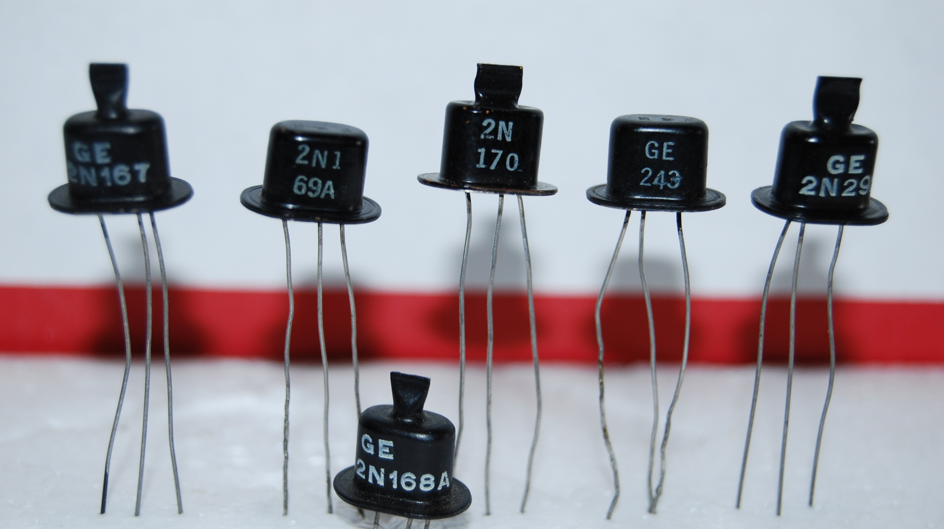
Semiconductors
What are they?

Slide 2
What will be discussed?
What are semiconductors?
What are the components in semiconductors?
The many different devices which semiconductors are massively involved in
The Semiconductor chip industry and how it can affect the world

Slide 3
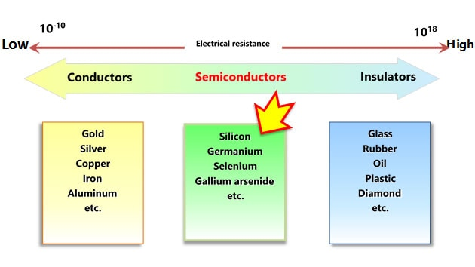
What are semiconductors and why they work the way they are?
They are considered a mix between an inductor and conductor
Their conduciveness is highly dependent on temperature
They tend to be made out of silicon
Note. Image of graph Sourced from Toshiba (n.d)

Slide 4
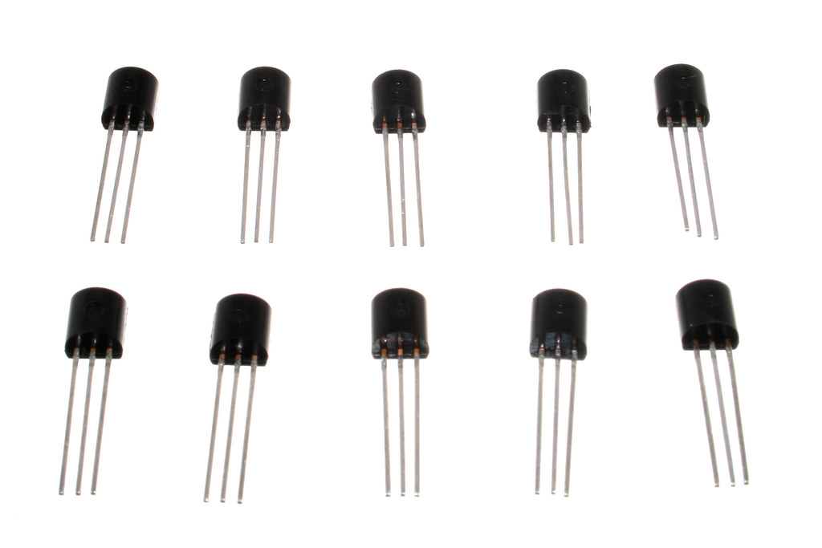
The types of semiconductor devices
Transistors – used for “amplifying” ,“controlling”, and generating electric signals
Diodes – Limits the flow of current to certain directions
A combination of those get made into chips
Note. Image of transistors Sourced from oomlout (2009)

Slide 5
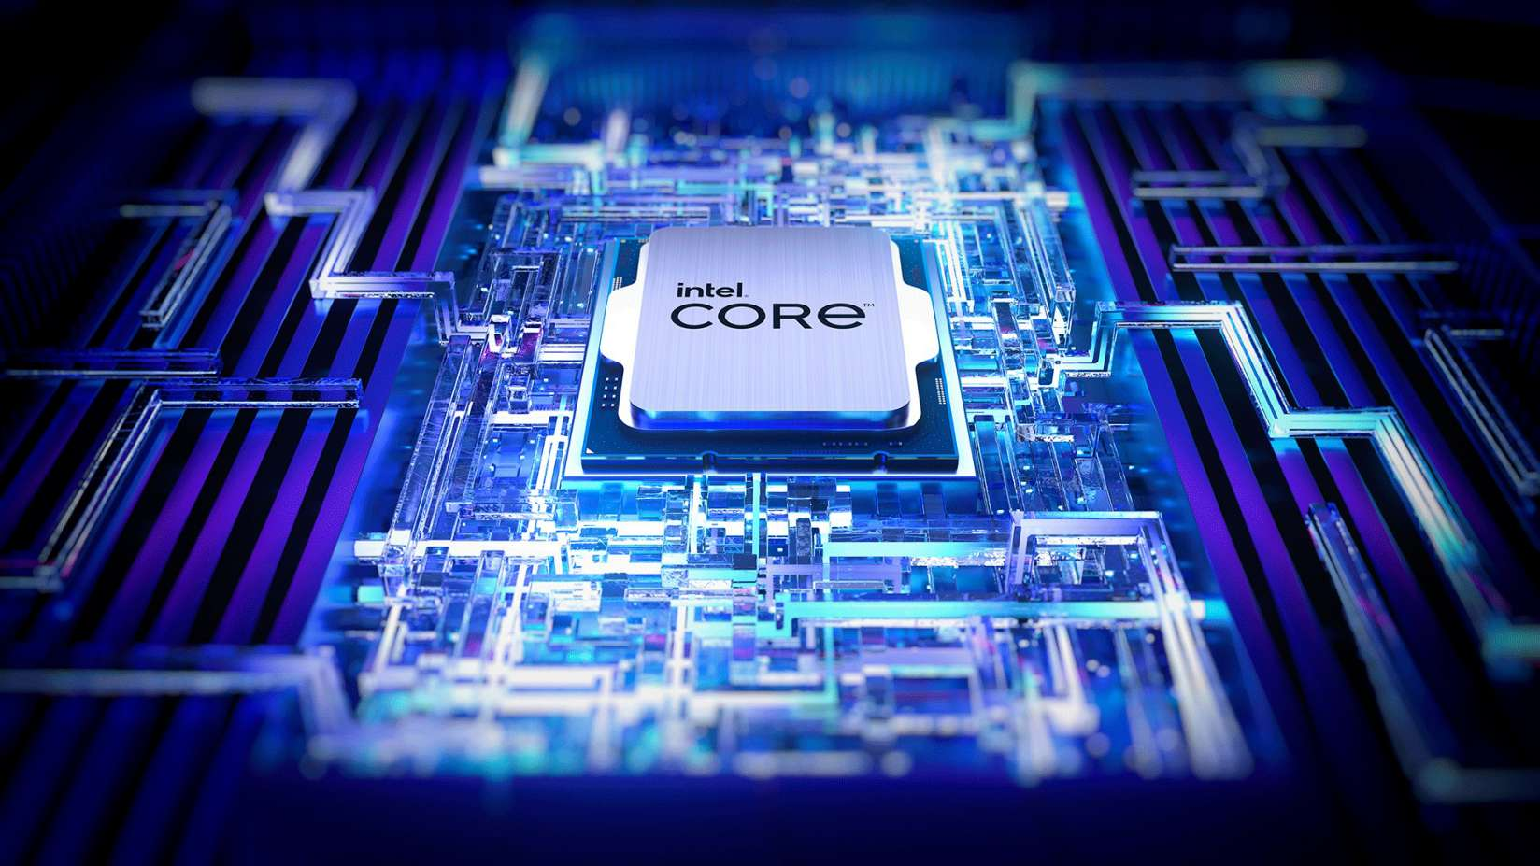
But what exactly are they used for?
Memory
Microprocessors or (CPU)
GPUS
integrated Circuits (chips)
Note. Image of CPU Sourced from intel (n.d)

Slide 6

The Semiconductor Industry
TSMC (Largest semiconductor Manufacturer)
There is a presence of semiconductor chips in practically any electronic device
A recession in semiconductor production can greatly affect any industry that uses semiconductors
Semiconductors can have a large impact on international relations
Note. TSMC logo. Sourced from TSMC

Slide 7
Summary
I went over…
What semiconductors are
Semiconductor chips
What they are used in
The semiconductor industry

Slide 8
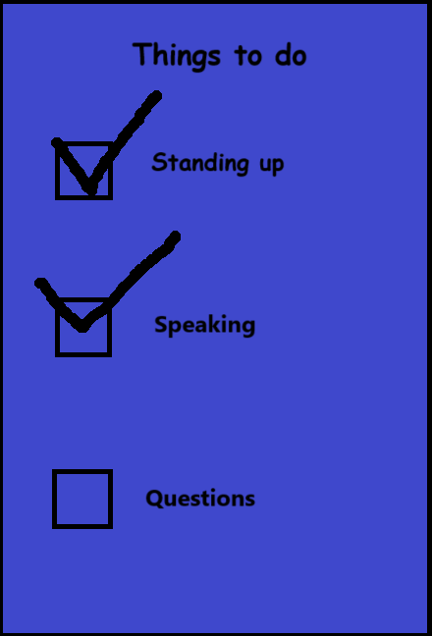
That’s all!
Note. Checklist Sourced from Simon Cui

Slide 9
Image links (for now
https://www.flickr.com/photos/snazzyguy/3632897786 (slide 4)
https://www.trustedreviews.com/explainer/what-is-a-cpu-2950255 (slide 5)

Slide 10
References
Line of transistors [Photograph]. (n.d). Raypcb. https://www.raypcb.com/transistor-circuit-diagram/
Spectrum of conductors and insulators [Diagram]. (n.d). Toshiba. https://toshiba.semicon-storage.com/us/semiconductor/knowledge/e-learning/basics-of-schottky-barrier-diodes/chap1/chap1-1.html
Britannica. (2024, Nov 22). Semiconductor. https://www.britannica.com/science/semiconductor/The-p-n-junction
Britannica. (2024, Dec 11). Diode. https://www.britannica.com/technology/diode
Britannica. (2024, Nov 13). Integrated Circuit. https://www.britannica.com/technology/integrated-circuit
Britannica. (2024, Oct 30). Transistor. https://www.britannica.com/technology/transistor
Segal, T (2024, July 25). What is a Semiconductor and How is it Used. Investopedia. https://www.investopedia.com/terms/s/semiconductor.asp
Liberto, D (2024, July 31). 10 Biggest Semiconductor Companies. Investopedia. https://www.investopedia.com/articles/markets/012216/worlds-top-10-semiconductor-companies-tsmintc.asp
Deloitte. (2019, April. Semiconductors – the Next Wave. https://www2.deloitte.com/tw/en/pages/technology-media-and-telecommunications/articles/semiconductor-next-wave.html

