Slide 1
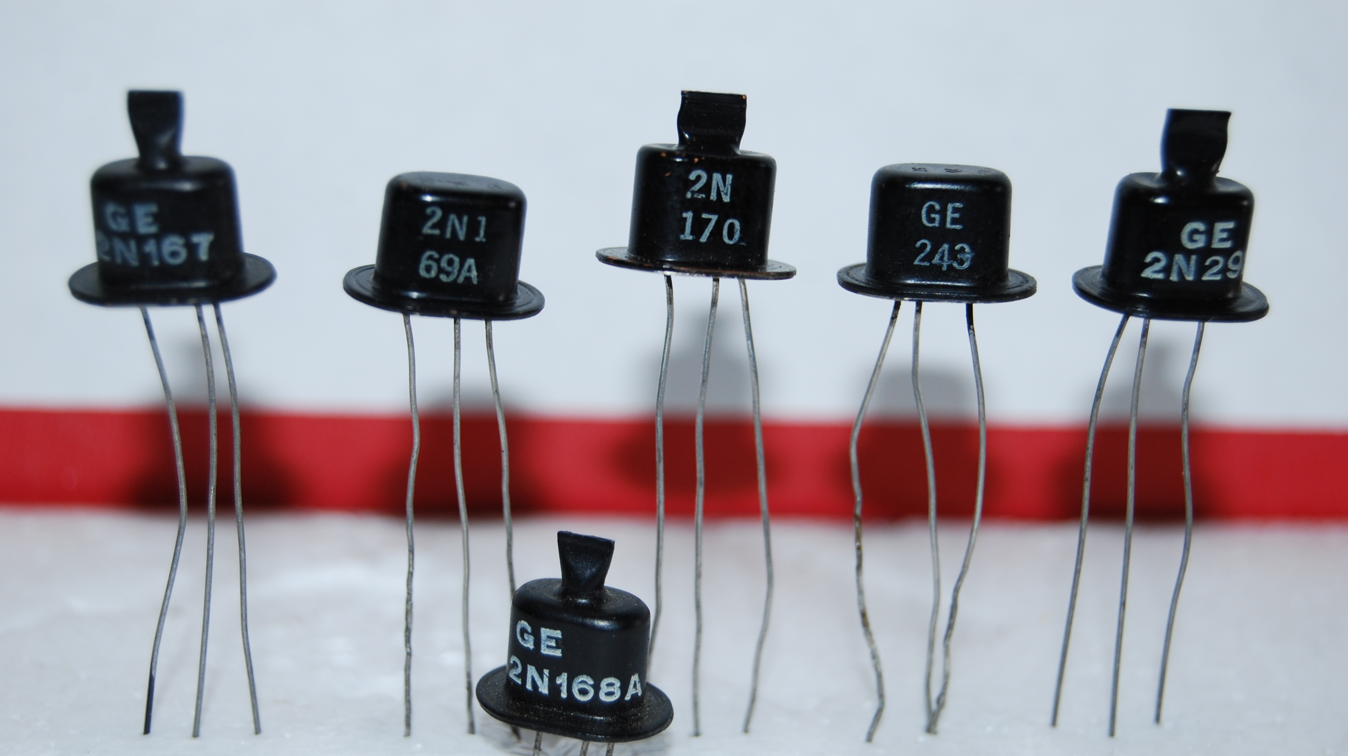
Semiconductors
What are they?

Slide 2
What will be discussed?
What are semiconductors?
What are the components in semiconductors?
The many different uses of the semiconductor
The Semiconductor chip industry

Slide 3
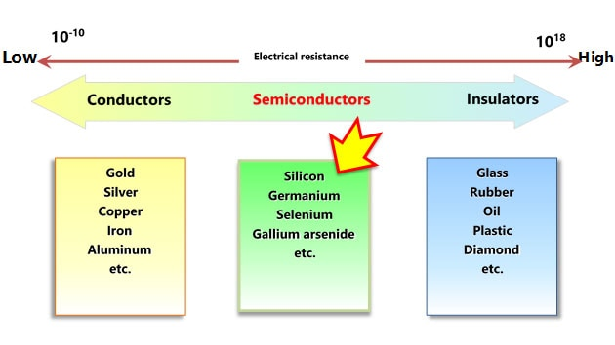
What are semiconductors and why they work the way they are?
They are considered a mix between an inductor and conductor
Note. Image of graph Sourced from Toshiba (n.d)

Slide 4
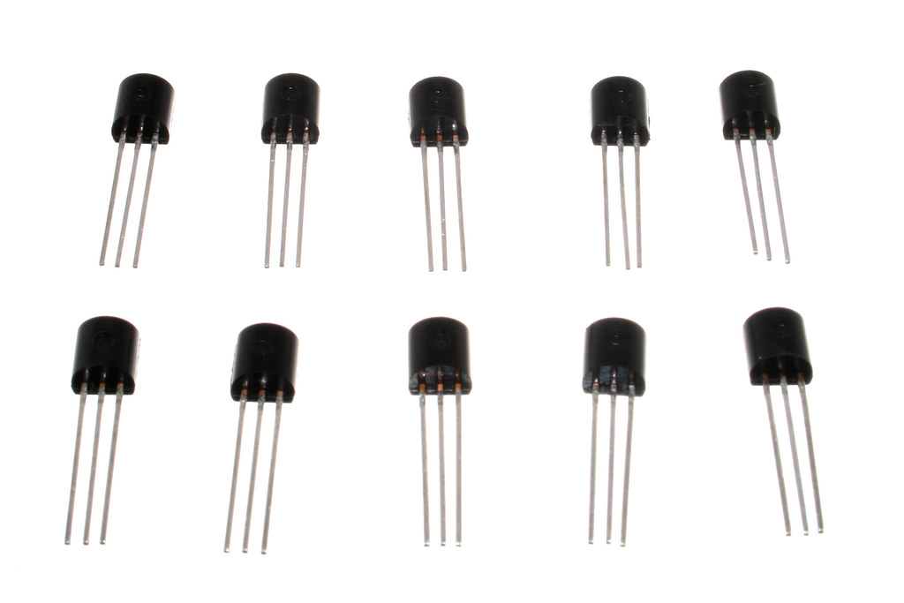
The types of semiconductor devices
Transistors
Diodes
Integrated circuits (small circuits)
Note. Image of transistors Sourced from oomlout (2009)

Slide 5
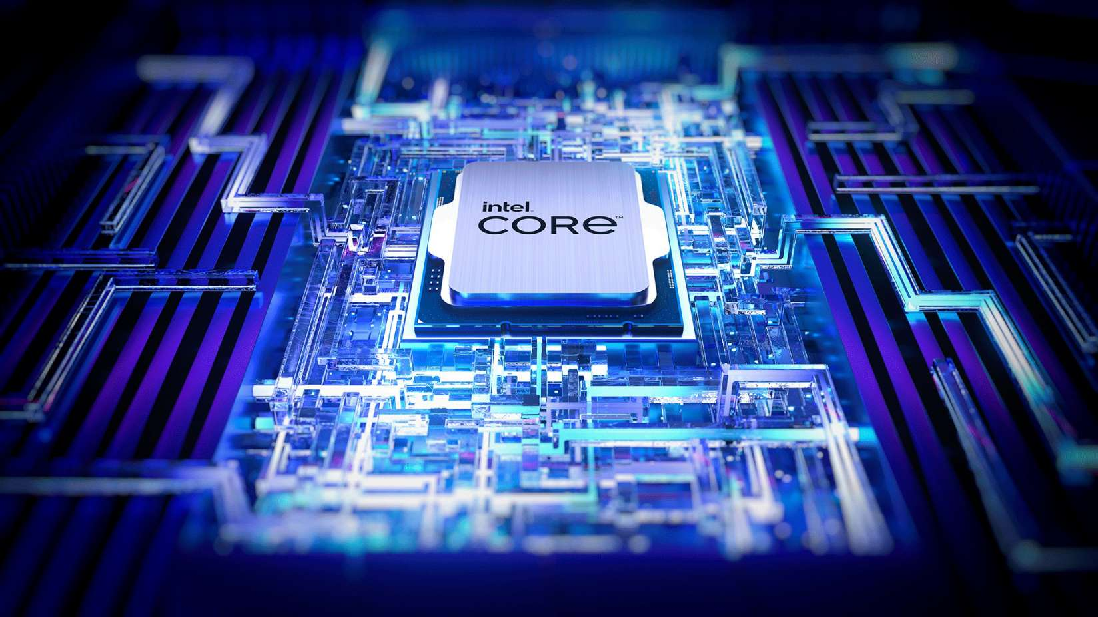
But what exactly are they used for?
Memory
Microprocessors or (CPU)
GPUS
integrated Circuits (chips)
Note. Image of CPU Sourced from intel (n.d)

Slide 6
The Semiconductor Industry
TSMC (Largest semiconductor Manufacturer)
CPU and GPU companies such as intel and Nivida

Slide 7
Summary
I went over…
What semiconductors are
Semiconductor chips
What they are used in
The semiconductor industry

Slide 8

That’s all!
Note. Checklist Sourced from Simon Cui

Slide 9
Image links (for now
https://www.flickr.com/photos/snazzyguy/3632897786 (slide 4)
https://www.trustedreviews.com/explainer/what-is-a-cpu-2950255 (slide 5)

Slide 10
References
Line of transistors [Photograph]. (n.d). Raypcb. https://www.raypcb.com/transistor-circuit-diagram/
Spectrum of conductors and insulators [Diagram]. (n.d). Toshiba. https://toshiba.semicon-storage.com/us/semiconductor/knowledge/e-learning/basics-of-schottky-barrier-diodes/chap1/chap1-1.html
Britannica. (2024, Nov 22). Semiconductor. https://www.britannica.com/science/semiconductor/The-p-n-junction
Britannica. (2024, Dec 11). Diode. https://www.britannica.com/technology/diode
Britannica. (2024, Nov 13). Integrated Circuit. https://www.britannica.com/technology/integrated-circuit
Britannica. (2024, Oct 30). Transistor. https://www.britannica.com/technology/transistor
Segal, T (2024, July 25). What is a Semiconductor and How is it Used. Investopedia. https://www.investopedia.com/terms/s/semiconductor.asp
Liberto, D (2024, July 31). 10 Biggest Semiconductor Companies. Investopedia. https://www.investopedia.com/articles/markets/012216/worlds-top-10-semiconductor-companies-tsmintc.asp

