Slide 1
Siemens Profinet
Protocol Forwarder

Slide 2
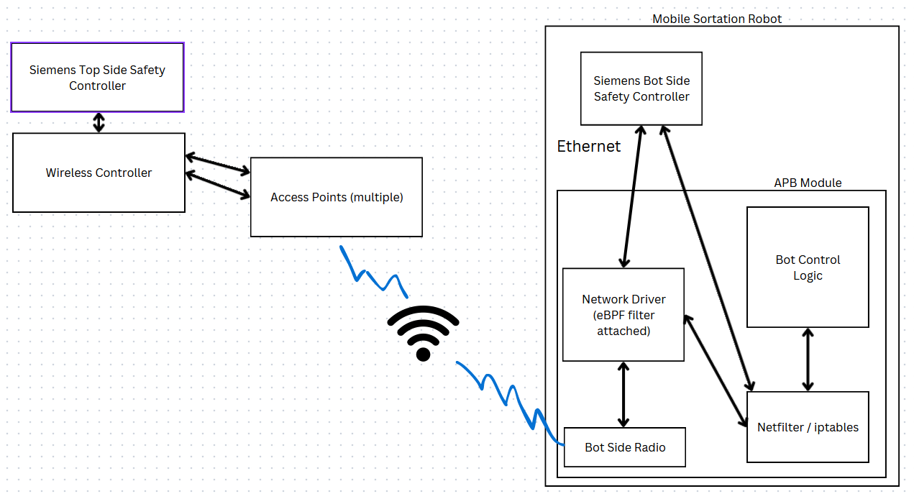

Slide 3
Reisong A50
Modding a Chinese Tube Amplifier

Slide 4
Design Goals
Maximize perceived audio quality
Increase reliability & robustness
Fits on existing chassis
Reduce complexity when possible

Slide 5
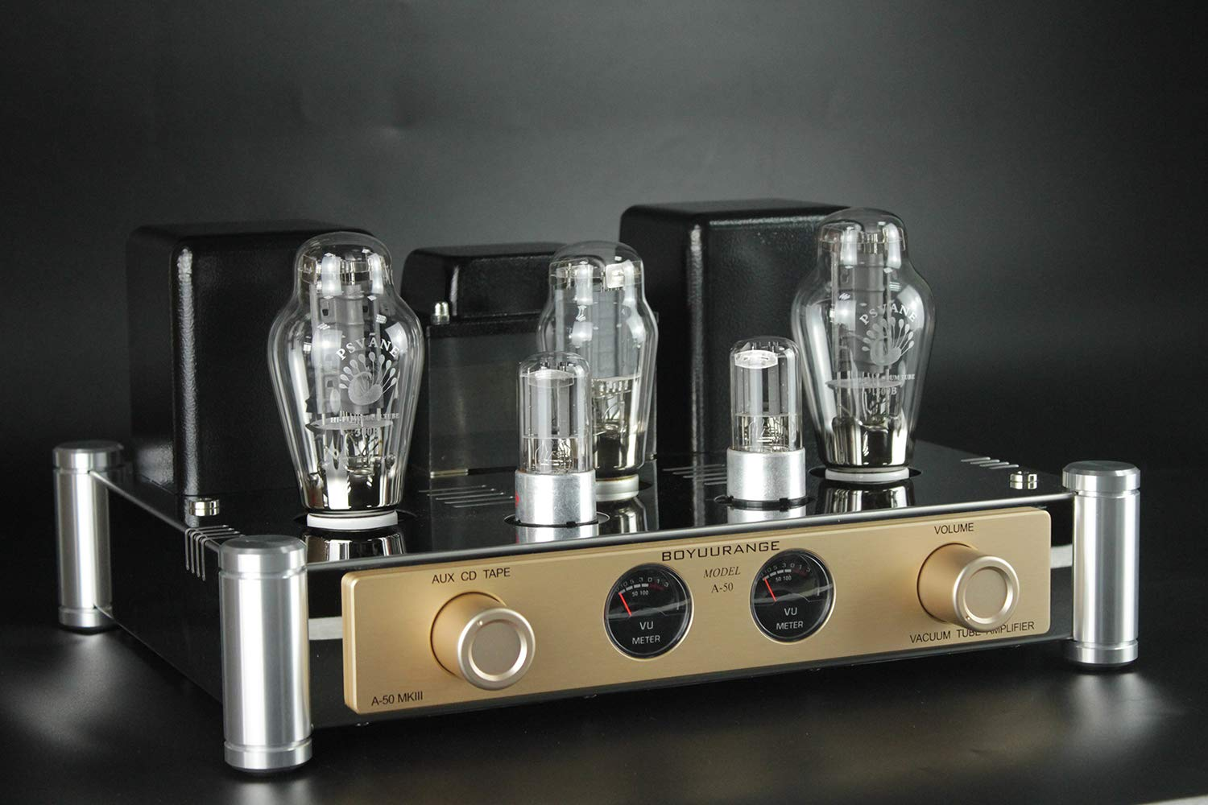
Factory - Front

Slide 6
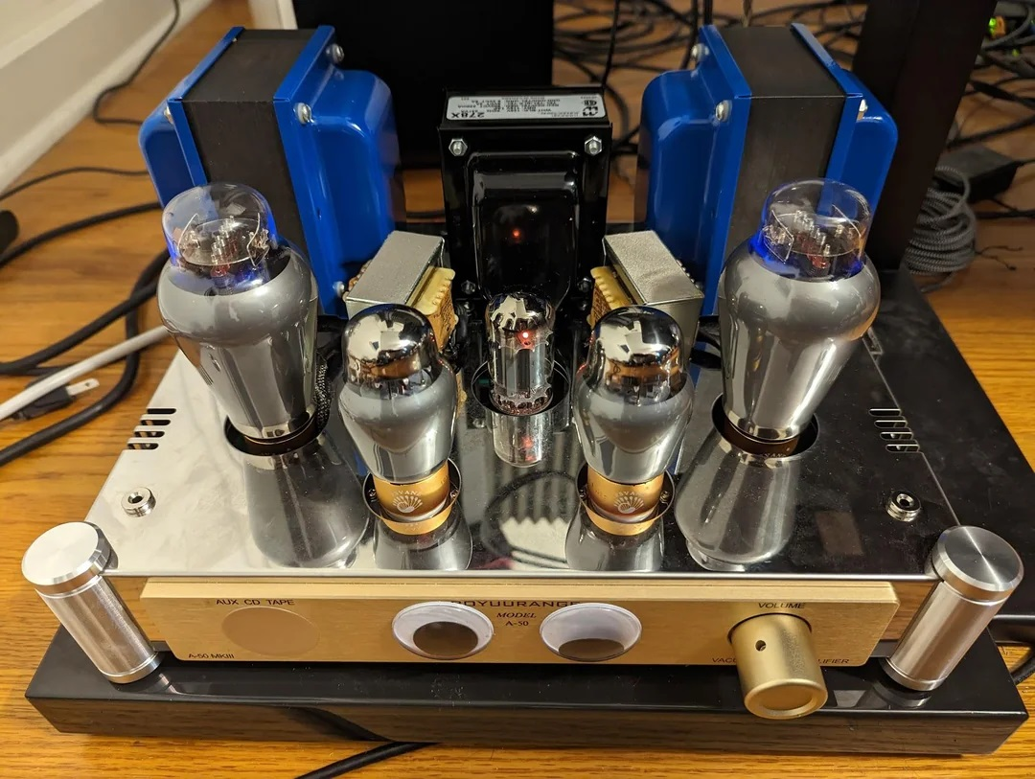
My Version Front

Slide 7
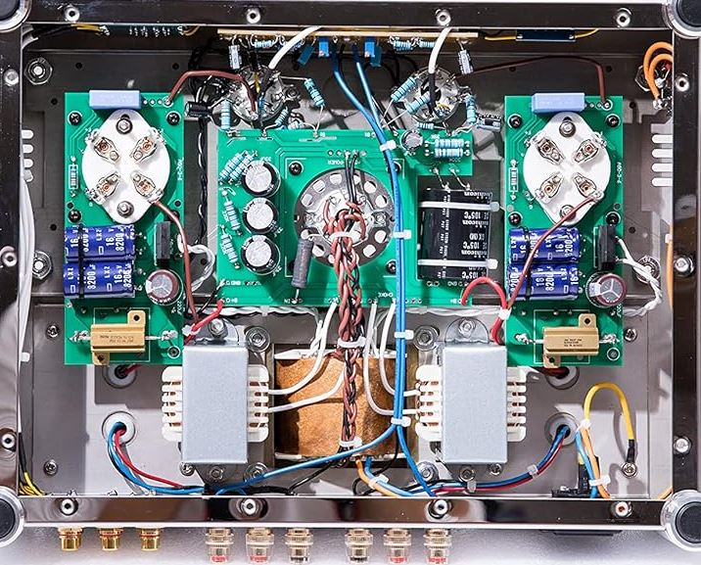
Factory - Internals

Slide 8
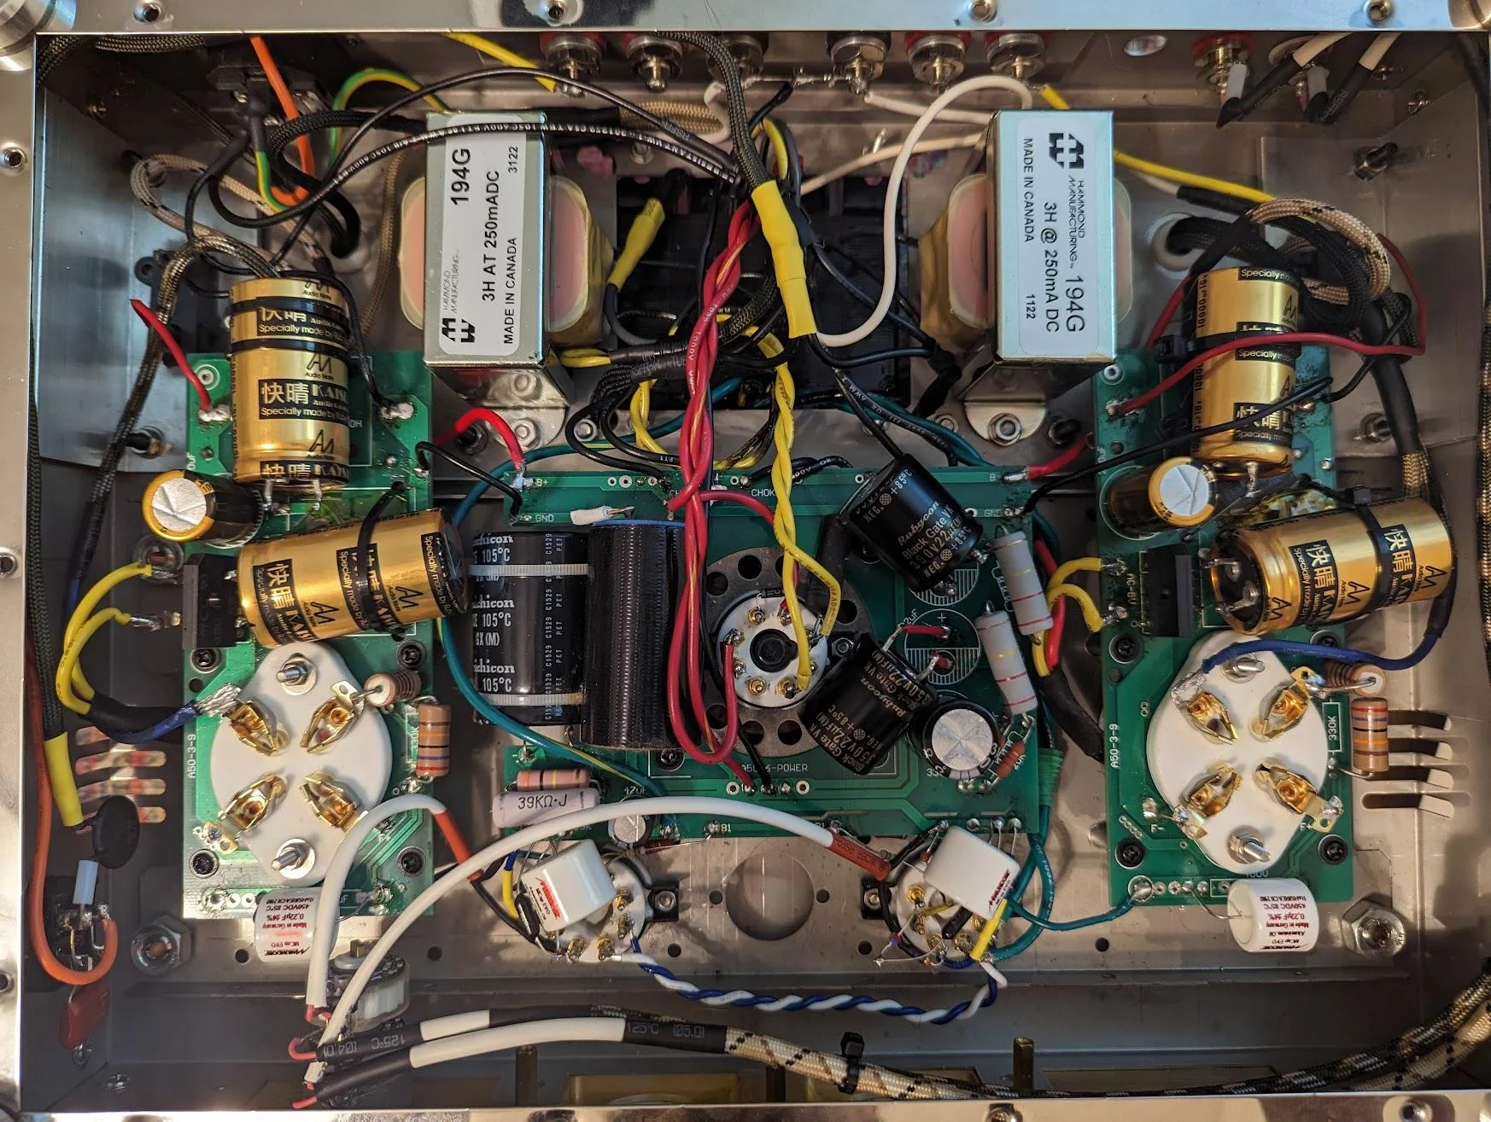
My Version Internals

Slide 9
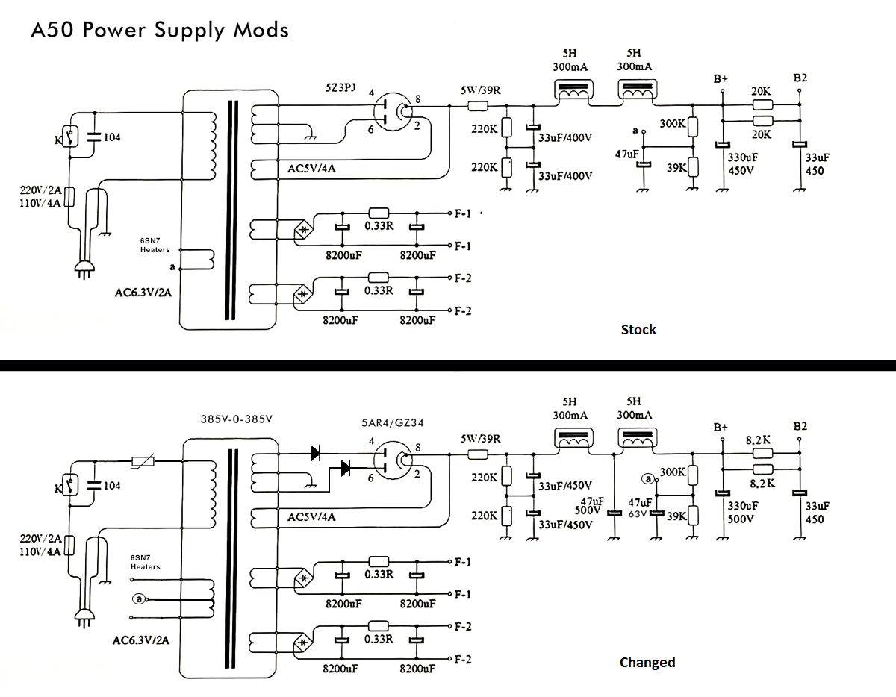
Power Supply Section

Slide 10
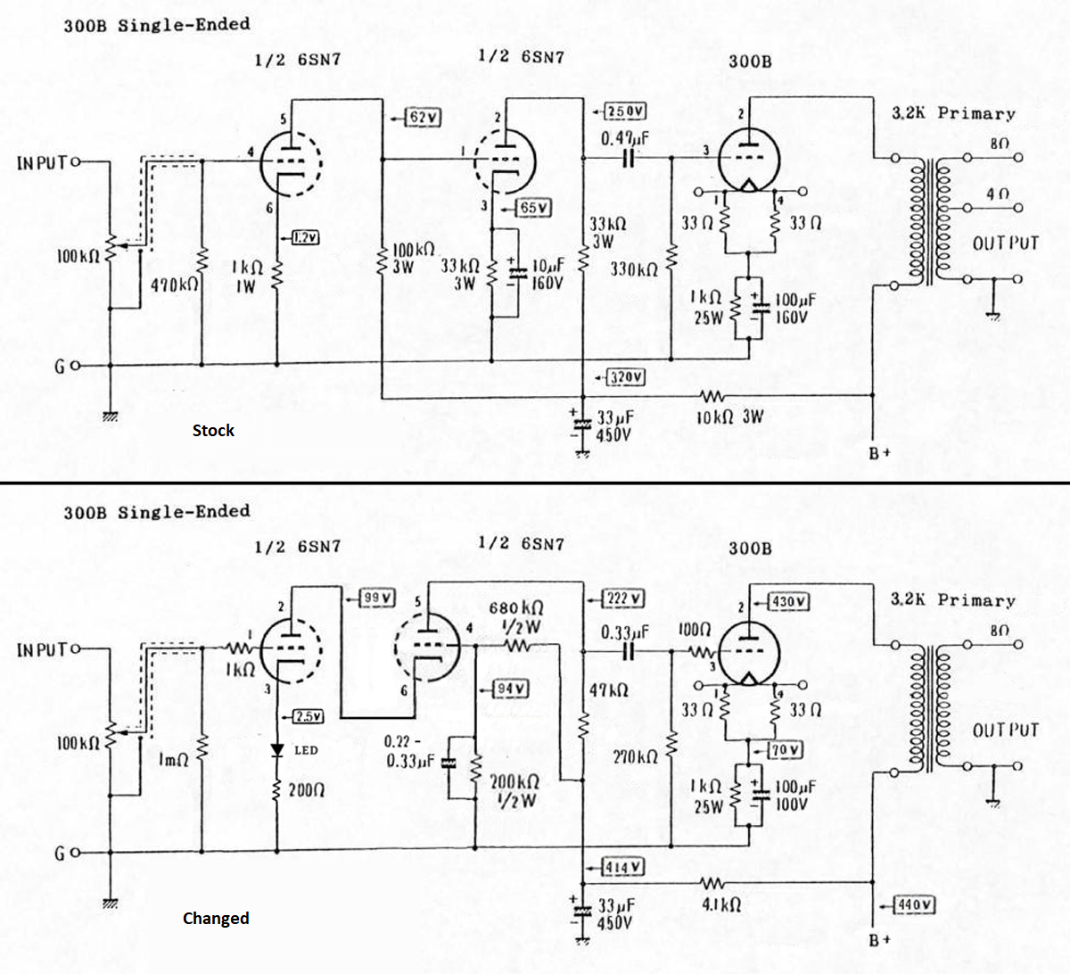
Signal Amplification Section

Slide 11
Improvements
Rectifier 5AR5 instead of 5U4: Voltage drop of 10V vs 44V, higher B+ operating point at recommended 400V, supporting more voltage swing. The WE 300B data sheet shows among recommended operating points one of 400V plate, -87V bias, and 3500 Ohm load with 60ma current for 10.5 watts out at acceptable distortion.
Added new DC smoothing capacitor between chokes to reduce ripple.
Cascade -> Cascode layout: advantages include higher gain and lower noise. The phase is no longer shifted as the cascode works as a single inverting stage.
Thermistor reduces inrush current when turning amplifier on, slower power up.
Diodes added in series to half-wave tube rectifier increases reverse bias protection and prevents arcing.
Mounted 300B cathode power resistors to chassis for better thermal dissipation.
Signal path is simplified, input selector removed.
New OPT uses only 8 ohm secondary winding – matched with speakers.
Stepped attenuator provides higher precision for resistance on stereo volume control.
Removed unnecessary low quality VU meter.
Component quality increased across entire amplifier.

Slide 12
Future enhancement potential
Change to a regulated 5V DC IC for 300B filament supply voltage.
Alternatively experiment with grounding 300B cathode into a center tapped 5V transformer and use AC heating on filament. (seen @ Decware design)
Split power supply smoothing into R/L channels adding separate filtering and supply capacitors.
Further enhance DC supply using 2 separate rectifiers for R/L.
Add a switch to swap between pure solid state rectification for A/B testing.
Add another pair of 6SN7 tubes to allow for paralleling drive stages, increasing current, lowering noise, and lowering output impedance. (Drawback - more matched tubes needed)
Separate entire power supply into another chassis for lower EMF from supply portion.
Change input signal wiring to be as short as possible.

