Slide 1
CPPS Polynomial Interpolation
Luke Martin

Slide 2
Polynomials:
a polynomial is an expression consisting of variables and coefficients
That involves only the operations:
addition
subtraction
multiplication
and non-negative integer exponents
Degree: The highest exponent within its terms

Slide 3
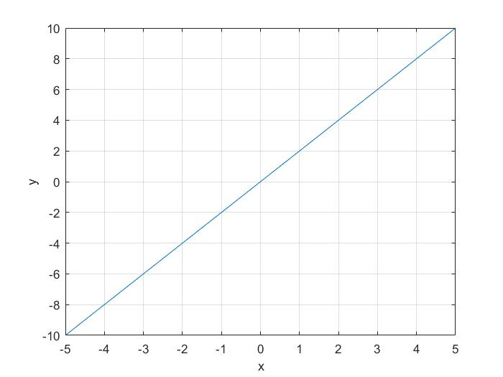
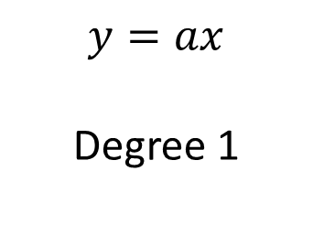
Polynomials:
$$y=ax$$
Degree 1

Slide 4
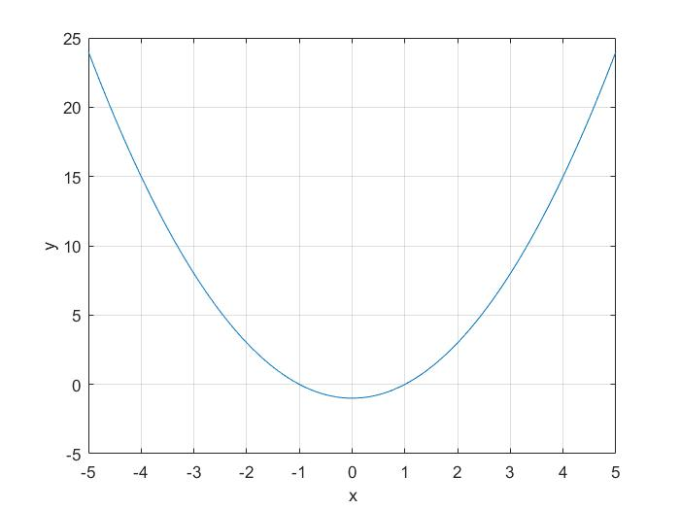
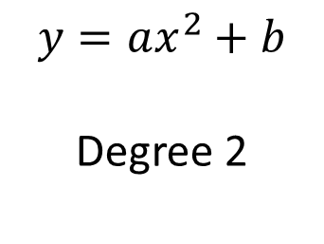
Polynomials:
$$y=ax^{2}+b$$
Degree 2

Slide 5
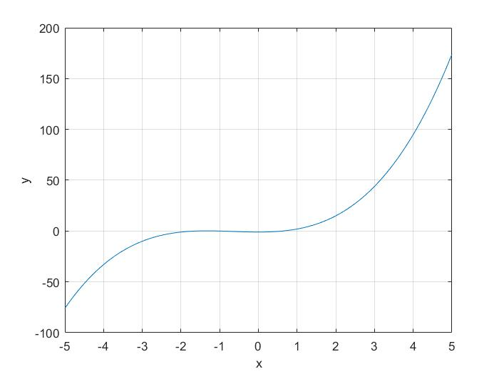
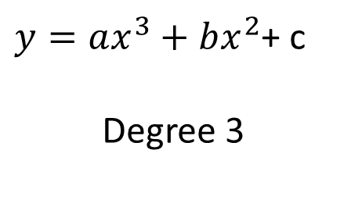
Polynomials:
$y=ax^{3}+bx^{2}$+ c
Degree 3

Slide 6
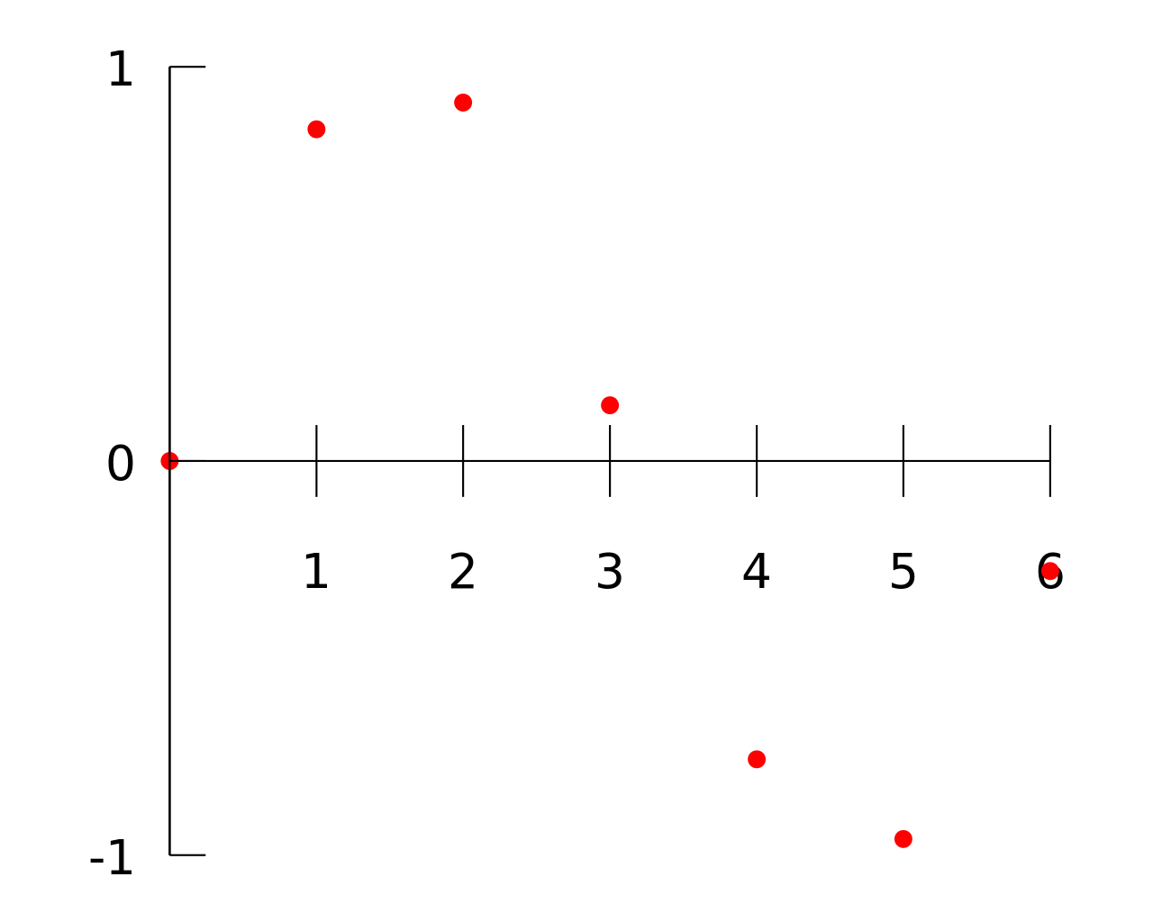
Interpolation
Using a set of data,
construct new data points
Within the range of a discrete set of known data points

Slide 7
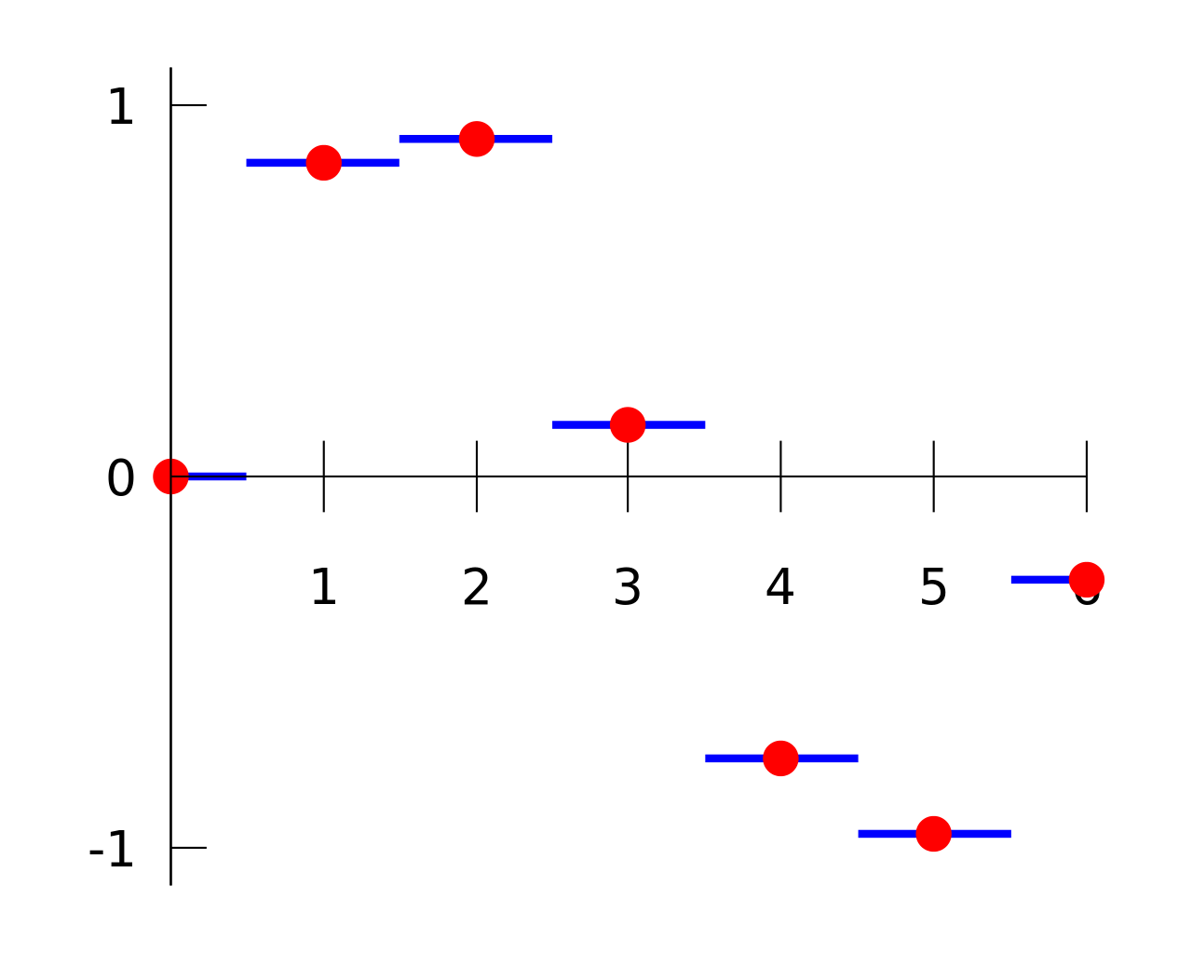
Interpolation
Nearest Neighbor:
Assumes the value is equal to the nearest know data point

Slide 8
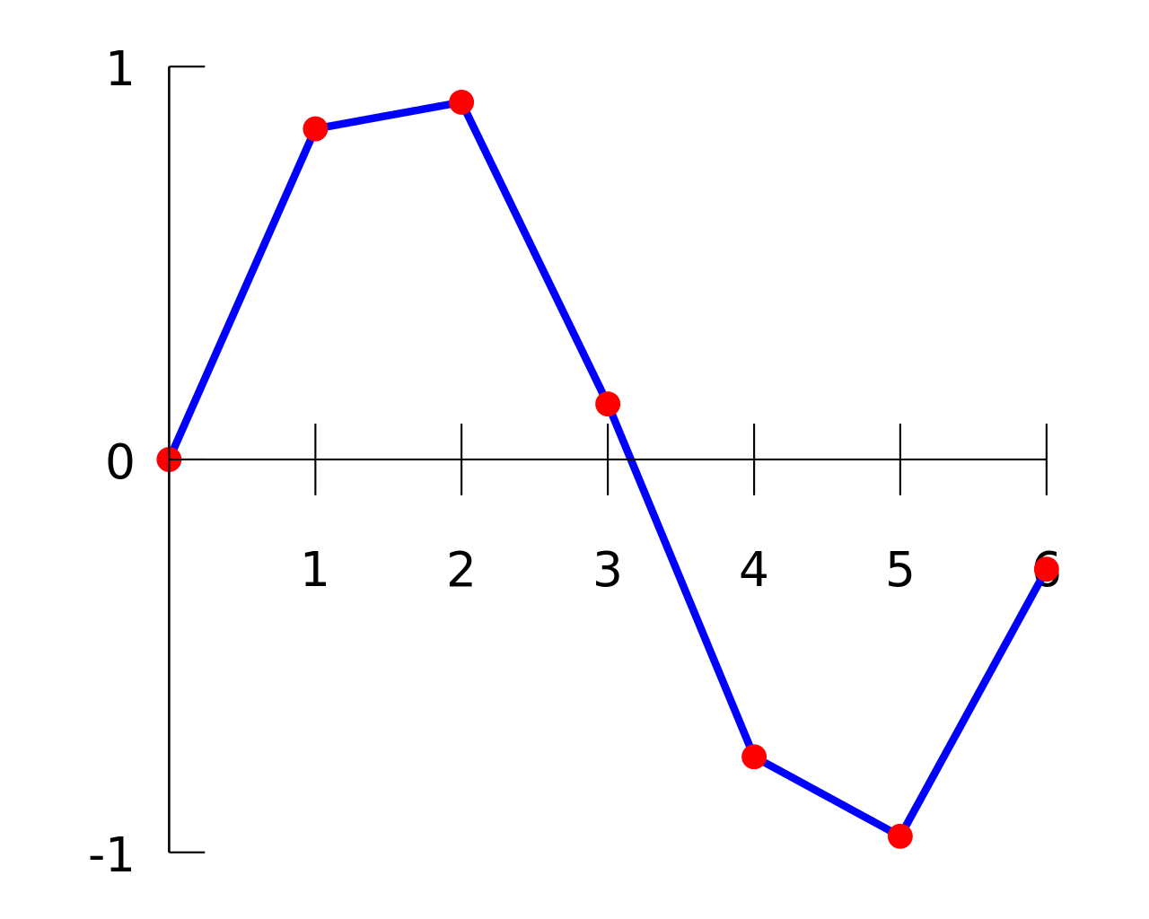
Interpolation
Linear:
Connects neighboring points linearly

Slide 9
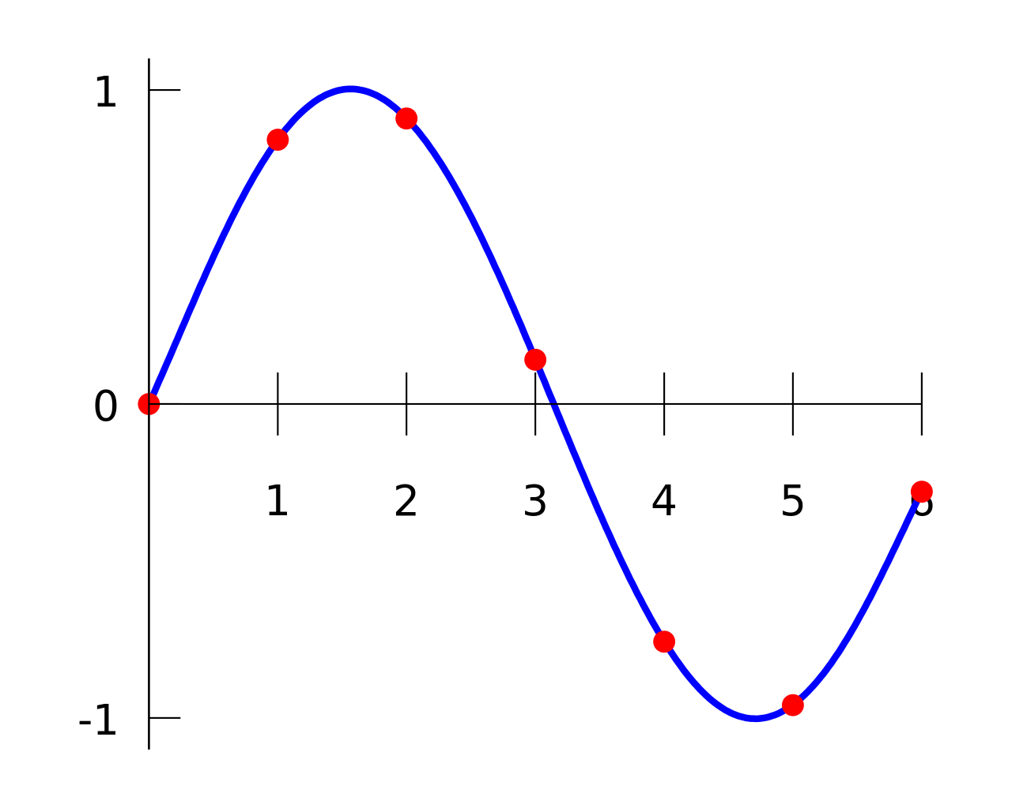
Interpolation
Polynomial Interpolation:
Connects neighboring points with a polynomial.

Slide 10
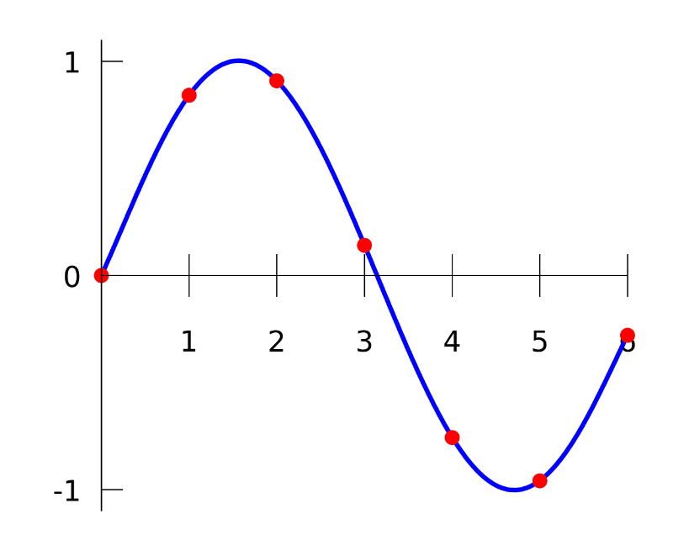
Polynomial Interpolation
Definition:
Interpolation of a given data set by a polynomial
The polynomial goes exactly through each known point
Given K+1 data points, a polynomial of degree K can be constructed that goes through every K+1 point

Slide 11
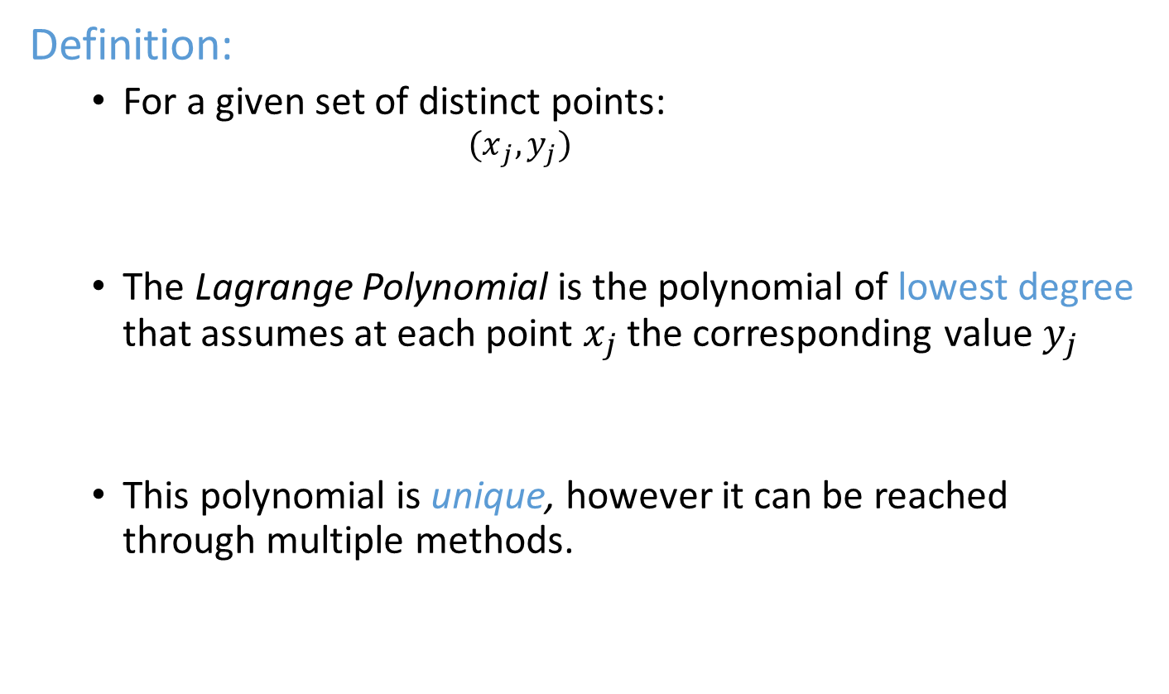
Lagrange polynomials
Definition:
For a given set of distinct points:
$${(x}_{j},y_{j})$$
The Lagrange Polynomial is the polynomial of lowest degree that assumes at each point $x_{j}$ the corresponding value $y_{j}$
This polynomial is unique, however it can be reached through multiple methods.

Slide 12
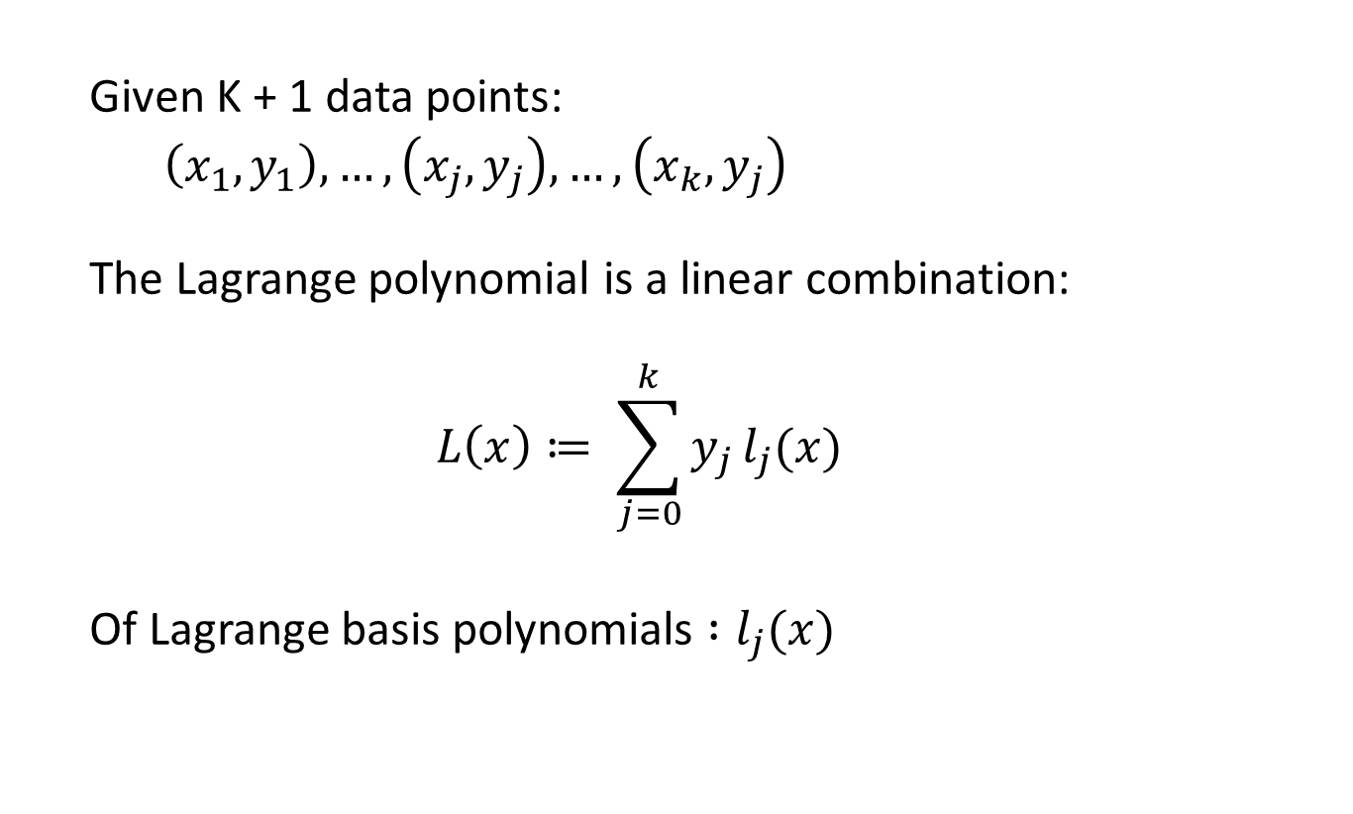
Constructing Lagrange polynomials
Given K + 1 data points:
$\left(x_{1},y_{1}\right),…,\left(x_{j},y_{j}\right),…, \left(x_{k},y_{j}\right)$
The Lagrange polynomial is a linear combination:
$$L\left(x\right)≔ \sum_{j=0}^{k}{y_{j}}l_{j}(x)$$
Of Lagrange basis polynomials $:l_{j}(x)$

Slide 13


Lagrange polynomials
$$L\left(x\right)≔ \sum_{j=0}^{k}{y_{j}}l_{j}(x)$$
Of Lagrange basis polynomials $:l_{j}(x)$
$$l_{j}\left(x\right) :=\prod_{\begin{aligned}0≤m≤k \\ m≠j\end{aligned}}{\frac{x−x_{m}}{x_{j}−x_{m}}}=\frac{(x−x_{0 })}{(x_{j}−x_{0})}…\frac{\left(x −x_{j−1}\right)}{\left(x_{j}−x_{j−1}\right)}\frac{\left(x −x_{j+1}\right)}{\left(x_{j}−x_{j+ 1}\right)}…\frac{(x−x_{k})}{(x_{j}−x_{k})}$$
NOT $j$

Slide 14
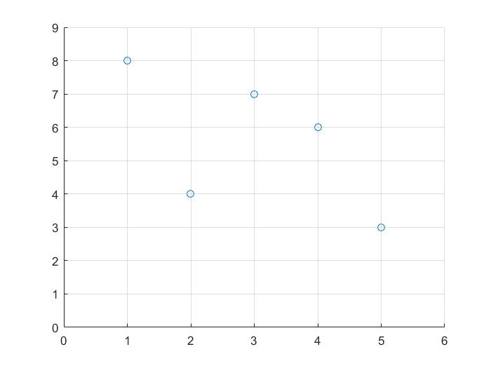
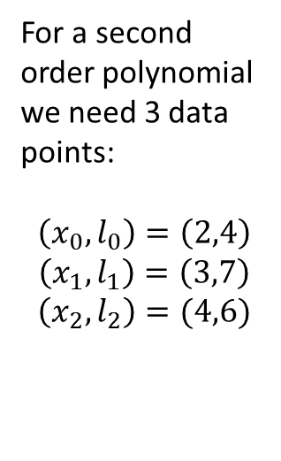


Lagrange polynomial - Example
x | y
1 | 8
2 | 4
3 | 7
4 | 6
5 | 3
Estimate the value at x = 1.5 with a 2-order polynomial
Find the Lagrange basis polynomials ($l_{0}$, $l_{1}$, $l_{2}$)
For a second order polynomial we need 3 data points:
$$\left(x_{0},l_{0}\right)=\left(2,4\right)$$
$$\left(x_{1},l_{1}\right)=\left(3,7\right)$$
$$\left(x_{2},l_{2}\right)=(4,6)$$
$$L\left(x\right)=y_{0}l_{0}+y_{1}l_{1}+y_{2}l_{2}$$

Slide 15
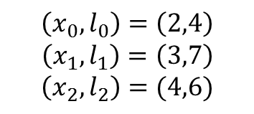
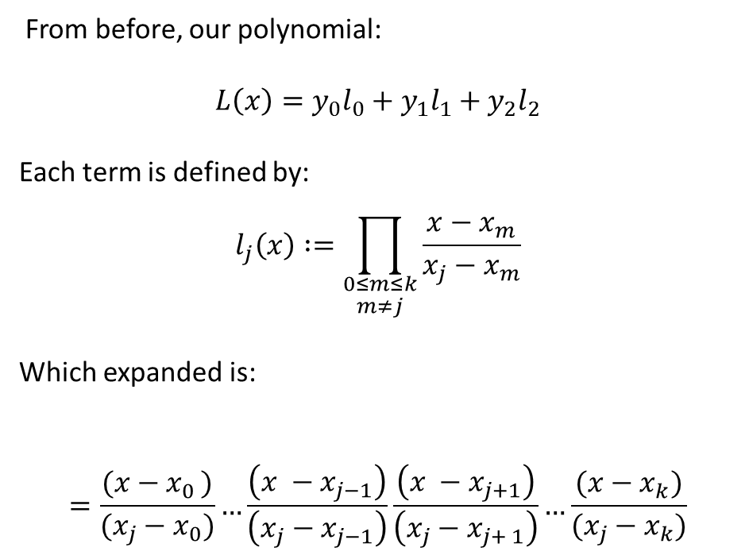
Lagrange polynomial - Example
x | y
1 | 8
2 | 4
3 | 7
4 | 6
5 | 3
From before, our polynomial:
$$L\left(x\right)=y_{0}l_{0}+y_{1}l_{1}+y_{2}l_{2}$$
Each term is defined by:
$$l_{j}\left(x\right) :=\prod_{\begin{aligned}0≤m≤k \\ m≠j\end{aligned}}{\frac{x−x_{m}}{x_{j}−x_{m}}}$$
Which expanded is:
$$=\frac{(x−x_{0 })}{(x_{j}−x_{0})}…\frac{\left(x −x_{j−1}\right)}{\left(x_{j}−x_{j−1}\right)}\frac{\left(x −x_{j+1}\right)}{\left(x_{j}−x_{j+ 1}\right)}…\frac{(x−x_{k})}{(x_{j}−x_{k})}$$
$$\left(x_{0},l_{0}\right)=\left(2,4\right)$$
$$\left(x_{1},l_{1}\right)=\left(3,7\right)$$
$$\left(x_{2},l_{2}\right)=(4,6)$$

Slide 16
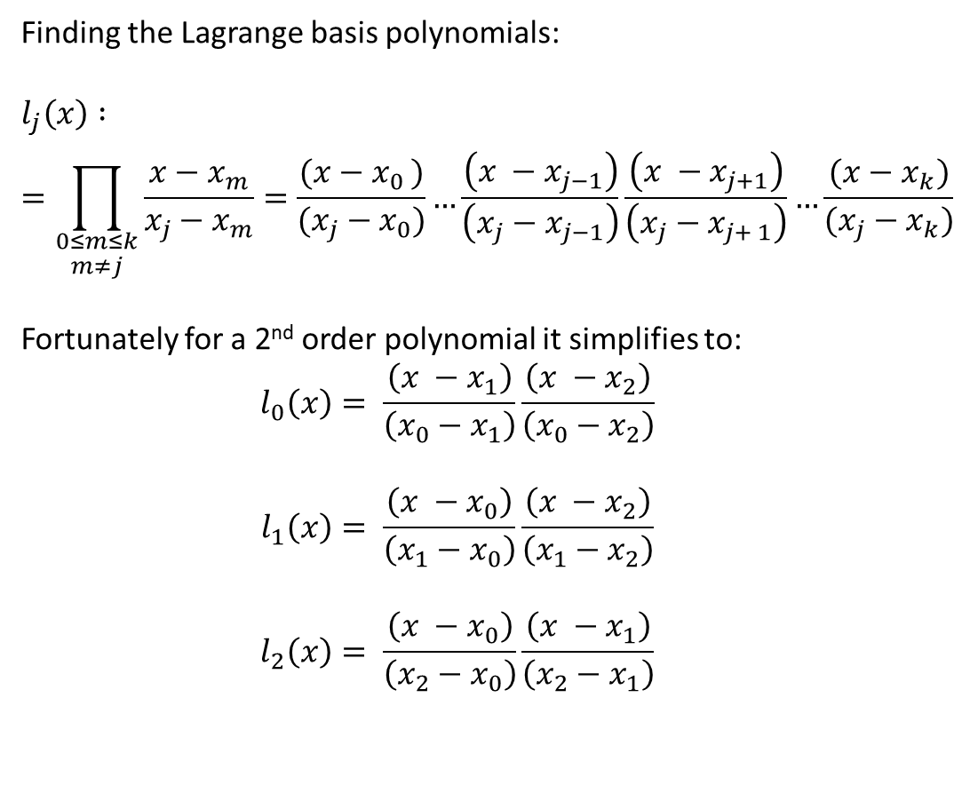
Lagrange polynomial - Example
x | y
1 | 8
2 | 4
3 | 7
4 | 6
5 | 3
Finding the Lagrange basis polynomials:
$$l_{j}\left(x\right) :=\prod_{\begin{aligned}0≤m≤k \\ m≠j\end{aligned}}{\frac{x−x_{m}}{x_{j}−x_{m}}=\frac{(x−x_{0 })}{(x_{j}−x_{0})}…\frac{\left(x −x_{j−1}\right)}{\left(x_{j}−x_{j−1}\right)}\frac{\left(x −x_{j+1}\right)}{\left(x_{j}−x_{j+ 1}\right)}…\frac{(x−x_{k})}{(x_{j}−x_{k})}}$$
Fortunately for a 2nd order polynomial it simplifies to:
$$l_{0}\left(x\right)= \frac{\left(x −x_{1}\right)}{\left(x_{0}−x_{1}\right)}\frac{\left(x −x_{2}\right)}{\left(x_{0}−x_{2}\right)}$$
$$l_{1}\left(x\right)= \frac{\left(x −x_{0}\right)}{\left(x_{1}−x_{0}\right)}\frac{\left(x −x_{2}\right)}{\left(x_{1}−x_{2}\right)}$$
$$l_{2}\left(x\right)= \frac{\left(x −x_{0}\right)}{\left(x_{2}−x_{0}\right)}\frac{\left(x −x_{1}\right)}{\left(x_{2}−x_{1}\right)}$$
$$\left(x_{0},l_{0}\right)=\left(2,4\right)$$
$$\left(x_{1},l_{1}\right)=\left(3,7\right)$$
$$\left(x_{2},l_{2}\right)=(4,6)$$

Slide 17

Lagrange polynomial - Example
x | y
1 | 8
2 | 4
3 | 7
4 | 6
5 | 3
$$l_{0}\left(x\right)= \frac{\left(x −x_{1}\right)}{\left(x_{0}−x_{1}\right)}\frac{\left(x −x_{2}\right)}{\left(x_{0}−x_{2}\right)}$$
Filling in the values:
$$l_{0}\left(x\right)= \frac{\left(x −2\right)}{\left(1−2\right)}\frac{\left(x −3\right)}{\left(1−3\right)}$$
$$l_{0}\left(x\right)=\frac{x^{2}}{2}−\frac{5x}{2}+3$$
$y_{0}l_{0}$ = $8(\frac{x^{2}}{2}−\frac{5x}{2}+3)$
$$\left(x_{0},l_{0}\right)=\left(2,4\right)$$
$$\left(x_{1},l_{1}\right)=\left(3,7\right)$$
$$\left(x_{2},l_{2}\right)=(4,6)$$

Slide 18
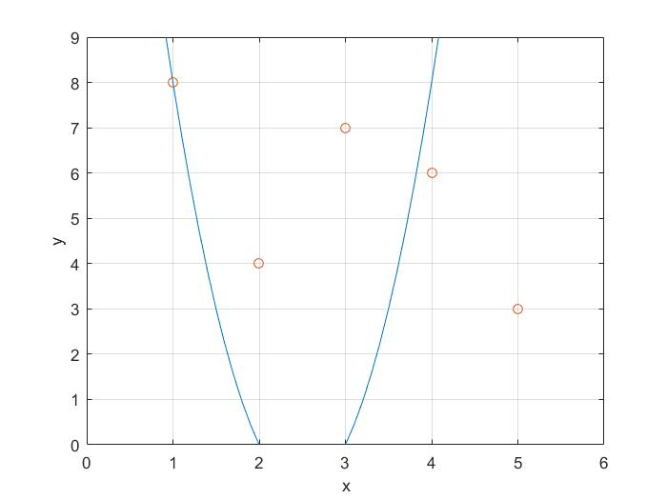

$y_{0}l_{0}$ = $8(\frac{x^{2}}{2}−\frac{5x}{2}+3)$

Slide 19

Lagrange polynomial - Example
x | y
1 | 8
2 | 4
3 | 7
4 | 6
5 | 3
$$l_{1}\left(x\right)= \frac{\left(x −x_{0}\right)}{\left(x_{1}−x_{0}\right)}\frac{\left(x −x_{2}\right)}{\left(x_{1}−x_{2}\right)}$$
Filling in the values:
$$l_{1}\left(x\right)= \frac{\left(x −1\right)}{\left(2−1\right)}\frac{\left(x −3\right)}{\left(2−3\right)}$$
$$l_{1}\left(x\right)=−x^{2}+4x −3$$
$y_{1}l_{1}$ = $4(−x^{2}+4x −3)$
$$\left(x_{0},l_{0}\right)=\left(2,4\right)$$
$$\left(x_{1},l_{1}\right)=\left(3,7\right)$$
$$\left(x_{2},l_{2}\right)=(4,6)$$

Slide 20
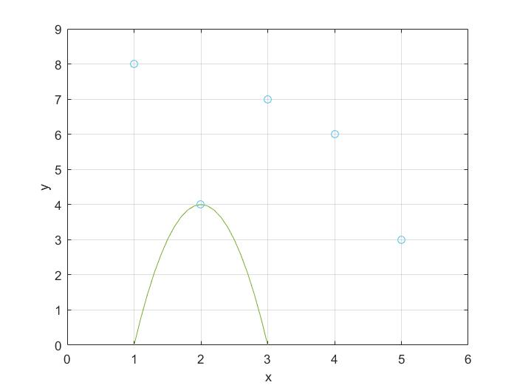

$y_{1}l_{1}$ = $4(−x^{2}+4x −3)$

Slide 21

Lagrange polynomial - Example
x | y
1 | 8
2 | 4
3 | 7
4 | 6
5 | 3
$$l_{2}\left(x\right)= \frac{\left(x −x_{0}\right)}{\left(x_{2}−x_{0}\right)}\frac{\left(x −x_{1}\right)}{\left(x_{2}−x_{1}\right)}$$
Filling in the values:
$$l_{2}\left(x\right)= \frac{\left(x −1\right)}{\left(3−1\right)}\frac{\left(x −2\right)}{\left(3−2\right)}$$
$$l_{2}\left(x\right)=\frac{x^{2}}{2}−\frac{3x}{2}+1$$
$y_{2}l_{2}$ = $7(\frac{x^{2}}{2}−\frac{3x}{2}+1)$
$$\left(x_{0},l_{0}\right)=\left(2,4\right)$$
$$\left(x_{1},l_{1}\right)=\left(3,7\right)$$
$$\left(x_{2},l_{2}\right)=(4,6)$$

Slide 22
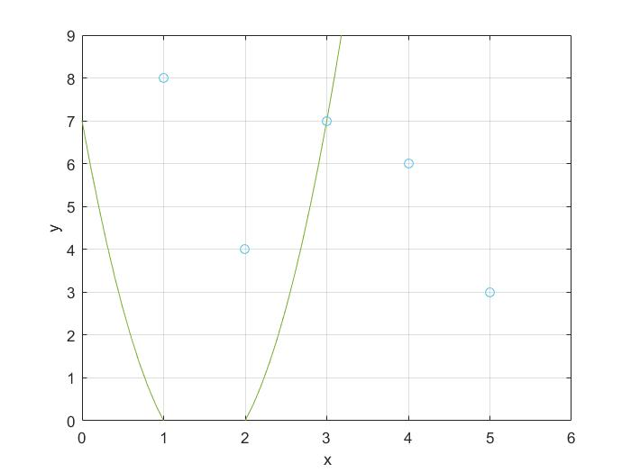

$y_{2}l_{2}$ = $7(\frac{x^{2}}{2}−\frac{3x}{2}+1)$

Slide 23
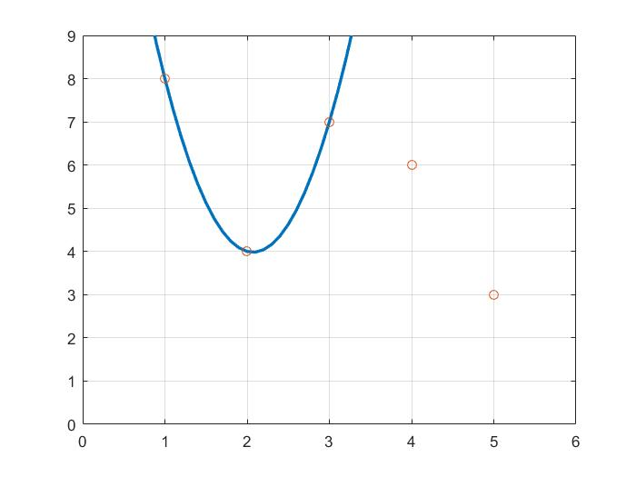


Everything together…
$$L(x)= 8\left(\frac{x^{2}}{2}−\frac{5x}{2}+3\right)+4(−x^{2}+4x −3)+7(\frac{x^{2}}{2}−\frac{3x}{2}+1)$$
$$L(1.5)≈5$$

Slide 24
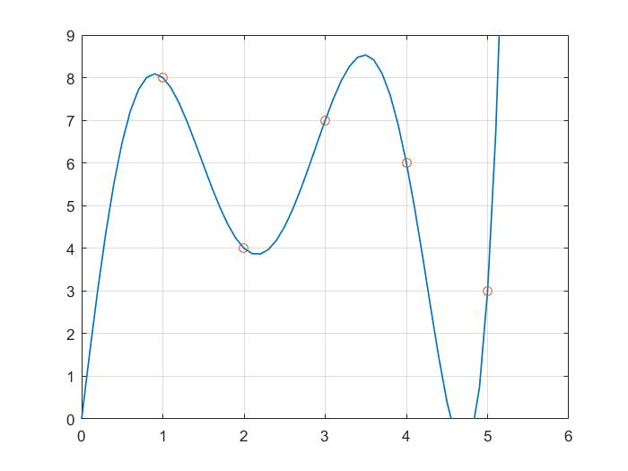
Higher Order Approximation
Out of Domain
Out of Domain

Slide 25
Applications
Cryptography
Shamir Secrete Sharing
Vector Graphics
Bezier Curves

Slide 26
Shamir Secret Sharing
An algorithm in Cryptography created by Adi Shamir
A form of Secret Sharing:
A secret is divided into parts and distributed to participants, each of whom is allocated a share of the secret. The secret can then be reconstructed from some or all of the shares
Based on the properties of polynomials

Slide 27
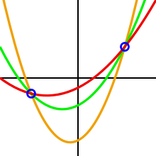
Shamir Secret Sharing
Functions on the basis that a k degree polynomial is uniquely defined by k + 1 points.

Slide 28
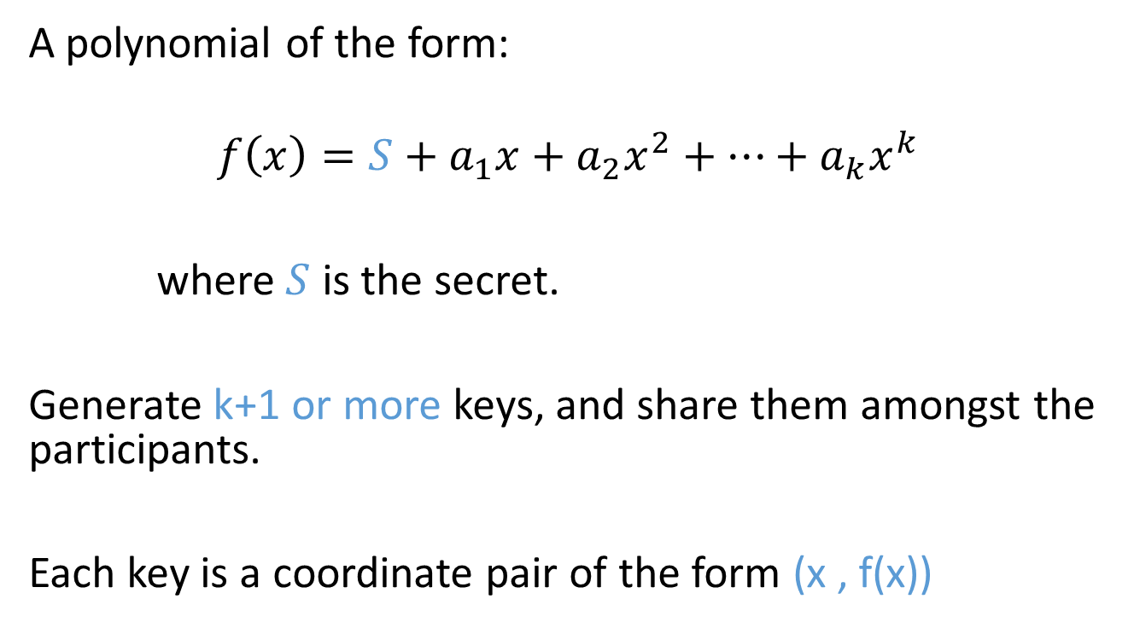
Shamir Secret Sharing
A polynomial of the form:
$$f\left(x\right)=S+a_{1}x+a_{2}x^{2}+…+a_{k}x^{k}$$
where $S$ is the secret.
Generate k+1 or more keys, and share them amongst the participants.
Each key is a coordinate pair of the form (x , f(x))

Slide 29
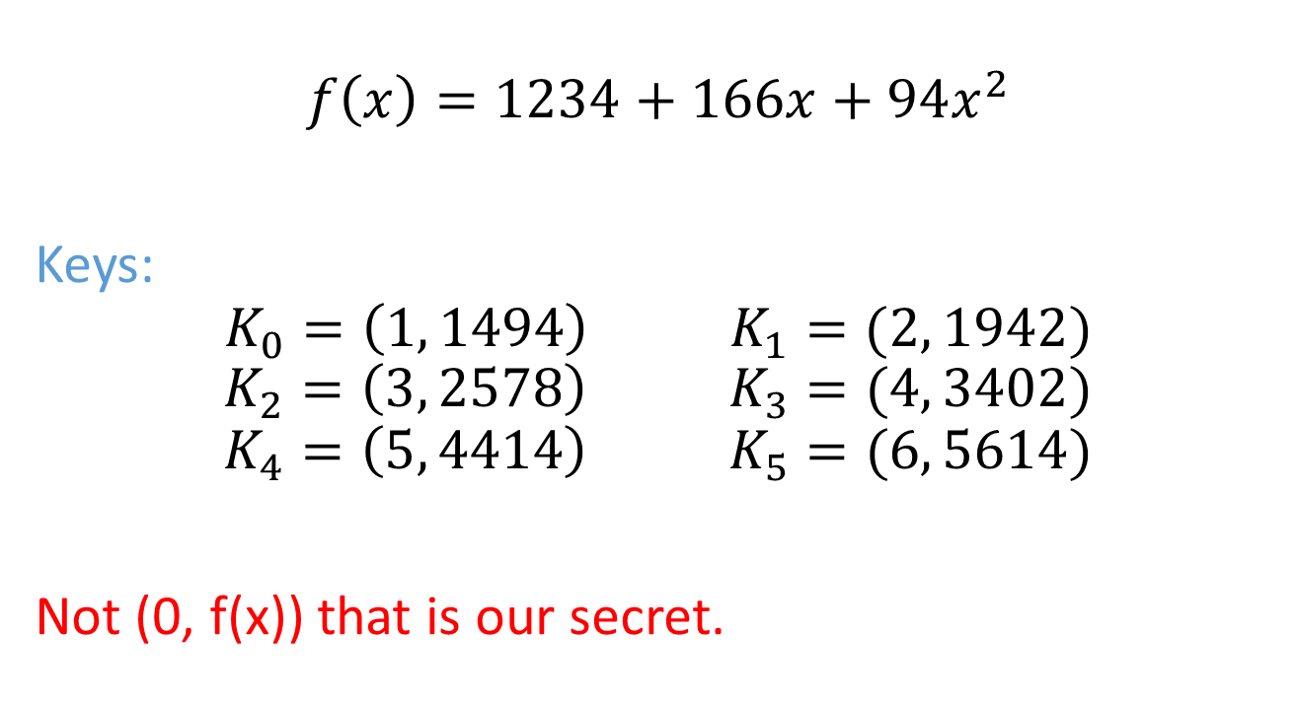
Shamir Secret Sharing Example
$$f\left(x\right)=1234+166x+94x^{2}$$
Keys:
$$K_{0}=\left(1, 1494\right) K_{1}=(2, 1942)$$
$$K_{2}=\left(3, 2578\right) K_{3}=(4, 3402)$$
$$K_{4}=\left(5, 4414\right) K_{5}=(6, 5614)$$
Not (0, f(x)) that is our secret.

Slide 30
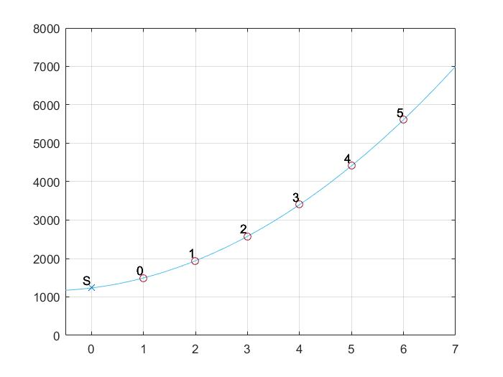

Shamir Secret Sharing Example
$$f\left(x\right)=1234+166x+94x^{2}$$
Our secret (S)
The y-intercept
Keys

Slide 31
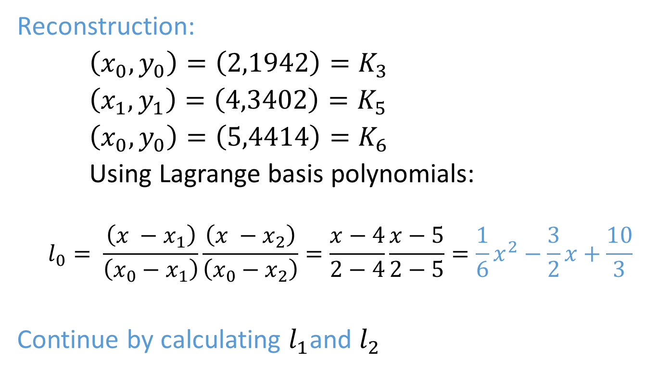
Shamir Secret Sharing Example
Reconstruction:
$\left(x_{0},y_{0}\right)=\left(2,1942\right)=K_{3}$
$\left(x_{1},y_{1}\right)=\left(4,3402\right)=K_{5}$
$\left(x_{0},y_{0}\right)=\left(5,4414\right)=K_{6}$
Using Lagrange basis polynomials:
$$l_{0}= \frac{\left(x −x_{1}\right)}{\left(x_{0}−x_{1}\right)}\frac{\left(x −x_{2}\right)}{\left(x_{0}−x_{2}\right)}=\frac{x−4}{2−4}\frac{x−5}{2−5}=\frac{1}{6}x^{2}−\frac{3}{2}x+\frac{10}{3}$$
Continue by calculating $l_{1}$and $l_{2}$

Slide 32
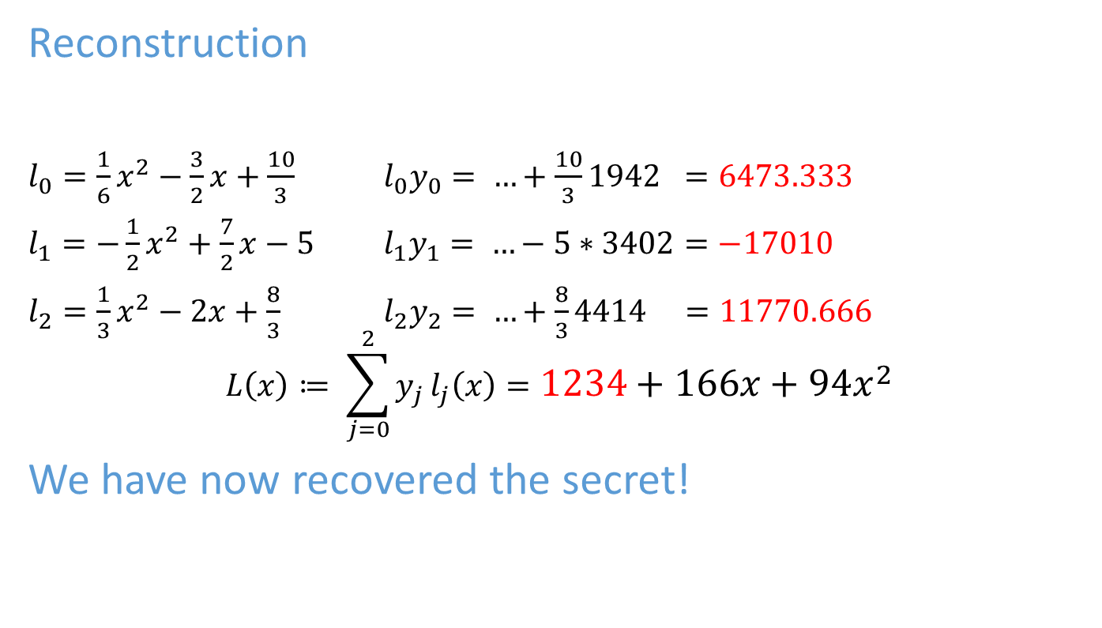
Shamir Secret Sharing Example
Reconstruction
$l_{0}=\frac{1}{6}x^{2}−\frac{3}{2}x+\frac{10}{3}$ $l_{0}y_{0}= …+\frac{10}{3}1942 =6473.333$
$l_{1}=−\frac{1}{2}x^{2}+\frac{7}{2}x−5$ $l_{1}y_{1}= …−5∗3402=−17010$
$l_{2}=\frac{1}{3}x^{2}−2x+\frac{8}{3}$ $l_{2}y_{2}= …+\frac{8}{3}4414 =11770.666$
$$L\left(x\right)≔ \sum_{j=0}^{2}{y_{j}}l_{j}\left(x\right)=1234+166x+94x^{2}$$
We have now recovered the secret!

Slide 33
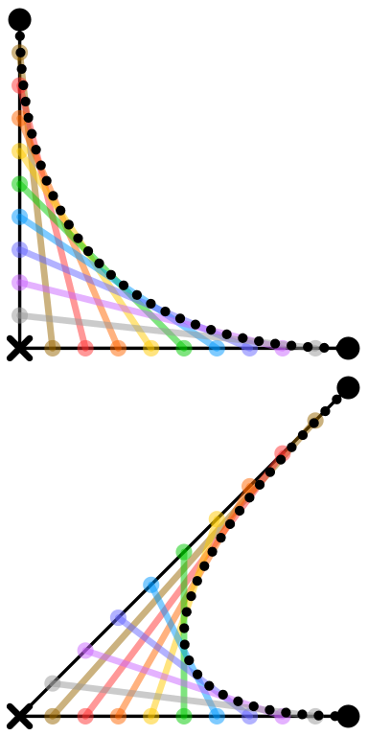
Bezier Curves [Vector Graphics]

Slide 34
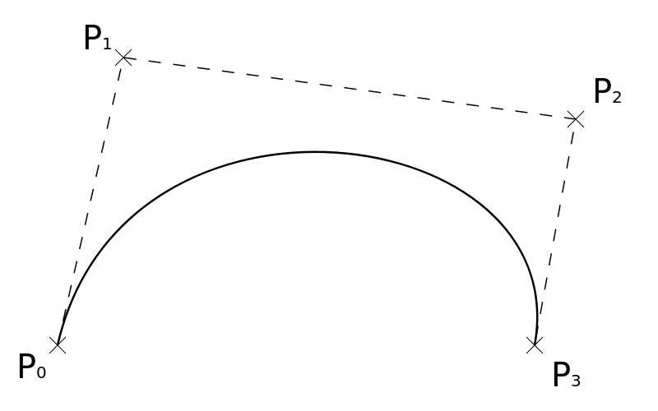
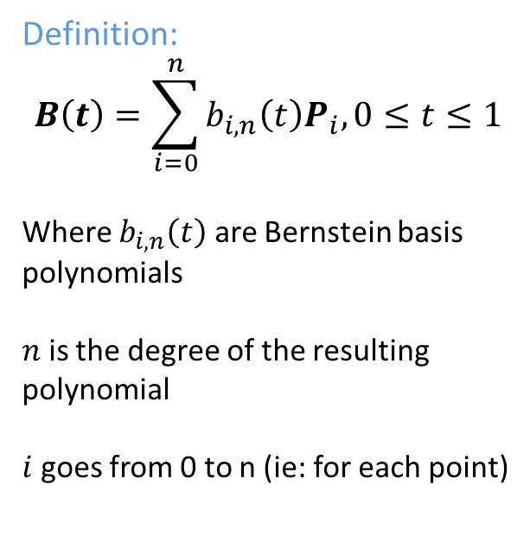

Bezier Curves
$$Vector: \left({x \atop y}\right)$$
Definition:
$$B\left(t\right)=\sum_{i=0}^{n}{b_{i,n}\left(t\right)P_{i}, 0≤t≤1}$$
Where $b_{i,n}\left(t\right)$ are Bernstein basis polynomials
$n$ is the degree of the resulting polynomial
$i$ goes from 0 to n (ie: for each point)

Slide 35
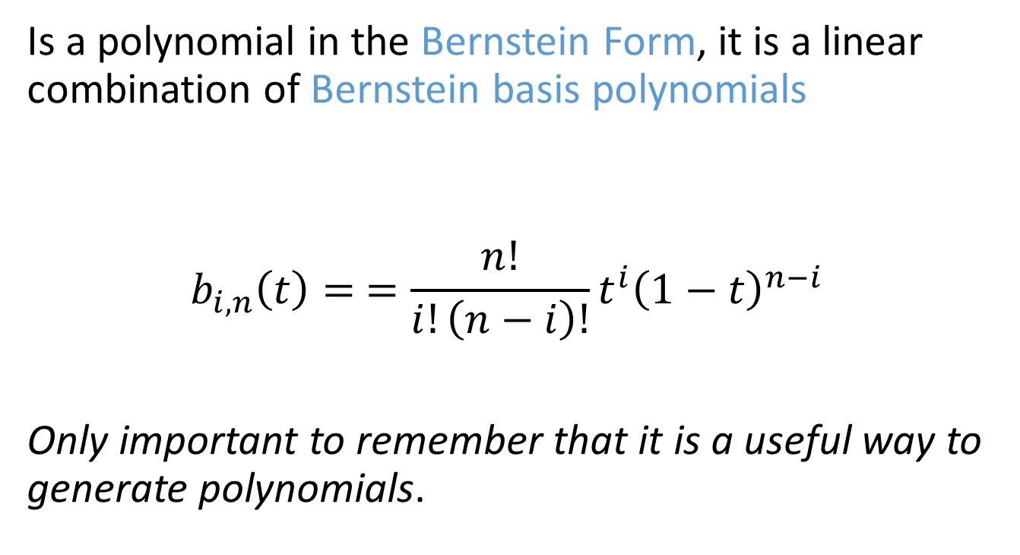
Bernstein Polynomial
Is a polynomial in the Bernstein Form, it is a linear combination of Bernstein basis polynomials
$$b_{i,n}\left(t\right)= =\frac{n!}{i!\left(n−i\right)!}t^{i}{\left(1−t\right)}^{n−i}$$
Only important to remember that it is a useful way to generate polynomials.

Slide 36
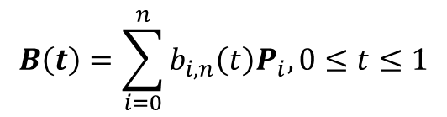
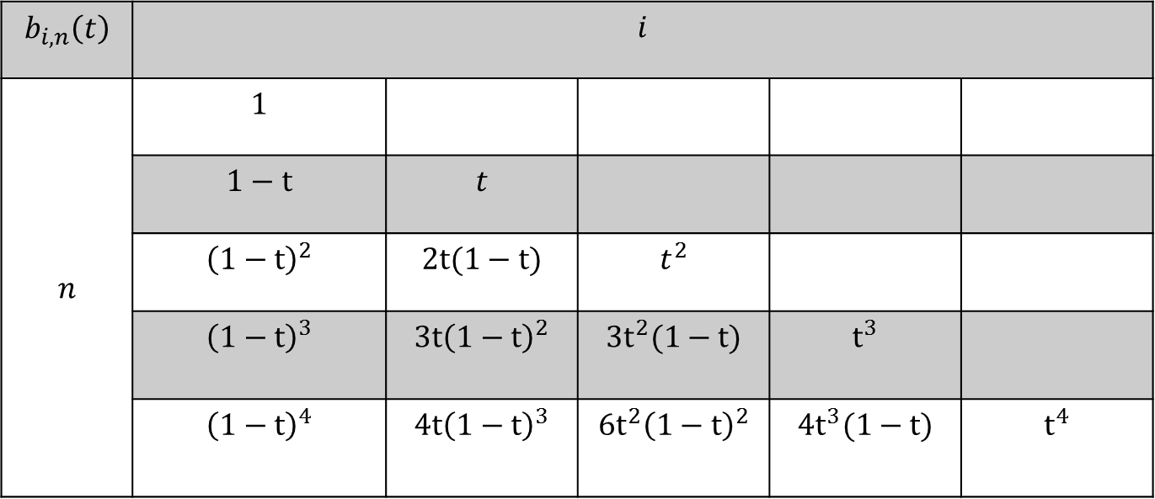
Bernstein Basis Polynomial
$$B\left(t\right)=\sum_{i=0}^{n}{b_{i,n}\left(t\right)P_{i}, 0≤t≤1}$$
$$b_{i,n}\left(t\right)$$ | $$i$$
$$n$$ | $$1$$
 | $$1−t$$ | $$t$$
 | $${\left(1−t\right)}^{2}$$ | $$2t(1−t)$$ | $$t^{2}$$
 | $${\left(1−t\right)}^{3}$$ | $$3t{\left(1−t\right)}^{2}$$ | $$3t^{2}(1−t)$$ | $$t^{3}$$
 | $${\left(1−t\right)}^{4}$$ | $$4t{\left(1−t\right)}^{3}$$ | $$6t^{2}{\left(1−t\right)}^{2}$$ | $$4t^{3}(1−t)$$ | $$t^{4}$$

Slide 37
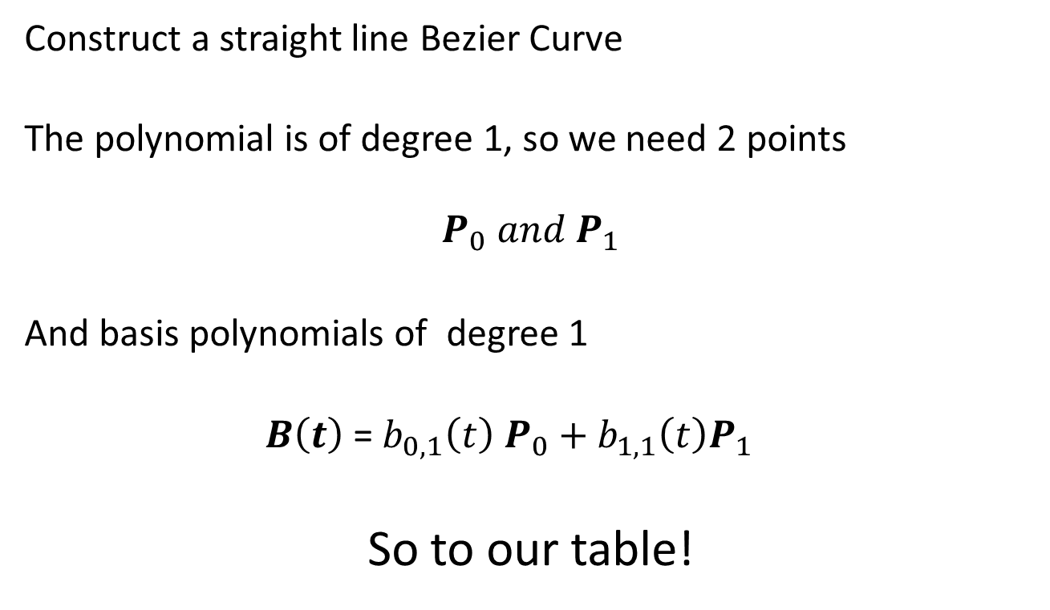
Example
Construct a straight line Bezier Curve
The polynomial is of degree 1, so we need 2 points
$$P_{0} and{ P}_{1}$$
And basis polynomials of degree 1
$B\left(t\right)$ = $b_{0,1}\left(t\right) P_{0}+b_{1,1}\left(t\right)P_{1}$
So to our table!

Slide 38
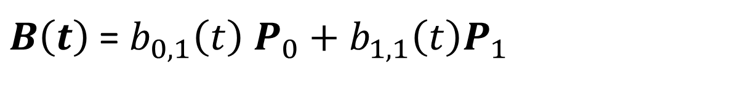
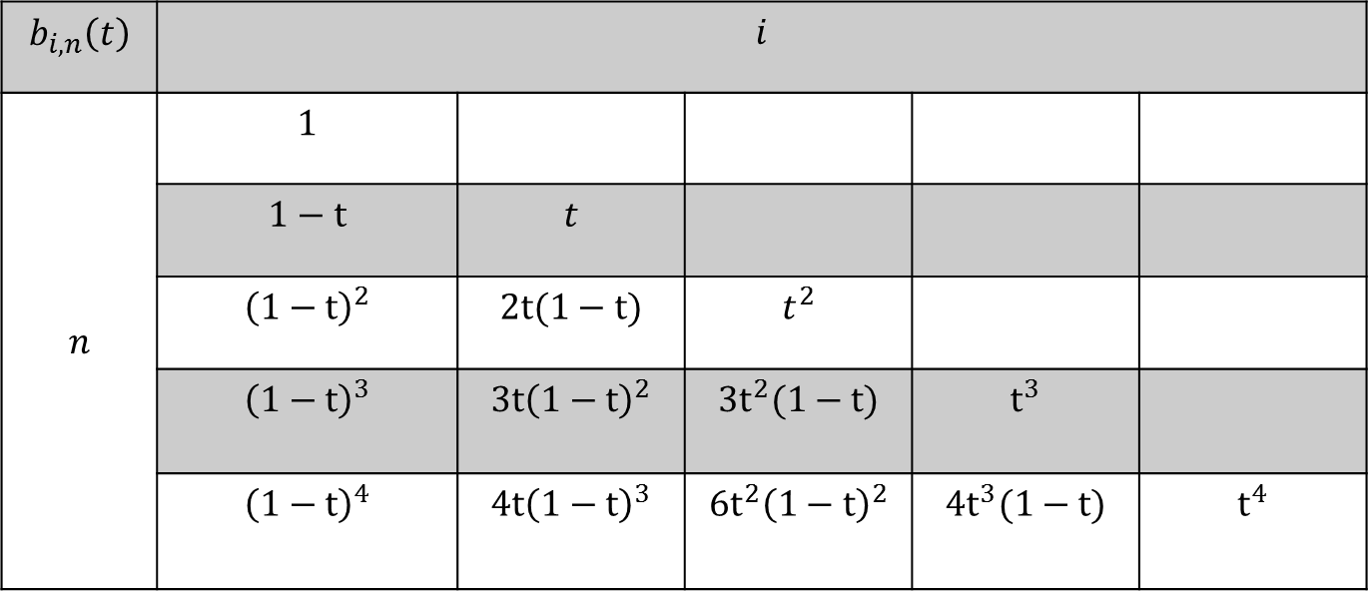


Bernstein Basis Polynomial
$$b_{i,n}\left(t\right)$$ | $$i$$
$$n$$ | $$1$$
 | $$1−t$$ | $$t$$
 | $${\left(1−t\right)}^{2}$$ | $$2t(1−t)$$ | $$t^{2}$$
 | $${\left(1−t\right)}^{3}$$ | $$3t{\left(1−t\right)}^{2}$$ | $$3t^{2}(1−t)$$ | $$t^{3}$$
 | $${\left(1−t\right)}^{4}$$ | $$4t{\left(1−t\right)}^{3}$$ | $$6t^{2}{\left(1−t\right)}^{2}$$ | $$4t^{3}(1−t)$$ | $$t^{4}$$
$$i=0$$
$$n=1$$
$B\left(t\right)$ = $b_{0,1}\left(t\right) P_{0}+b_{1,1}\left(t\right)P_{1}$

Slide 39

Bernstein Basis Polynomial
$$b_{i,n}\left(t\right)$$ | $$i$$
$$n$$ | $$1$$
 | $$1−t$$ | $$t$$
 | $${\left(1−t\right)}^{2}$$ | $$2t(1−t)$$ | $$t^{2}$$
 | $${\left(1−t\right)}^{3}$$ | $$3t{\left(1−t\right)}^{2}$$ | $$3t^{2}(1−t)$$ | $$t^{3}$$
 | $${\left(1−t\right)}^{4}$$ | $$4t{\left(1−t\right)}^{3}$$ | $$6t^{2}{\left(1−t\right)}^{2}$$ | $$4t^{3}(1−t)$$ | $$t^{4}$$
$$i=1$$
$$n=1$$
$B\left(t\right)$ = $b_{0,1}\left(t\right) P_{0}+b_{1,1}\left(t\right)P_{1}$

Slide 40
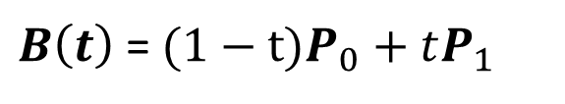
Bernstein Basis Polynomial
$B\left(t\right)$ = $(1−t)P_{0}+tP_{1}$

Slide 41
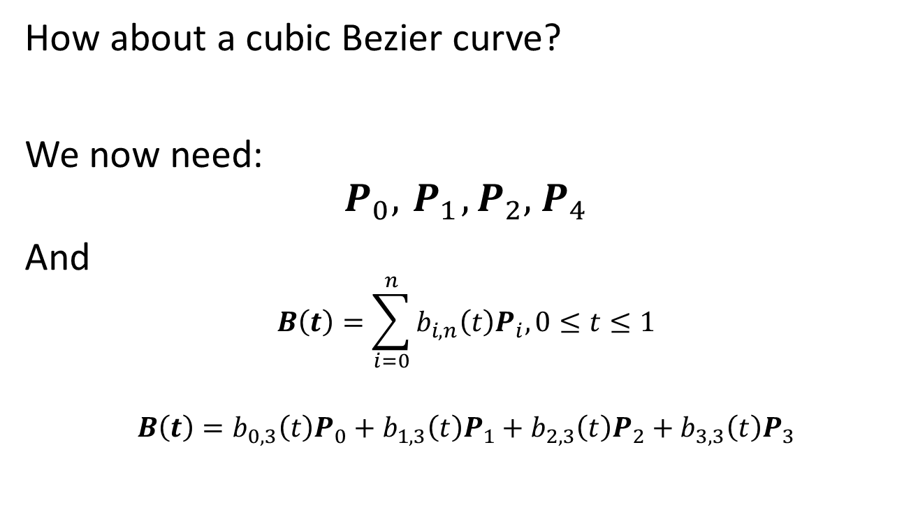
Example
How about a cubic Bezier curve?
We now need:
$$P_{0},{ P}_{1},P_{2},{ P}_{4}$$
And
$$B\left(t\right)=\sum_{i=0}^{n}{b_{i,n}\left(t\right)P_{i}, 0≤t≤1}$$
$$B\left(t\right)=b_{0,3}\left(t\right)P_{0}+b_{1,3}\left(t\right)P_{1}+b_{2,3}\left(t\right)P_{2}+b_{3,3}\left(t\right)P_{3}$$

Slide 42
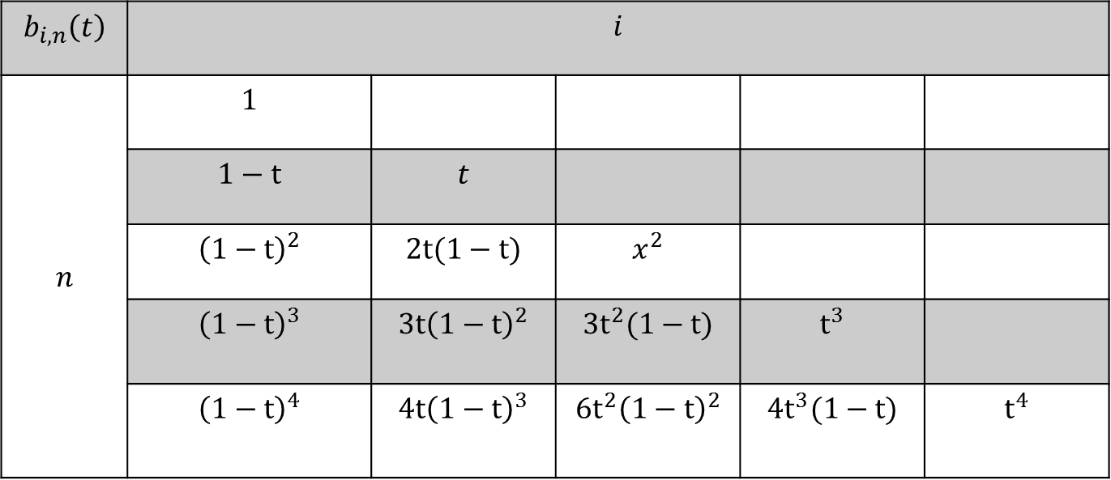


Example
$$b_{i,n}\left(t\right)$$ | $$i$$
$$n$$ | $$1$$
 | $$1−t$$ | $$t$$
 | $${\left(1−t\right)}^{2}$$ | $$2t(1−t)$$ | $$x^{2}$$
 | $${\left(1−t\right)}^{3}$$ | $$3t{\left(1−t\right)}^{2}$$ | $$3t^{2}(1−t)$$ | $$t^{3}$$
 | $${\left(1−t\right)}^{4}$$ | $$4t{\left(1−t\right)}^{3}$$ | $$6t^{2}{\left(1−t\right)}^{2}$$ | $$4t^{3}(1−t)$$ | $$t^{4}$$
$$1−t$$
$$n=3$$
$$B\left(t\right)=b_{0,3}\left(t\right)P_{0}+b_{1,3}\left(t\right)P_{1}+b_{2,3}\left(t\right)P_{2}+b_{3,3}\left(t\right)P_{3}$$

Slide 43
Example
$$B\left(t\right)={\left(1−t\right)}^{3}P_{0}+3t{\left(1−t\right)}^{2}P_{1}+3t^{2}(1−t)P_{2}+t^{3}P_{3}$$

Slide 44
Online Tool
LINK

