Slide 1
Pope Francis

Slide 2
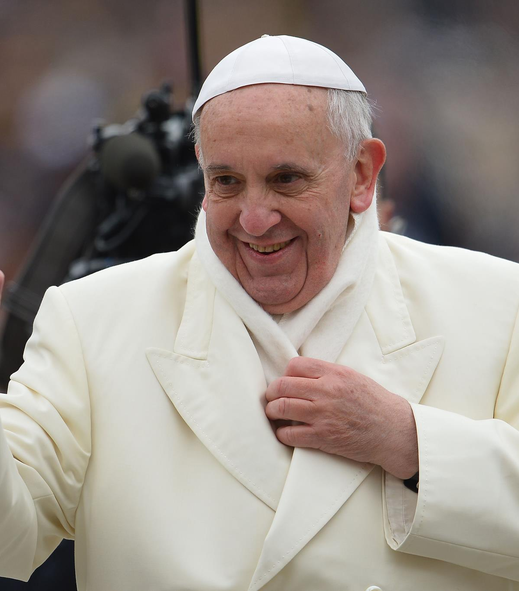
Who Is Pope Francis?

Slide 3
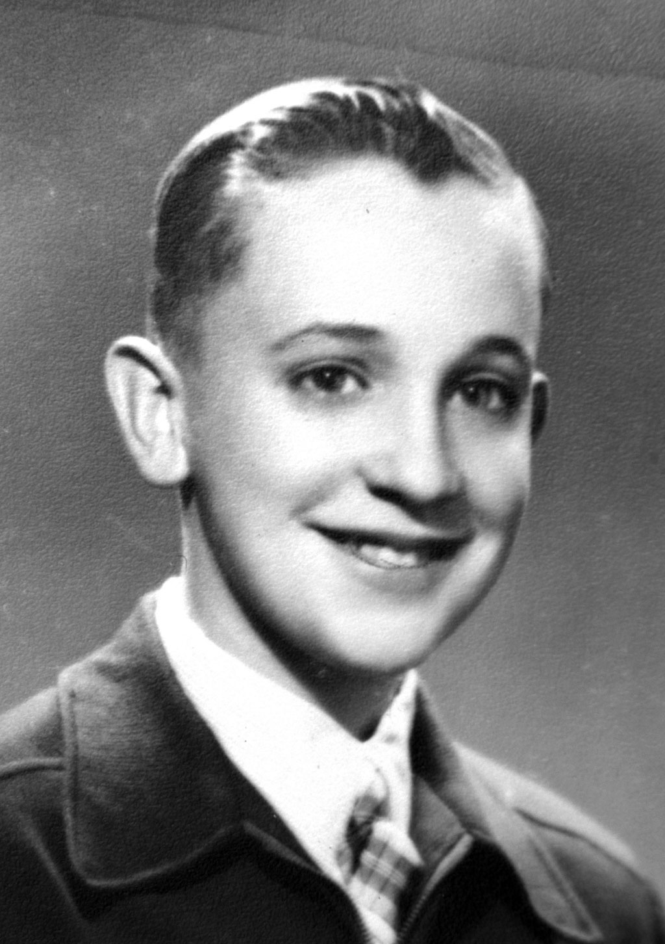
Early Life and Education

Slide 4
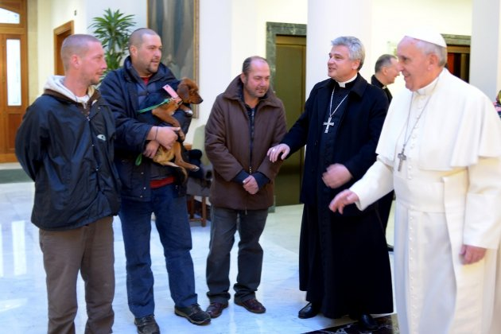
Becoming Pope

Slide 5
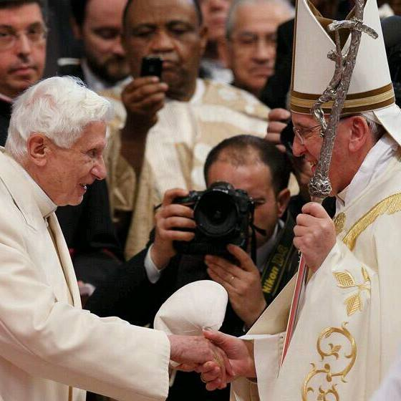
Pope as Spiritual and World Leader

Slide 6
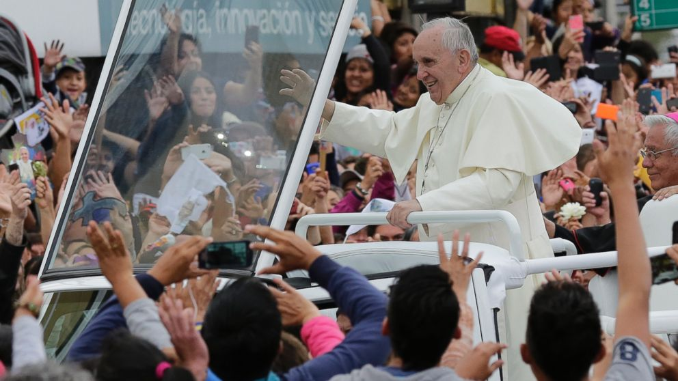
First International Visit as Pope

Slide 7

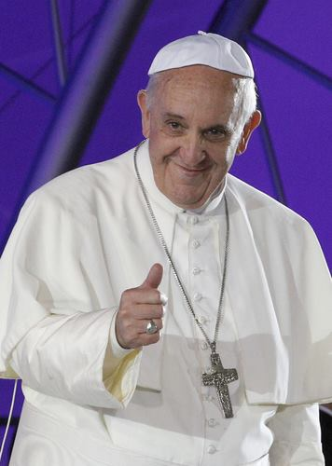
Progressive Stances

Slide 8
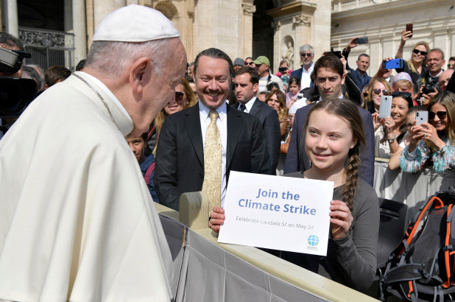
Pope as Environmental Activist

Slide 9
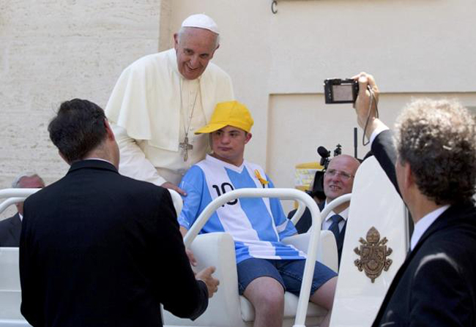
'A Man of His Word'

