Slide 1
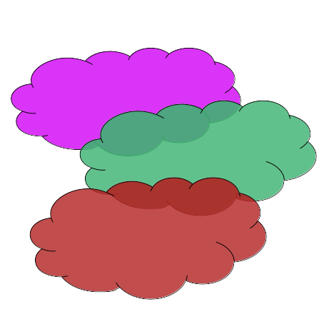
CloudClusters.jl

Slide 2
Who is it intended for
Julia users, mainly interactive;
Non-advanced users of IaaS cloud services;
  AWS EC2, Google Cloud Platform (GCP), Microsoft Azure, …
High demand for advanced computing resources
  e.g., high-end processors, accelerators, network, and storage

Slide 3
CloudClusters.jl
Deploy clusters of virtual machines over IaaS cloud providers
  free users of the burden of configuring and managing cloud-based clusters;
Launch computations by usual means (using Distributed.jl)
  Special support to to MPI.jl
Advanced features …
  Multicluster computations;
  Multilevel Distributed.jl extension (for supporting Manage-Workers clusters);
  Integration with PlatformAware.jl.

Slide 4
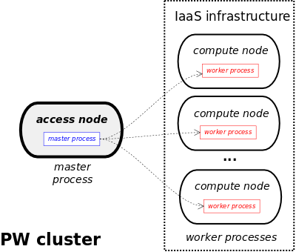
CloudClusters.jl
Types of Clusters – Peer-Workers cluster

Slide 5
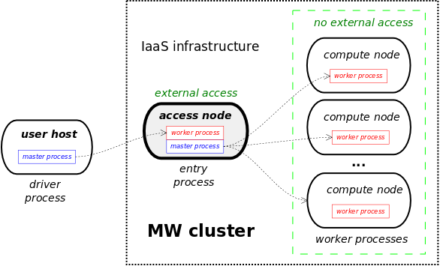
CloudClusters.jl
Types of Clusters – Manager-Workers cluster
currently not supported by
Distributed.jl

Slide 6
CloudClusters.jl
Multilevel Extension of Distributed.jl
m
Multilevel parallelism, where workers may launch workers.
A (non-root) process may have two roles
  master, w.r.t. the worker processes it creates (successors)
  worker, w.r.t. the master process that created it (predecessor)
All Distributed.jl operations with an additional keyword parameter named role:
  two possile values (:master and :worker)
  backward compatibility
SSCAD’2024 paper
  October 23-25 , 2024
  “Towards multicluster computations with Julia”, with Tiago Carneiro
w
mw
mw
mw
w
w
w

Slide 7
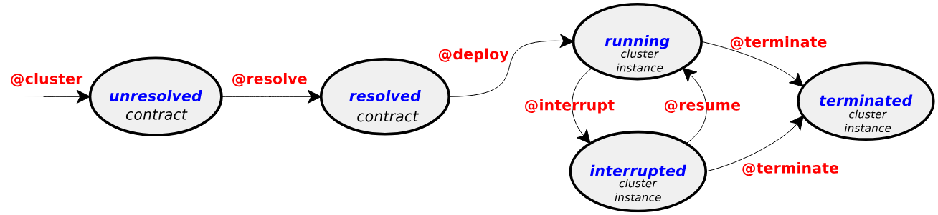
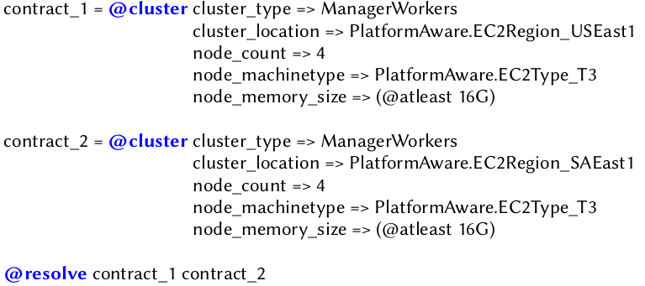
CloudClusters.jl
Primitives
@cluster
  specifies a contract with required cluster features
  returns a contract handle
@resolve
  finds a cluster setup that meets the contract
  idempotent

Slide 8


CloudClusters.jl
Primitives
@deploy
  instantiates the cluster from a resolved contract
  creates Julia processes across cluster nodes
  make the cluster ready to run computations
@terminate
  terminates the cluster nodes
  free cloud resources

Slide 9
CloudClusters.jl
Primitives
@interrupt
  finish processes and stop cluster nodes
  free the cloud resources temporarily
@resume
  put an interrupted node in the running state
  reclaim cloud resources
@interrupt cluster_1
⁞
@resume cluster_1

Slide 10
CloudClusters.jl additional operations
@select
  returns the list of VM instance/machine types that satisfy a set of node features
  helps the user to select directly between IaaS providers and instance types of nodes
@restart
  reconnect to a cluster that was not terminated in a previous section
  new processes are created in the nodes
    the previous state of Julia processes is lost
  fault tolerance and avoiding the cost of cluster deployment
@clusters
  lists the set of clusters that have not been terminated in a previous session in the host
  Useful to find clusters to be reused through restart

Slide 11
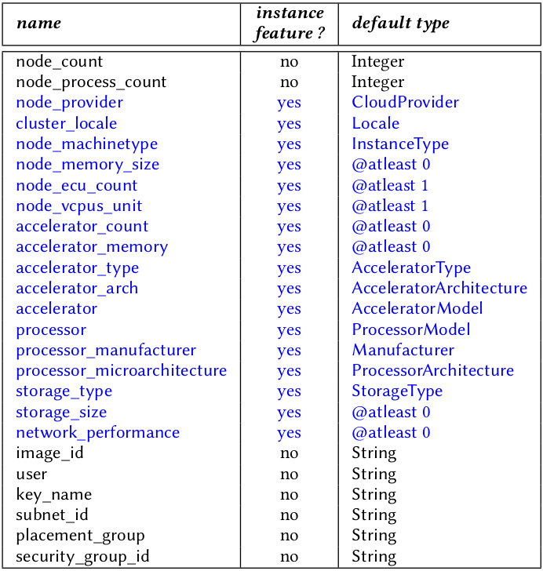
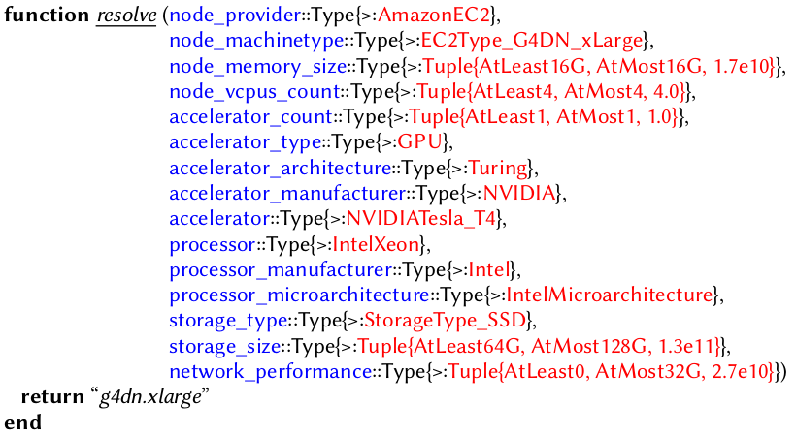
CloudClusters.jl cluster contracts
Instance features
  cluster and cluster nodes configuration
  characteristics of VM types offered by IaaS providers
Platform types of PlatformAware.jl
  database of virtual machine types
Contract resolution through multiple dispatch
  the resolve
  function
  A method for
  each VM type

Slide 12
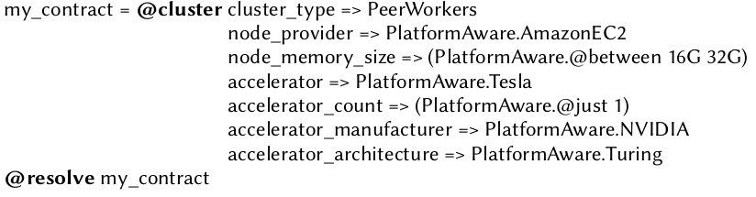
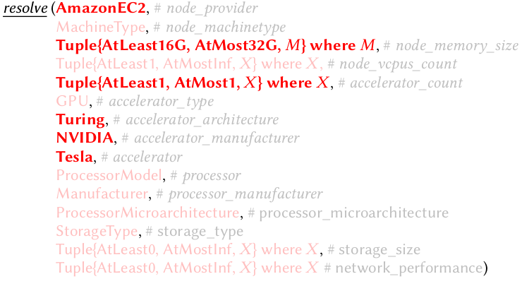
CloudClusters.jl cluster contracts – the resolve function and methods
CALLS

Slide 13
CloudClusters.jl cluster contracts – the resolve function and methods
CALLS

Slide 14
CloudClusters.jl

