Slide 1
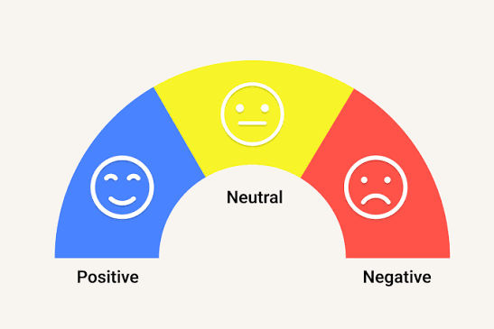
Transformer-Based Sentiment Classification Using Fine-Tuned DistilBERT
GROUP MEMBERS
Group 43
Sarthak Agrawal
2303002
Ahmad Ansari
2303009
Sunil Bhagat
2303020
Yash Bhardwaj
2303021
Guided by Prof. Jayant Gadge

Slide 2
Problem Statement & Input–Output
02
Task: binary text classification
Problem
Automatically classify an IMDb movie review as Positive or Negative from its text.
Input
A natural-language review, e.g. “The acting was brilliant and I loved it!”
Output
Predicted sentiment label (Positive / Negative) and confidence percentage.
Motivation
Manual review analysis is slow at scale; automated classification helps summarize audience opinion.

Slide 3
Dataset & Project Objectives
03
Dataset and scope
Dataset
IMDb movie reviews loaded from Hugging Face: stanfordnlp/imdb. Labels: 0 = Negative, 1 = Positive.
Training subset
4,000 shuffled training reviews selected with seed 42: 2,015 Negative and 1,985 Positive.
Evaluation
Final reported evaluation used the full 25,000-review IMDb test split.
Objectives
Fine-tune a pretrained transformer, demonstrate five NLP experiments, and evaluate classification performance.

Slide 4
Five Required NLP Preprocessing Experiments
04
Each experiment is demonstrated separately in the notebook
1. Sentence boundary identification
Split review text into sentences using NLTK sentence tokenization.
2. Tokenization
Split text into word tokens using NLTK; DistilBERT also applies its own tokenizer.
3. Lemmatization
Reduce words to dictionary base forms using WordNetLemmatizer.
4. Syntactic analysis - POS tagging
Assign grammatical categories such as noun, verb, adjective, and adverb.
5. Semantic analysis - WordNet
Explore synonym sets and semantic relationships between words.

Slide 5
Model Choice: DistilBERT
05
Why a pretrained transformer?
Classification workflow
• Learns contextual meaning rather than treating words independently.
Review text
DistilBERT tokenizer
• Pretrained model is adapted to sentiment labels through fine-tuning.
• DistilBERT is a smaller, faster variant of BERT.
Fine-tuned model
• Balances model capability with training and inference efficiency.
Sentiment + confidence
Classes: Negative (0) | Positive (1)

Slide 6
Fine-Tuning Workflow & Configuration
06
Actual training setup
1. Load data
Load IMDb with Hugging Face Datasets; shuffle with seed 42; select 4,000 training examples.
2. Tokenize
Convert review text to input IDs and attention masks.
3. Fine-tune
Pretrained distilbert-base-uncased with a sequence-classification head.
Configuration
1 epoch • batch size 16 • learning rate 2e-5 • weight decay 0.01.
Environment
Google Colab with NVIDIA Tesla T4 GPU; Hugging Face Transformers and PyTorch.

Slide 7
Implementation & Sample Predictions
07
Implementation stack
Example outputs from your model
• Hugging Face Datasets - IMDb loading
“This movie was fantastic. The acting was brilliant and I loved it!”
• Transformers + PyTorch - fine-tuning and inference
POSITIVE
Confidence: 94.87%
• NLTK + WordNet - preprocessing experiments
“The movie was boring, badly written, and a complete waste of time.”
• scikit-learn - metrics and confusion matrix
NEGATIVE
Confidence: 94.19%
• Google Colab - GPU training environment
“it was an interesting movie”
POSITIVE
Confidence: 90.28%

Slide 8
Evaluation Results
08
Full 25,000-review test set
Confusion matrix
Predicted
Accuracy
Precision
Negative
Positive
88.13%
0.8813
TN
FP
Negative
11,018
1,482
Recall
F1-score
0.8813
0.8813
Positive
FN
TP
1,485
11,015
Correct predictions: 22,033 / 25,000
Similar precision and recall indicate balanced performance across both classes.

Slide 9
Interpretation, Challenges & Limitations
09
What the metrics tell us
Interpretation
88.13% accuracy means about 88 out of every 100 test reviews were classified correctly.
Observed errors
The confusion matrix shows false positives and false negatives; sentiment can be nuanced.
Challenges
Compute limits motivated fine-tuning on 4,000 reviews rather than the full training split.
Limitations
IMDb movie reviews are English and domain-specific; sarcasm and mixed sentiment remain difficult.
Future improvements
Tune hyperparameters, inspect errors, compare models, and test on another dataset.

Slide 10

10
THANK YOU

