Slide 1
Automatic Differentiaton
autodiff Bo-Sheng Li

Slide 2
Outline
Introduction
Implementation
API Description
Engineering Infrastructure
Future Work
Reference

Slide 3
Introduction

Slide 4



How do computers calculate derivatives
Numerical differentiation
Let h approach to 0, like (${10}^{−9}$).
$$f^{′}\left(x\right)=\lim_{h→0}{{\frac{f\left(x+h\right)−f(x)}{h}}^{}}$$
Roundoff error
Truncation error
Easy to implement

Slide 5
How do computers calculate derivatives
Automatic differentiation
All numerical computations are compositions of elementary operations.
Combining the derivatives of the operations through the chain rule gives the derivative of the overall composition.
Notes:
All numerical computations are ultimately compositions of a finite set of elementary operations for which derivatives are known and combining the derivatives of the constituent operations through the chain rule gives the derivative of the overall composition

Slide 6




Automatic Differentiation
Example:
$$y= f\left(X_{1},X_{2}\right)=\ln{X_{1}}+X_{1}X_{2} −\sin{X_{2}}$$
ln
V₁
$$X_{1}$$
V₋₁
V₄
+
V₂
V₅
$$y_{}$$
*
-
$$X_{2}$$
V₀
sin
V₃
Notes:
All numerical computations are ultimately compositions of a finite set of elementary operations for which derivatives are known and combining the derivatives of the constituent operations through the chain rule gives the derivative of the overall composition

Slide 7
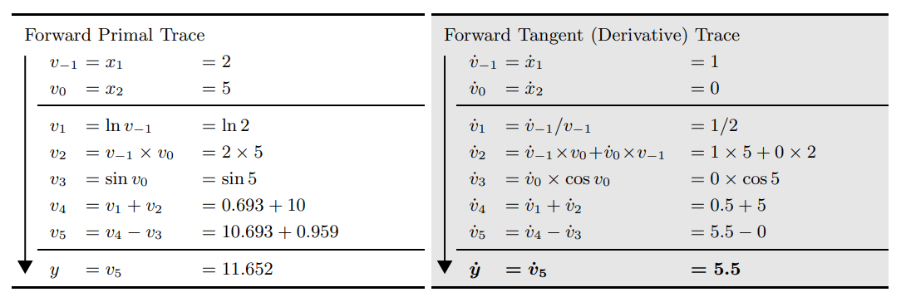




Automatic Differentiation
$$X_{1}$$
ln
V₁
V₋₁
+
V₄
V₂
V₅
$$y_{}$$
Forward Mode
*
-
$$X_{2}$$
V₀
sin
V₃

Slide 8
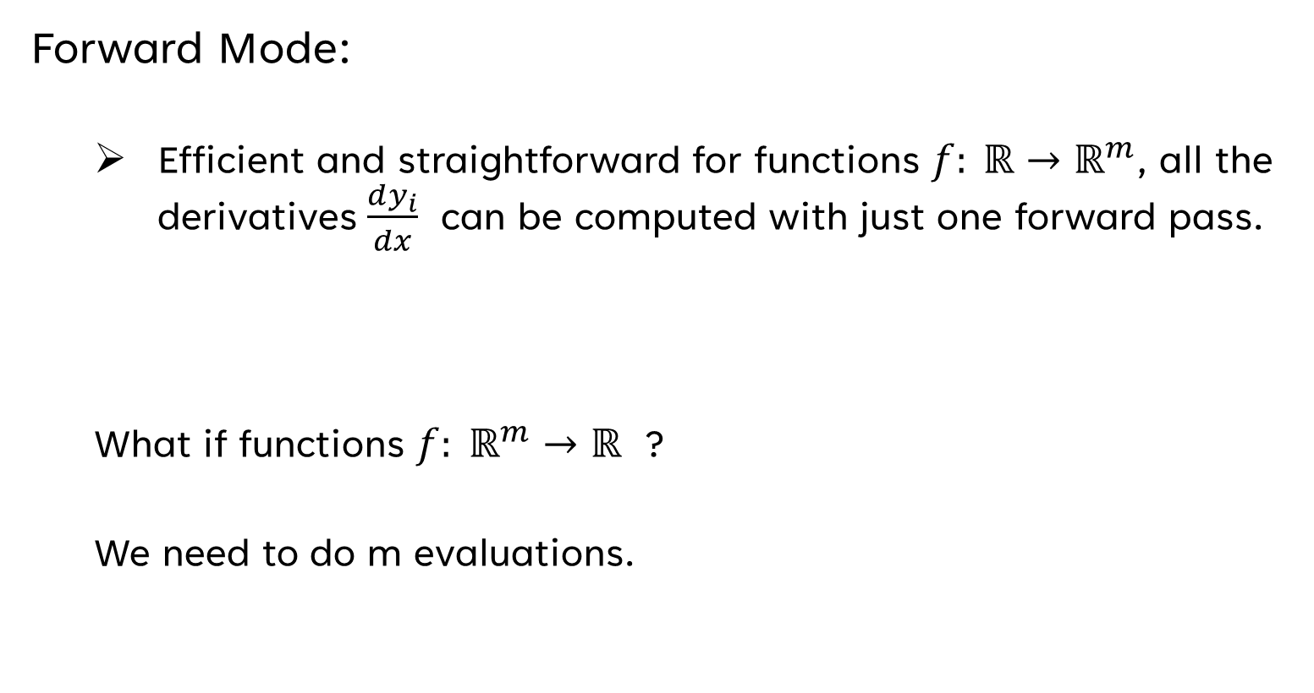
Automatic Differentiation
Forward Mode:
Efficient and straightforward for functions $f: ℝ{→ℝ}^{m}$, all the derivatives $\frac{dy_{i}}{dx}$ can be computed with just one forward pass.
What if functions $f: ℝ^{m}→ℝ$ ?
We need to do m evaluations.

Slide 9
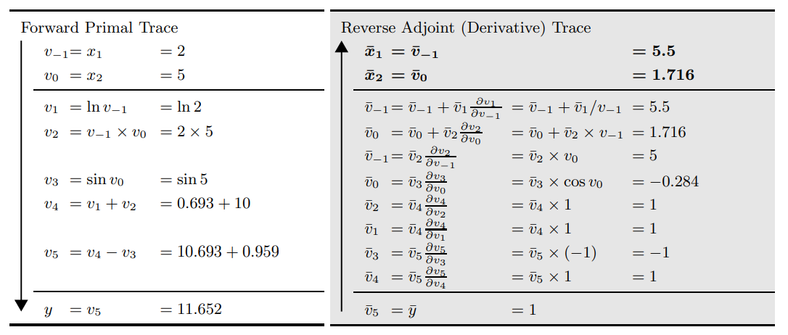








Automatic Differentiation
$$X_{1}$$
ln
V₁
V₋₁
+
V₄
V₂
V₅
$$y_{}$$
*
-
Reverse Mode
$$X_{2}$$
V₀
sin
V₃
$$\frac{∂y}{∂v_{2}}=\frac{∂y}{∂v_{4}}\frac{∂v_{4}}{∂v_{2}}$$
$$\frac{∂y}{∂v_{1}}=\frac{∂y}{∂v_{4}}\frac{∂v_{4}}{∂v_{1}}$$
$$\frac{∂y}{∂v_{3}}=\frac{∂y}{∂v_{5}}\frac{∂v_{5}}{∂v_{3}}$$
$$\frac{∂y}{∂v_{4}}=\frac{∂y}{∂v_{5}}\frac{∂v_{5}}{∂v_{4}}$$

Slide 10
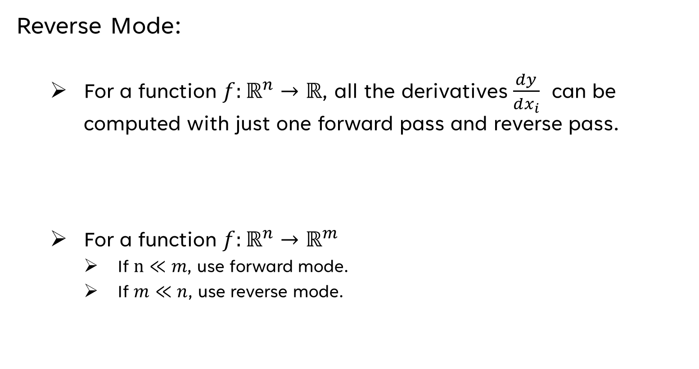
Automatic Differentiation
Reverse Mode:
For a function $f:ℝ^{n}→ℝ$, all the derivatives $\frac{dy}{dx_{i}}$ can be computed with just one forward pass and reverse pass.
For a function $f:ℝ^{n}→ℝ^{m}$
If $n≪m$, use forward mode.
If $m≪n$, use reverse mode.

Slide 11
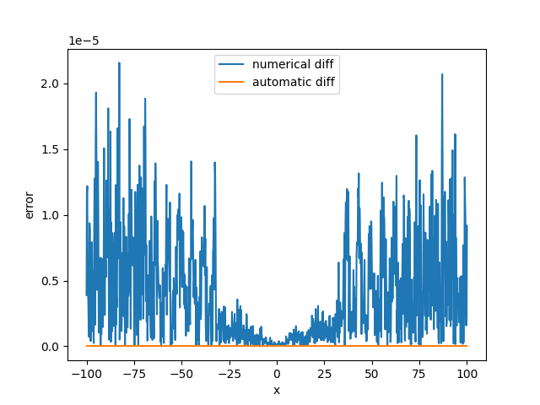
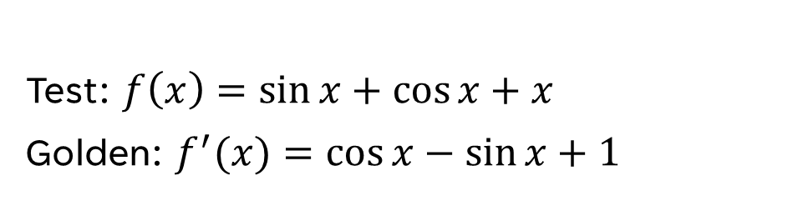
Result Between ND and AD
Test: $f\left(x\right)=\sin{x}+\cos{x+x}$
Golden: $f^{′}(x)=\cos{x}−\sin{x+1}$

Slide 12
Implementation

Slide 13
Workflow
User definite the math function.
Generate computation graph and calculate values (forward pass).
Calculate gradients from right to left (backward pass).
Output gradients to user.

Slide 14
Class hierarchy diagram
_{Node}
_{Variable}
_{Constant}
_{BinaryOP}
_{UnaryOP}
_{math functions}
₊
₋
*
/
₋

Slide 15
Class members & member functions
Members
Member functions
Node
value
VariableNode
gradient
BinaryOPNode
leftNodePtr
RightNodePtr
UnaryOPNode
NodePtr
All nodes have function called propagate(output).

Slide 16
API Description

Slide 17
API Description
autodiff.vec(a) : Create autodiff.vec object
Parameters: a : list
Returns: result: autodiff.vec object
autodiff.vec.backward() : Do automatic differentiation
autodiff.vec.grad() : Return gradients
Returns: result: list
autodiff.vec.values() : Return values
Returns: result: list

Slide 18
Example
>>> import autodiff
>>> a = autodiff.vec([ i+1 for i in range(3) ])
>>> b = autodiff.vec([ i+2+1 for i in range(3) ])
>>> Q = a.sin() * b.exp() + a - b
>>> Q.backward()
>>> a.grad()
[11.852, -21.720, -145.927]
>>> b.grad()
[15.901, 48.645, 19.944]
>>> Q.values()
[14.901, 47.645, 18.944]

Slide 19
Engineering Infrastructure

Slide 20
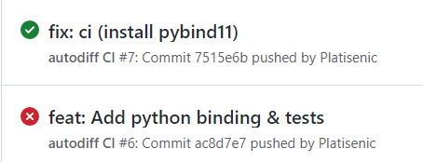
Engineering Infrastructure
Build system:
Makefile ( c++14, pybind11)
Testing framework:
C++: Google Test
Python: pytest
Version control: git
Linter: cpplint
CI: Github Actions

Slide 21
Future Work

Slide 22
Future Work
Support more math functions
Support multidimensional vector
Support GPU Acceleration

Slide 23
Reference
Atilim Gunes Baydin, Barak A. Pearlmutter, Alexey Andreyevich Radul, Jeffrey Mark Siskind. Automatic differentiation in machine learning: a survey. The Journal of Machine Learning Research, 18(153):1--43, 2018
https://github.com/Platisenic/autodiff

Slide 24
Thank you
Bo-Sheng Li
ID: 310552029

