Slide 1
Discussion
Xiaoli Yang

Slide 2
Question 1
consider a logical address space of 64 pages of 1,024 words each, mapped onto a physical memory of 32 frames. a. how many bits are there in the logical address? b. how many bits are there in the physical address?

Slide 3
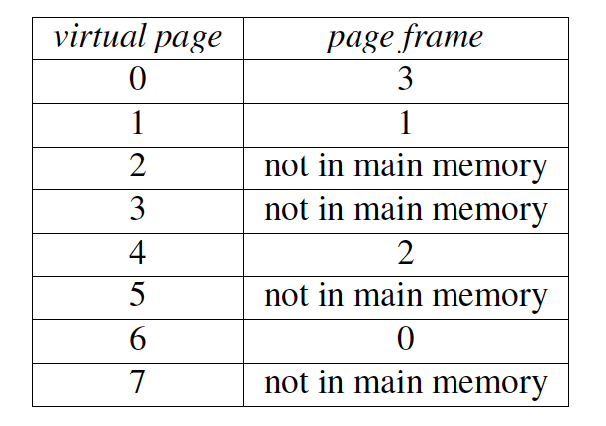
Question 2
Use the following givens to answer 1-7 and 1-8 questions. A virtual memory has a page size of 1024 words, eight virtual pages, and four physical frames. The page table is as follows:
1-7 What is the physical addresses for 1020?
A. 3096 B. fault C. 4092 D. 1024 E. 2048
1-8 What is the physical addresses for 3030?
A. 3072 B. 4095 C. 2048D. fault E. 1024

